Slide 1
Human Response to Environmental Issues presented by Aušrinė Živaitienė
December 10, 2021

Slide 2
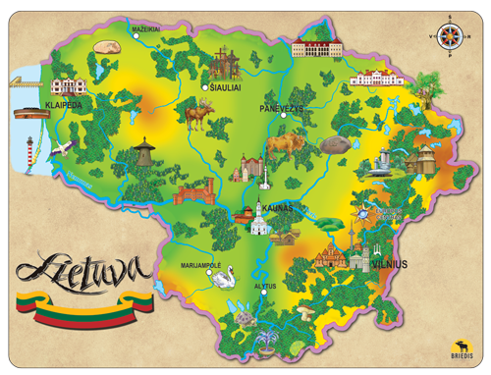

Slide 3
The role of a person in nature has always been significant.
We notice people thinking in different ways: some think that a human being in the ecosystem is just a parasite that destroys everything, others think that human activity helps to survive for some species of animals and plants.
Looking back, we will see that the number of species have disappeared due to human fault, we have caused many ecological catastrophes, but there is a middle ground between these two prevailing opinions.
People can help nature, but they should feel much closer connection with it.

Slide 4
Getting ready for a group work task
We choose a colourful piece of paper
We divide into groups by colour
Mind map - "Environment"

Slide 5
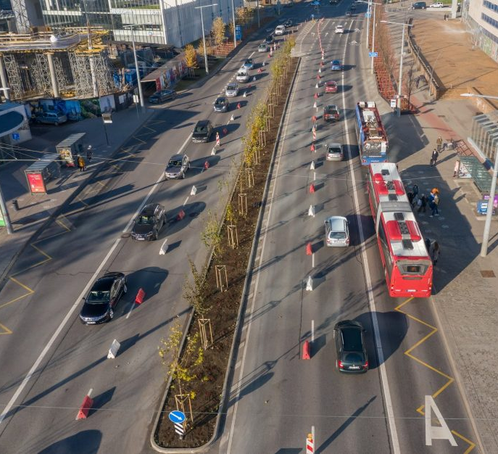
Vilnius was declared the greenest city in Europe for the second year in a row and the third in the world (61% of the city's total area is green zones)

Slide 6
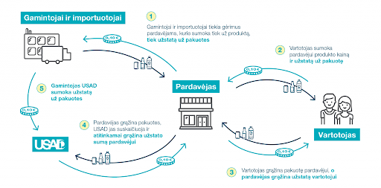

Slide 7
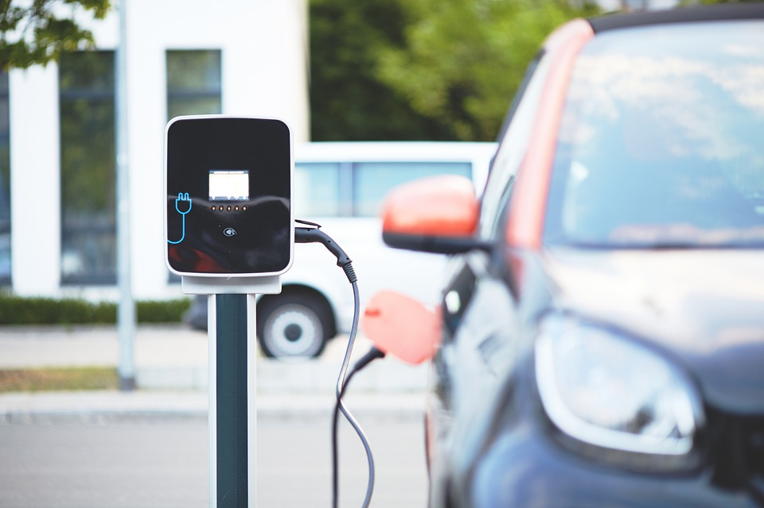

Slide 9
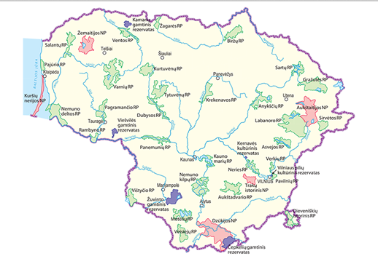

Slide 10
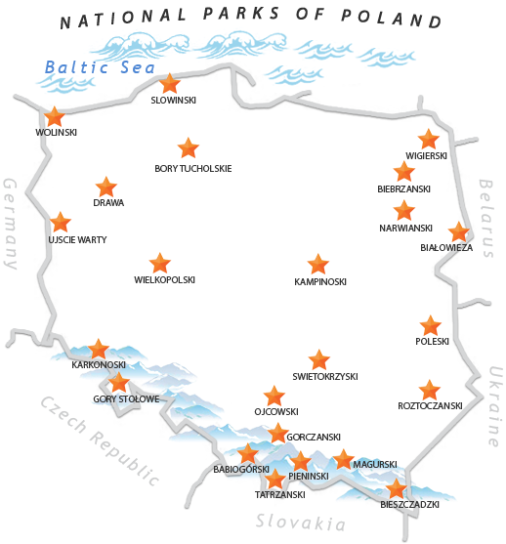
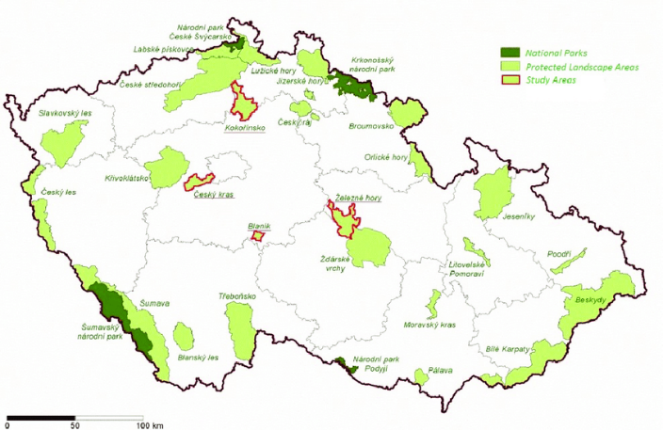
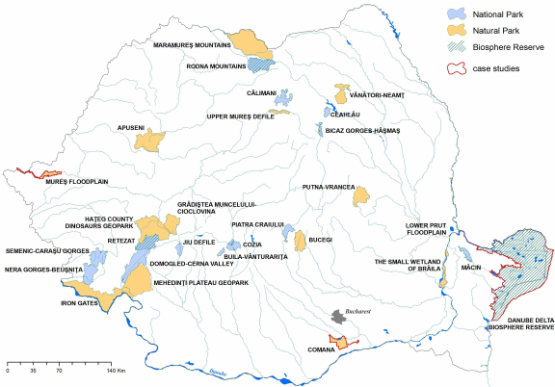

Slide 11
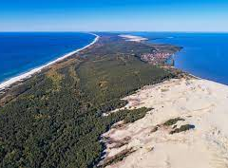
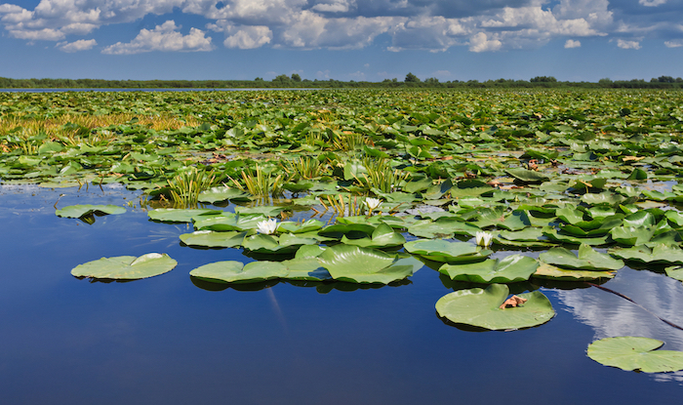
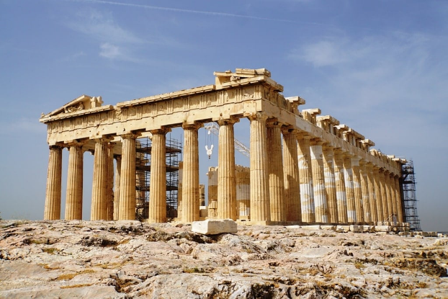
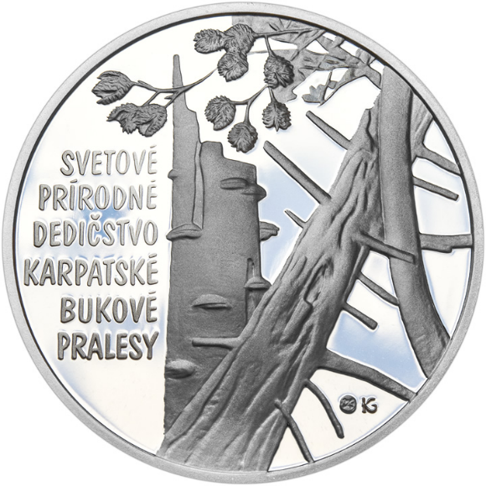

Slide 12
Identify what you consider to be the most complicated environmental problem for the European Union;
Discuss and write two solutions to this problem. Present them.
How can each of us contribute to the environment? Try to portray it visually.

