Slide 1
What makes a good life?
Lessons from the longest study of happiness
Teacher Cristina Moldoveanu

Slide 2
What makes a good life? What makes you happy? Express your ideas of happiness in a drawing.

Slide 3
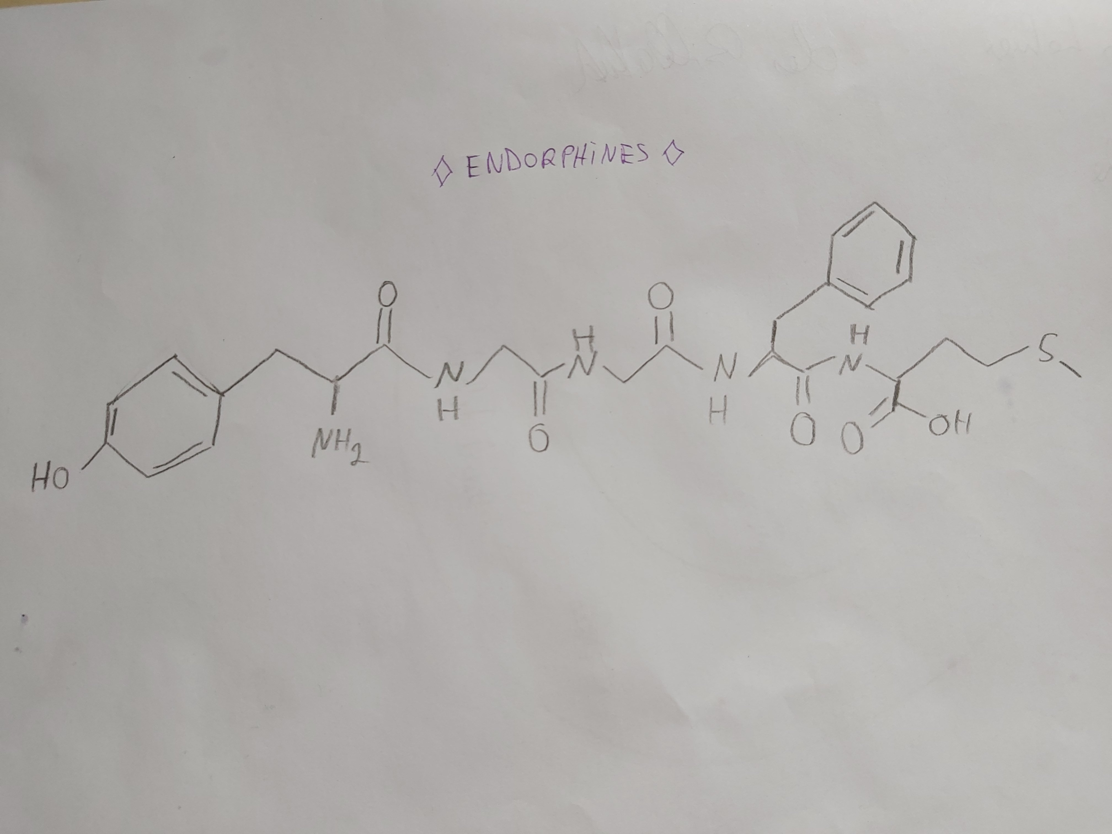
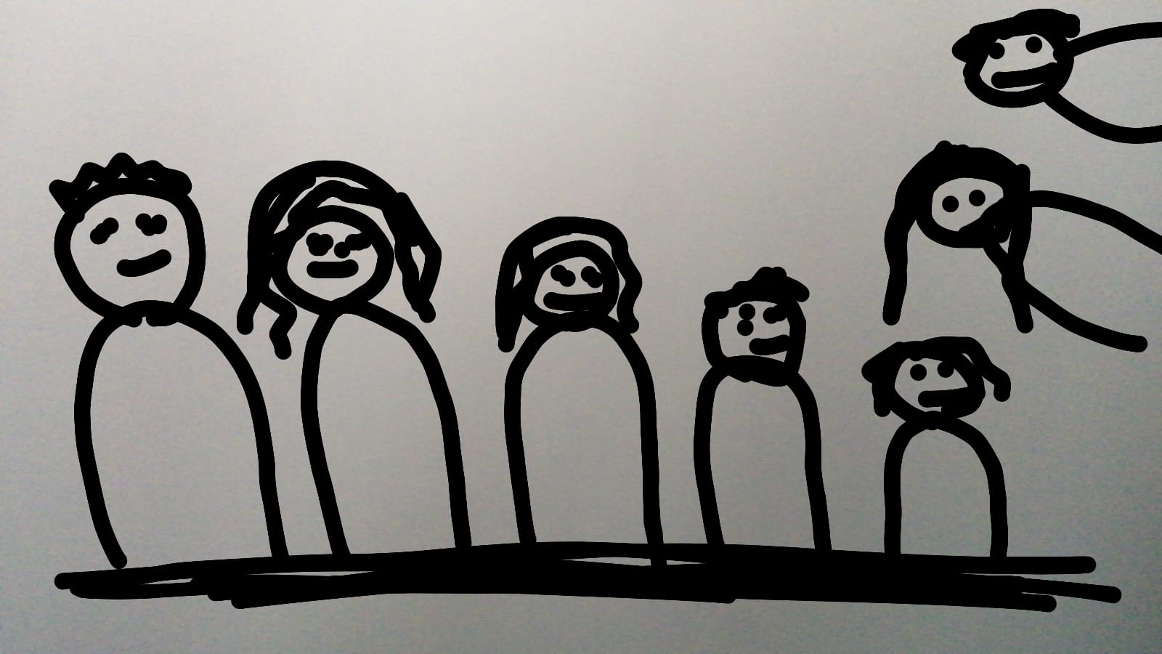
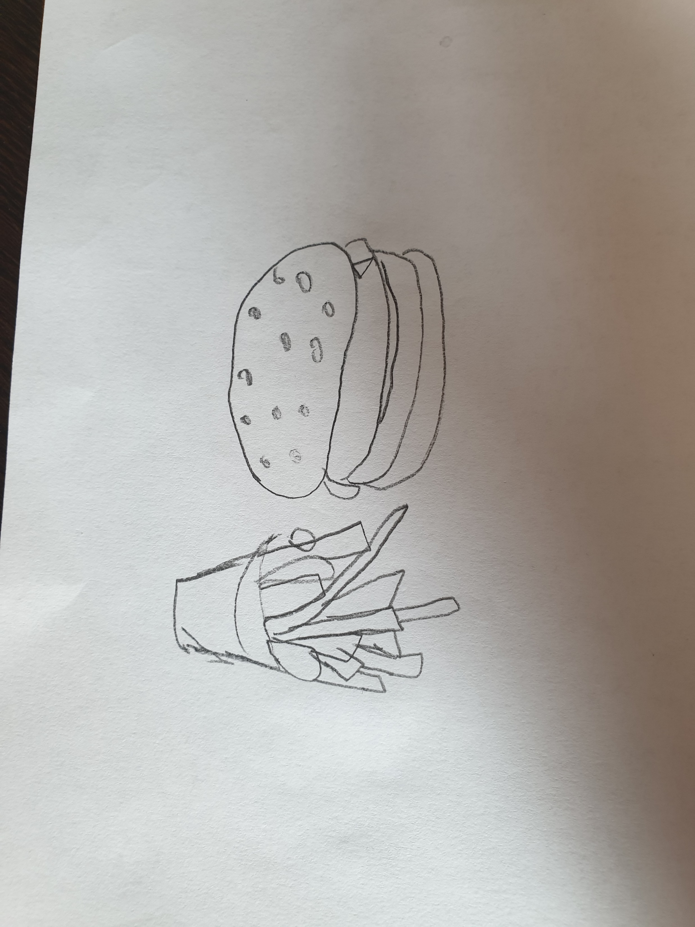
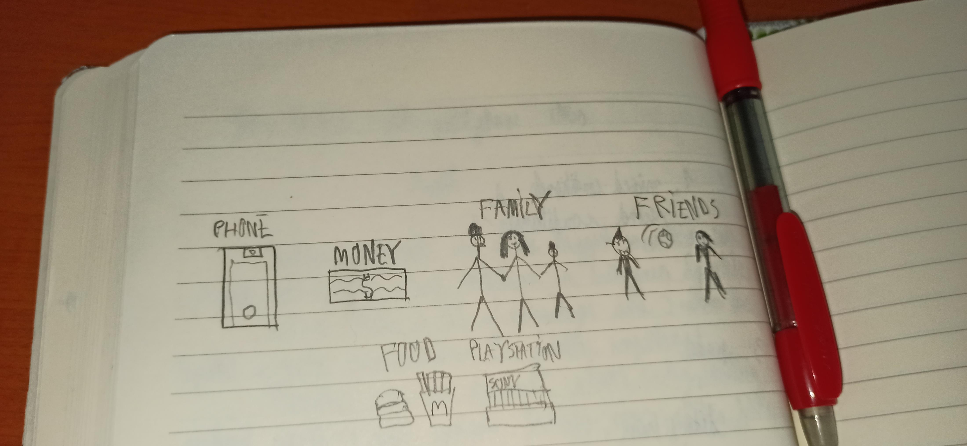
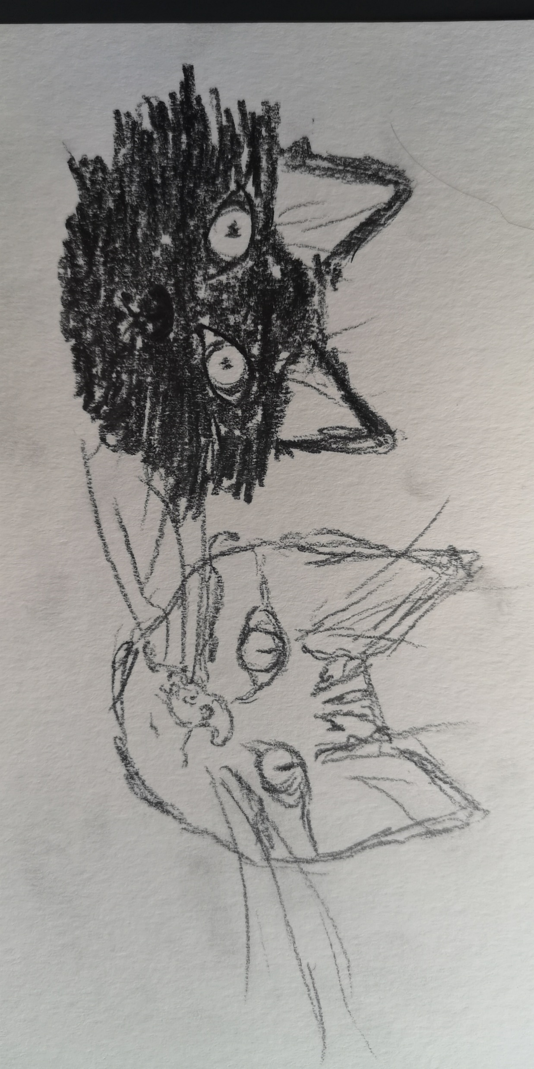
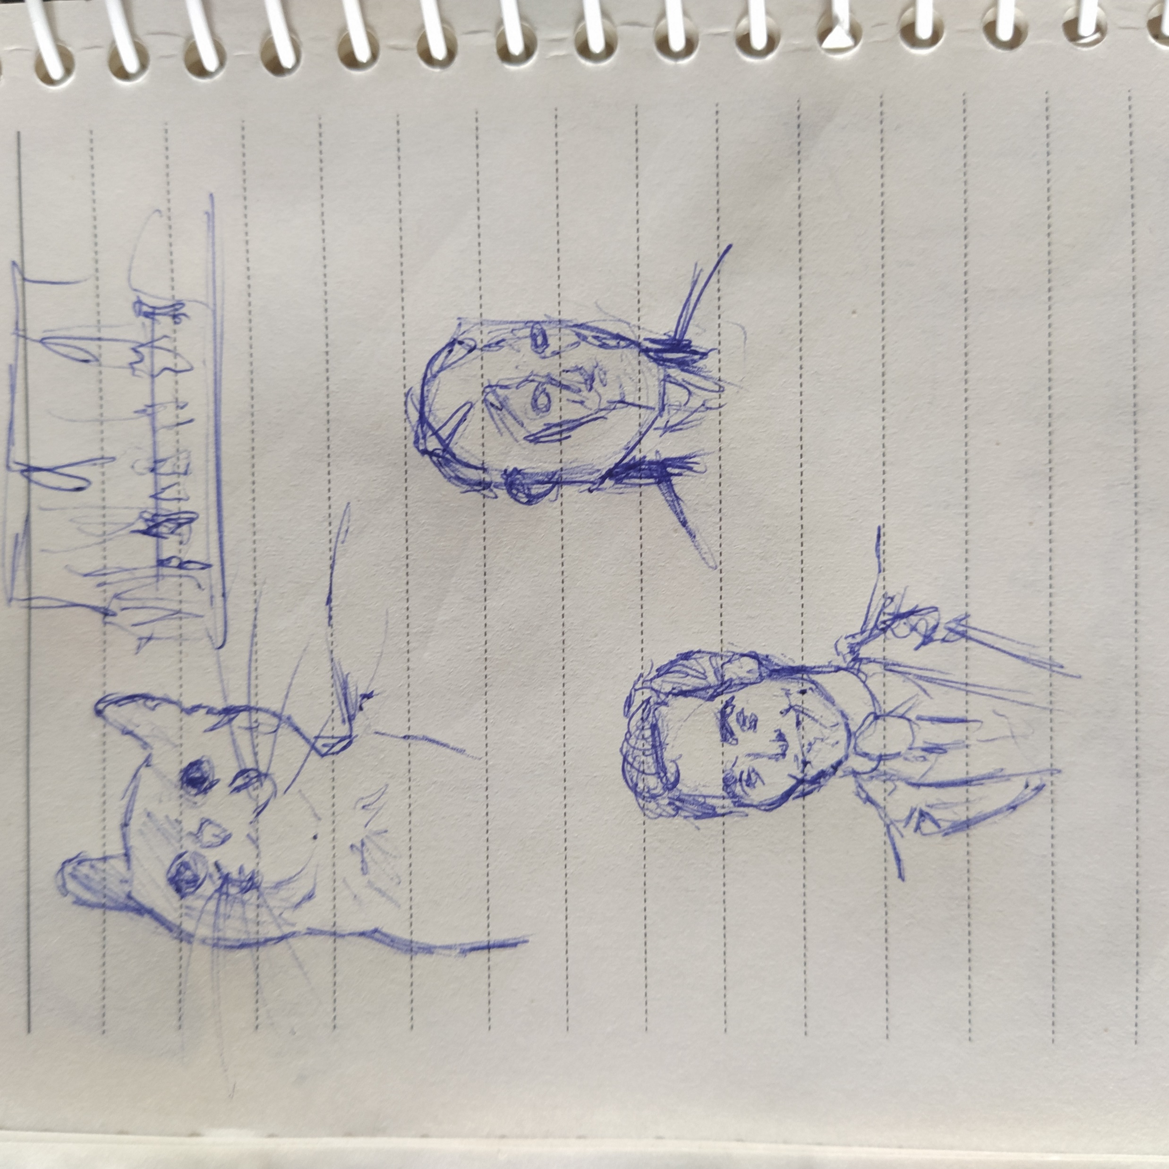
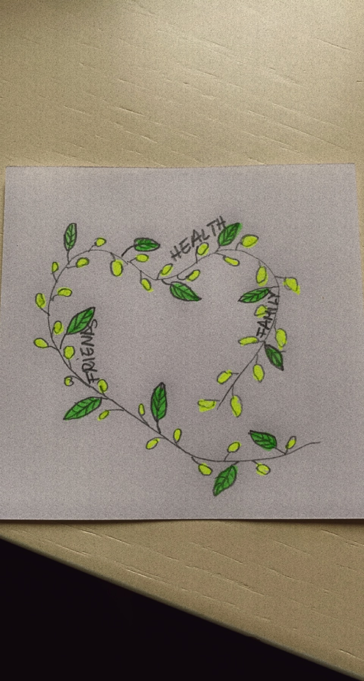
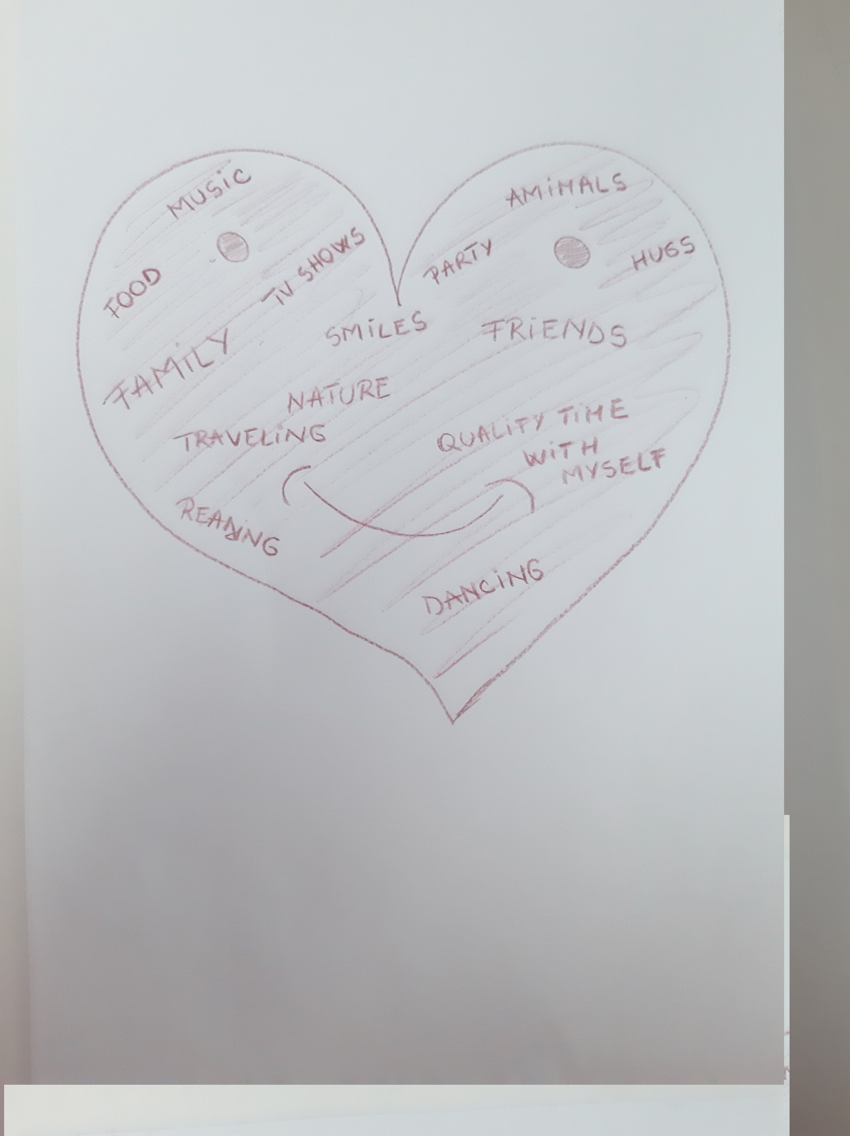
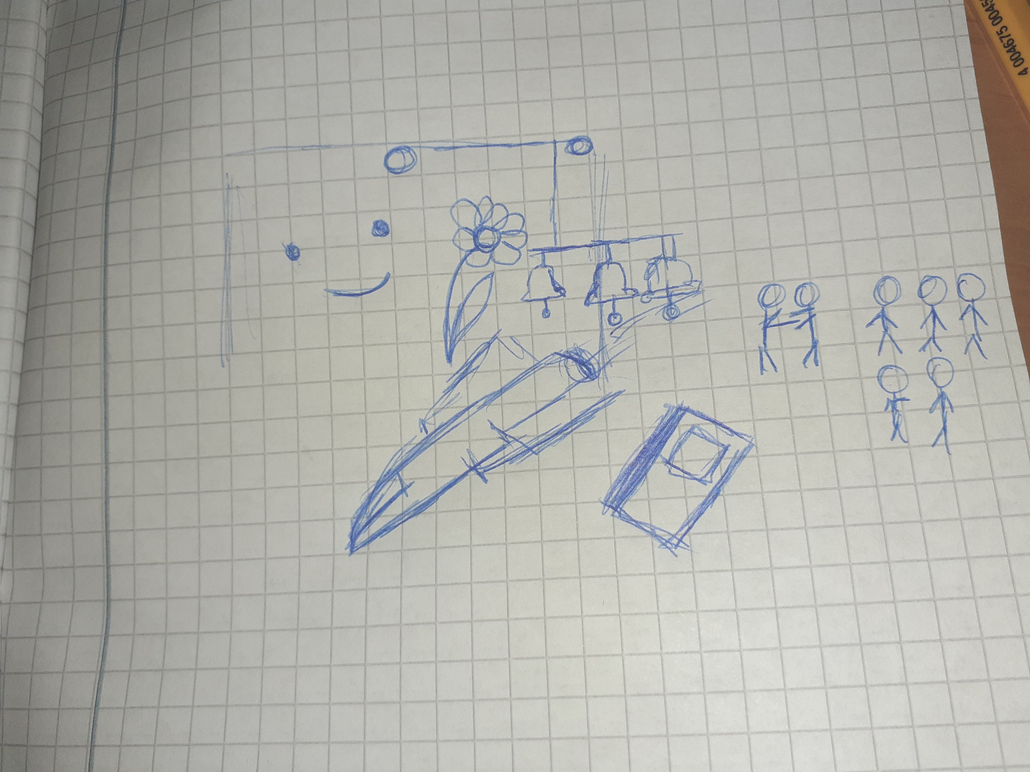
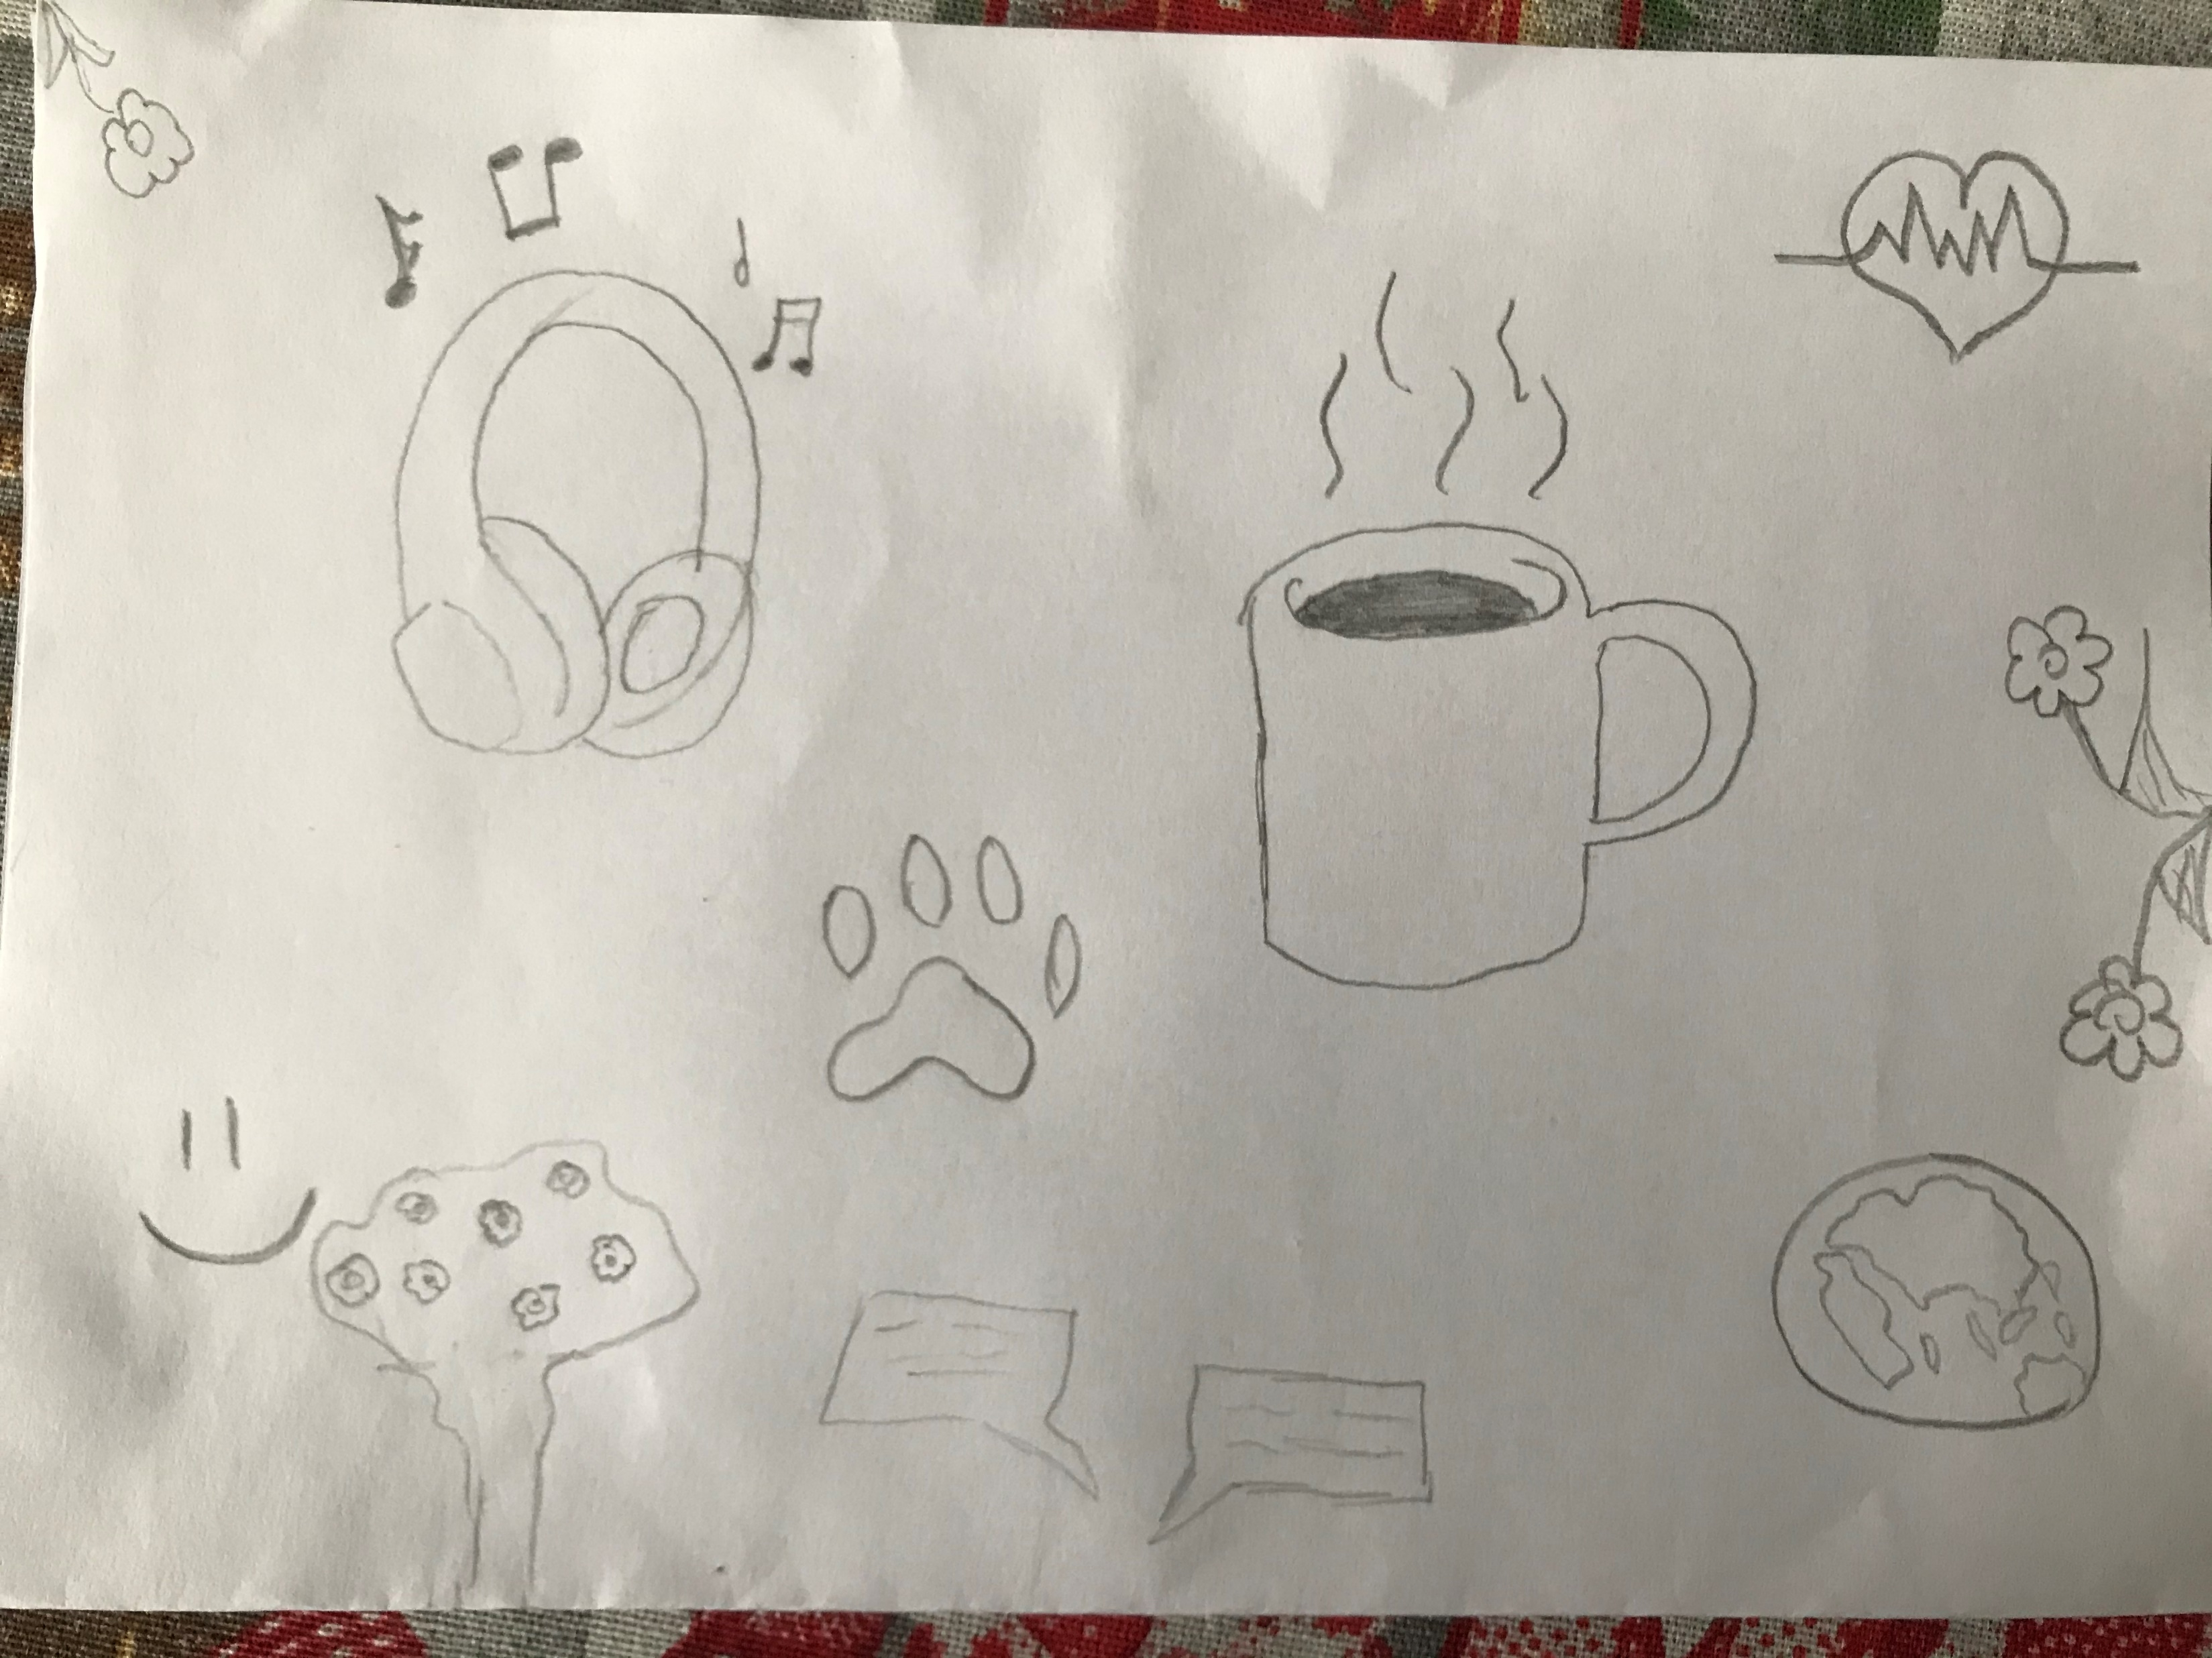

Slide 4
What are the three lessons that make us living a good life (according Waldinger to Robert)?

Slide 5
What are the three lessons that make us living a good life (according to Robert Waldinger)?
Social connections are really good for us: The more social connections one has, the happier, healthier, and longer that individual will live.

Slide 6
What are the three lessons that make us living a good life (according to Robert Waldinger)?
Social connections are really good for us: The more social connections one has, the happier, healthier, and longer that individual will live.
The quality of relationships is greater than the quantity.
Close relationships protect our bodies and our brains but also our wellbeing.

Slide 7
Is happiness more important than success?

Slide 8
Is happiness more important than success? -debate-

Slide 9
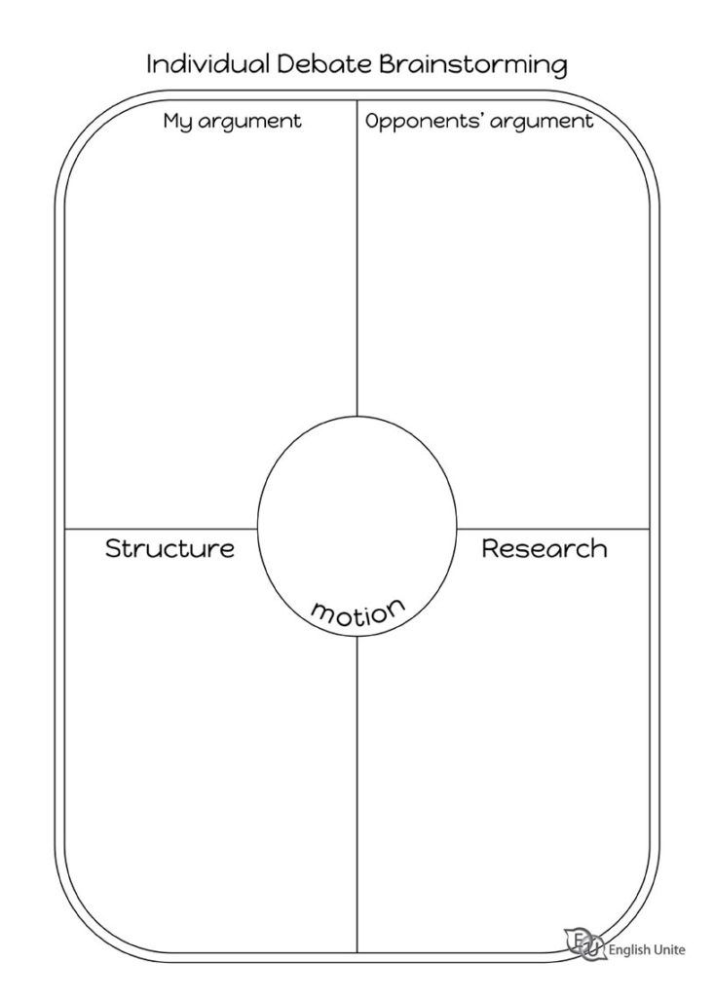
Plan a debate
Position : neutral/ + happiness /+ success
Reason 1:
Reason 2:
Reason 3:
Possible counterargument 1 (What do you think the other side will say?):
Why is that argument weak?
Possible counterargument 2:
……………………………………………
……………………………………………

