Slide 2
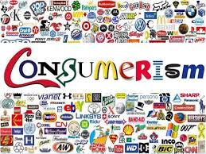

Slide 3
consumer society
a society in which people often buy new goods, especially goods that they do not need, and in which a high value is placed on owning many things
A podcast on consumerism:
https://blog.esllibrary.com/2011/05/11/podcast-consumerism/

Slide 4
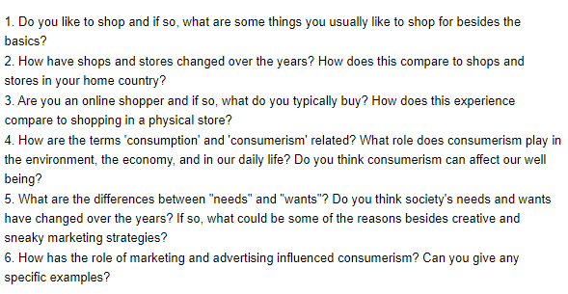

Slide 5
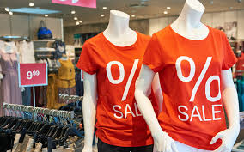
the Pros of Consumerism
stimulates economic growth.
boosts creativity and innovation.
encourages freelancing, entrepreneurialism, and self-employment.

Slide 6
the Cons of Consumerism
The economy takes precedence over the environment.
encourages debt
leads to health problems.

Slide 7
How Does Consumer Culture Affect the Environment?
One of the main issues that we see present with consumer culture is its impact on the environment. William Rees of the University of British Columbia reports that we consume 30% more material than is sustainable from the world resources (Scientific American, 2011).
Since the 1920s the amount of waste that humans produce has increased by nearly 10,000 percent (Atkin, 2019).

Slide 8
Initiatives for change
in the UK where there is a movement occurring called the Right to Repair (Harrabin, 2020). This movement is trying to reduce the throw-away culture that is present.
Another initiative seen is the increase in consumers participating in No Buy Day, which is held the Saturday after Black Friday every year(Macleod, 2019). The whole goal of this day is urging the world to change their purchasing habits, by consuming and producing less.

Slide 9
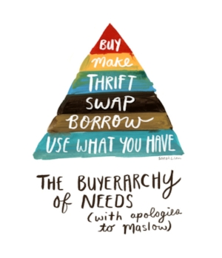

Slide 10
A song: Shania Twain „Ka- Ching“
ttps://www.youtube.com/watch?v=iEe3hBXZEyI

Slide 11
