Slide 1
Public speaking
Presented by
Lina Rainyte IIIb

Slide 2
Content:
What Is Public Speaking? & Why Is It Important? ;
Why do I have a fear of public speaking?
How to deal with public speaking anxiety;
How to Be a Better Public Speaker: 6 Tips;

Slide 3
What Is Public Speaking? & Why Is It Important?
Public speaking is the act of presenting an idea to the public, using your voice. The ‘public’ can range from a very small group of people to a huge audience. For most people, a bigger audience equates to more fear, but some people are just as terrified as presenting to a small group.

Slide 4
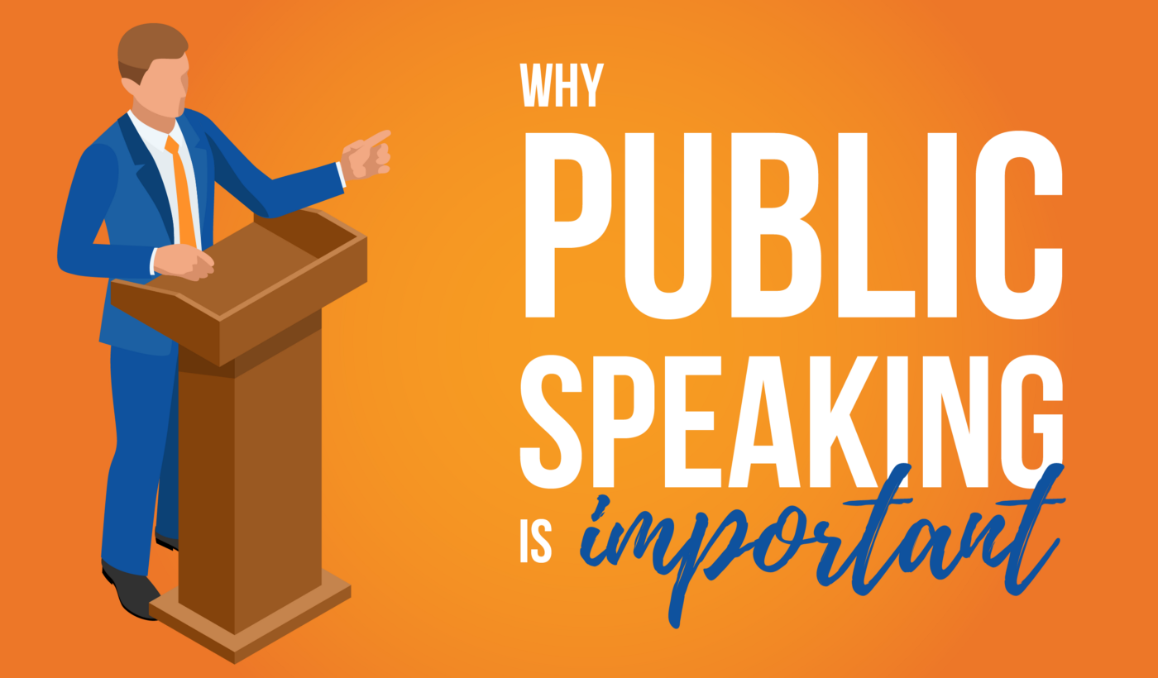
When we fear public speaking or are required to give a speech you may ask yourself why is public speaking important? Believe it or not but public speaking is one of the most important skills you will ever develop in your life.
Public speaking is so important that it could be the deciding factor in many things such as your career development, your business growth and even in the relationships you have with your friends and family. Public speaking is a skill worth learning

Slide 5
Why do I have a fear of public speaking?
In order to face your fears head-on, it’s important to understand why you feel anxious about public speaking. There could be many reasons why, but the reasons we’re going to talk about are pretty universal.

Slide 6
1. You feel self-conscious as the centre of attention. If you try to view the talk as a conversation between people, rather than a presentation to an unknown audience, you may be able to rise above your self-consciousness.
2. You’re having a physiological response. This can cause rapid breathing, shaking, and an increased heart rate, all of which make it harder to talk confidently. You may even be tempted to run away and exit the scary situation completely. Not to worry though, as later we’ll explore some strategies you can use to slow down this physiological response.
3. You’re worried about appearing nervous. The hard truth is, that the audience will not notice or remember a lot of the things that you’re concerned about. Gary Genard, public speaking expert, suggests that you should place the spotlight on your audience instead, and think about how you can impact them.
4. You’re comparing yourself to others. It’s easy to compare yourself to great speakers, whether that’s professionals or one of your friends who has bucket loads of confidence. However, if all speakers were the same, speeches wouldn’t be interesting at all. Besides, your purpose isn’t to be an amazing speaker, it’s to provide something for your audience, whether that’s inspiration or something else.
5. You’ve failed or experienced difficulties in the past. If fear of failure can impede your ability to speak well, then anticipating success can have an equally positive impact. It’s all about changing your mindset.

Slide 7
How to deal with public speaking anxiety?
Fear of public speaking is a common form of anxiety. It can range from slight nervousness to paralyzing fear and panic. Many people with this fear avoid public speaking situations altogether, or they suffer through them with shaking hands and a quavering voice. But with preparation and persistence, you can overcome your fear.
These steps may help:
Know your topic;
Get organized;
Practice, and then practice some more;
Challenge specific worries;
Visualize your success;
Do some deep breathing;
Focus on your material, not on your audience;
Don't fear a moment of silence;
Recognize your success.

Slide 9
1. Nail Your Opening. The presenter’s anxiety is at highest during the first 30-60 seconds of the speaking. Once you get past that, you’ll hail more confidently through the rest of your speech. Hence, make sure to get a positive response from your audience from the get-go.
Here are some ideas for starting a public speech:
Begin with the ending: use BLUF technique — bottom line upfront
Share a personal story to build empathy
Ask a rhetorical question to make the audience think
Provide a quote that sets the tone for your narrative
Project into the future to get the audience focused on outcomes
Use some humor to squeeze out some laughs and relax yourself

Slide 10
2. Maintain Eye Contact with the Audience. By maintaining such gradual eye contact, you can build a better rapport with all audience members. Then again, it prevents your thoughts from getting scattered if you leave your gaze scanning over everyone. Also, by focusing on one person at a time, you deliberately ignore the stares from others. This helps minimize the anxiety-inducing “fight or flee” reflex.

Slide 11
3. Try the “Inward, Outward, Forward” Formula For Your Speech. The Inward, Outward, Forward format of structuring your speech is a good way to make a strong point within a short time span. It helps the listeners retain your core message and align with your way of thinking. Here’s how it works:
Explain why you are bringing up the topic.
Provide evidence on what others think about it.
End with a solution to the stated problem.
For example, if you are doing an after-action review meeting with your team, you can first summarize the main challenge you’ve faced. Then present examples of how individuals or other teams are handling similar issues. Lastly, sum up your proposal on the follow-up steps and solutions you’d recommend trying.

Slide 12
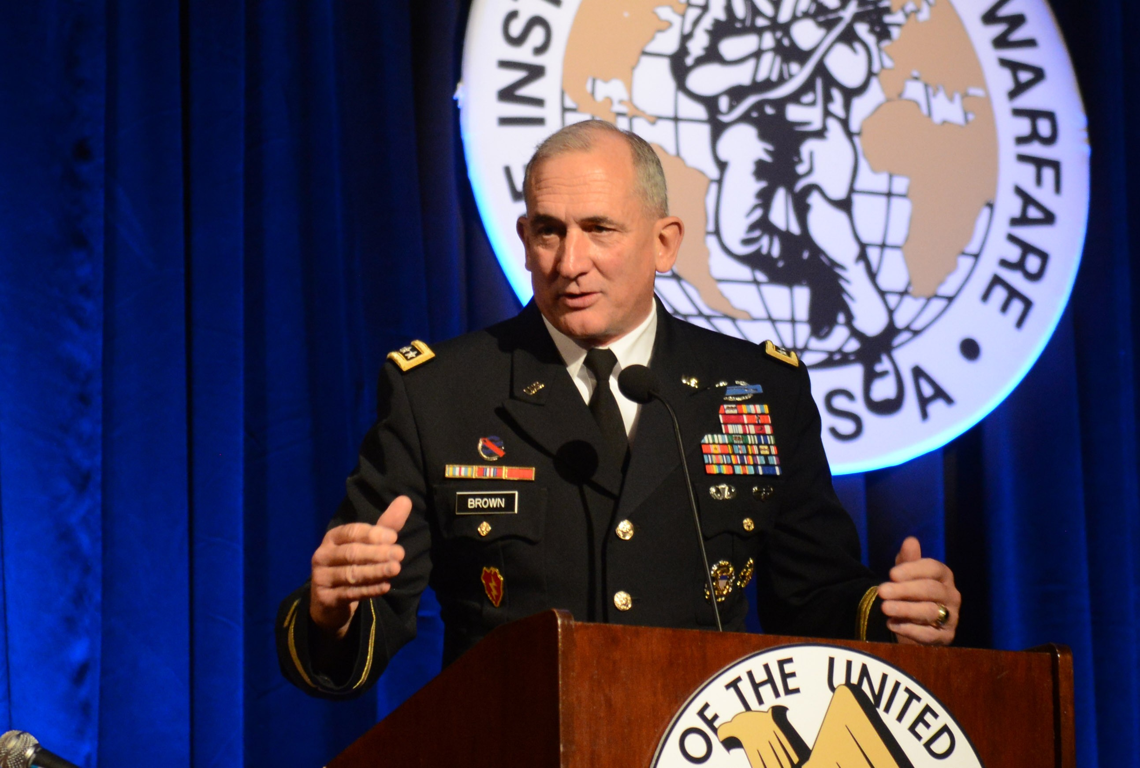
4. Use the “Commander’s Intent” Technique to Make Your Ideas Stick. Commander’s Intent (CI) is a technique the military personnel uses to communicate the main directive.
A CI is a brief statement, placed on top of every order, summarizing the plan’s goal and desired end results. You can apply the same tactic to highlight the main points from each section of your speech. Or to prepare accompanying slides for the presentation.
Add a CI statement to the most important slides. Then expand on the idea within your speech. Doing so will help the audience focus on the key discussion point and retain the information better.

Slide 13
5. Choose the Right Pitch and Tone of Voice.
Voice is the most effective means for conveying emotions. It’s more channeling to disguise your attitude when you talk. So if you sound unconfident, anxious, doubting, or bored, the audience will likely sense that and act accordingly.
For that reason, many amazing public speakers undergo voice coaching. They train to project the right emotions via their voice and naturally adjust pitch and vocal tone to convey different ideas. Most strive to achieve the maximum resonance point — a resonance that infers power to your voice.

Slide 14
Final Tip: Work on Your Body Language. When presenting in person, your body language will also be telling of your confidence and authority. Plus, it will shape the audience’s perception of you, just like your voice.
Don’t self-block (aka trying to shrink your body). This means crossing arms, slouching, keeping hands in the pocket, etc. Such movements act as a barricade between you and the audience. They make you appear less trustworthy. To avoid them, hold on to the microphone or a presentation clicker.
Practice breathing and hand gestures. Uneven, raspy breathing will affect your pitch and tone of voice. So practice taking slow, measured breaths to pace your speech better. Take longer pauses when you want to emphasize a point. Also, use mild hand gestures, head nods, and arm movements to engage with the audience. But don’t gesticulate too much as this will appear distractive.

Slide 15
Links:
https://slidemodel.com/public-speaking/
https://www.mayoclinic.org/diseases-conditions/specific-phobias/expert-answers/fear-of-public-speaking/faq-20058416
https://professional.dce.harvard.edu/blog/10-tips-for-improving-your-public-speaking-skills/
https://business.tutsplus.com/tutorials/what-is-public-speaking--cms-31255
https://www.futurelearn.com/info/blog/the-art-of-public-speaking

