Slide 1
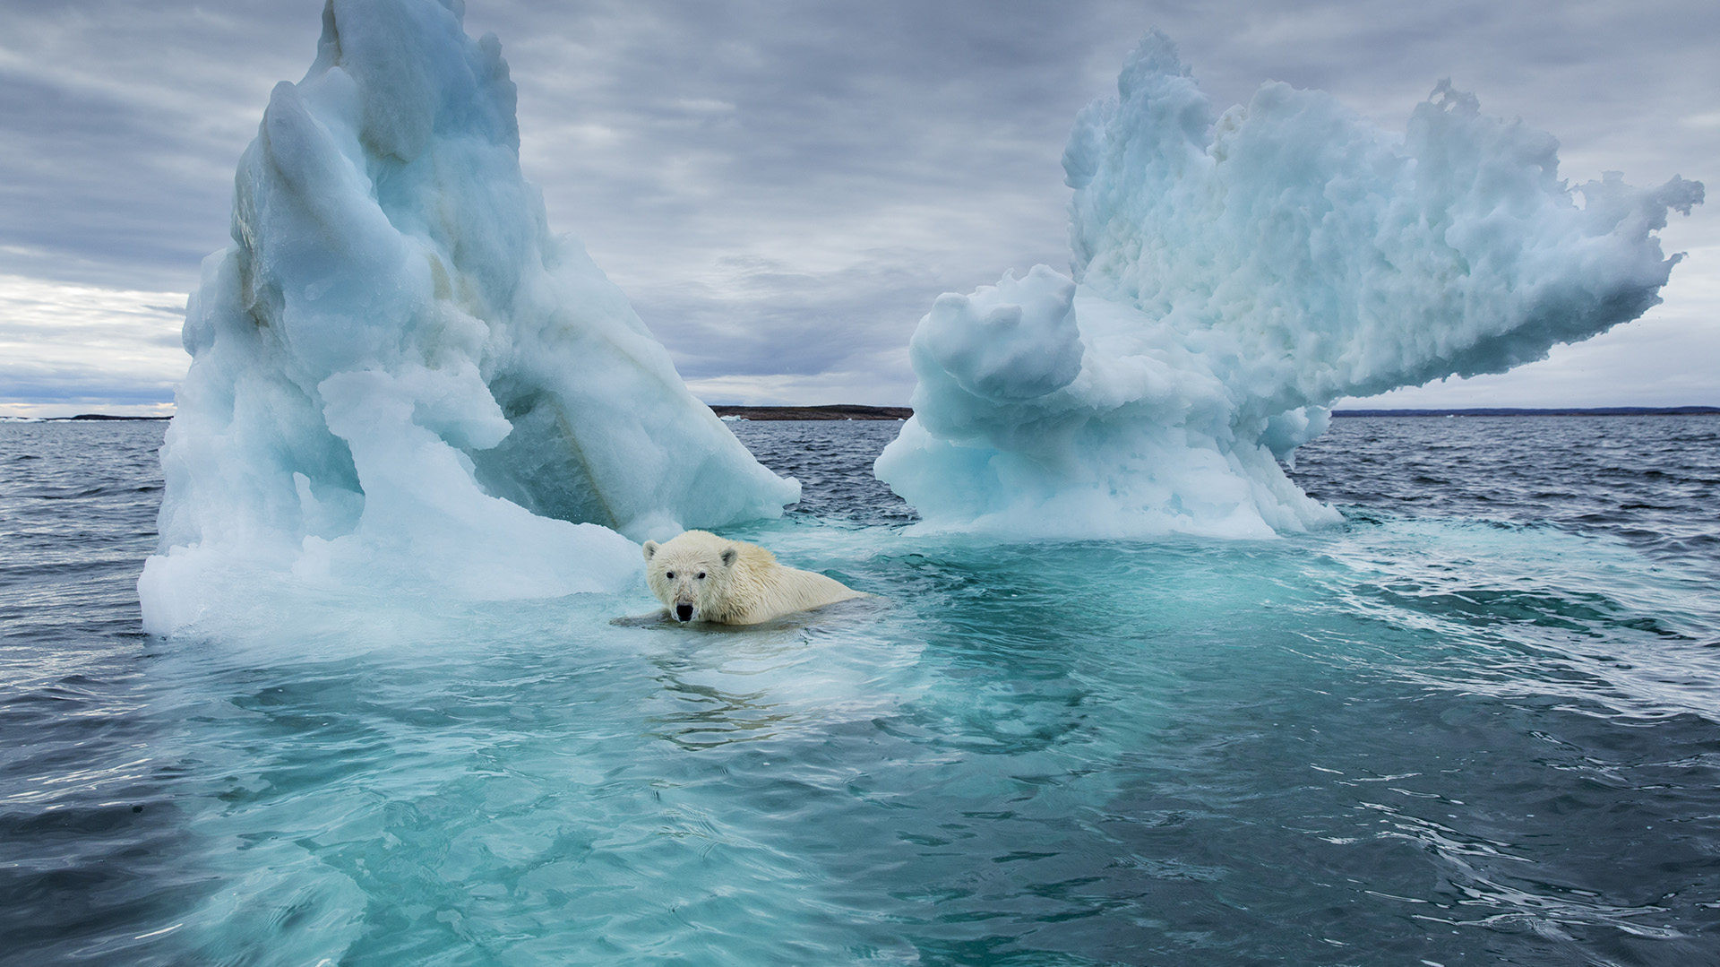
GLOBAL WARMING
Presentation by:
Agnius Stučinskas IIB

Slide 2
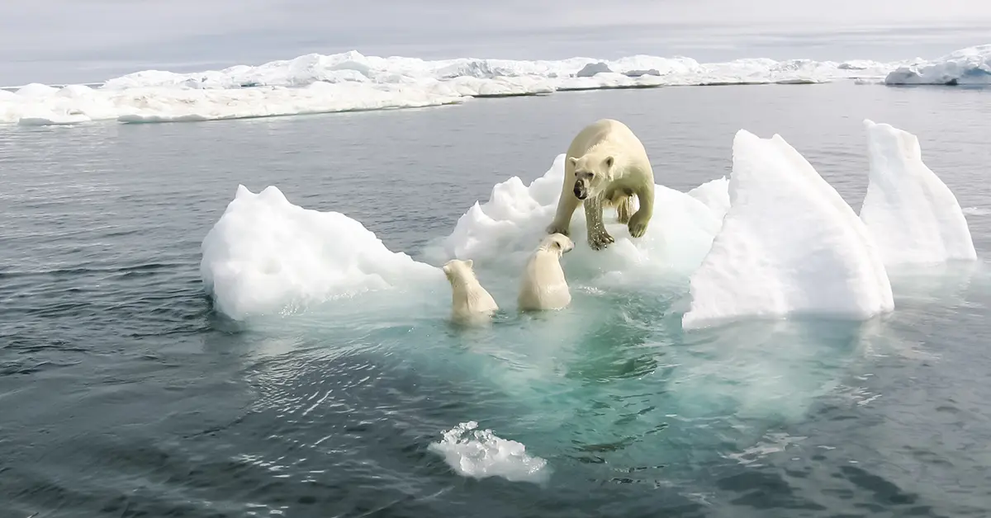
What is global warming?
Global warming usually refers to human-induced warming of the Earth system, whereas climate change can refer to natural as well as anthropogenic change. The two terms are often used interchangeably.

Slide 3
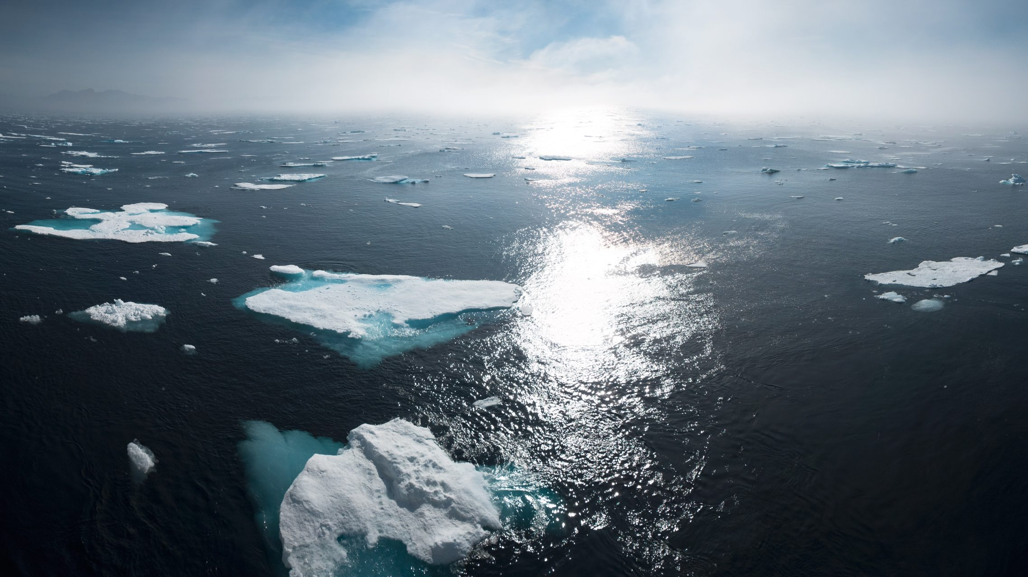
Consequences of global warming on our planet
So the main points about global warming is change in weather. Of course we have many other major problems that occur during global warming and in the future, those problems could destroy our planet.
The main key points to global warming are:
Change in weather.
Extreme weather conditions.
Increase in average temperatures.
Ice melt.
Sea levels and ocean acidification.
Plants and animals.

Slide 4
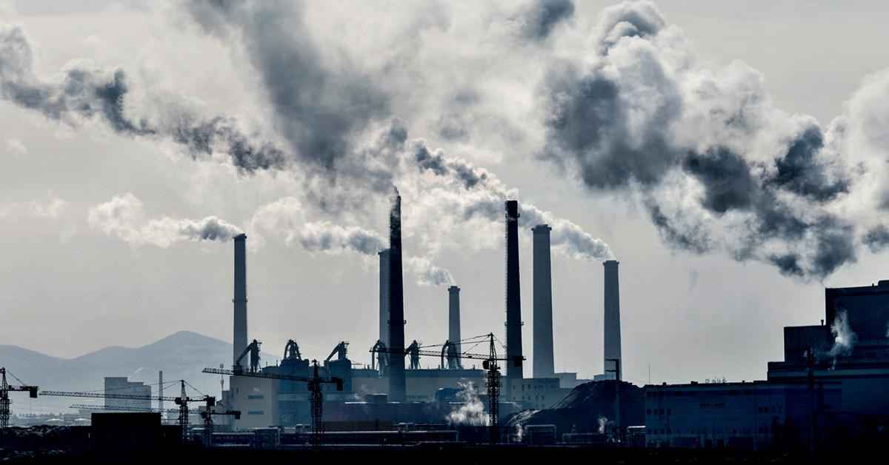
Example of global warming
The rate at which sea levels are rising throughout the world is increasing. This is due to both the melting of glaciers and the thermal expansion of the oceans as they absorb atmospheric heat increases caused by emissions. Widespread decreases in the extent of snow and ice is an example of global warming.
Some climate models predict that there will be a nearly complete unfreezing and de-icing of the Arctic by September 2037.
A major rise in sea levels is also anticipated. Manhattan, California and other coastal areas could find themselves underwater with homes and buildings destroyed and people displaced. The Golden Gate Bridge, an icon of San Francisco, could be partially underwater as could Manhattan subways and iconic buildings in New York City.

Slide 5
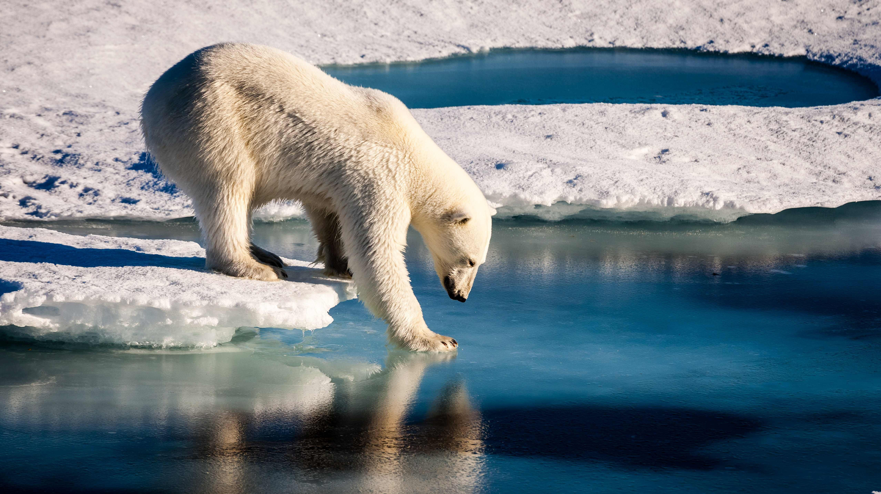
Strategies to fight back global warming
Demand Climate Action
Speak up! ...
Power your home with renewable energy. ...
Weatherize, weatherize, weatherize. ...
Invest in energy-efficient appliances. ...
Reduce water waste. ...
Actually eat the food you buy—and make less of it meat. ...
Buy better bulbs. ...
Pull the plug(s).

Slide 6
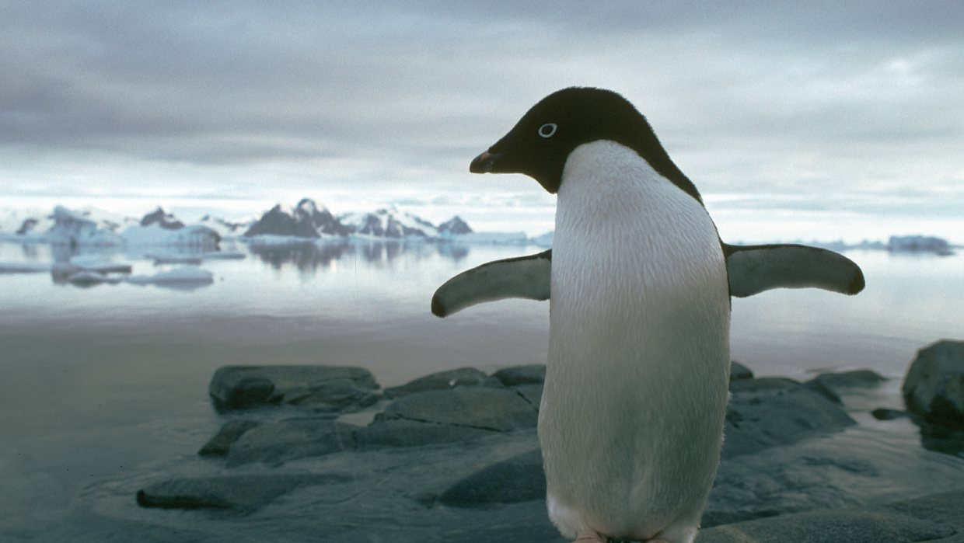
Videos about global warming
https://www.youtube.com/watch?v=oJAbATJCugs - National geographic.
https://www.youtube.com/watch?v=0YssYbZ-EhU - What if we don't stop global warming?
https://www.youtube.com/watch?v=G4H1N_yXBiA - Causes and effects of global warming.

