Slide 1
DESTINATION: HAPPINESS!

Slide 2
Hygge WORKSHOP
DESTINATION: HAPPINESS!
Teacher Cristina Moldoveanu

Slide 3
Objectives:
This workshop aims to:
develop the Danish concept of wellbeing
Incorporate hygge in your life through a short crafting activity

Slide 4
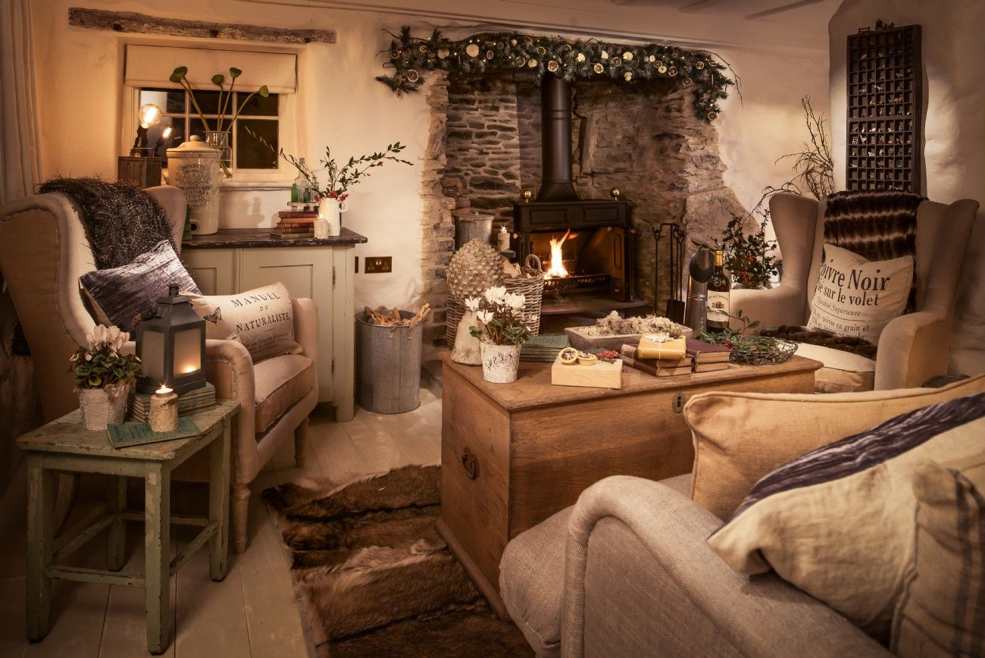
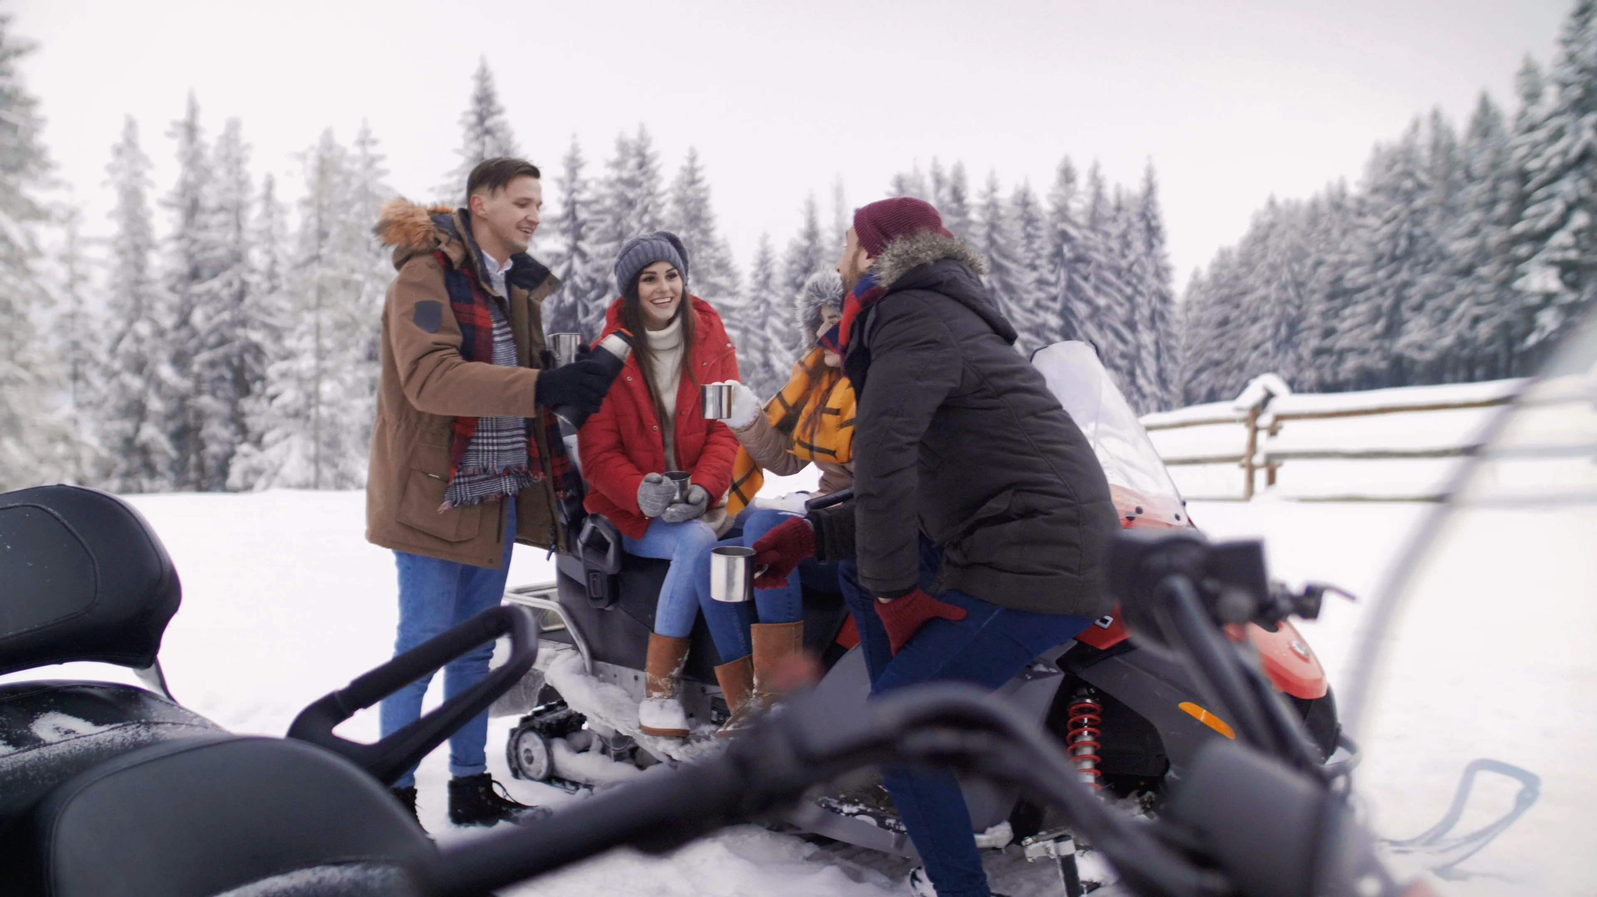
Describe the photos:
*suggested vocabulary: comfy, cosy/cozy, homely, intimate, pleasant, warm, welcoming

Slide 5
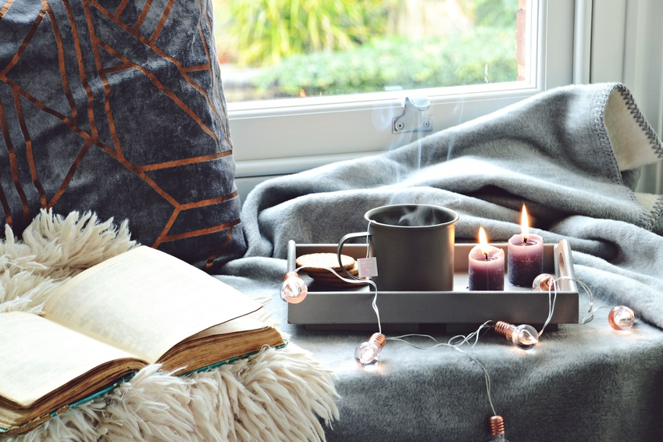
Complete the sentences with correct forms of the words in brackets.
1. There are many ways you can express your ____________ to the people who love and support you. [GRATEFUL]
2. After the operation she was able to enjoy simple ___________such as walking in the park. [PLEASE]
3. This restaurant offers delicious food and has a relaxed ___________. [AMBIENT]
4. I rarely go for sugary products, but Belgian hot chocolate is a little _____________. I just can’t resist. [INDULGENCE]
5. The book deals with the ___________of everyday happiness. [PURSUE]
6. Try to master the art of creating an atmosphere of relaxation, warmth and __________. [COSY]
7. The goal of our weekly meetings is to encourage a sense of ___________among the community. [TOGETHER]

Slide 6
CHECK WITH THE BOARD!
1. There are many ways you can express your gratitude to the people who love and support you.
2. After the operation she was able to enjoy simple pleasures such as walking in the park.
3. This restaurant offers delicious food and has a relaxed ambiance.
4. I rarely go for sugary products, but Belgian hot chocolate is a little indulgence. I just can’t resist.
5. The book deals with the pursuit of everyday happiness.
6. Try to master the art of creating an atmosphere of relaxation, warmth and cosiness.
7. The goal of our weekly meetings is to encourage a sense of togetherness among the community.

Slide 7
In a nutshell…
Gratitude
Simple pleasures
A relaxed ambiance
Indulgence
The pursuit of everyday happiness
Cosiness
Togetherness
Hygge - The Danish concept of wellbeing

Slide 8
Why “hygge”?

Slide 9
Hygge comes from Old English and Old Norse, the language the Vikings used for communicating. Hygge is the feeling of coming inside after a long day of being outside in the cold.

Slide 10
Hygge comes from Old English and Old Norse, the language the Vikings used for communicating. Hygge is the feeling of coming inside after a long day of being outside in the cold.
Hygge is being kind to yourself.

Slide 11
Hygge comes from Old English and Old Norse, the language the Vikings used for communicating. Hygge is the feeling of coming inside after a long day of being outside in the cold.
Hygge is being kind to yourself.
Hygge is enjoying simple pleasures.

Slide 12
What are examples of hygge?

Slide 13
Lightning candles

Slide 14
A cup of coffee

Slide 15
A mug of hot chocolate and marshmallows

Slide 16
Stroking a cat

Slide 17
Family

Slide 18
Doing whatever makes you happy ☺

Slide 19
B.R. Discuss the questions:
Which of these simple pleasures and indulgences do you do to lift your mood during autumn and winter? Would you add anything to the list?
drinking hot tea or chocolate
eating comfort food
listening to music
wearing comfy clothes
socialising with friends
sitting by the fire or taking long baths or walking in nature
• Do you try to create cosiness and a warm ambience at home by burning candles, making a fire, adding cushions, etc.?
• What can we do to maintain a sense of togetherness in our workplace or local community?
• Have you ever heard of the concept of hygge before?

Slide 20
4. Watch the following video and answer the questions.
Who is Meik Wiking?
What is hygge?
Is hygge a lifestyle trend or self-help?
d) What type of activities does hygge involve?
e) Are Danish people the only ones who practise hygge?

Slide 21
4. Watch the following video and answer the questions.
a) Who is Meik Wiking? The author of The Little Book of Hygge. [00:21]
b) What is hygge? Hygge is being consciously cosy and it has also been called the pursuit of everyday happiness or socialising for introverts. [00:36]
c) Is hygge a lifestyle trend or self-help? It’s neither. It’s a part of Danish culture. [01:02]
d) What type of activities does hygge involve? All of the sinful pleasures or indulgences, such as sweets, or eating unhealthily. [01:35]
c) Are Danish people the only ones who practise hygge? No, they’re not. Other people also practise it, but call it something different. [04:29]

Slide 22
Do you like the concept of hygge? Why/Why not?

Slide 23
Do you like the concept of hygge? Why/Why not?
Do you think that people all around the world practise hygge, but Danes just have a name for it?

Slide 24
hygge
sp
Do you like the concept of hygge? Why/Why not?
Do you think that people all around the world practise hygge, but Danes just have a name for it?
Do you have a word in your language that refers to a similar idea?
Relaxare
Acasa
Confort
Stare de bine
jaukumas
spitogatos
Hommy/ comfy/ wellbeing

Slide 25
Work in groups. Look at the list of activities below. Choose five that would bring everyday happiness and pleasure to people from your country. Justify your choices.

Slide 26
National Groups:
Discover your hygge!
1.
Create your own corner of comfort and relaxation (hygge corner/hyggekrog). You can make use of the suggested materials mentioned in the agenda (fruit, leaves, your favourite book, cup of tea, etc.)
2.
Take a picture of it and send it on my email address! You may be the winner of the “The Most Popular Hygge Photo”.
3.
Email address: cristina.moldoveanu@outlook.com

Slide 27
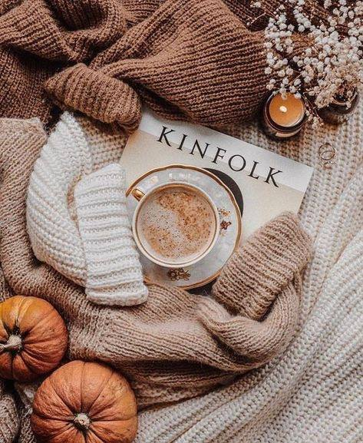
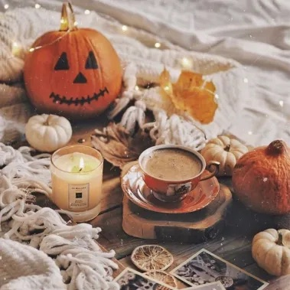
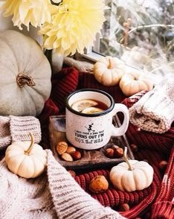
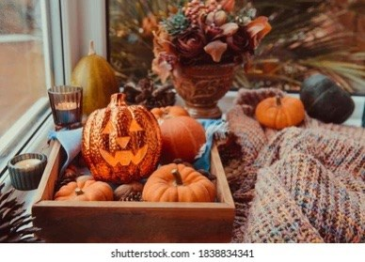

Slide 28
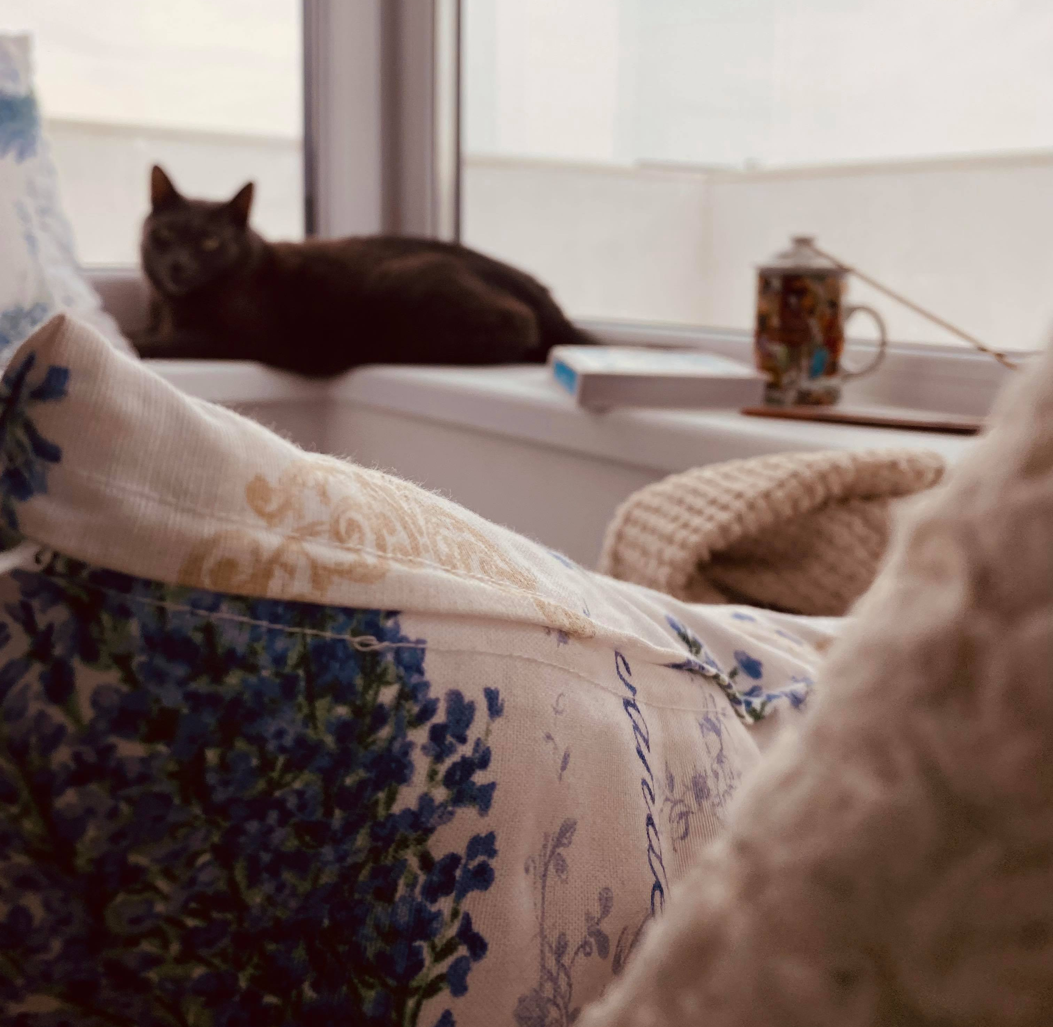
My hygge corner ☺

Slide 29
Do whatever makes you happy! Do whatever makes your soul shine!

Slide 30
Thank you!

Slide 31
References:
MICA ENCICLOPEDIE HYGGE, REȚETA DANEZĂ A FERICIRII, MEIK WIKING
Embrace the Danish way of living - Lesson Plan - ESL Brains

