Slide 1
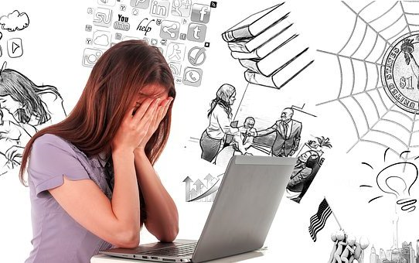
Online stress
by Kristýna Mudříková

Slide 2
LEGEND
MENU
NEXT SLIDE
PREVIOUS SLIDE
UNDO

Slide 3
ONLINE STRESS
You can choose a theme by clicking on the rectangle
Social network
Digital stress
Digital technology

Slide 4
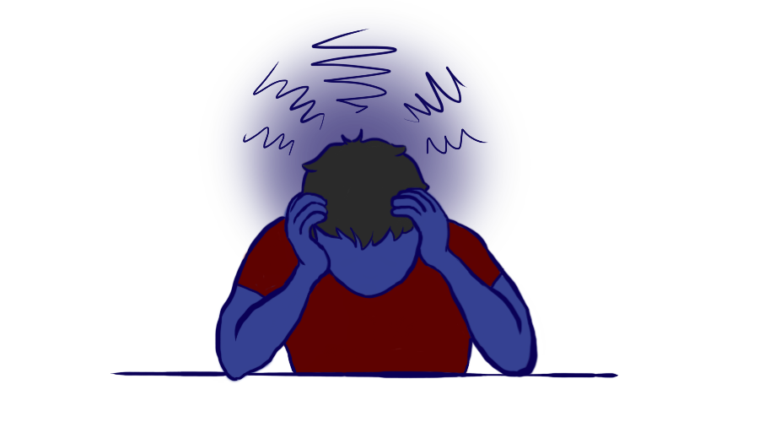
SOCIAL NETWORK
We are on social network almost every day.
Social networks generally bring us a lot of stress, so we should give them up sometimes to make us feel better.
Social media have never recover personal contact.

Slide 5
Experiment - SOCIAL NETWORK
Experts found some people who were supposed to give up Facebook for a week.
All of them had reduced lower cortisol (stress hormone).
They also said their lives were happier.

Slide 6
My opinion - SOCIAL NETWORK
I take a break from social media sometimes, and I feel better, too.
It makes me prosecute more things than when I'm on social media all the time.
Plus, I can fight over stupid things on social media. They're a bad influence on me.
I'll spend at least four hours on my phone. And that's only on social media.

Slide 7
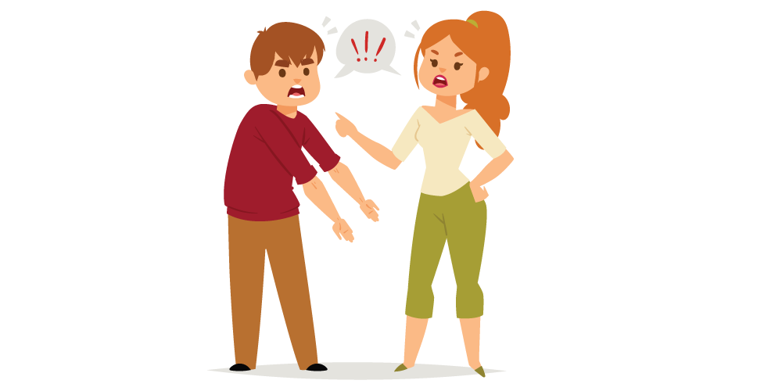
DIGITAL STRESS
We need to be available online all the time.
Digital stress is probably everywhere nowadays.
When you post on forums, someone can argue with us.

Slide 8
DIGITAL TECHNOLOGY
Nowadays, there are a lot of people who depend on digital technologies.
Children who easily become dependent on a computer are most at risk.
This then affects their mentally health, and when they're not at the computer for a long time, they're depressed.

Slide 9
SOURCES
https://www.whitmoreschool.org/wp-content/uploads/2017/03/frustrated.jpg
https://www.idnes.cz/onadnes/zdravi/deprese-socialni-site-facebook-instagram-twitter.A180605_091735_zdravi_job
https://re-life.cz/novinky/digitalni-stres-novy-fenomen-dneska/
https://refresher.cz/53152-Lide-pouzivajici-Facebook-jsou-vice-ve-stresu-Nejvetsi-socialni-sit-si-bere-svoji-dan
https://www.rizeniskoly.cz/cz/aktuality/digitalni-technologie-mohou-za-stres-i-odcizeni-nejohrozenejsi-jsou-deti-rika-psycholozka.a-3141.html
https://brandslogo.net/wp-content/uploads/2018/03/social-network-logo-vector.png
https://www.theonlineclarion.com/wp-content/uploads/2021/04/Stress1.png
https://drthurstone.com/wp-content/uploads/2014/11/arrow.png

Slide 10
SOURCES
https://st4.depositphotos.com/12141488/38095/v/950/depositphotos_380950450-stock-illustration-blue-distress-everywhere-stamp-and.jpg
https://wellness.usask.ca/images/articles/communication-argument.png
http://4.bp.blogspot.com/_hRy63Hhyu8o/THQbQGQZkfI/AAAAAAAAC3E/jHQVp8SlqUk/s320/Kids__Computers_0005.gif
EXIT

Slide 11
ONLINE STRESS
Social network
Digital stress
Digital technology
You can choose a theme by clicking on the rectangle

