Slide 1
Reduce? Reuse? Recycle? A lesson on minimalism
by
Rita Lamokovskienė
2021 November

Slide 2
The Aim of the lesson
To analyze and understand the concept of minimalism better by taking into account a real life actions of using less by reducing, reusing or recycling.

Slide 3
Minimalism is about avoiding the unnecessary , it's about simplicity, utility and elegance. It's all about “LESS IS MORE” in terms of embracing the most of fewer things.

Slide 4
What can we do on a daily basis to become more Minimalistic and Eco- Friendly?
Simplify:
Simplify your life as much as possible.
Only keep belongings that you use/enjoy on a regular basis.
By making the effort to reduce what you own, you will naturally purchase less/create less waste in the future.

Slide 5
Reduce Purchases: In general, think before you buy any product - do you really need it?
Try the 30-Day Rule -- wait 30 days after the first time you decide you want a product to really make your decision. This will eliminate impulse buying.

Slide 6
Buy Used: Buy used products whenever possible.
Some sources:
local thrift stores
local newspaper listings
local material exchange sites (search in your area)
local used furniture stores

Slide 7
Share With Friends
Share things like books, magazines, movies, games, and newspapers between friends and neighbors.

Slide 8
Avoid Creating Trash
*when ordering food, avoid receiving any unnecessary plastic utensils, straws, etc.
*buy ice cream in a cone instead of a cup,
*don't accept "free" promotional products,
*buy products with the least amount of packaging, etc.
Every little bit of trash avoided does make a difference!

Slide 9
Shopping Bags
While shopping, if you only buy a few products skip the shopping bag.
For larger purchases, bring your own eco-friendly bags.

Slide 10
http://www.globalstewards.org/ecotips.htm
There are MORE tips to EXPLORE☺

Slide 11
„Less stuff, More Happiness“

Slide 12
What are your ECO rules???

Slide 13
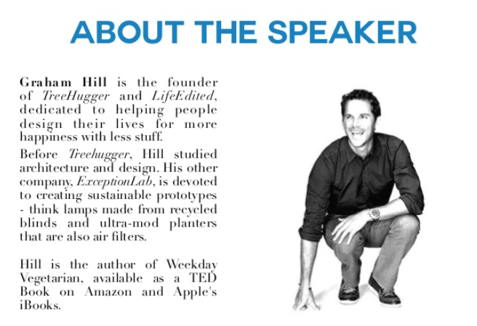

Slide 14
Watching a video „Less stuff, more Happiness“
https://www.ted.com/talks/graham_hill_less_stuff_more_happiness#t-6528

Slide 15
Think and take some notes...

Slide 18
What would you put in the box???

