Slide 1
Virtual Mobility
Bucharest, Romania
11-15 October 2021

Slide 2
Creativity
Introspection
Self-care

Slide 3
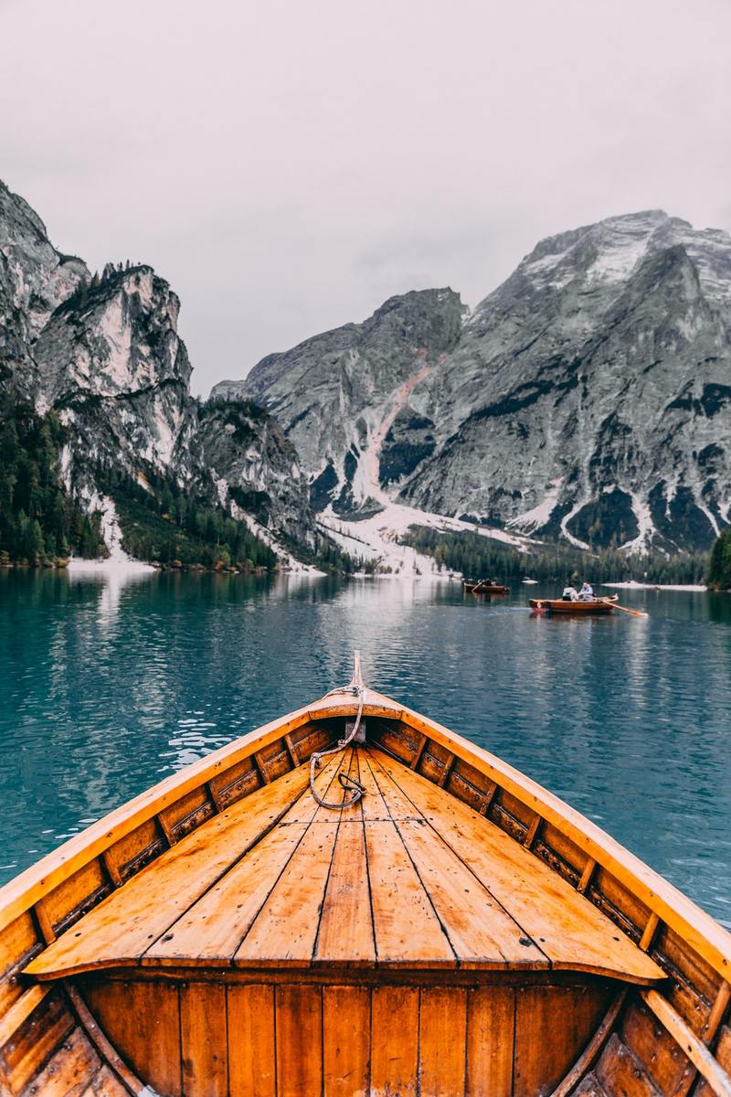
Life is a ….
a journey
a box of chocolates
a novel
a maze
a river
a mountain climb
a canvas
your own idea

Slide 4
Who do you turn to when you need advice?

Slide 5
Letter to My Future Self
We often think of advice as passing on wisdom from the elderly to youth, from teacher to student, from parent to child.
But what if we, as our present-day selves, offer advice to an older, more worn version of ourselves?
Think of it as an exercise in self-love, a means of preserving and protecting what’s important today well into the future.

Slide 6
Dear future me, ☺
Take a breath. Look down at your two feet. Where are they right now? Look around you. Do you see nature? Go touch the leaves. Pick a flower and deeply inhale its beautiful fragrance. Do you hear birds? Stop and take a moment to go listen to their music, because not everyone is so fortunate enough to be able to hear and enjoy that experience. Do you feel the sunshine on your skin? If not, go step outside and be grateful for the fact that it is constantly shining down on you, and that you are alive. Go take a bite of something delicious and savor every moment with absolutely no concern around any kind of weight gain. Not everyone is so privileged to have access to food, so superficial aesthetics should be the least of your worries regardless of the deep societal impositions. How have you been of service to others today?

Slide 7
Why is it a good idea?
Reality check
Self-reflection
Time-capsule
Reminder

Slide 8
How to write a letter to yourself
Ask yourself questions
What lessons have I learned up until this point?
What goals have I achieved?
Am I happy?
What is important to me?
Am I spending enough time on things that matter?
Do I take enough care of my health and myself?

Slide 9
How to write a letter to yourself
2. Share Your Current Beliefs
Family and friends
Relationships
Health
Career
Spirituality
Money

Slide 10
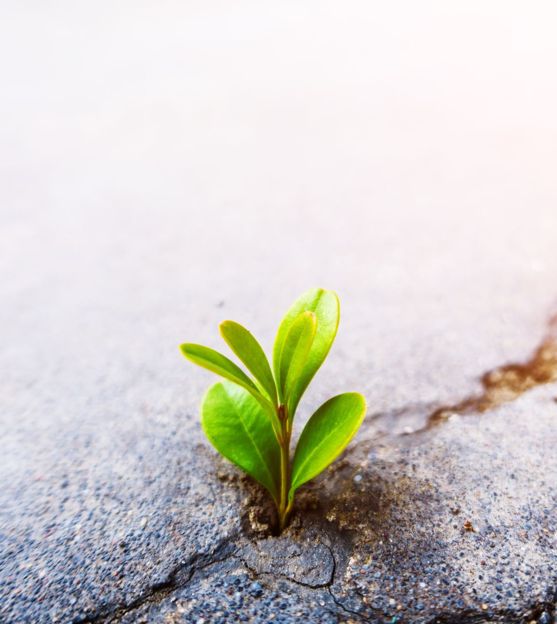
3. Define Things You Want to Change in the Future
What should I remember?
What are my goals for the future?
What habits should I start to be healthier?
What relationships need more attention and what ones need to be dissolved?
What should I exclude from my life? What should I add to my life?

Slide 11
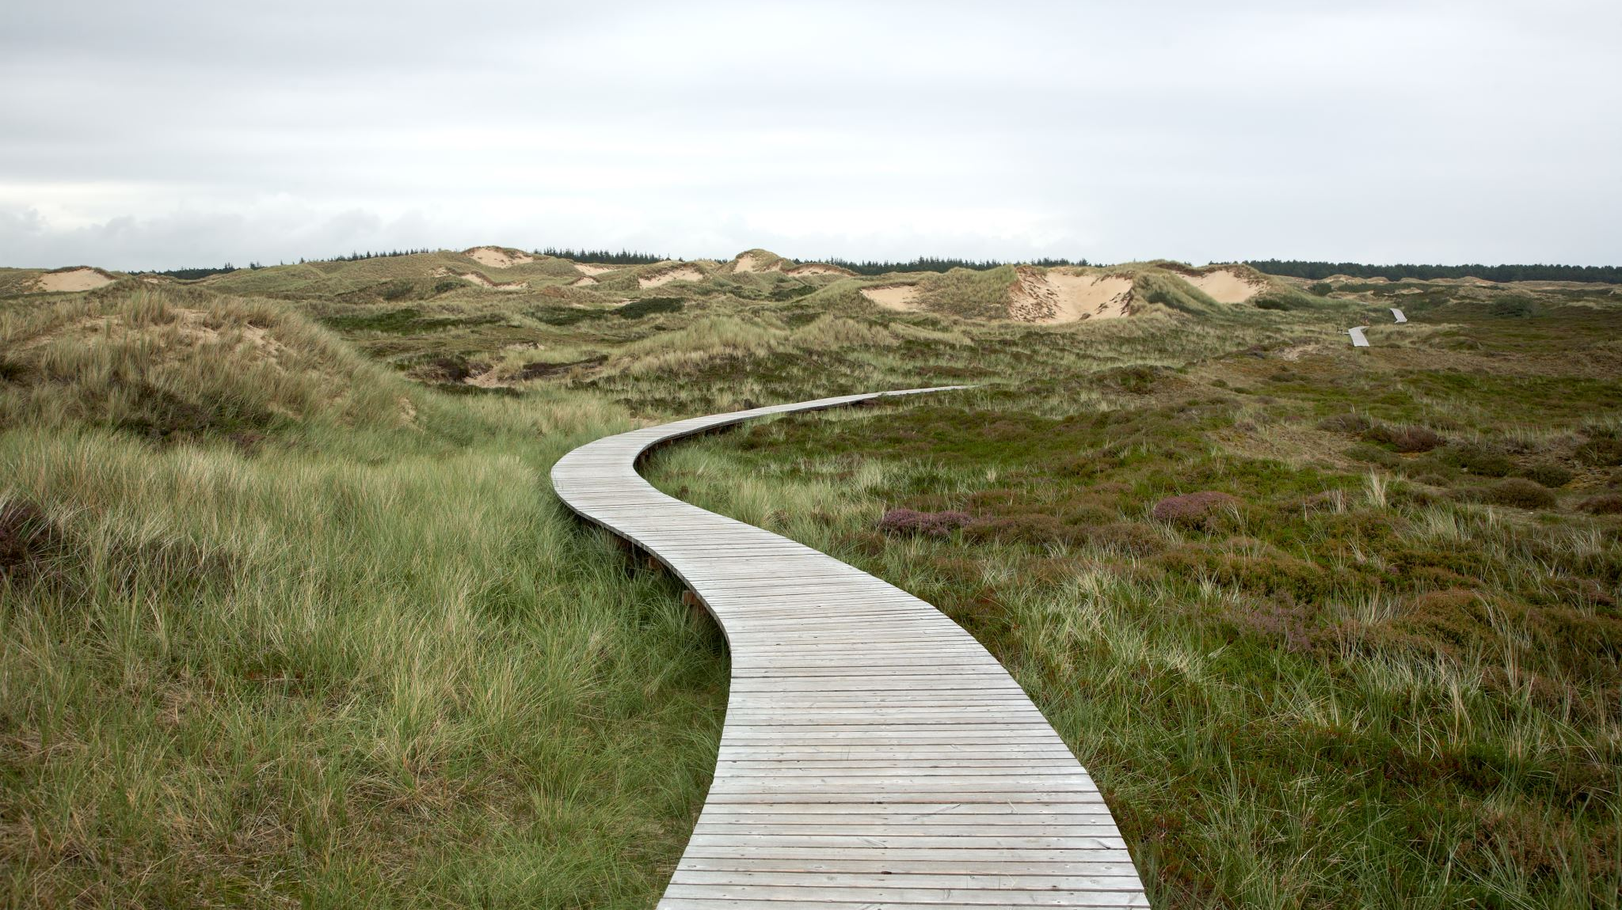
Inspire and be inspired
LOOKING BACK AND MOVING FORWARD

Slide 12
Debrief
What was it like to write a letter to your future self?
Choose 3 adjectives to describe the experience.
In way(s), if any, has this experience been useful to you?
What do you want your letter to be?
a Reminder/a Time-capsule/a Reality Check
Are you willing to share the letter with the others?

Slide 13
References
https://wanderlust.com/journal/open-letter-future-self/
https://bucketlistjourney.net/write-a-letter-to-my-future-self/
https://www.theteenmagazine.com/a-letter-to-my-future-self-e8f8cb24-c109-4a63-896e-3030e5828d32
https://www.futureme.org/

