Slide 1
Workshop: Integration games and activities
DESTINATION: HAPPINESS!
Facilitator: Anca Purcari

Slide 2
1. How are you feeling today?
Join us on Jambord and write your name next to the picture that best reflects your current state of mind.
Link in the chat box.
Share your option.

Slide 3
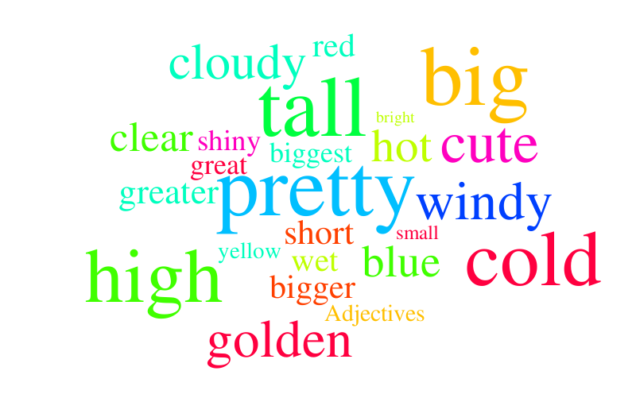
2. Describe yourself in one word
Each of you is going to say his / her name preceded by an adjective that describes him / her that starts with the first letter of his / her name.
We`ll take turns in alphabetical order.
For example, I might say attentive Anca

Slide 4
3. ID Numbers
Please write your first name, in big letters, in the top half of a piece of paper. There`s no problem if you don`t have a piece of paper, you`ll just put everything in the chat.
Then, directly below, write a series of numbers and letters which provide a set of cryptic clues which represent an interesting personal insight, an ‘id number’ so to speak. (2 minutes)
For example, I could write the following:
ANCA 1988-5Y-1S-1C-7M

Slide 5
3. ID Numbers
Share your ID Number with us.
Can we guess what the numbers represent?

Slide 6
4. Common ground
In this next activity we`ll search for things we have in common.
In breakout rooms, try to find out as many things as possible you have in common with your peers. You have 5 minutes to complete this task.

Slide 7
4. Common ground
Present your lists.
Which group has the longest list?

Slide 8
5. Dilemmas
I will ask a few questions, there are no right or wrong answers. If you like the first option best please raise one hand and if you like the second option best please raise both hands.

Slide 9
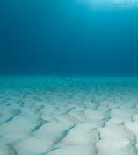
Would you rather live in the ocean or on the moon?
Can you tell me why?

Slide 10
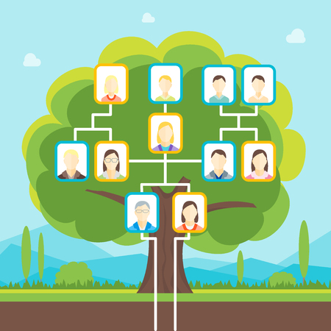
ANCESTORS
Would you rather travel back in time to meet your ancestors or to the future to meet your descendants?
DESCENDANTS
Can you tell me why?

Slide 11
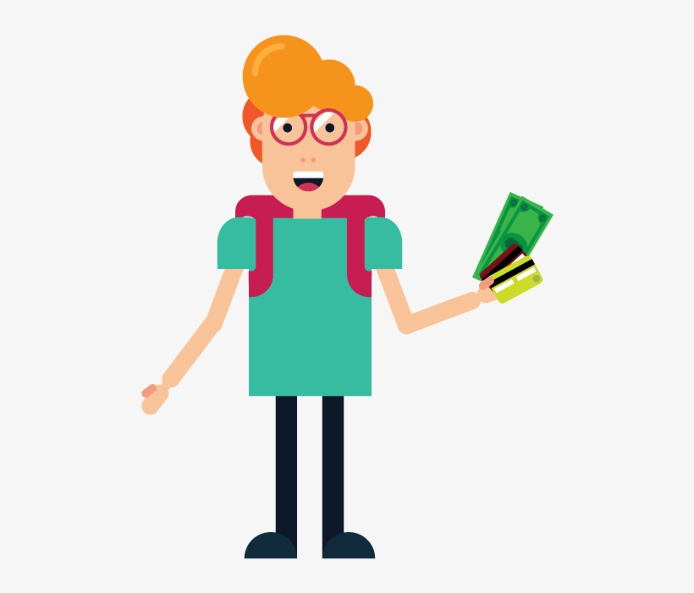
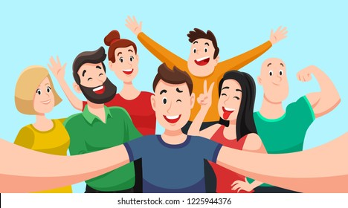
Would you rather lose all of your money or all of your photos?
Can you tell me why?

Slide 12
INVISIBILITY
Would you rather have invisibility or flight?
FLIGHT
Can you tell me why?

Slide 13
Would you rather live where it only snows or where the temperature never falls below 35 degrees?
Can you tell me why?

Slide 14
Would you rather be the funniest or smartest person in the room?
Can you tell me why?

Slide 15
Would you rather move to a new city or town every week or never be able to leave the city or town you were born in?
Can you tell me why?

Slide 16
Would you rather always speak your mind or never speak again?
Can you tell me why?

Slide 17
Would you rather be an unhappy millionaire or a happy hobo?
Can you tell me why?

Slide 18
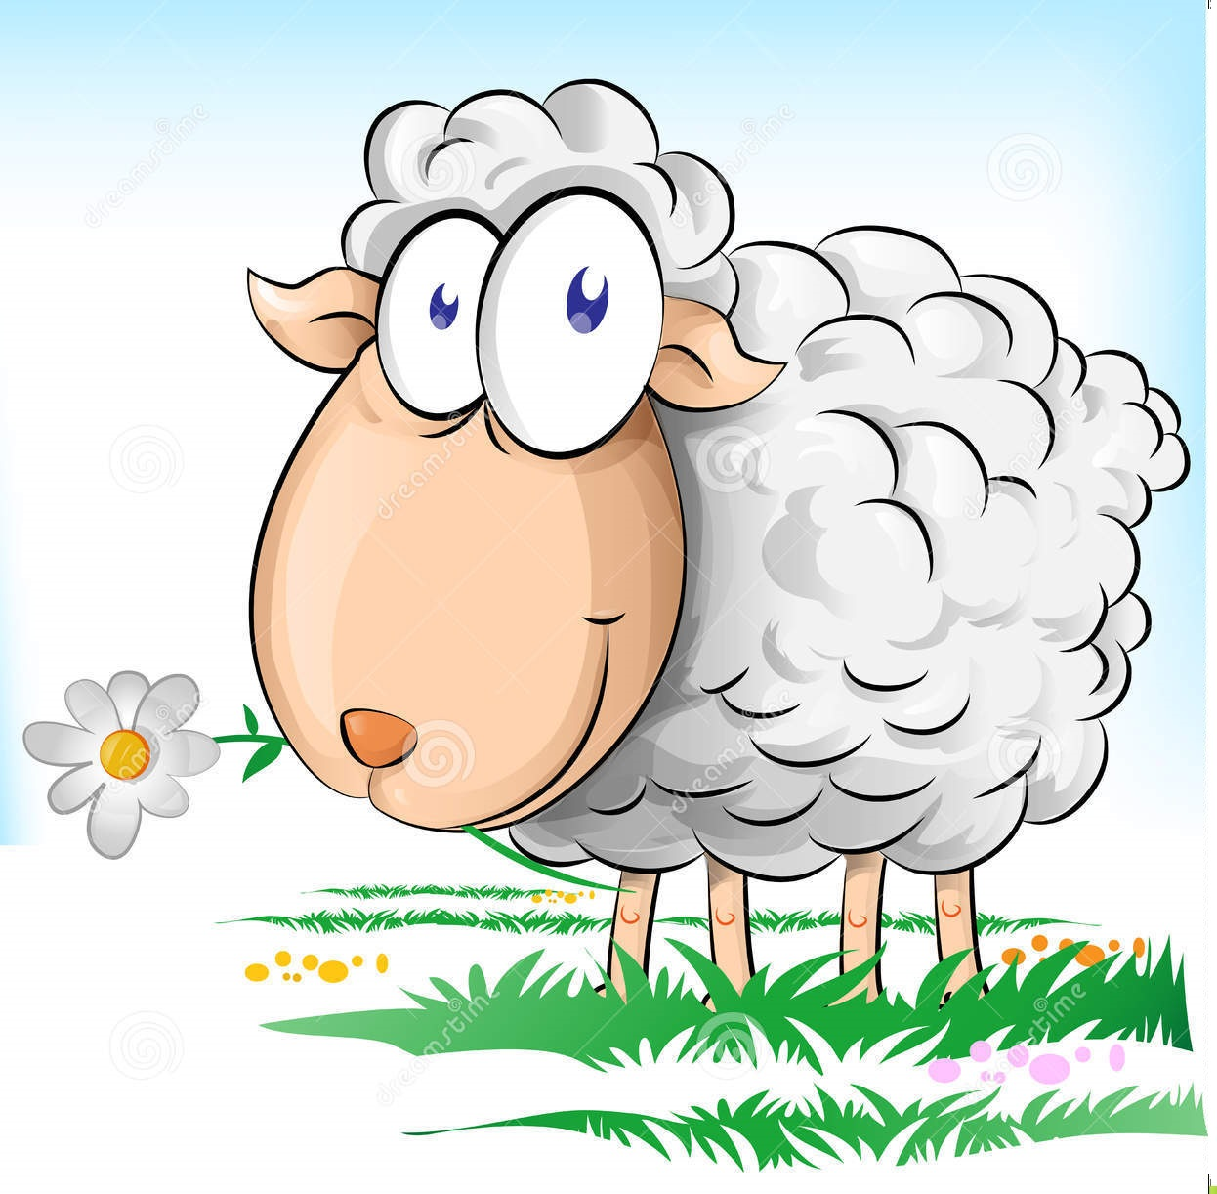
Would you rather be an unhappy genius or a happy sheep
Can you tell me why?

Slide 19
Sources
https://www.youtube.com/watch?v=Y5Roy_LcKB
https://www.playmeo.com/activities/ice-breakers-get-to-know-you-games/id-numbers/
https://museumhack.com/list-icebreakers-questions/#wouldyourather
https://www.freshtracks.co.uk/blog/free-team-building-activity-common-ground/
https://www.youtube.com/watch?v=o74h-JqCbqU

