Slide 1
Public Speaking Ugnė Macionytė IIId

Slide 2
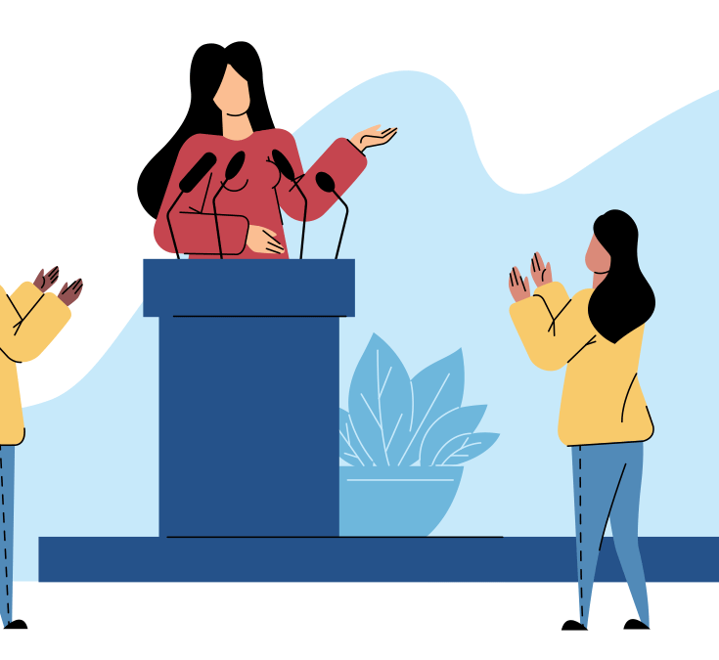
What is public speaking?
It's a presentation that's given live before an audience. Public speeches can cover a wide variety of different topics. The goal of the speech may be to educate, entertain, or influence the listeners. Often, visual aids in the form of an electronic slideshow are used to supplement the speech. This makes it more interesting to the listeners.

Slide 3
The Importance of Public Speaking
Over the years, public speaking in communication has played a major role in education, government, and business. Words have the power to inform, persuade, educate, and even entertain. And the spoken word can be even more powerful than the written word in the hands of the right speaker.
Benefits to speaking in public include:
improves confidence
better research skills
stronger deductive skills
ability to advocate for causes
and more

Slide 4
Strategies for Becoming a Better Speaker:
Plan Appropriately
First, make sure that you plan your communication appropriately. When you do this, think about how important a book's first paragraph is; if it doesn't grab you, you're likely going to put it down. The same principle goes for your speech: from the beginning, you need to intrigue your audience.

Slide 5
Practice
To get practice, seek opportunities to speak in front of others. You could put yourself in situations that require public speaking, such as by cross-training a group from another department, or by volunteering to speak at team meetings.

Slide 6
Engage With Your Audience
When you speak, try to engage your audience. This makes you feel less isolated as a speaker and keeps everyone involved with your message. If appropriate, ask leading questions targeted to individuals or groups, and encourage people to participate and ask questions. Also, pay attention to how you're speaking. If you're nervous, you might talk quickly. This increases the chances that you'll trip over your words, or say something you don't mean.

Slide 7
Pay Attention to Body Language
Stand up straight, take deep breaths, look people in the eye, and smile. Don't lean on one leg or use gestures that feel unnatural. Instead of standing behind a podium, walk around and use gestures to engage the audience. This movement and energy will also come through in your voice, making it more active and passionate.

Slide 8
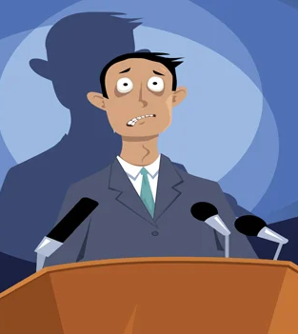
Cope With Nerves
First, make an effort to stop thinking about yourself, your nervousness, and your fear. Instead, focus on your audience: what you're saying is "about them." Remember that you're trying to help or educate them in some way, and your message is more important than your fear. Concentrate on the audience's wants and needs, instead of your own.

Slide 9
Negative impact of public speaking fear on career statistics

Slide 10
Sources
https://business.tutsplus.com/tutorials/what-is-public-speaking--cms-31255
https://www.mindtools.com/CommSkll/PublicSpeaking.htm
https://magneticspeaking.com/7-unbelievable-fear-of-public-speaking-statistics/

