Slide 1
 | How to make a Reportage Teacher: Aura Andrici The 11th of October 2021

Slide 2
https://www.youtube.com/watch?v=h29z-l3XTlk&t=29s

Slide 3
What is the subject of the video?
What kind of video have you just watched?
a witness report
an event description
a portrait
an analysis
an editorial
How was the video shot?
dynamic
static
large angle
close angle

Slide 4
What is a reportage?

Slide 5
A REPORTAGE IS
a type of journalism that provides a readable and vivid account, with all essential details, of an eyewitness event or one in which the author has taken part.
The manner of presenting reportage depends on the means of mass media—press, radio, or television—for which the material is intended.
Press reportage, usually in newspapers, may center on events or may be thematic, describing
events unified by a single theme but occurring at different times. It is usually illustrated with
photographs taken at the scene of the events; features illustrated with photographs are also in wide
use.
Reportage on the radio always follows a chronological sequence of events and uses vivid language to
present the events realistically.
Reportage on television often becomes a commentary on the event being depicted.

Slide 6
How to film an audiovisual production
PREPARATION
Content:
What is your common thread?
What is the synopsis of your report?
What are the questions you are going to ask?
Have you done research on the subject? What are your findings?
Who will be the interviewees?
Organization:
Who records the meetings?
Who edits the video?
What is the role of every member of the team?

Slide 7
How to film an audiovisual production
2. THE SHOOT
Organization:
Technicians set up the equipment.
The reporter prepares the guest, discusses how the interview will proceed.
The cameraman frames the interview.
Make sure that phones are turned off!
Check the recording at the end!

Slide 8
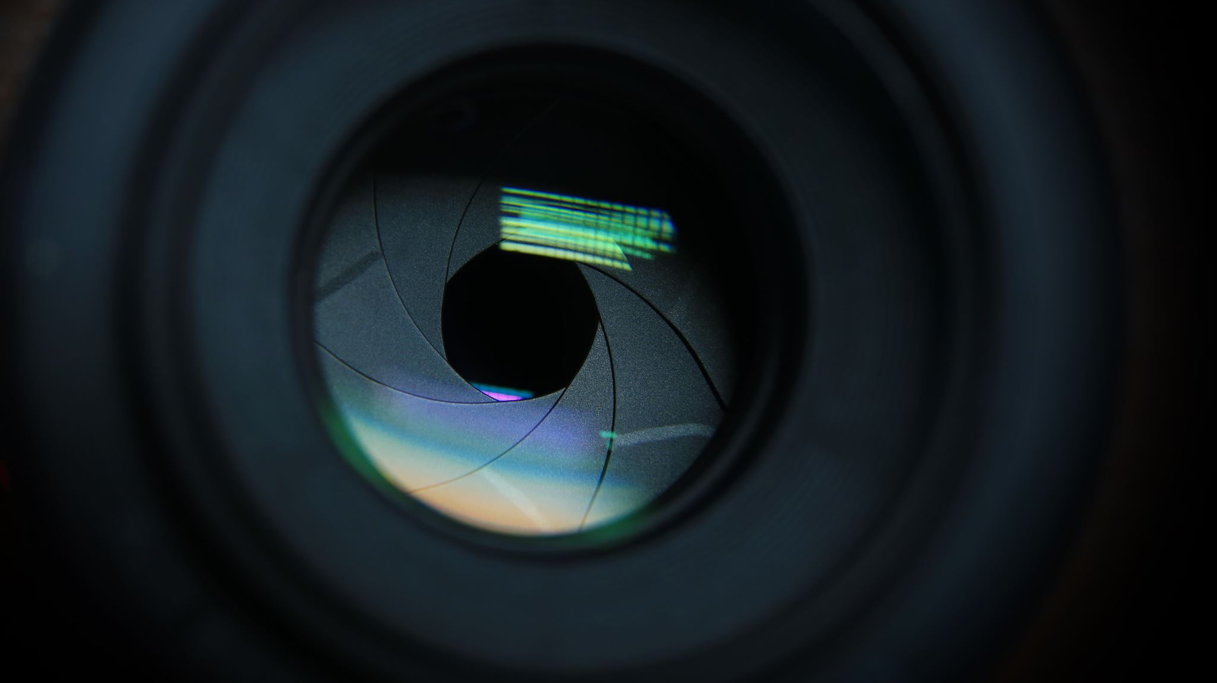
Camera shots

Slide 9
GENERAL SHOT situates the action and shows all the protagonists in their context. This shot must last long enough for the viewer to be able to assimilate the information that the director wanted to give.

Slide 10
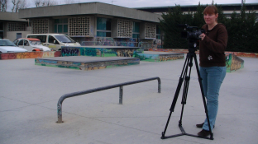
MEDIUM SHOT frames one or more full-length characters.
It focuses the viewer's attention on the character(s) possibly in a space that locates them.

Slide 11
AMERICAN SHOT frames the characters mid-thigh. It brings the viewer even closer to the characters. The American plan was so named because it is the typical plan of American films of the years 1930-1940.

Slide 12
SIZE CLOSING SHOT frames the characters at the waist. It accentuates the intimacy; it allows viewers to read the psychological reactions. The duration of this plan depends on the dialogue and the action in progress.

Slide 13
CLOSE-UP CHEST has the same functions as the close-up waist, emphasizing a little more the features of the character's face.

Slide 14
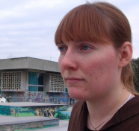
CLOSE UP
You only see part of a character that you want to draw attention to.
It allows you to directly read the inner life of a character, his emotions, his most intimate reactions.
This is the plan of psychological analysis.

Slide 15
Camera movements
When filming, different camera movements are possible.
In all cases:
Be careful not to make sudden movements.
Never to combine all the angles and all the movements in the same shot.
Don't forget what is behind your shot.
Fixed camera: no movement of the camera, it is on foot and does not move.
Traveling camera: the camera and its support move.

Slide 17
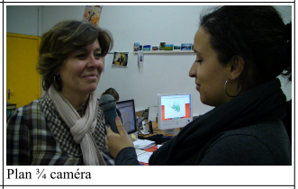

Slide 19
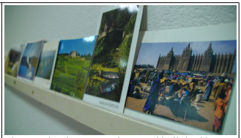

Slide 21
How to film an audiovisual production
3. POST-PRODUCTION
Organize the video material (your footage).
Add title, logo, music, end credits, etc.
Calibration - color balance, brightness. Try to anticipate this at the shooting level to minimize the post-production work on this point.
Sound mixing - an important final step for listening comfort.

Slide 22
https://www.youtube.com/watch?v=xl9r_hOh9r4
What Is Emotional Well-Being? | Drs. Richard Davidson and Bruce McEwen
https://www.youtube.com/watch?v=DMKJ0u116uw

Slide 23
Schools and well being
What is the current situation in your school? (pluses and minuses)
Who are the people/professionals that can support the students and teachers in your school? What do they do? Are there any events that promote the students’ wellbeing?
How can the current situation be improved? What else could be done so that students and teachers feel happier at school?

Slide 24
Make a reportage
WHO? Who is questioned, who will be interviewed? WHAT? What is the purpose of your reportage? What are the questions, or the issues raised? What is the desired end? What are the highlights?
Type of reportage: audio/audiovisual
Topic: Schools and wellbeing
Duration: 5 -10 minutes
Deadline: Wednesday, 13th of October

Slide 25
Notes and references
http://digitalstorylab.com/wp-content/uploads/2020/06/video-reportage-tutorial-4.pdf
https://movilab.org/wiki/Cr%C3%A9er_un_reportage_audiovisuel
Manier P-S. (2011), Le journalisme audiovisuel : Les techniques rédactionnelles en télévision et sur Internet, INA Edition

