Slide 1
NATURAL DISASTERS
Emilis Zareckas

Slide 2
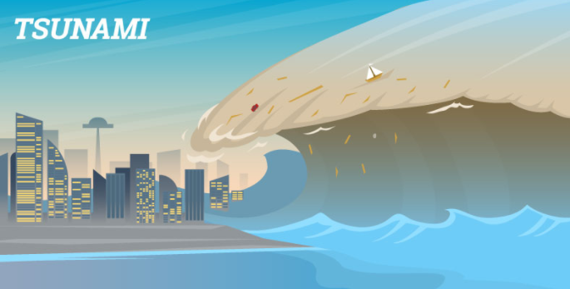
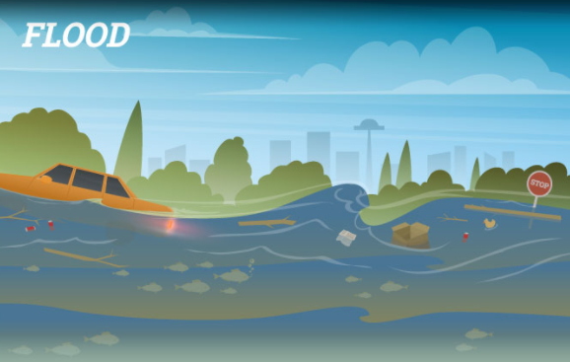
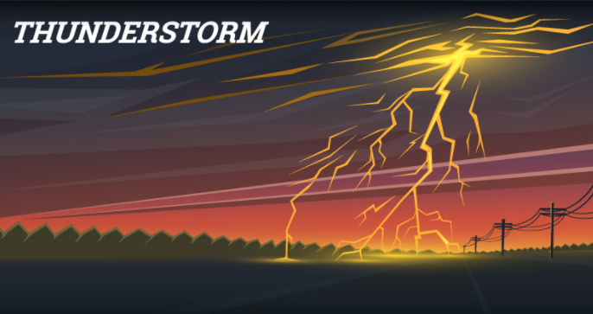
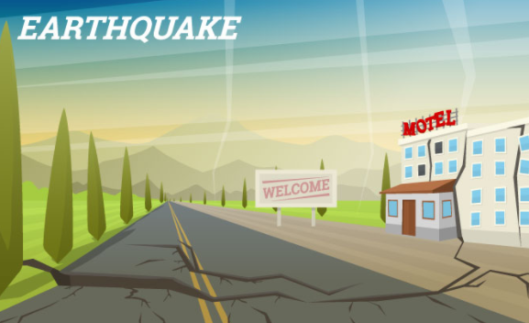
What is A natural disaster?
A natural disaster is a major adverse event resulting from natural processes of the Earth.

Slide 3
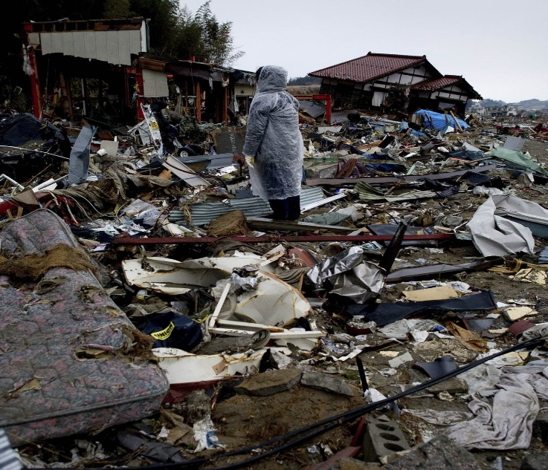
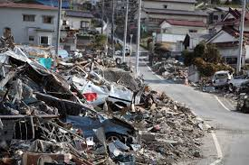
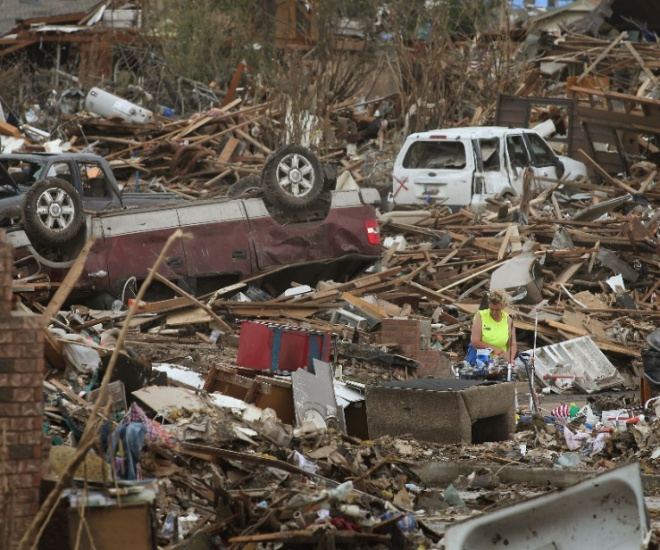
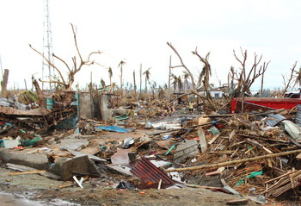
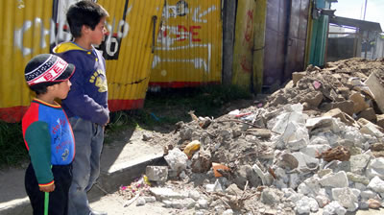
CONSEQUENCES OF NATURAL DISASTERS

Slide 4
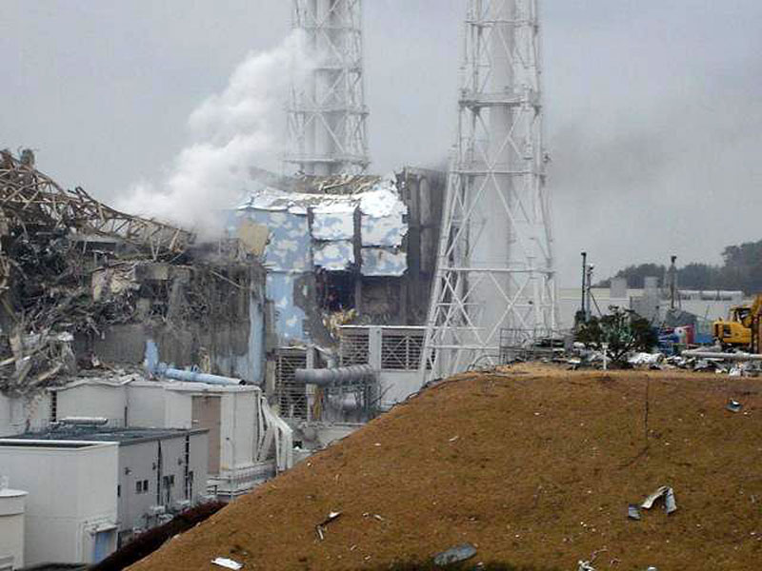
Fukushima Daiichi nuclear disaster
On 2011 march 11 a 15-metre tsunami disabled the power supply and cooling of three Fukushima Daiichi reactors, causing a nuclear accident.
The reactor accident in Fukushima in 2011 resulted in the release of radioactive material (radionuclides) into the atmosphere.
The radioactive fallout was dispersed locally, regionally and globally over land and sea by the weather (wind and precipitation).
A video link about an accident:
https://www.youtube.com/watch?v=5mVKVeU75ZA

Slide 5
HOW TO AVOID NATURAL DISASTERS?
Not all countries have the same resources to deal with a natural disaster. It is precisely this issue that is being addressed at this year's conference, which is focusing on increasing the number of countries with response strategies for this type of disaster. We can prevent or avoid extensive damage if we are prepared to handle such disasters.
Good governance of disaster risk is essential for making communities resilient to natural phenomena. This theory is already applied in many countries. For example, in the Netherlands, where rainfall is intense, there is a good control system in place for flooding; and in Japan, the country's high level of earthquake risk is well managed.
Investing in disaster resistance creates jobs and saves money. This is the view of António Guterres, Secretary-General of the United Nations. "Making infrastructure more climate-resilient can have a benefit-cost ratio of about six to one. For every dollar invested, six dollars can be saved", says Guterres.
https://www.youtube.com/watch?v=OCjl6tp8dnw&t=20s
Tips how to survive a natural disaster

