Slide 1
Climate change
Jonava Jeronimas Ralys gymnasium
Presented by Erikas Markūnas
2021-06-13

Slide 2
Content
Climate change explanation
Effects on our planet
Example of climate change
Strategies to fight back against climate change
A video of climate change
Photos

Slide 3
Climate change explanation
Climate change includes both global warming driven by human-induced emissions of greenhouse gases and the resulting large-scale shifts in weather patterns.
Though there have been previous periods of climatic change, since the mid-20th century humans have had an unprecedented impact on Earth's climate system and caused change on a global scale.

Slide 4
Effects on our planet
Global climate change has already had observable effects on the environment. Glaciers have shrunk, ice on rivers and lakes is breaking up earlier, plant and animal ranges have shifted and trees are flowering sooner.
Effects that scientists had predicted in the past would result from global climate change are now occurring: loss of sea ice, accelerated sea level rise and longer, more intense heat waves.

Slide 5
Example of Climate change
These include warming temperatures and changes in precipitation, as well as the effects of Earth's warming, such as: Rising sea levels. Shrinking mountain glaciers. Ice melting at a faster rate than usual in Greenland, Antarctica and the Arctic.

Slide 6
Strategies to fight back against Climate change
Learn more about your carbon emissions. There is much more you can do to reduce your household carbon emissions.
Commute by carpooling or using mass transit.
Plan and combine trips.
Drive more efficiently.
Switch to “green power.”

Slide 7
Video of Climate change
https://www.youtube.com/watch?v=09LaDAlTr_k

Slide 8
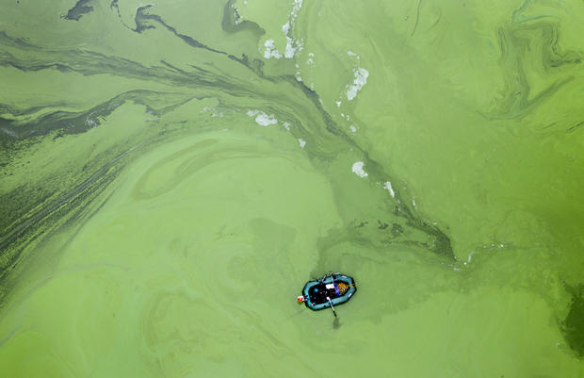
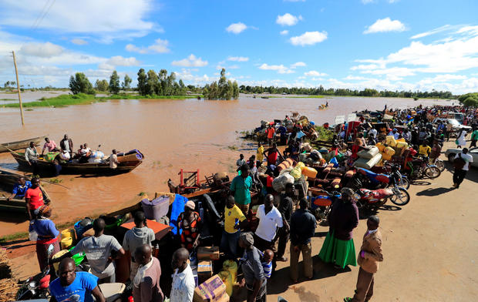
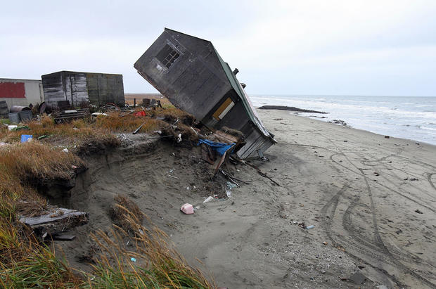
Photos which prove that climate is changing
Very green water
Flooded villages
Beach erosion

