Slide 1
Public Speaking
Luka Lenčiauskaitė IIId
Jonava Jeronimas Ralys gymnasium

Slide 2
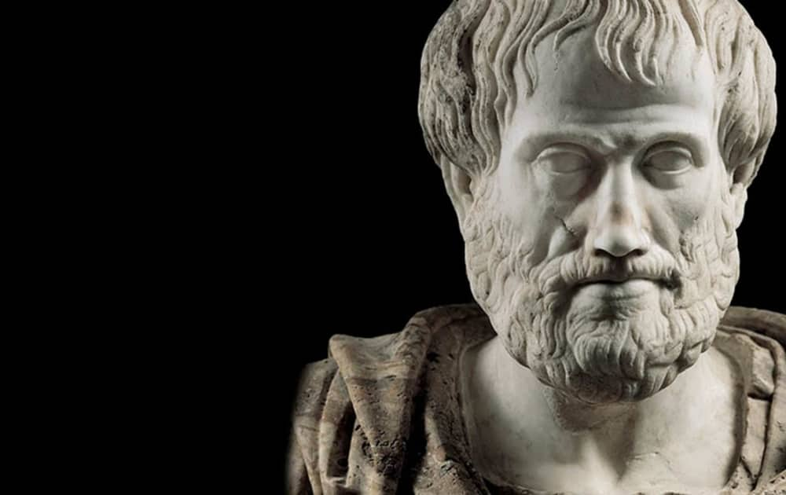
The study of public speaking began about 2,500 years ago in ancient Athens. Men were required to give speeches as part of their civic duties, which included speaking in legislative assembly and at court (sometimes to defend themselves as there were no lawyers for the average Athenian).

Slide 3
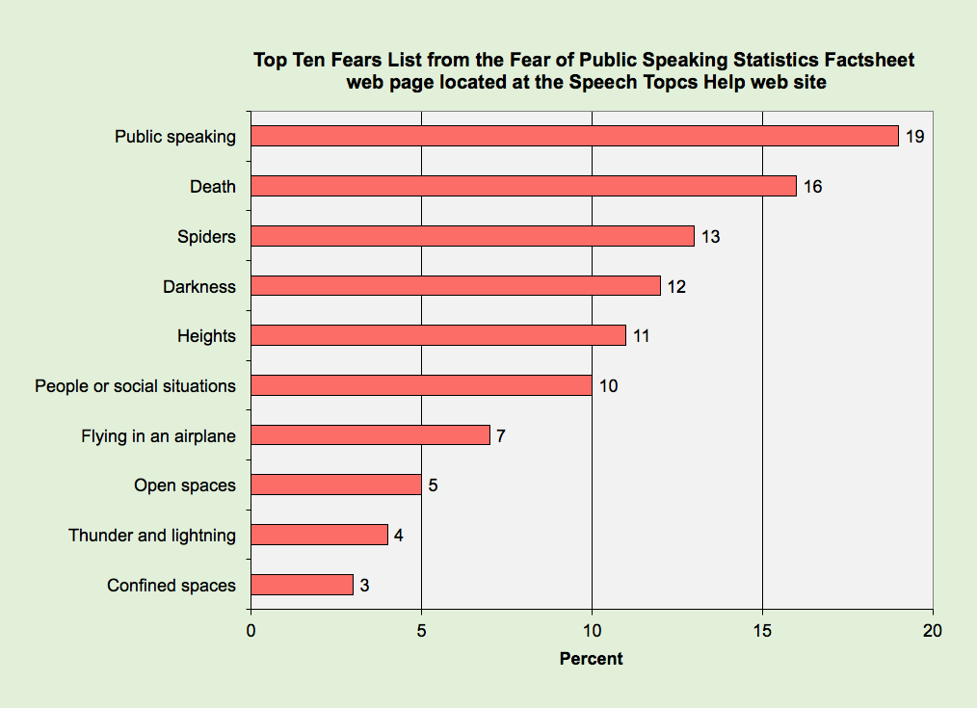
People are more afraid of public speaking than death, spiders, heights, and the dark!

Slide 4
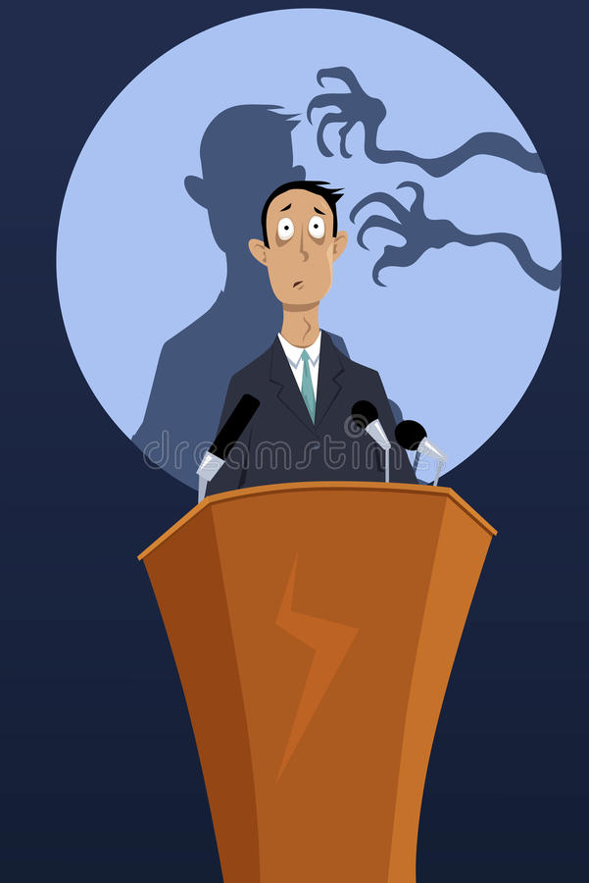
Glossophobia, or the fear of public speaking, is remarkably common. In fact, some experts estimate that as much as 77% of the population has some level of anxiety regarding public speaking. 1﻿ Of course, many people are able to manage and control the fear.
Phobia may arise because of a combination of genetic tendencies and other environmental, biological, and psychological factors. People who fear public speaking may have a real fear of being embarrassed or rejected. Glossophobia may relate to one's prior experiences, Dr. Strawn says

Slide 5
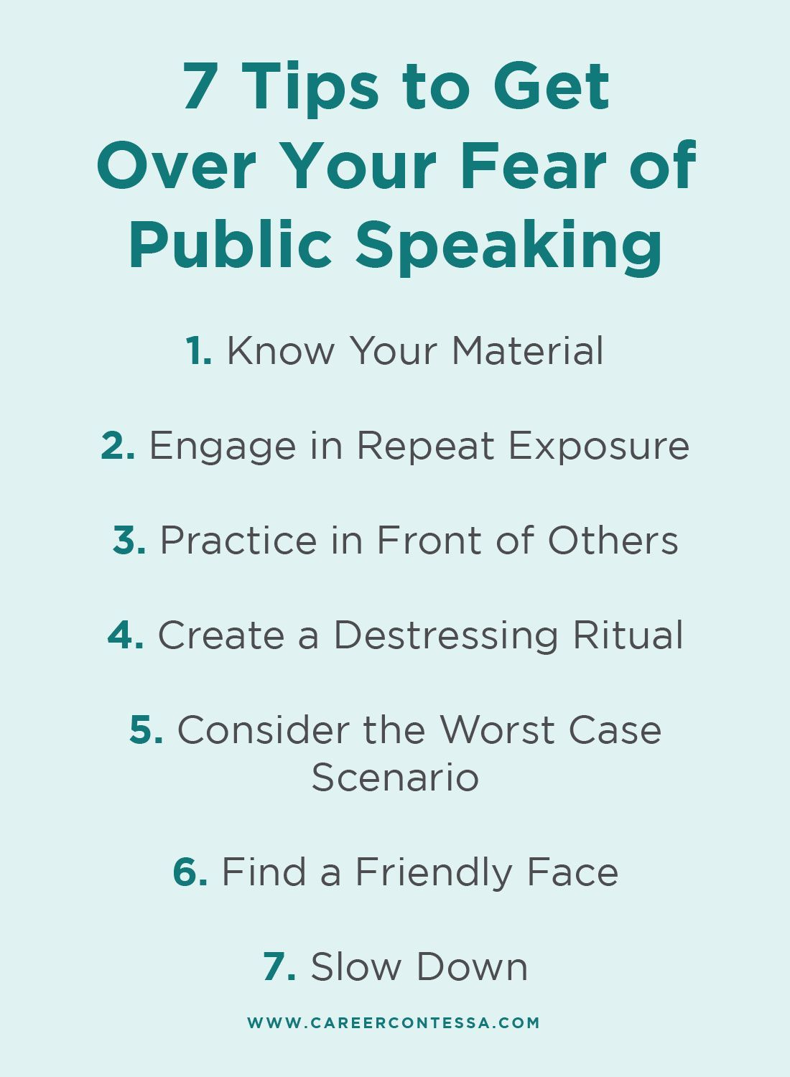
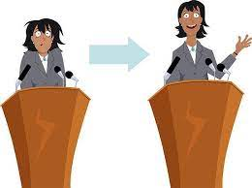

Slide 6
Facts
Social phobias, regardless of which they are, begin with shyness in childhood.
While fear of public speaking is common, it leads to lack of success when we do nothing about it
Adding facts and figures to a presentation increases audience retention by 20%
Talk less to engage your audience more

Slide 7
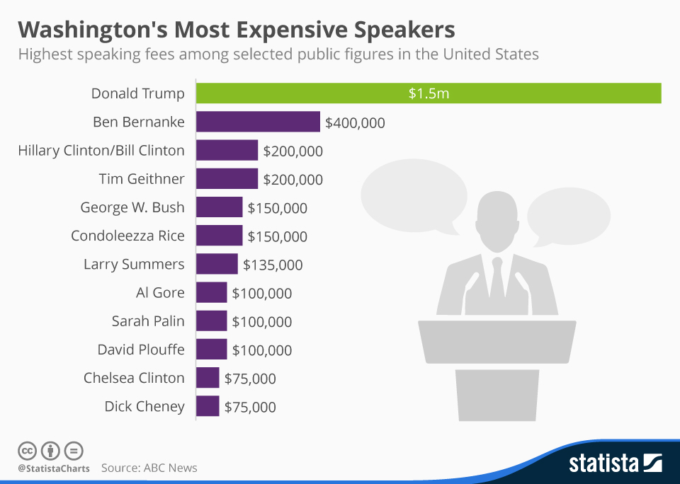
Most politicians love the spotlight. And if they don’t, they do a fantastic job of looking cool, calm, and collected speaking in front of huge crowds. Here is a list of Washington’s top earning speakers, with Donald Trump in the lead at $1.5 million per appearance!

Slide 8
RESOURCES
https://franticallyspeaking.com/the-history-and-evolution-of-public-speaking/
https://andrewstapleton.com.au/fear-of-public-speaking-facts/
https://infogram.com/blog/public-speaking-fears-and-facts-visualized/

