Slide 1
A lesson plan on Making a Short Public Speech
Presented by
Rita Lamokovskienė
May 10, 2022
Jonava Jeronimas Ralys gymnasium

Slide 2
The aims of the lesson:
*To present the main aspects of public presentations:
Preparation for a speech writing;
Analysis of a speech structure;
*To make a detailed analysis of sample speeches;
Discussion based on two sample speeches
To choose a topic for a potential speech on eco-friendly lifestyle
Three options will be given

Slide 3
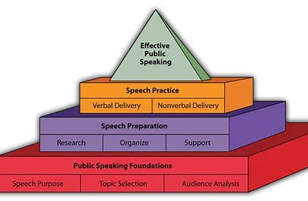

Slide 4
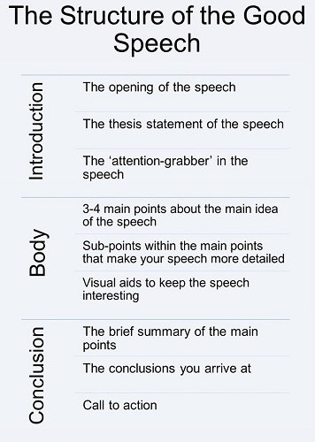

Slide 5
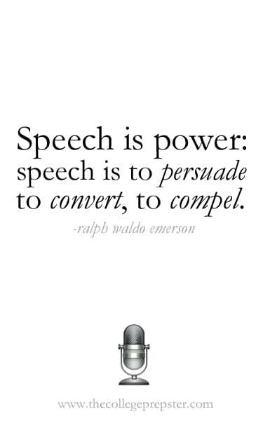

Slide 6
Greta Thunberg full speech at UN Climate Change COP24 Conference
https://www.youtube.com/watch?v=VFkQSGyeCWg
Questions to answer:
1. Does the intro of the speech grab a listener‘s attention? Why/ why not?
2. How persuasive Greta stays during the speech?
3. What expressions/words does she use to „stay alert“ ( write 5)?
4. How does Greta finish her speech? Write a quote. Do you agree with her final statement?

Slide 7
A sample analysis based on a video: „Climate Change Best Speech“
https://www.youtube.com/watch?v=Uz6w3Klsrr4

Slide 8
Write a short public speech on 1 chosen topic
Topic 1
Recycling should be mandatory.
Topic 2
We should strive for creating a paperless society at school.
Topic 3
Is consumerism a threat?

Slide 9
Changemakers matter!!!

