Slide 1
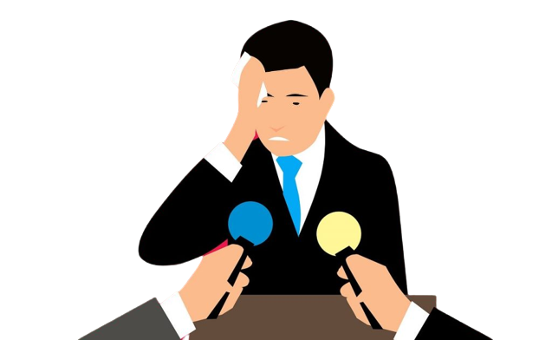
Psychological Aspects of Public speaking
Slides prepared by:
Justinas Liktaravičius
Emilis Zareckas

Slide 2
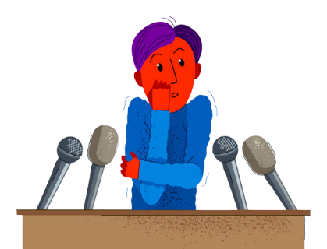
The first thing we want to talk about is problems that people often do while speaking in public,
and offer some solutions how to get rid of them.

Slide 3
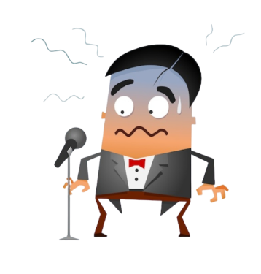
PROBLEM 1:
LACK OF CONFIDENCE
SOLUTION:
Visualize delivering your presentation confidently and successfully as this will reinforce your confidence.
Stand tall. Shoulders back, head up, eyes up and forward.
Positive mental imagery.

Slide 4
PROBLEM 2:
LACK OF PREPARATION AND ORGANIZATION
SOLUTION:
Practice repeatedly.
Visit the venue and room you'll be presenting in beforehand.
Ensure you print any materials you need at least the day before.

Slide 5
90% of anxiety we feel before public speech comes from lack of preparation so that’s very important to prepare well before your presentation.

Slide 6
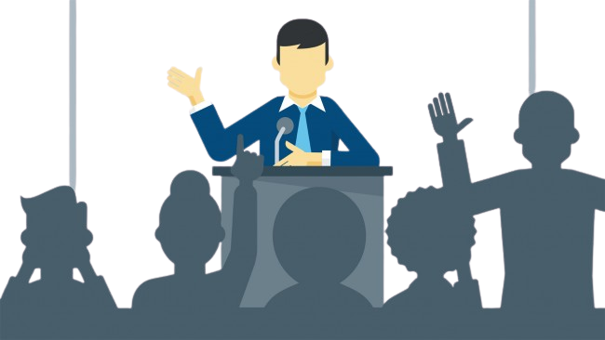
PROBLEM 3:
LACK OF ATTENTION TO AUDIENCE
SOLUTION:
Tell a story. We’re hardwired to listen to stories. They instantly engage us and require very little effort to stay focused.
Make them laugh. Nobody can not pay attention when the rest of the audience is laughing.
Do a short Q&A session during your presentation.

Slide 7
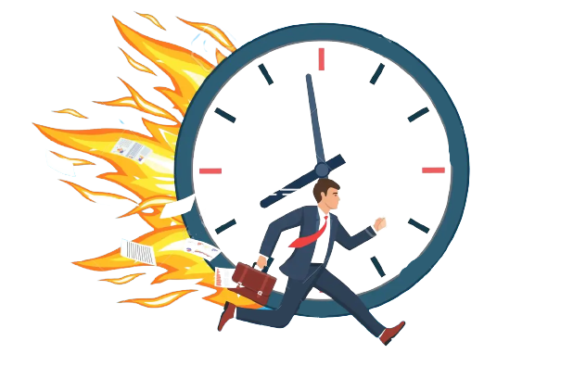
PROBLEM 4:
LACK OF TIME MANAGEMENT
SOLUTION:
Make sure you practiced and organized your speech well.
Practice repeatedly.
Arrive early for your speech.

Slide 8
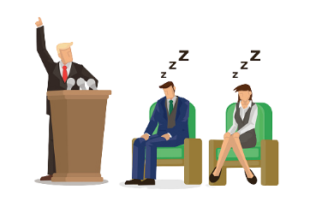
PROBLEM 5:
USE OF BORING LANGUAGE AND LACK OF INTERESTING MATERIAL
SOLUTION:
Keep it short, sweet and understandable.
Show a video related to your speech topic (If possible).
Express yourself expressively, use body language.

Slide 9
Danish Dhamani discusses how overcoming your fear of public speaking is key to leading a fulfilling life and unlocking your true potential.
He talks from his own experience, how he got rid of public speaking fear and also givea some advice.

Slide 10
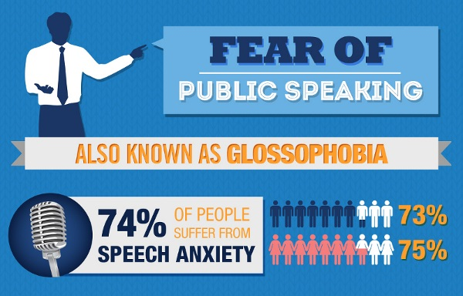
Even 74% of population has public speaking anxiety.

Slide 11
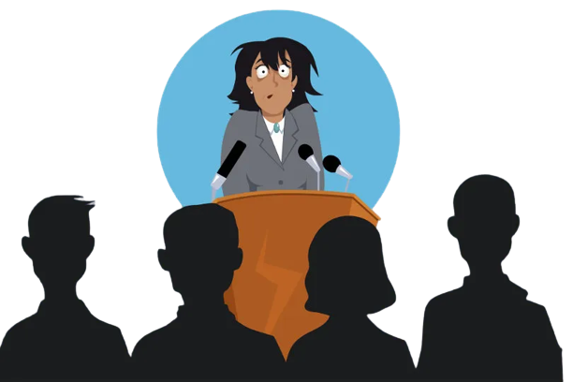
Why are we scared of public speaking?

Slide 12
1. Physiology
Physiological responses to public speaking anxiety include increased heart rate, flushing of the skin or face, and sweaty palms, among other things. These reactions are the result of natural chemical processes in the human body. The fight or flight instinct helped early humans survive threatening situations.

Slide 13
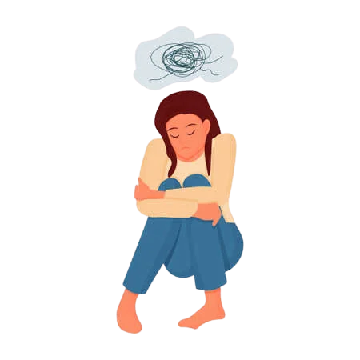
2. Thoughts
When you’re preparing, think about your audience.
When we start preparing for a presentation, the mistake we all make is starting with the topic. This immediately gets us inside the details — and makes it harder to break down the wall between us and others.

Slide 14
3. Situations
Lack of experience.
Degree of evaluation.
Status difference.
New ideas.
New audiences.

Slide 15
Fear of public speaking cuts wages by 10% A fear of public speaking can have a significant impact on your career given that those who have it make about 10% less, on average, than those who don’t.
What is Glossophobia?
What is the meaning of glossophobia? Formally, the term meaning the fear of public speaking is called “glossophobia” and is commonly found with people who have social anxiety.

Slide 16
If you are tired of reading tips on how to become a better public speaker, you can watch a short video that I guarantee will help you avoid problems while standing in front of an audience.

Slide 17
Information sources:
https://www.google.com/search?q=time+managment+and+public+speaking&rlz=1C1CHBD_ltLT936LT936&oq=time+managment+and+public+speaking&aqs=chrome..69i57j0i22i30j0i390l4.9432j0j7&sourceid=chrome&ie=UTF-8
https://corporatecommunicationexperts.com.au/9-public-speaking-statistics-know/#:~:text=The%20University%20of%20California%2C%20Los,comes%20from%20your%20nonverbal%20communication
https://ethos3.com/5-shocking-public-speaking-statistics/
https://www.briantracy.com/blog/public-speaking/27-useful-tips-to-overcome-your-fear-of-public-speaking/
https://speakerhubhq.medium.com/the-problems-most-public-speakers-face-and-the-7-apps-that-will-save-the-day-6ab9d6f265ca
https://franticallyspeaking.com/a-guide-to-making-your-speech-interesting/
https://brandongaille.com/14-fear-public-speaking-statistics/
https://www.psychologytoday.com/us/blog/smashing-the-brainblocks/201711/why-are-we-scared-public-speaking
https://magneticspeaking.com/7-unbelievable-fear-of-public-speaking-statistics/

