Slide 1
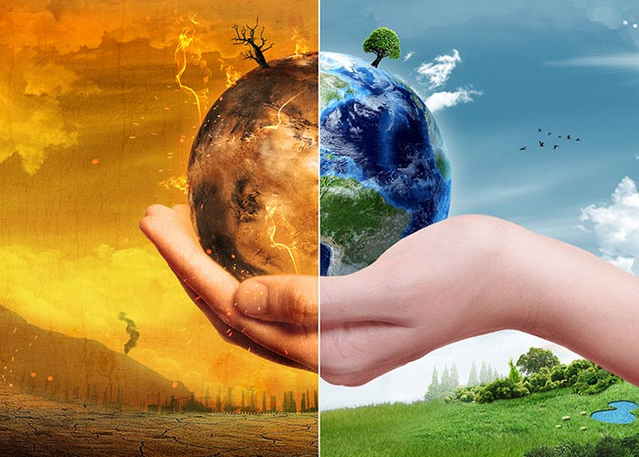
Global Warming
PRESENTED BY IIG CLASS STUDENT D.D.

Slide 2
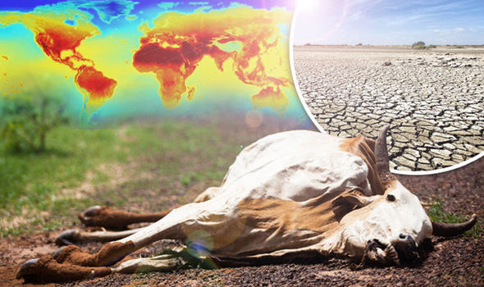
What is global warming?
Global warming is the gradual temperature rise of Earth's surface, oceans and atmosphere.

Slide 3
What are the effects of global warming?
Global warming is damaging the Earth's climate. One of the most visible effects of global warming the Arctic glaciers, sea ice is melting . Global warming is damaging in many ways, including the earth:
droughts
Increased melting of snow and ice
Sea level rise
Stronger hurricanes and cyclones

Slide 4
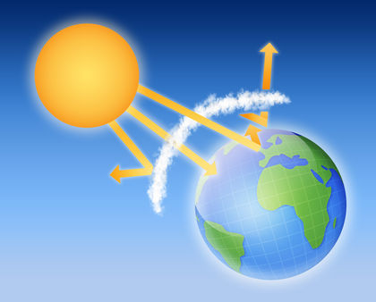
The greenhouse effect
Greenhouse effect - a process, which is absorbed in the atmosphere gas and sun heat which heats the planet. Gas in Earth's atmosphere absorbs about 90 % of this heat and radiates it back to the surface.This very helpful process is called the greenhouse effecting radiation from the sun.

Slide 6
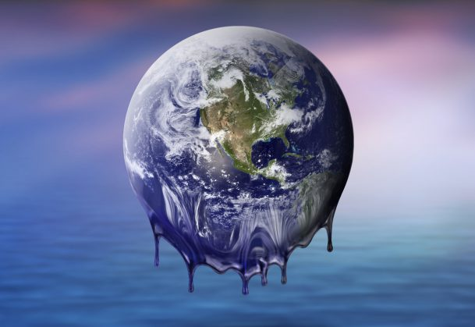
Videos about global warming and greenhouse effect
https://www.youtube.com/watch?v=oJAbATJCugs
https://www.youtube.com/watch?v=SN5-DnOHQmE

