Slide 1
A Healthy Mind in A Healthy Body
A project for creating and presenting
POSTERS
February 23- March 2, 2021
Rita Lamokovskienė

Slide 2
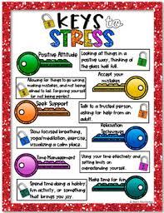
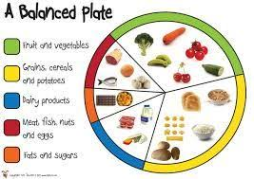
The aim of the project:
To create a poster on a chosen topic and present it to classmates.

Slide 3
Poster Topics
HEALTHY DIET TIPS (up to 10)
STRESS RELIEF TECHNIQUES (up to 8-10)
HEALTHY FOOD RECIPES (2-3)
YOUTUBE VIDEOS related to healthy lifestyle (5)
HEALTHY LIFESTYLE WEBSITES (blogs) (5)

Slide 4
YOUTUBE VIDEOS POSTER related to healthy lifestyle
- a title of a video;
- a link;
- a short description of a video;
A poster should be creative, attractive and informative

Slide 5
A poster on HEALTHY LIFESTYLE WEBSITES (blogs)
- a title of a website;
- a link;
-what type of information can be found on each website;
A poster should be creative, attractive and informative

Slide 6
Evaluation Criterias
Creativity (photos/ pictures/drawings) – 3 points
Use of English – 2 points
Poster presentation - 3 points
Neat work - 2 points
Posters can be digital or handmade ☺

