Slide 1
In the News!
Create a newspaper of about 2 pages for your book. Summarize the plot in one article, cover the setting in another, do a feature story on one of the more interesting characters in another. Include an editorial appreciation of the book, a section with reader’s criticism and a fake news article on your book. Add a collection of advertisements that would be pertinent to the story and any other info that you want to share. So, your newspaper should have at least 7 sections (plot, setting, character, appreciation, criticism, fake news and ads) but there can be more of course. Why not talk about a movie release of the book, discuss the book cover, say something relevant on the author,…..
The title of the newspaper should be something appropriate to the book.

Slide 2
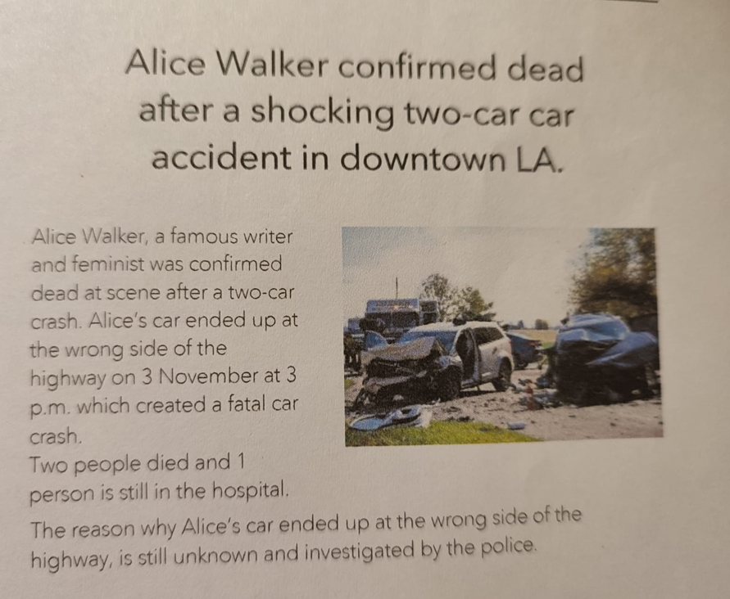

Slide 3
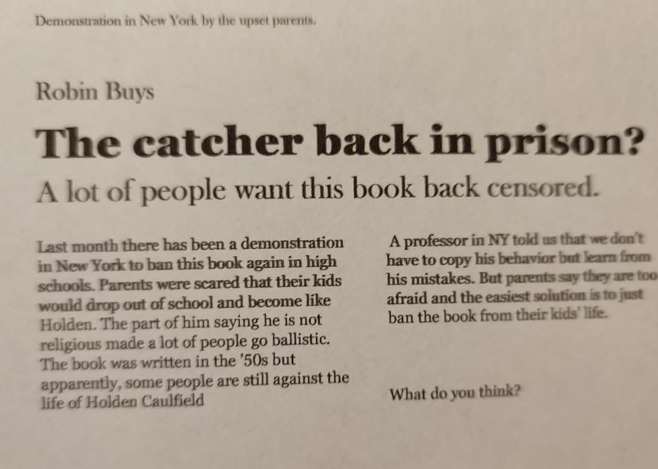

Slide 4
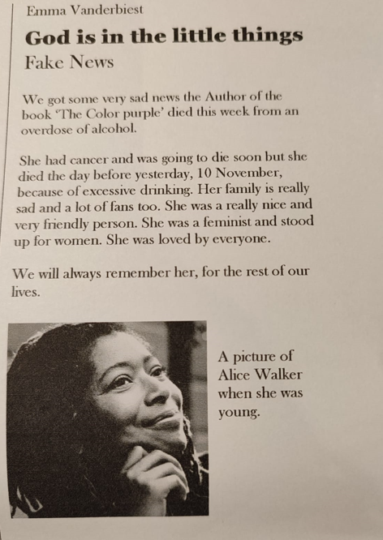
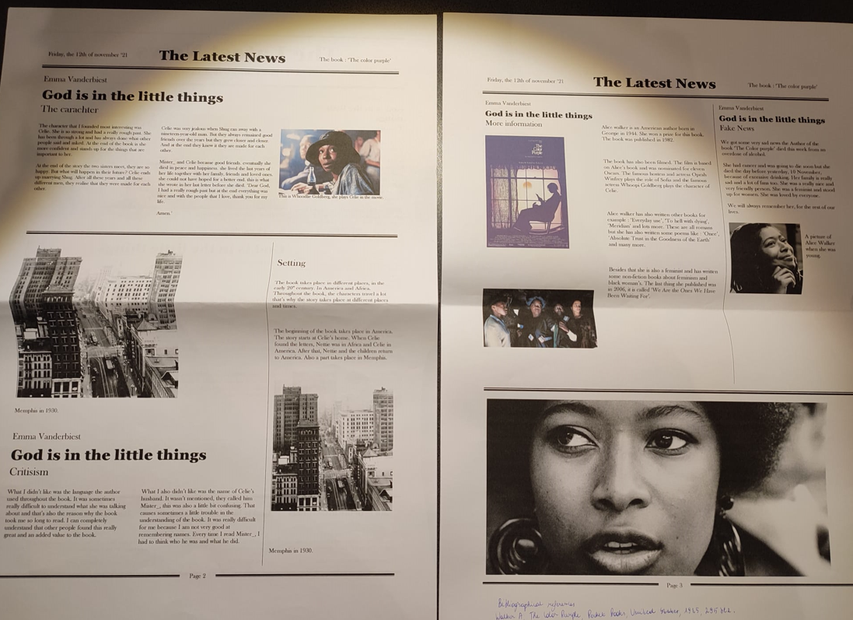

Slide 5
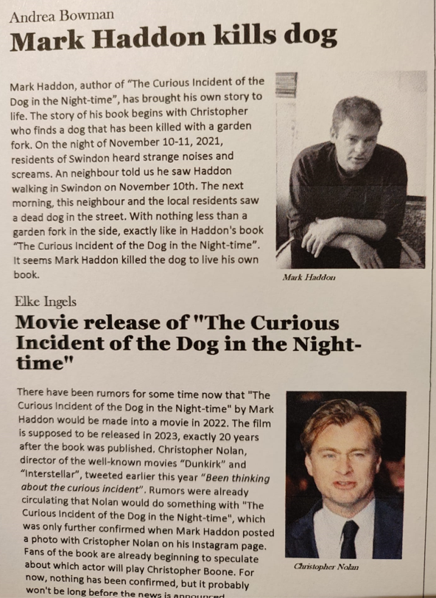
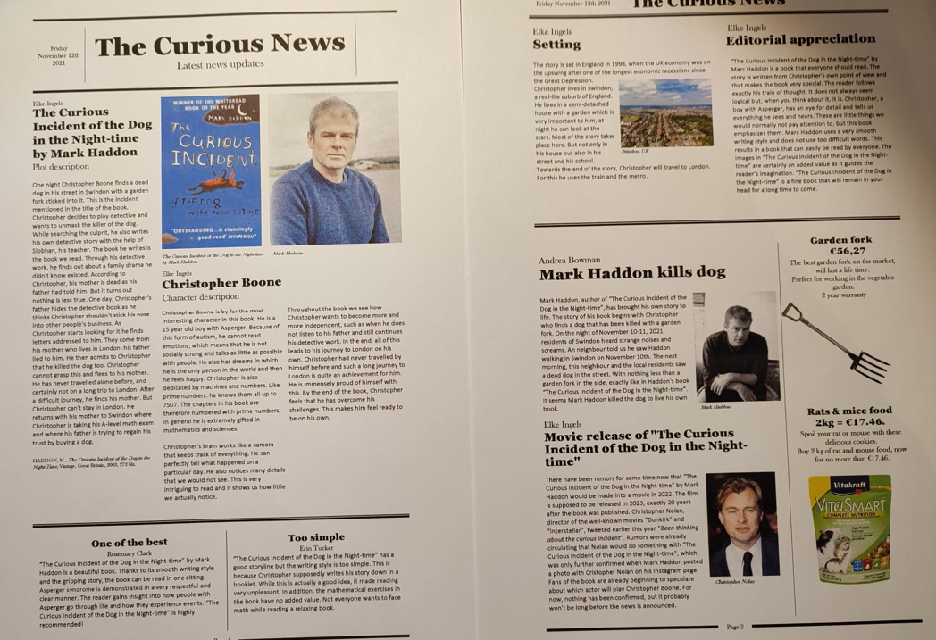

Slide 6
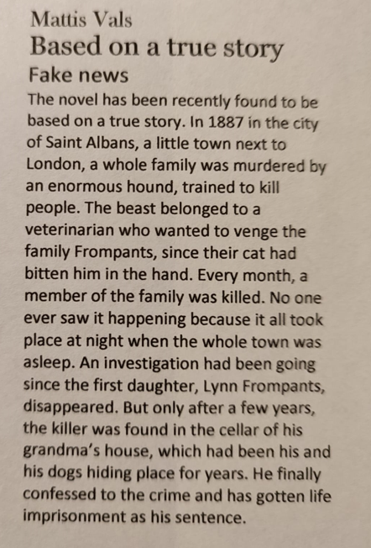

Slide 7
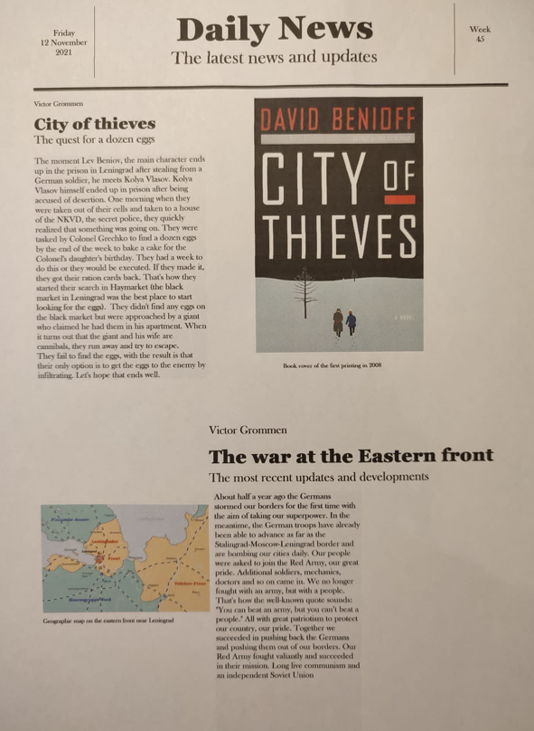
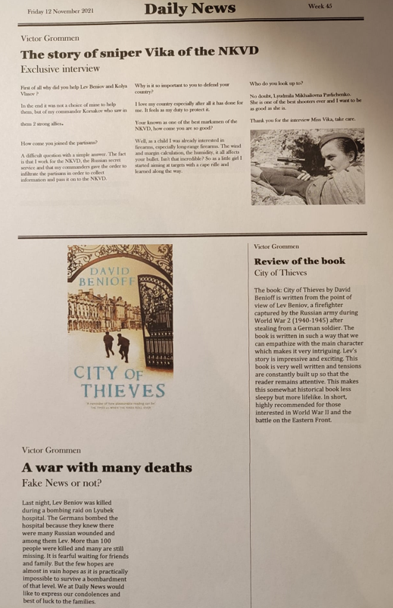

Slide 8
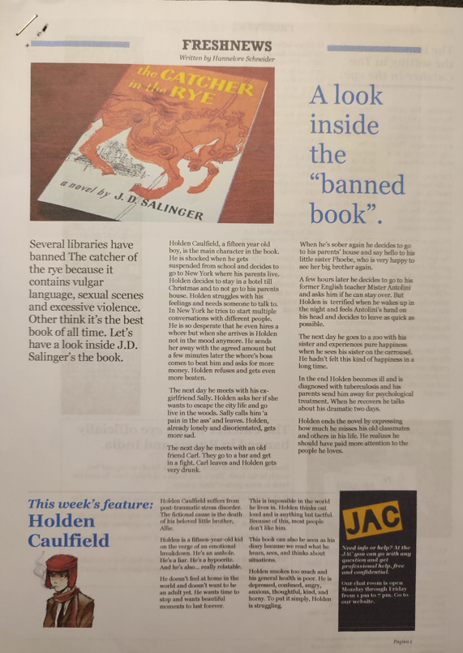

Slide 9
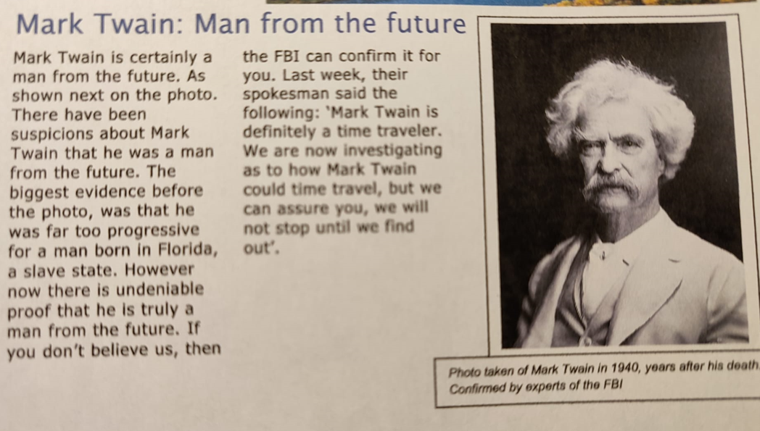

Slide 10
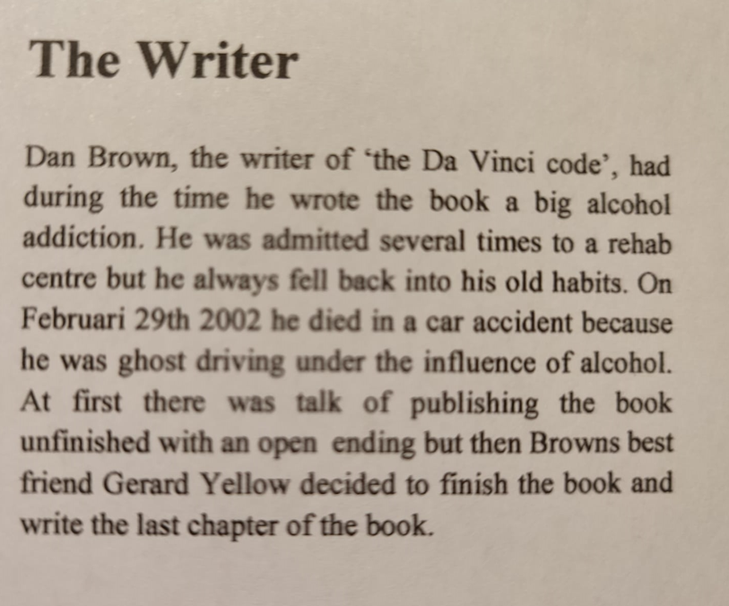

Slide 11
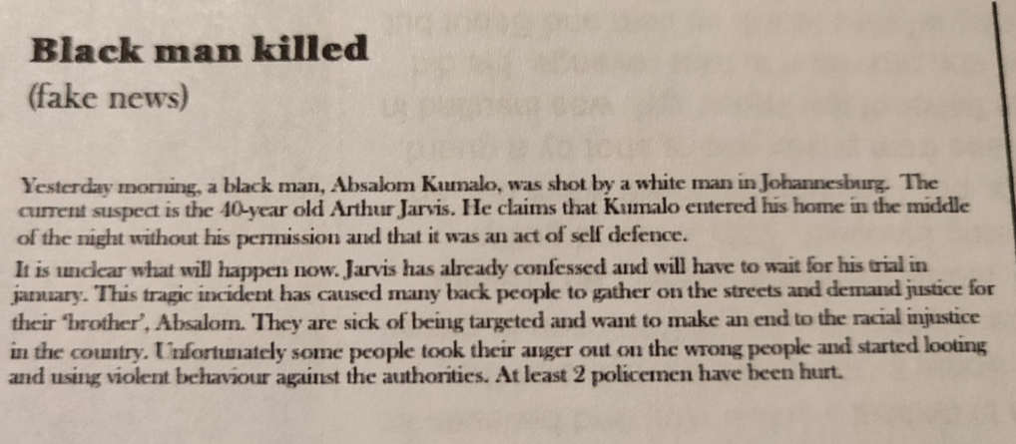

Slide 12
