Slide 1
LITHUANIA

Slide 2
Our country is like heart.

Slide 3
Our Prezident is Dalia Grybauskaitė.

Slide 4
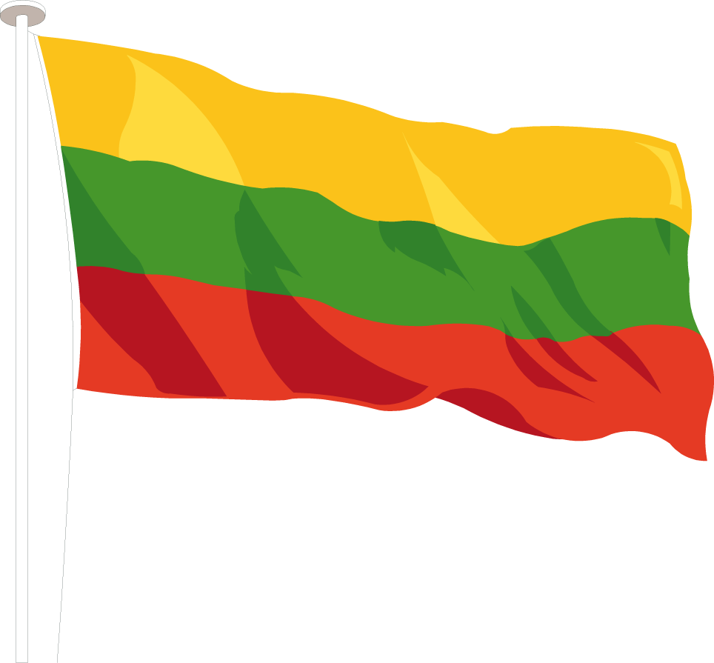
Our national symbols:
coat of arms
flag

Slide 5
National Anthem:
https://www.youtube.com/watch?v=mAz4DZg1dVE

Slide 6
Our capital city is Vilnius.

Slide 7
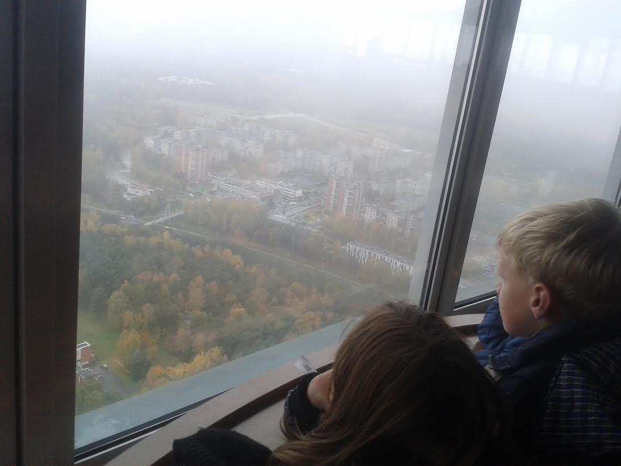
There is the tallest tower of Lithuania - TV tower.

Slide 8
Our National bird is the stork.

Slide 9
Our national dishes are dumplings. Made from potatoes and meat.

Slide 10
The most popular sports are basketball game.

Slide 11
The most famous basketball player was Arvydas Sabonis. At this time very popular his son- Domantas Sabonis. And Jonas Valančiūnas.

Slide 12
Arvydas Sabonis

Slide 13
Domantas Sabonis

Slide 14
Jonas Valančiūnas

Slide 15
Rūta Meilutytė- the best our swimmer.

Slide 16
Ricardas Berankis is the best tennis player.

