Slide 1
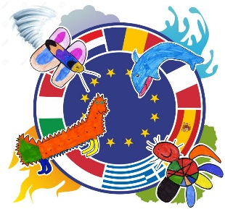
EVALUATION OF THE 2ND YEAR OF THE PROJECT “ENERGY FOR LIFE” (2016-19)

Slide 2
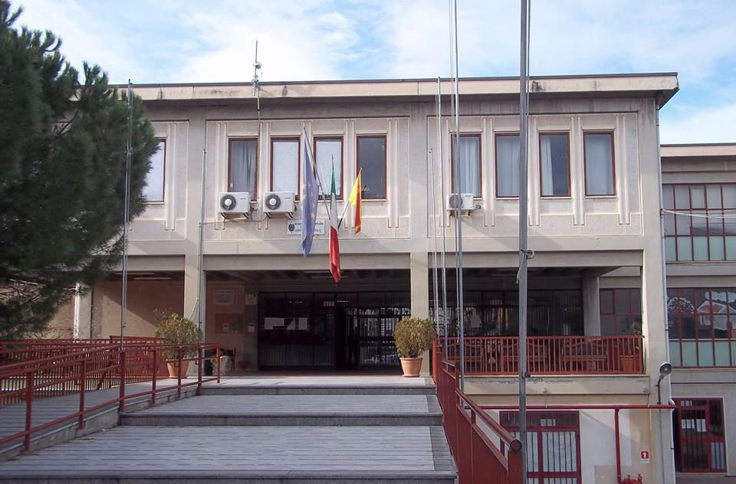
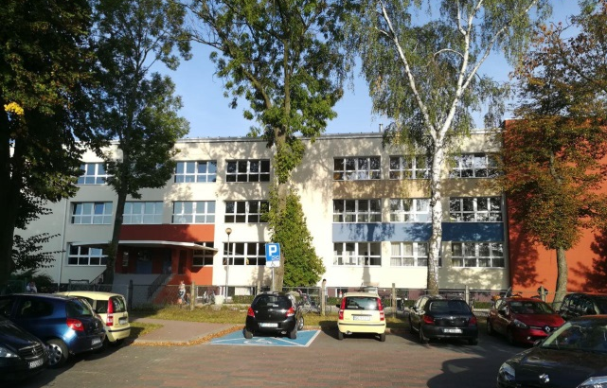
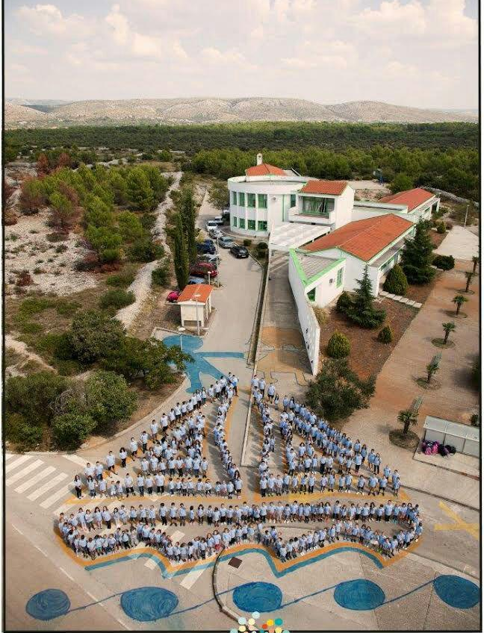
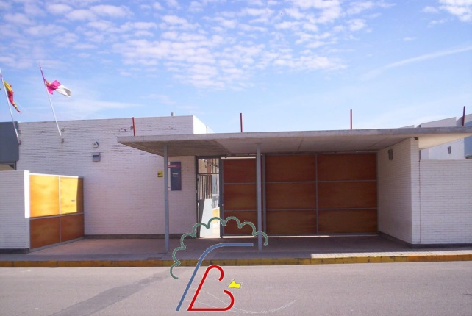
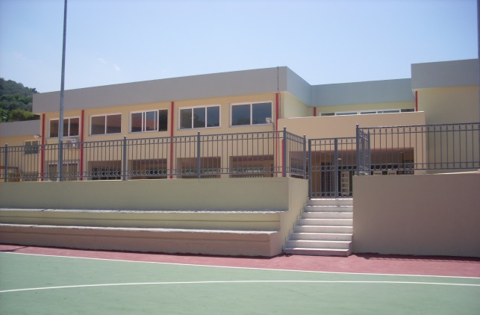
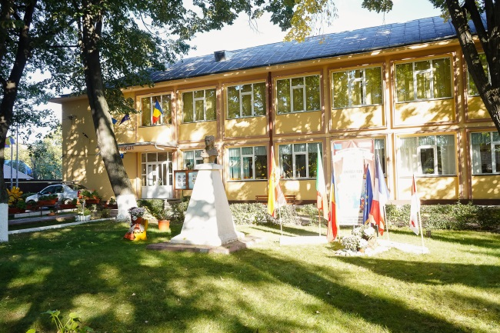
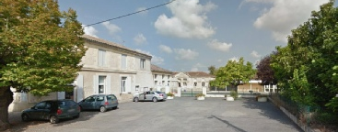
The partner schools:
D.D.Statale 3° Circolo Luigi Pirandello,
Bagheria, Sicily - Italy
Szkola Podstawowa nr 52 im. Malego Powstanca w Czestochowie, Poland
Osnovna skola Brodarica, Brodarica, Croatia
CP FELIX GRANDE ,
Tomelloso, Spain
14^{ο} Δημοτικό Σχολείο Ρεθύμνου,
Crete, Greece
Scoala Gimnaziala Elena Doamna,
Tecuci, Romania
Ecole Primaire Publique de Frontenac 12,
Frontenac, France

Slide 3
BY WHOM- AIM - HOW
The evaluation of the 2nd year of our project was conducted by all the school partners in the ERASMUS+ project “Energy For Life”, with code number “2016‐1‐ES01‐KA219‐024968_4”, at the end of the second year of the project. The aim of this evaluation is to assess the implementation and impact of our ERASMUS+ project, including its strengths and weaknesses. This report presents the conclusions based on data collected by common questionnaires for all partners that where answered by students, teachers and parents of each school. The evaluation focuses on mainly quantitative, but also qualitative outputs and results.

Slide 4
Outcomes of Students’ evaluation
How they feel about it
The students feel satisfied for taking part in the project, most of them liked all the activities and they consider important to know about the environment and energy.
They rated most important gains from the project the cooperation, knowledge, socialization, language learning, enjoyable activities and responsibility.
The French pupils mention that they regretted not to be matched with a child of their age in some countries or all the countries.
The most popular activities among them were the experiments, the environmental exploration, the study of the literature book, the Europe day, the European Language Day, the European Garden, the Christmas activities, the activities with the meteorological station and the presentation of the four elements.
Beneficial fields
Popular activities

Slide 5
Outcomes of Parents’ evaluation
Impact
They consider the project as a good opportunity for their children to learn about the environment and energy. The majority says that the activities developed were safe and their pupils have a lot to gain from the project that they really like. Parents consider that children benefited from STEM activities
The range of the benefits for parents is teamwork and cooperation, knowledge and critical thinking, respect on other cultures, communication, interesting teaching, responsibility, and foreign languages. Most of them encourage school teachers to develop more STEM activities in the future. Parents can involve in dissemination of the project in collecting material (books, movies, music, crafts etc.), or some can make contact with various services. The main reason that would keep them from helping in the project is lack of time.
Benefits
Involve-
ment

Slide 6
Outcomes of Teachers’ evaluation (I)
The teachers consider that an international project has a good impact on school and community. The main objectives of the project were achieved. Just 2 Spanish and 2 Greek teachers admitted that objectives were partially achieved. 100% consider that an international project has a good impact in school and in educational and local community.
The benefits from the project mentioned by the teachers are the fact that the different and various activities involved students in a good way, they were simple but actual. And they lead to a good cooperation and collaboration between teachers and between students. Also there was update and enrichment in teaching practice. In addition, the students improved in science, linguistic and digital skills, as mentioned by the Italian and French teachers. And finally, the Greek teachers mention also the opening of the school unit to the community, the use of the scientific method and the STEM approach, the exchange of experiences and educational material, and the broadening of the language and cultural knowledge.
Impact & Aims
Benefits

Slide 7
Outcomes of Teachers’ evaluation (II)
Difficulties
There were some difficulties with the limited teaching time mentioned almost by all teachers of all schools. In addition to that, some teachers also mentioned the integration of the STEM activities to the National Curriculum, the bulk Curriculum, the lack of logistical infrastructure, the lack of knowledge on STEM approach (Spain, Romania, Greece); the plenty activities, the language as an obstacle especially with distribution and presentation of results (Croatia).
The activities developed during the second year in the partner schools were: European Day of Languages 2017, Hour of Code, the study of Luis Sepulveda book ”The story of the cat and the seagull”, Christmas tradition, STEM activities on natural disasters of the 4th elements projects ( with CLIL methodology), STEM activities on natural benefits of the 4th elements projects ( with CLIL methodology), Erasmus Day, European Garden.
Popular activities

Slide 8
Outcomes of Teachers’ evaluation (III)
Extra activities
For the Romanian school, they also had a STEM Discovery week – Say yes to STEM. The French school hosted the 3rd Transnational Meeting. The Greek school participated in the Researcher’s Night 2017 and organized a disseminating Open School event for parents and the local community, where they presented the outcomes of the STEM activities and held an experiment workshop at the end of the school year. The Spanish school took part in the regional STEAM meeting to show and learn different experiments in regarding with this methodology. The Italian school organized an Erasmus parade on Open School Day of School and Experiments Day and hosted a TTLA meeting, hosting successfully 15 foreign students. The Croatian school used Micro:bit for watering the Erasmus garden and they hosted the 4th Transnational Meeting.

Slide 9
The outcomes of the evaluation that each school-partner has conducted are reported here as followed. Also, in the next pages the links provided by each country can be found for further details.

Slide 10
SPAIN
SPANISH STUDENTS: The total number of Spanish students that took part in this survey is 21 pupils, 47,6% aged between 8-11 years old and 52,4% between 12-15 years old. They never participated in an Erasmus+ project before. They are very proud to take part in such a project and 52,4% consider that is very necessary to know about environment and energy, the rest of students is fair enough.
The study of the data from the questionnaires answered by the Spanish students also showed that:
They rated most important gains from the project the cooperation (76,2%), languages (47,6%), responsibility (42,9%), skill development (33,3%).

Slide 11
SPAIN
…SPANISH STUDENTS:
The most popular activities were the experiments (57,1%), the online meetings (52,4%), the environment exploration (19%), the activities with the meteorological station (14,3%).
100% of the students liked all the activities.
STEM activities
100 %likes STEM activities that they done in their classroom
The study of the data from the questionnaires about STEM activities answered by the Spanish students also showed that
66,7% learned many things
66,7% collaborate a lot with their colleagues
61,9% enjoy a lot the activities
19%used critical thinking

Slide 12
SPAIN
SPANISH PARENTS: The Parents’ questionnaire was answered by 9 families to make sure the accuracy of answers. Range of answered families was between 36-45 years old (66,7%) and older than 45 years old (33,3%). Most of them (77,8 %) had heard about the project by the teachers of the school; 11,1 % by the children and 11,1% by others. All of them consider that an international project is a good opportunity for children , parents, community. 66,7% never participated in an Erasmus project before, where as 100% consider that is very important to learn about energy and environment. Most of them consider that activities developed were safe (55,6%).
The range of the benefits for children to take part in this project was 33,3% what makes think about some confusion in answering because it is in contradiction with other positive results.

Slide 13
SPAIN
…SPANISH PARENTS:
Most important are cooperation (77,8%), new fields of knowledge (66,7%), awareness and respectful to other cultures (55,6%), socialization and communication (44,4%), responsibility (44,4%) and developed skills (critical thinking, creativity, problem solving) (33,3%).
STEM activities
Parents that answered consider that children benefited from STEM activities like
66,7% Increased willing to learn
44,4% Getting out of the boring classroom routines
44,4% Foster love for school
33,3% Deep learning
And parents consider that STEM activities help students to discover new ways to learn and become conscious for taking care of the environment and energy.

Slide 14
SPAIN
SPANISH TEACHERS: The total number of teacher who participated in answering this report was 15 teachers by 10 female teachers 66,7% and by 5 male teachers 33,3%. Most of them worked in Primary Education except for one teacher who belongs to Kindergarten. Two of this group of teachers have a master degree. And 93,3% assert this is the first participation in Erasmus+ project and 13 teachers (86,7%) consider that all objectives of the first year of the project have been achieved. Just only two teachers admitted that objectives were partially achieved.
The benefits from the project mentioned by the teachers are the fact that update and enrichment of teachers practice, as the most relevant benefit.
There were some difficulties for some of the teacher such as: too much contents, need to have a bigger classroom or support teacher.
100% consider that an international project has a good impact in school and in community.

Slide 15
SPAIN
…SPANISH TEACHERS:
Activities developed during the first year in the Romanian school were: European Day of Languages 2017, Hour of Code, Story The cat and the seagull, Christmas tradition, STEM activities on natural disasters of the 4th elements projects ( with CLIL methodology), STEM activities on natural benefits of the 4th elements projects ( with CLIL methodology), regional STEAM meeting to show and learn different experiments in regarding with this methodology. STEM Erasmus Garden.

Slide 16
SPAIN
…SPANISH TEACHERS:
STEM activities
About difficulties teachers face this 2nd year of the project with regard to the STEM activities?
40% The integration of the activities STEM to the National Curriculum
80% Limited teaching time and bulk Curriculum
33,3% Lack of logistical infrastructure
6,7 % Lack of opportunities for educational development on STEM

Slide 17
SPAIN
…SPANISH TEACHERS:
STEM activities
The benefits from the adoption of STEM approach in 2017-2018
66,7% Challenged to learn something new on teaching
80% Noticed increased students’ motivation
6,7% Freedom for students to choose what they want to learn and how on the certain topics of this year
53,3% Chance to study dangers and benefits derived from the 4 elements of nature in our region
LINKS TO QUESTIONNAIRES:
Students:https://goo.gl/eMLBpc
Parents: https://goo.gl/XYpmwU
Teachers:https://goo.gl/hJyEmX

Slide 18
FRANCE
The second year of the project started with two key-moments in the eyes of pupils and families in France.
During the Teaching Learning Meeting in Sicilia (October 2017) the school was represented by two girls aged 8 who really felt as ambassadors of our village.
The impact both of the project itself and the meetings (including the meeting that took place in Frontenac in November 2017) was and is still very strong.
Most families committed themselves in the organization of the meeting or in supporting their children in the activities of the project.

Slide 19
FRANCE
On the side of pupils:
63 pupils took part to the survey (aged 6 to 8)
1/ As activities were mostly integrated in the national curriculum, the first obvious result of the project is that they feel their work is good enough to be shared with partners.
It is a strong belief they are still getting and expressing: “What we learn and know is worth and deserves to be spread around, shared and improved with other schools in Europe”. 76%
2/ Learning foreign languages and especially English seems more relevant to 82% of them.
3/ Sciences and experiments have deeply motivated them. 61%
4/ 78% enjoyed any concrete result we got (Xmas objects for example, Erasmus Days and the flashmob) It is probably a high result which is due to their young age. But it also means they still need to have visible results of the partnership.
5/ 24% regretted not to be matched with a child of their age in some countries or all the countries.

Slide 20
FRANCE
On the side of parents
27 families answered the questionnaire.
They mostly pointed the fact that before 2017 they probably didn’t realize what the project and its consequences on their children were. The trigger was the TLM in Sicilia and the departure of two pupils and the meeting in France when they could involve themselves directly. 75%
They explain that they trust teachers to make good choices for their children, 92%, and feel they might not be helpful enough because they’re not skilled enough in foreign languages. 68%
As often the international buffet they shared with European teachers during the meeting in Frontenac made them realize that communication was not always or only subject to language. 70%
They noticed their children enjoyed to talk about the project when a new step was done. 85%
100% of them support the project and consider it as a great chance for their children.

Slide 21
FRANCE
On the side of teachers
6 teachers are concerned in our school: 5 permanent teachers + 1 substitute.
Only the headmaster has experience in Erasmus (Previously Comenius).
All mentioned results represent a 100% score.
Team work
Commitment of the pupils
Involvement of the community (municipality as well as parents)
Motivation to find new ways of teaching (STEM methodology)
Use of ICT
Teaching of English
A strong feeling about how our job and the way children are taught is valuable
A great curiosity on educational systems in Europe

Slide 22
FRANCE
As a conclusion, the Erasmus + project has strongly widened the mind of all the people involved in. And as we are about to start the last year of the project there is now a kind of mutual and cultural approach that is available both among pupils, teachers, families and municipality and a strong expectation.
LINKS TO QUESTIONNAIRES:
Evaluation was done with questionnaires in paper.

Slide 23
ROMANIA
ROMANIAN STUDENTS: The total number of Romanian students that took part in this survey is 336 pupils, 74,7,3% aged between 8-11 years old and 24.4 % between 4-8 years old. Most of them (90.2%) never participated in an Erasmus+ project before. The vast majority of them (90.8%) consider of high importance to learn about energy and the environment, and they also (88,7%) enjoyed the project.
The study of the data from the questionnaires answered by the Romanian students also showed that:
They rated most important gains from the project the cooperation (100%), knowledge (79,2%), socialization (77,4%) and responsibility (72,6%).

Slide 24
ROMANIA
…ROMANIAN STUDENTS:
The most popular activities were the experiments (53,9%), the environment exploration (26,8%), the activities with the meteorological station (8,6%), the presentation of the four elements (4%) and the online meetings (7%)
100% of the students liked all the activities
STEM activities
97.9 %likes STEM activities that they done in their classroom
The study of the data from the questionnaires about STEM activities answered by the Romanian students also showed that
90,8% learned many things
79,2% collaborate a lot with their colleagues
73,5% enjoy a lot the activities
62,2%used critical thinking

Slide 25
ROMANIA
ROMANIAN PARENTS: The Parents’ questionnaire was answered by 60 persons, 85% females and 15% males. Almost half of the sample was between 35-45 years old (60%) and the other half 20-35 years old (33,3%). Most of them (96,7 %) had heard about the project by the teachers of the school and 3,3 % by the children. All of them consider that an international project is a good opportunity for children , parents, community. 76,7% never participate in an Erasmus project before, where as 96,7% consider that is very important to learn about energy and environment. Most of them consider that activities developed were safe (93,3%), and that their children had a lot to get from the project (88,3%) or like to work into the project (86.9%).
The range of the benefits for parents is not very different from the students’. Most important are cooperation (81,7%), socialization (70%), knowledge (75%), abilities (45%), responsibility (39%) and foreign languages (51,7%).

Slide 26
ROMANIA
…ROMANIAN PARENTS:
66,7% of parents can involve in preparations of activities, where as 96,7% of parents, can`t involve into the project because of the less time
STEM activities
Parents that answered consider that children benefited from STEM activities like:
80% Increased willing to learn, 55% Deep learning, 76,7% Getting out of the boring classroom routines, 51,7% Foster love for school.
And parents consider that STEM activities help students to discover passions, next carrier, imagination, investigation, school performance, technology, engineering
96,3 encourage school teacher in conducting more STEM activities in the future

Slide 27
ROMANIA
ROMANIAN TEACHERS: The questionnaire was answered by 12 female teachers. 58,3% of them were 45 years old, whereas 33.3% were 35-45 years old and 8,3% were 25-35 years old. 83,3 of them had post graduate studies. All of them worked in Primary Education, admitted that this is their first Erasmus+ project and consider that all objectives of the first year of the project have been achieved.
The benefits from the project mentioned by the teachers are the fact that the different and various activities involved students in a good way, they were simple but actual. And they lead to a good cooperation and collaboration between teachers
There were some difficulties with the time.

Slide 28
ROMANIA
…ROMANIAN TEACHERS:
100% consider that an international project has a good impact in school and in community
Activities developed during the first year in the Romanian school were: European Day of Languages 2017, Hour of Code, Story The cat and the seagull, Christmas tradition, STEM activities on natural disasters of the 4th elements projects ( with CLIL methodology), STEM activities on natural benefits of the 4th elements projects ( with CLIL methodology), stem discovery week – Say yes to STEM Erasmus Garden.

Slide 29
ROMANIA
…ROMANIAN TEACHERS
STEM activities
About difficulties teachers face this 2nd year of the project with regard to the STEM activities:
33,3% The integration of the activities STEM to the National Curriculum
75% Limited teaching time and bulk Curriculum
33,3% Lack of logistical infrastructure
41,7 % Lack of opportunities for educational development on STEM

Slide 30
ROMANIA
…ROMANIAN TEACHERS:
STEM activities
The benefits from the adoption of STEM approach in 2017-2018 :
91,7% Challenged to learn something new on teaching
83,3% Noticed increased students’ motivation
75% Freedom for students to choose what they want to learn and how on the certain topics of this year
91,7% Chance to study dangers and benefits derived from the 4 elements of nature in our region
LINKS TO QUESTIONNAIRES:
Students: https://goo.gl/forms/TaZbWmD0bp5jTbV03
Parents: https://goo.gl/forms/yiCHGZsWJxE9pxsF3
Teachers: https://goo.gl/forms/h3iKRwfBsjrZoyd13

Slide 31
GREECE
GREEK STUDENTS: The total number of Greek students that took part in this survey is 140 pupils, 93,6% aged between 8-11 years old and 6,5 % between 4-8 and 12-13 years old. Most of them (92.1%) never participated in an Erasmus+ project before. The majority of them (64,3%) consider of high importance to learn about energy and the environment, and they also (58,6%) enjoyed the project.
The study of the data from the questionnaires answered by the Greek students also showed that:
They rated most important gains from the project the knowledge (47,9%), teamwork and cooperation (46,4%), communication (41,4%) and responsibility (37,1%).

Slide 32
GREECE
…GREEK STUDENTS:
The most popular activities were the study of the literature book (68,6%), the Europe day with STEM activities and cooking (60,7%), the European Language Day (32,9%), the STEM activities (28,6%), the European Garden (28,6%) and the Christmas activities (27,9%).
Most of the students liked all the activities
STEM activities
94.9 %likes STEM activities that they done in their classroom
The study of the data from the questionnaires about STEM activities answered by the Greek students also showed that:
46,4% learned many things, 18,1% collaborate a lot with their classmates, 34,1% enjoy a lot the activities, 1,4%all the above

Slide 33
GREECE
GREEK PARENTS: The Parents’ questionnaire was answered by 12 families. 75% of the sample was between 36-45 years old and 16,7% was 20-35 years old. Most of them (91,7 %) had heard about the project by the teachers of the school and 1 person by a relative. All of them consider that an international project is a good opportunity for children. Half of them had participated in an Erasmus project in the past, whereas all of them (100%) consider that is very important to learn about energy and environment. Most of them consider that activities developed were safe (100%), and that their children had a lot to get from the project (100%) or like to work into the project (100%).
The range of the benefits for parents is not very different from the students’. Most important are teamwork and cooperation (100%), knowledge and critical thinking (83,3%), respect on other cultures (75%), communication (50%), responsibility (33,3%) and foreign languages (25%).

Slide 34
GREECE
…GREEK PARENTS:
58,3% of parents can involve in dissemination of the project 33,3% in collecting material (books, movies, music, crafts etc), 8,3% of parents can make contact with various services.
The reason that would keep them from helping in the project is lack of time, whereas 1 parent answered that probably she would have hard time making an experiment.
STEM activities
Parents that answered consider that children benefited from STEM activities like:
50% getting out of the boring normal classroom routines, 25% More willing to learn, 25% Learning in depth. They all encourage school teachers to develop more STEM activities in the future

Slide 35
GREECE
GREEK TEACHERS: The questionnaire was answered by 12 female teachers and 1 male. 53,8% of them were over 46 years old, whereas 46,2% were 35-45 years old. 30,8% of them had post graduate studies. All of them worked in Primary Education, 38,5% say that his is not their first Erasmus+ project and 61,5% admitted that this is their first Erasmus+ project. They consider that all objectives of the first year of the project have been achieved, even though 2 teachers think that 1 objective was partly reached.
They consider that our project has a positive impact to our school and the educational community.
All of them consider that an international project has a good impact in school and in community
There were some difficulties with the time pressure, the lack of knowledge on STEM approach and the poor infrastructure.

Slide 36
GREECE
…GREEK TEACHERS:
Activities developed during the first year in the Greek school were: European Day of Languages 2017, Researcher’s night 2017, Hour of Code, the study of Luis Sepulveda book ”The story of the cat and the seagull”, Christmas tradition, STEM activities on natural disasters of the 4th elements projects ( with CLIL methodology), STEM activities on natural benefits of the 4th elements projects ( with CLIL methodology), Erasmus Day, European Garden, disseminating Open School event for parents and the local community, where they presented the outcomes of the STEM activities and held an experiment workshop at the end of the school year.

Slide 37
GREECE
…GREEK TEACHERS:
The benefits from the project mentioned by the teachers are the good cooperation between teachers of our school, among teachers of partner schools, and collaboration and creativity of pupils. Also, they mention the opening of our school unit to the community, the use of the scientific method and the STEM approach, the upgrading and enriching of the teaching practices, the exchange of experiences and educational material, and the broadening of the language and cultural knowledge.
LINKS TO QUESTIONAIRES:
https://goo.gl/forms/8ycsKt5a9jrKK7Yl1
https://goo.gl/forms/NL3tGU7NUY1zbyS43
https://goo.gl/forms/qHnnZLwYzYpXGB7Q2

Slide 38
GREECE
…GREEK TEACHERS: STEM activities
About difficulties teachers face this 2nd year of the project with regard to the STEM activities:
61,5% The limited teaching time and the vast curriculum volume.
41,7 % Lack of opportunities for educational development on STEM
7,7% Lack of logistical infrastructure
The benefits from the adoption of STEM approach in 2017-2018
24% Challenged to learn something new on teaching
33,3% Noticed increased students’ motivation
8,3% Freedom for students to choose what they want to learn and how on the certain topics of this year
25% Chance to study dangers and benefits derived from the 4 elements of nature in our region

Slide 39
POLAND
Polish students: 100 pupils participated in the survey, 45% aged between 9-11 years old,40% between 4-8 years old and 15% aged 12-15 years old. 80% didn’t take part in any Erasmus+ project before. The great majority of students (85%) find the importance of learning about energy and the environment, what is more (90%) enjoyed the project.
The study of the data from the questionnaires answered by the Polish students also showed that:
The most important benefits from the project were: cooperation (50%), knowledge (22%), socialization (20%) and responsibility (8%).
The most popular activities were the environment exploration (30%), the experiments (25%), the activities with the meteorological station (20%), the presentation of the four elements (15%) and the online meetings (10%)
100% of the students liked all the activities

Slide 40
POLAND
Polish parents: 30 people filled in parents’ questionnaire, 80% females and 20% males. 60% of respondents were 35-45 years and 40% were 20-35 years old . The vast majority (80%) knew about the project from school teachers and 20% from children. Everyone considers the project as a good opportunity for children , parents and community. 90% of parents never participated in such project before. In general parents found the project safe (80%), and that their children benefited from the project(85%) .
The advantages of the project for parents are very similar to students’. Most important factors of participating in project are: cooperation (35%), socialization (25%), knowledge (20%), responsibility (10%) and foreign languages (10%).
If parents had an opportunity to take part in the project most of them would like to collect materials 75%, whereas nearly 80% of parents, can`t be involved in the project due to lack of time.

Slide 41
POLAND
Polish teachers: The questionnaire was filled in by 10 teachers. 60% were over 45 years old, 20% were 35-45 years old and 20% were 25-35 years old. 80% of teachers participated in Erasmus (Comenius ) project before and consider that all objectives of the first year of the project have been achieved.
The benefits from the project mentioned by the teachers are the fact that the different and various activities involved students in a good way, they were simple but actual. And they lead to a good cooperation and collaboration between teachers
There were some difficulties with the time.

Slide 42
POLAND
…Polish teachers:
100% consider that an international project has a good impact on school and community
Polish school carried out following activities: drawing four elements, logo of the project, Mascot of the project, four element around us – photos, CLIL activities Christmas, creating texts about the four elements, experiments on four elements, activities concerning book “The story of a seagull and the cat who taught her to fly”.
LINKS TO QUESTIONNAIRES:
Evaluation was done with questionnaires in paper.

Slide 43
ITALY
Italian students:
The total number of Italian students that took part in this survey is 137 , between 6-9 years old. All of them enjoyed every moment of the project and demonstrate to remember activities we did along the years of the project. The 100% of participants think that is important to talk about nature and environment at school.
Students liked the experiments and furthermore to replace them at laboratory
The 39% of students liked to stay in contact with foreign students and think that the project help them to communicate in English

Slide 44
ITALY
Italian parents: The Parents’ questionnaire was answered by 28 persons. The average was between 35-45 years old. Most of them (92.3%) had heard about the project by the teachers of the school and 10.5% by the children. All of them consider that an international project is a good opportunity for children, parents, community. 100% of them consider that is very important to learn about energy and the environment. Most of them consider that activities developed were safe and that their children had a lot to get from the project (100%) . Most important is cooperation (25%), working in a group (31%), respect of the other culture (25%), abilities (7,1%), responsibility (28,6%) and foreign languages (7,1%).
77% of parents can involve in preparations of activities, whereas 23% of parents, can`t involve into the project because of the little time.

Slide 45
ITALY
Italian teachers: The questionnaire was answered by 21 female teachers. 85,7% of them were over 46 years old, the rest between 20-35 years old. 66.7% of them worked in Primary Education and the33.3 at kindergarten school. Many of them are at first Erasmus+ project and consider that all objectives of the project have been achieved.
The benefits from the project mentioned by the teachers are the good competences that students reach in science and digital skills and the good way to cooperate with the classmates and the Erasmus school teachers
The negative point was the time, too short between an activity and another one.
100% consider that an international project has a good impact in school and in community

Slide 46
ITALY
…Italian teachers:
Activities developed during the second year in the Italian school were: Investigation about danger coming to Nature and Natural disaster ( volcano eruptions, avalanche,flood…) Experiments for the four elements, Erasmus parade on Open Day of school and Experiments Day. Also important the outside activities visiting Science Lab and participating in Code week and Palermo Scienza big events about science and schools. Also, we hosted a TTLA meeting, hosting 15 foreign students and it was a success. Parents host students and they were really collaborative each moment.
LINKS TO QUESTIONNAIRES:
Students: https://goo.gl/forms/XQvPb2w8suQ2Tlx03
Parents: https://goo.gl/forms/LAMzXc8XIk4bC8l73
Teachers: https://goo.gl/forms/go65s7LFkctE0ArT2

Slide 47
CROATIA
CROATIAN STUDENTS: In this survey, 40 students took part. The majority of them was 8-10 years old (70.3%) and the rest 6-7 (29.7%). They never participated in an Erasmus+ project in the past but they are active in eTwinning projects. It is very important that most of them (99.6%) believe that it is important to have knowledge about energy and nature and they are enjoying in taking part in the project (100%).
The study of the data from the questionnaires answered by the Croatian students also showed that:
They rated most important gains from the project the cooperation (55.4%), knowledge (24.2%), socialization (11%) and responsibility (9.4%).
The most popular activities were the experiments (65%), the activities with the meteorological station (28%), the presentation of the four elements (4%) and the online meetings (2%), the environment exploration (1%),

Slide 48
CROATIA
…CROATIAN STUDENTS:
100% of the students liked all the activities
STE (A) M activities
97.9 %likes STE (A) M activities that they done in their classroom (we used and introduced Art in STEM projects)
The study of the data from the questionnaires about STE (A) M activities answered by the Croatian students also showed that:
70% learned many things
100% collaborate a lot with their colleagues
100% enjoy a lot the activities
63.3% used critical thinking

Slide 49
CROATIA
CROATIAN PARENTS: 15 people filled in parents’ questionnaire, 90% females and 10% males. All of them were 35-45 years. The vast majority (95%) knew about the project from teachers and 5% from children. Everyone considers the project as a good opportunity for children, parents and community. Moreover, 65% of parents never participated in such project before. In general, parents found the project safe (90%), and that their children benefited from the project (100%).
The advantages of the project for parents are very similar to students: cooperation (45%), socialization (15%), knowledge (20%), responsibility (10%) and foreign languages (10%).
If parents had an opportunity to take part in the project most of them would like to search for materials, whereas nearly 80% of parents, can`t be involved in the project due to lack of time.

Slide 50
CROATIA
CROATIAN TEACHERS: The questionnaire filled in seven teachers. Around 99 % were 35-45 years old and 1% were 25-35 years old. Moreover, 10% of teachers participated in Erasmus+ (Comenius) project before and consider that all objectives of the first year of the project achieved.
The benefits from the project mentioned by the teachers are the opportunity for a good cooperation and collaboration between teachers
There were some difficulties with the time and plenty activities and language, especially with distribution and presentation of results.
100% consider that an international project has a good impact on school and community

Slide 51
CROATIA
…CROATIAN TEACHERS:
We carried out following activities: drawing four elements, logo of the project, Mascot of the project. Activities concerning book “The story of a seagull and the cat who taught her to fly”. Activities about benefits and dangerous of four elements, CLIL activities Christmas. We create texts about the four elements, experiments on four elements and grow seeds that we exchanged in France and create Erasmus garden. We used Micro:bit for watering our Erasmus garden. We were host for the 4th Transnational meeting.
LINKS TO QUESTIONNAIRES:
Evaluation was done with questionnaires in paper.

Slide 52
You can learn more about our project “ENERGY FOR LIFE” in the following links:
https://twinspace.etwinning.net/24535/pages/page/146744
https://twinspace.etwinning.net/51404/pages/page/308194
http://erasmusenergyforlife.weebly.com/
Croatia: http://os-brodarica.skole.hr/erasmus_projekti/energy_for_life
Greece: https://energy4lifegr.blogspot.com
Poland: https://sp52.czest.pl/index.php/erasmus
Romania: https://www.facebook.com/energyforlifetecuci/ and
http://www.edschool.ro/activitati_erasmus.php
Spain: http://felixgrande20.blogspot.com/search/label/energyforlife?m=1

