Slide 1
Şcoala Gimnazială“I.G.DUCA”Petroşani
NO CHILD LEFT BEHIND !
Erasmus+ Project
2014/2016

Slide 2
Dragi colegi,
În anul şcolar 2014 - 2015 profesori şi elevi de la Şcoala Gimnazială “I.G.Duca” Petroşani au desfăşurat diverse activităţi şi au participat la întâlniri internaţionale în cadrul proiectului:” No Child Left Behind” proiect finantat prin programul Erasmus + - Acţiunea KA 2, +program de observare şi schimb de experienţă.
Obiectivele specifice cărora se adresează proiectul sunt:
- de a asigura dezvoltarea profesională a profesorilor;
- de a dobândi într-un timp scurt cunoştinţe şi experienţă profesională observând şi experimentând noi practici pedagogice;
- identificarea şi dezvoltarea dimensiunii europene în educaţie,
- să ofere elevilor o nouă viziune asupra identităţii europene , să abordeze noi metode de predare,viziune extinsă si asupra colegilor din şcoală şi în comunitatea locală având ca rezultat întărirea spiritului cetăţeniei active.

Slide 3
The first visit to Scartho Junior Academy, Grimsby, England
The Importance of Sports and Drama in our Life and Education
&
Revival National Authors
The first visit consisted of head teachers, teachers and other staff from Barcelona, Italy, Romania, Poland, Estonia and Turkey.

Slide 4
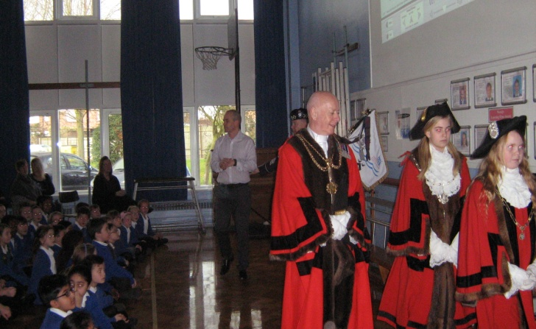
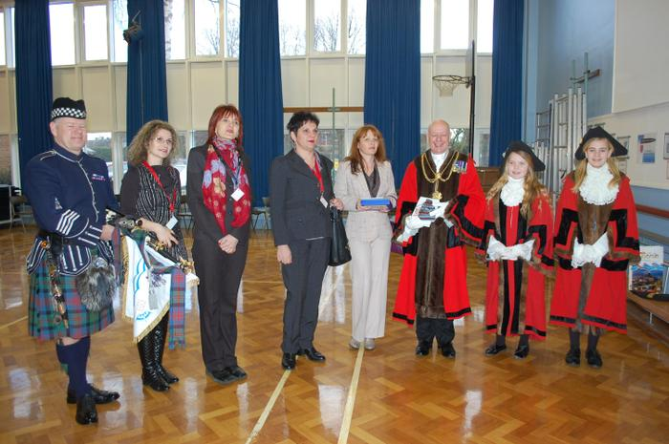
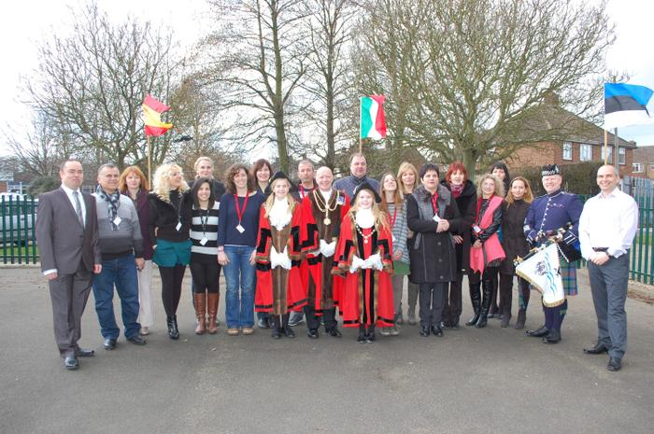
Drama and life
Through drama and sport everyone can be free to express HIS –HER feelings, joy efforts, wishes …, smiles, tears …
On the first morning of the visit, Monday 2nd March, all the schools from the different countries met at our school for the first time. It was held a welcome assembly which was attended by the Mayor of North East Lincolnshire and also his Deputy Junior Mayor and Assistant Deputy Junior Mayor, who both came to school.

Slide 5
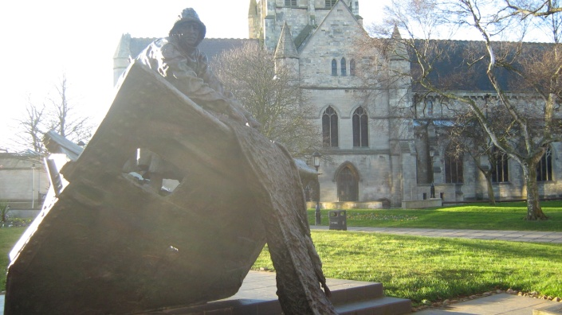
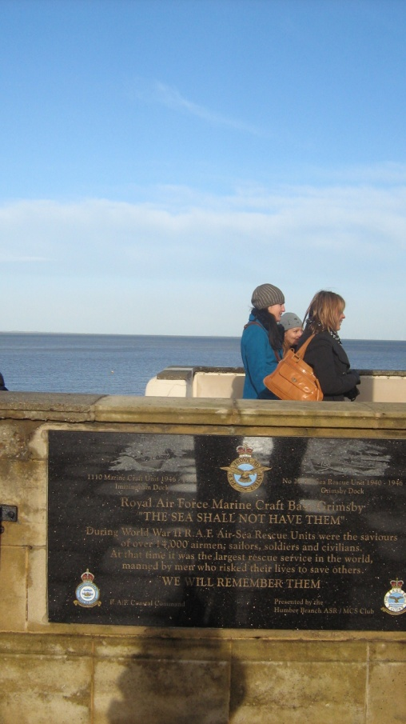
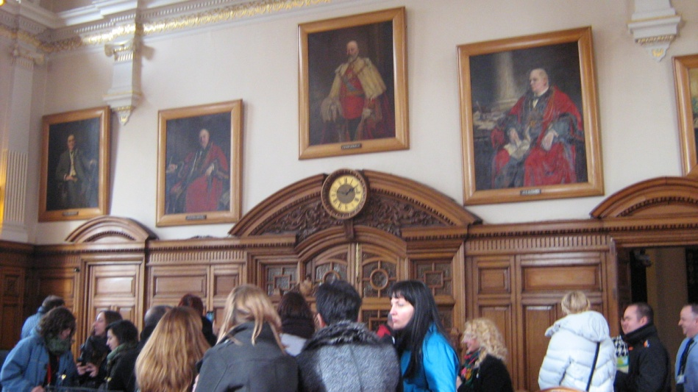
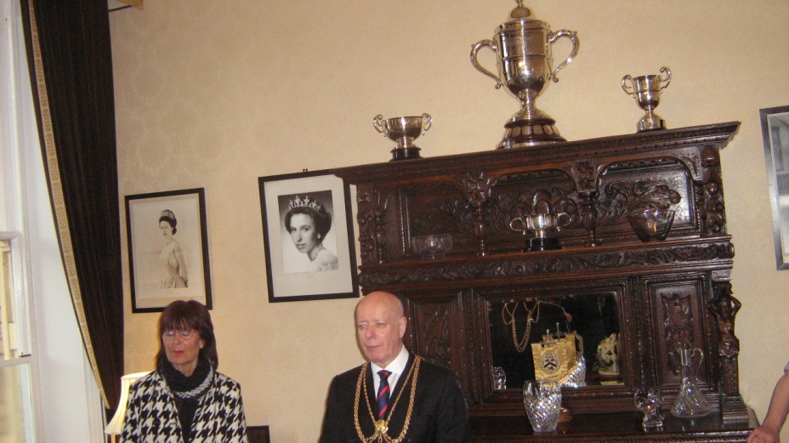
On the first day of this visit, after the welcome assembly, everyone went off to experience the local heritage. This consisted of a visit to Grimsby Town Hall and then a walk around the seaside town of Cleethorpes.

Slide 6
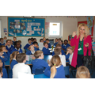
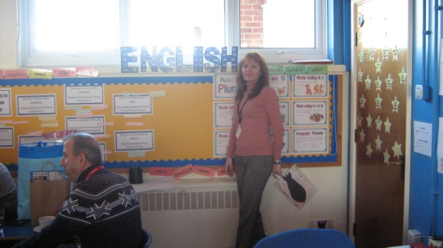
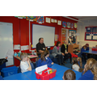
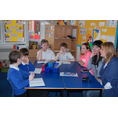
The second and third days were spent at school. The programme of visits were planned and there were opportunities for some schools to swap gifts. Each of the six classes in Y3, Y4 and Y5 have been paired with one of the countries in the Erasmus+ project. 3R are with Estonia, 3W with Turkey, 4V with Barcelona, 4M with Romania, 5K with Poland and 5G with Italy. Y6 are in charge of collating information on our area and then sending it to all the countries. On Wednesday , the visitors from each country visited their paired classrooms and had time with the children to explain about their school/country and answer any questions.

Slide 7
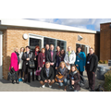
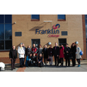
As part of the visit, there was the chance to visit Franklin 6th Form College. David Ranson has taken us on a tour of the college. During the visit to Scartho Junior Academy, there was the opportunity for all the visitors to have lunch with the children.

Slide 8
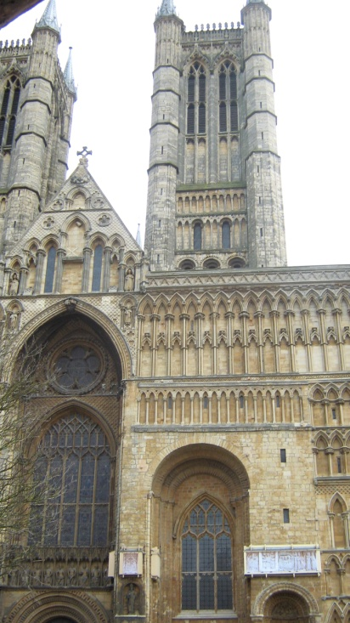
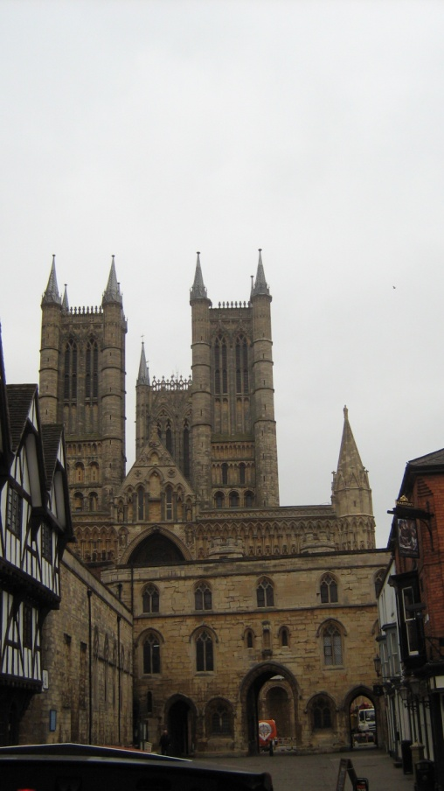
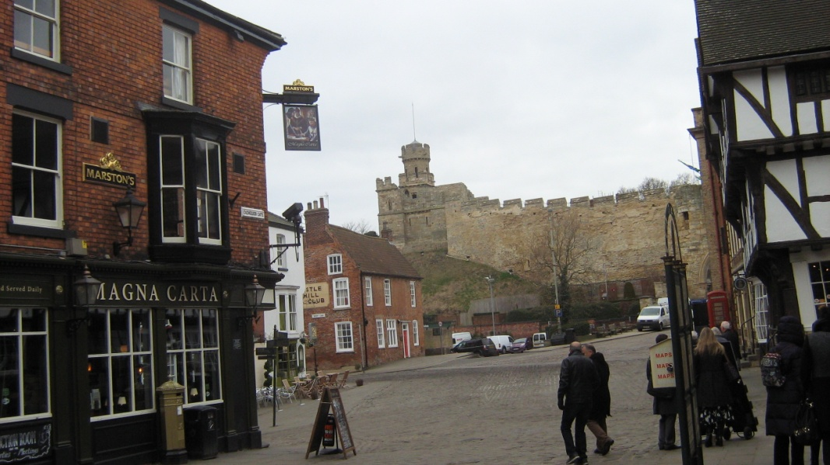
On Thursday , there was the opportunity to take part in a visit to the historical city of Lincoln.

Slide 9
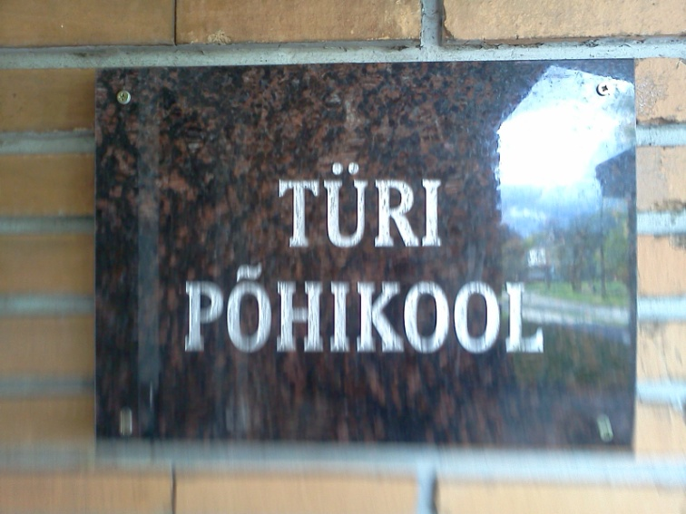
The second visit was in Tűri, Estonia, at Tűri Pőhikool
The Importance of Sports and Drama in our Life and Education
&
Revival National Authors
became the “Sports Tournaments and Drama Activities” meeting in Estonia

Slide 10
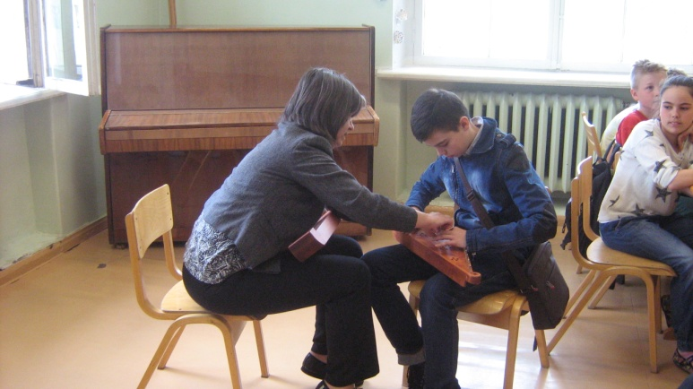
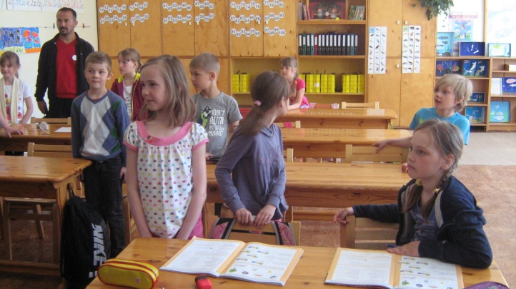
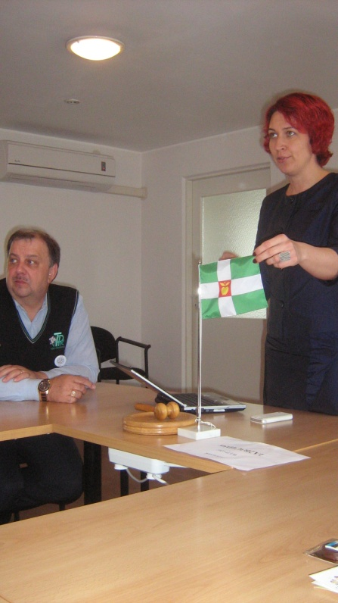
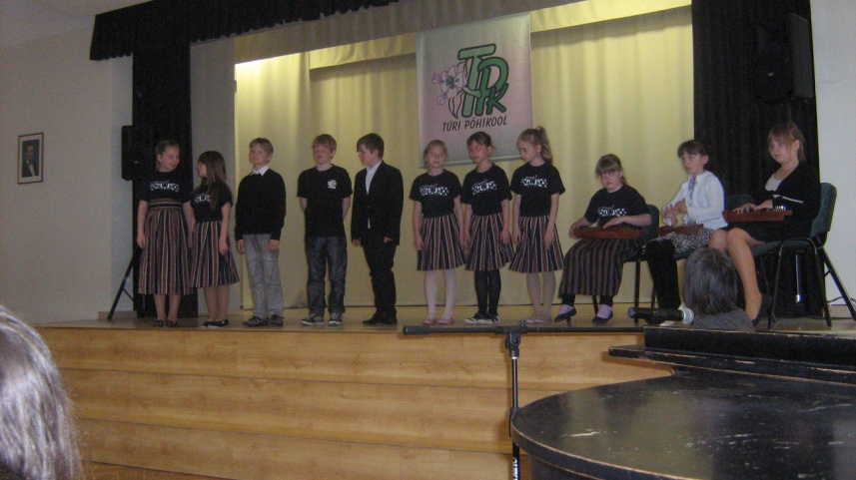
On Monday, May 18, The pupils attended classes and at 9 o’clock both teachers and pupils attended the welcome assembling. After that the pupils returned to classes and the teachers met the Munucipality Mayor.

Slide 11
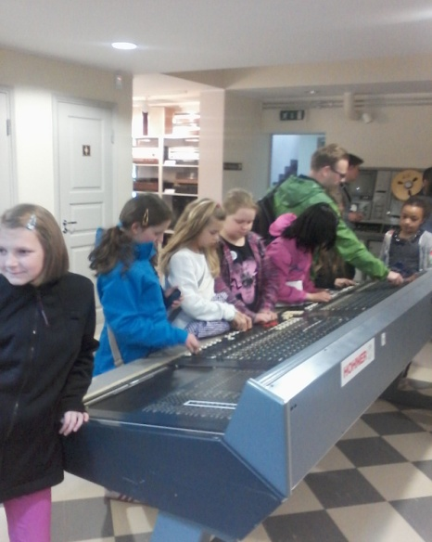
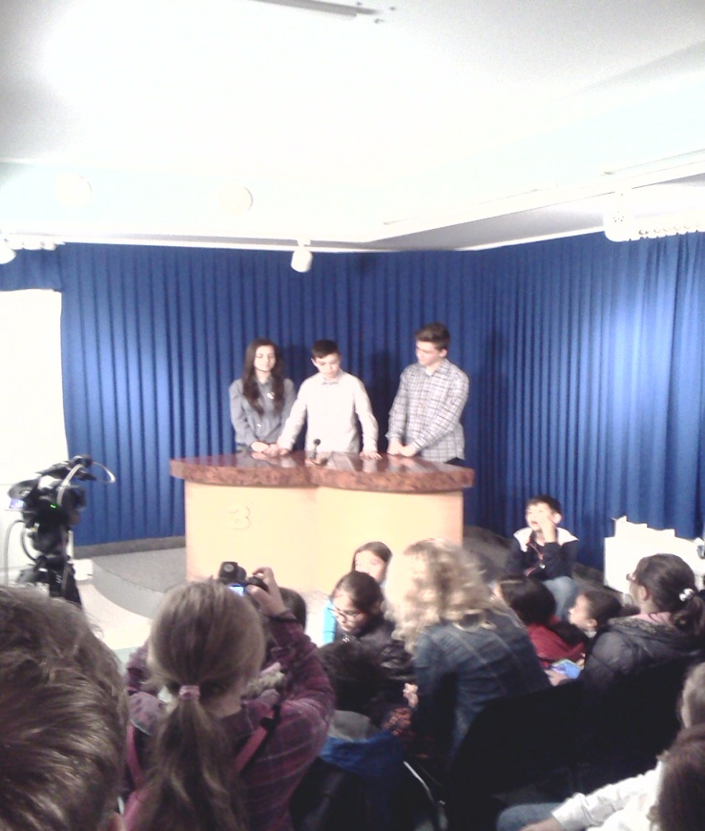
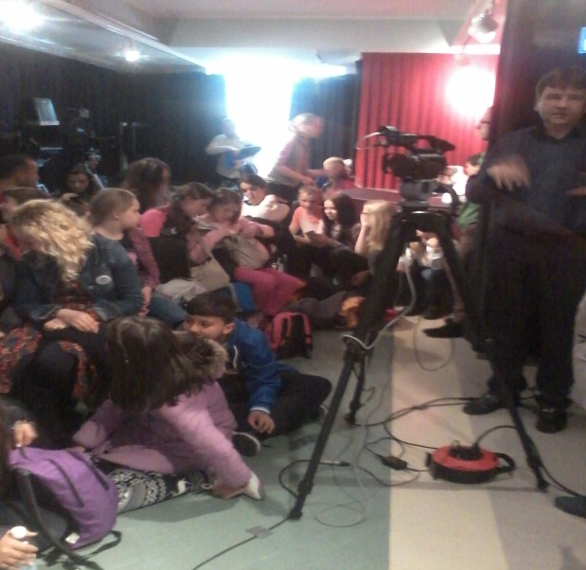
Next, later in the afternoon the pupils visited the Broadcast Museum and they made a news about the project and their visit to Estonia.

Slide 12
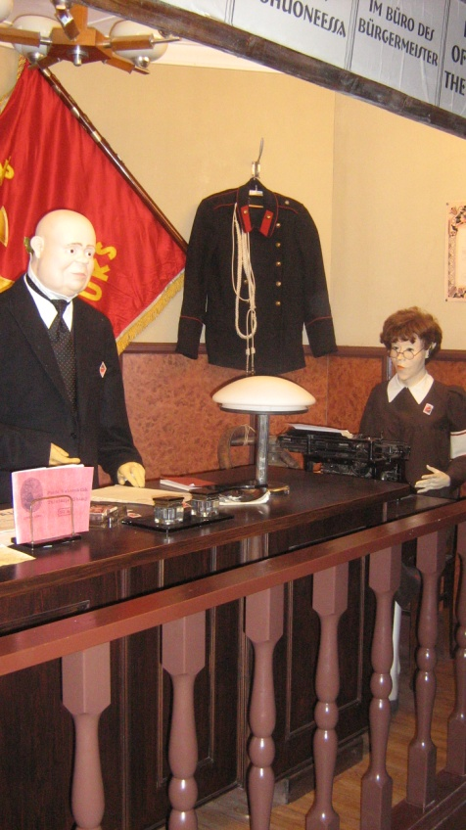
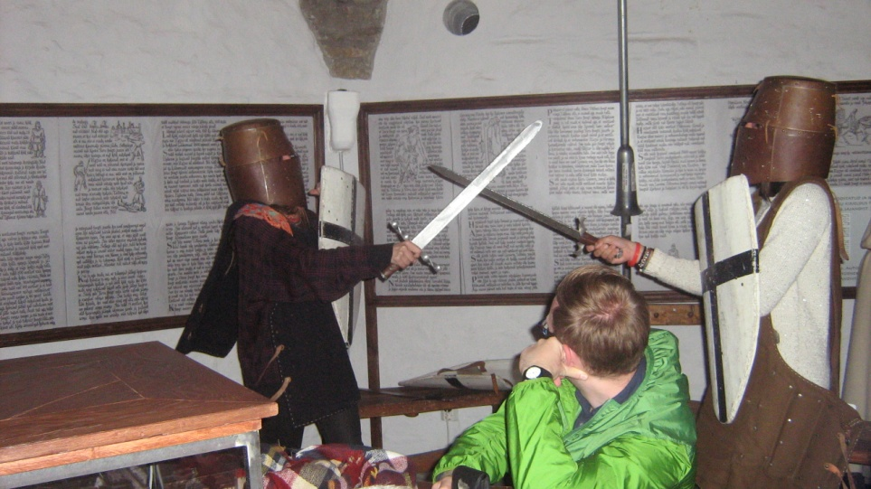
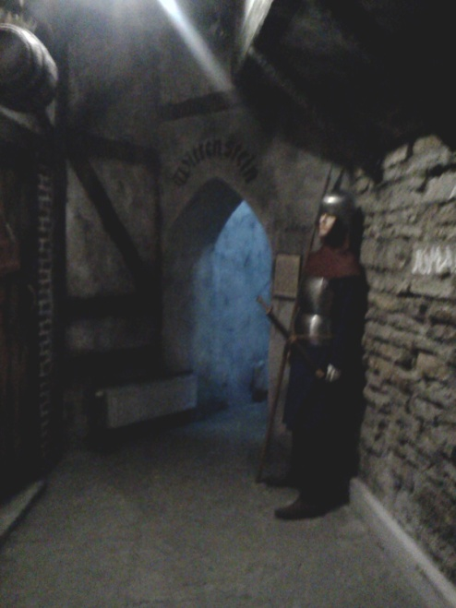
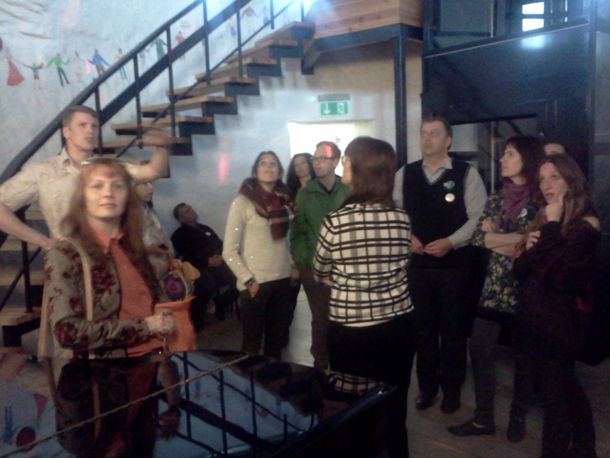
Finally, in the evening, everybody had a nice journey through the time while visiting the historical tower to Paide Ajakeskus Wittenstein

Slide 13
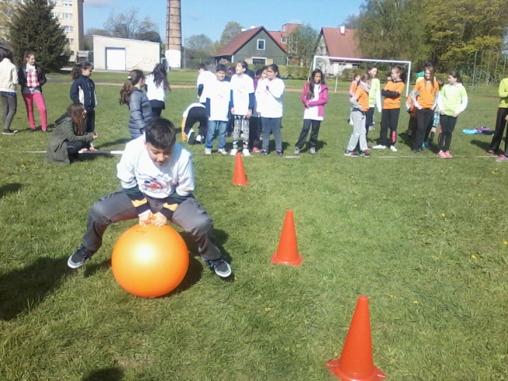
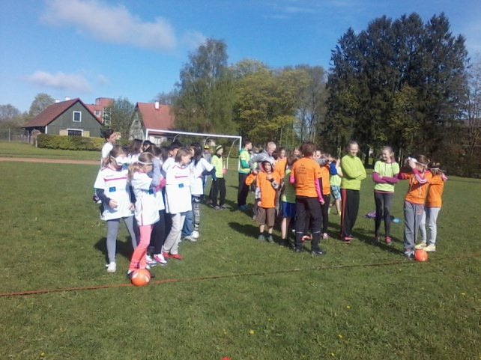
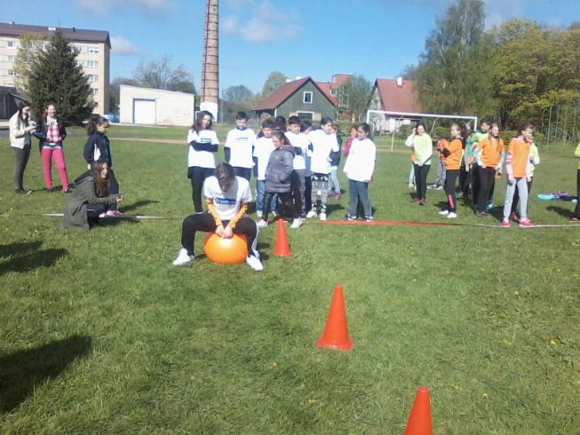
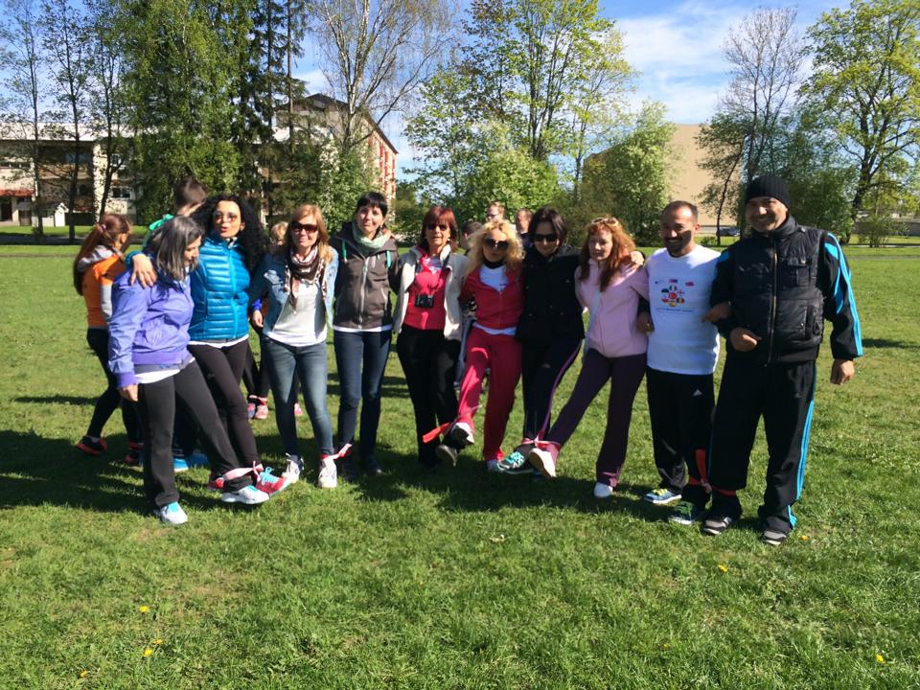
On Tuesday, the most important moment was the sport event for both pupils and teachers.

Slide 14
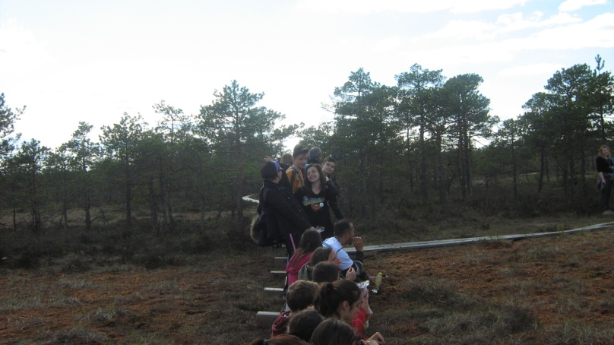
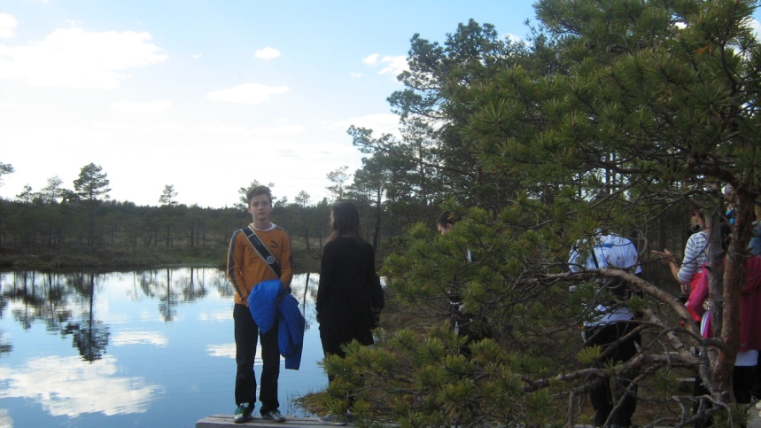
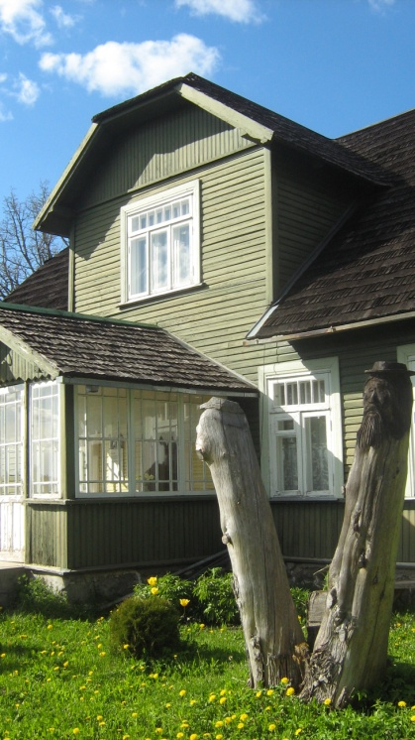
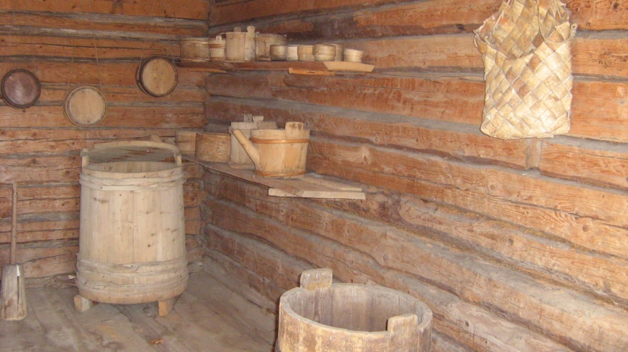
The bog walking , in Vargamäe, was outstanding. There, we also experienced something new and at the same time we learned a lot of interesting things about the life of Central Estonian peasants in the mid 19 th century.

Slide 15
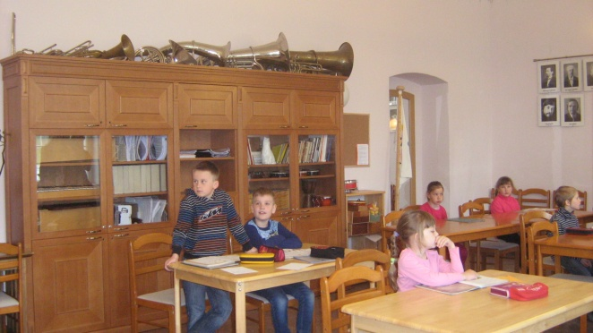
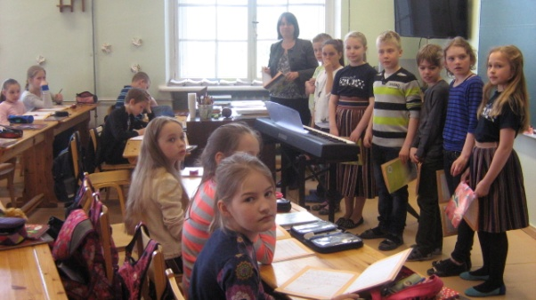
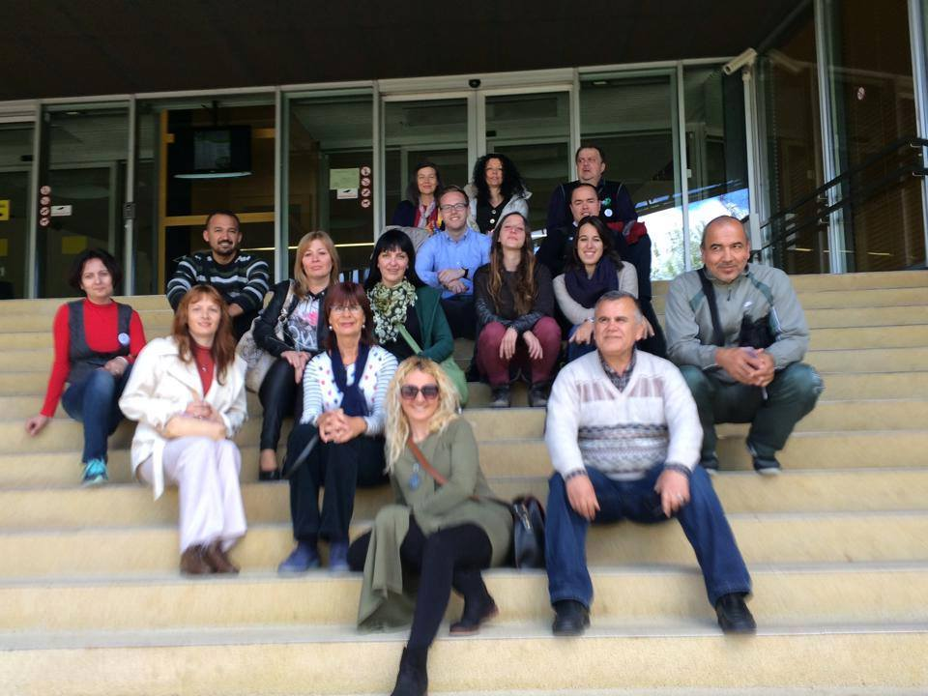
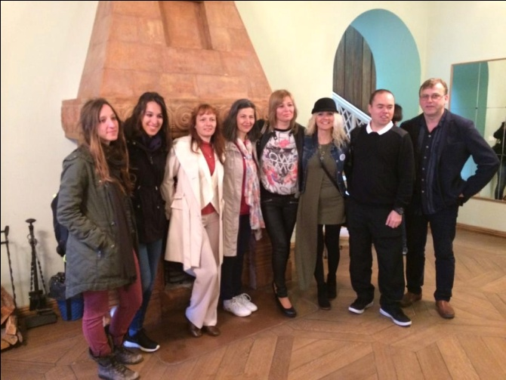
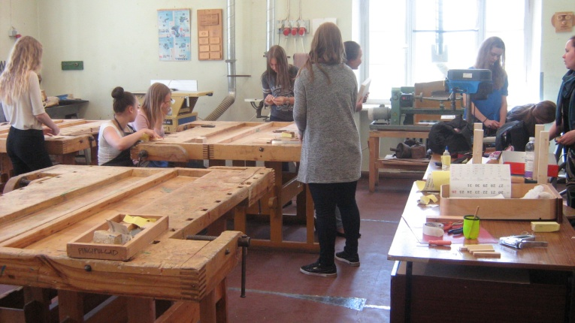
The third day in Estonia was a busy day as in the morning the pupils were to classes while the teachers were visiting some schools both in Tűri and Paide

Slide 16
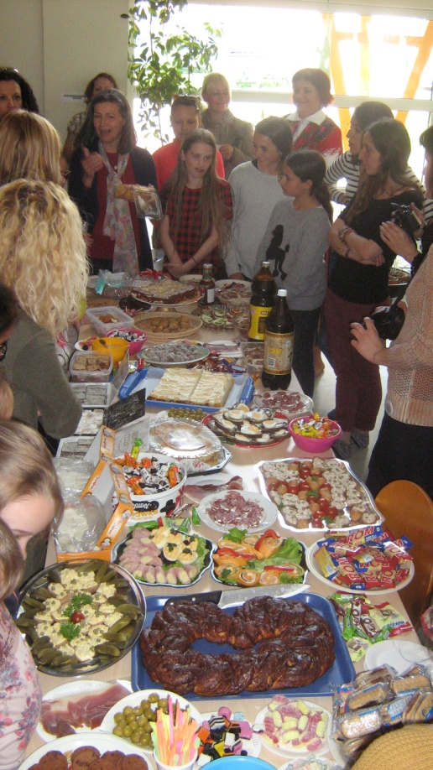
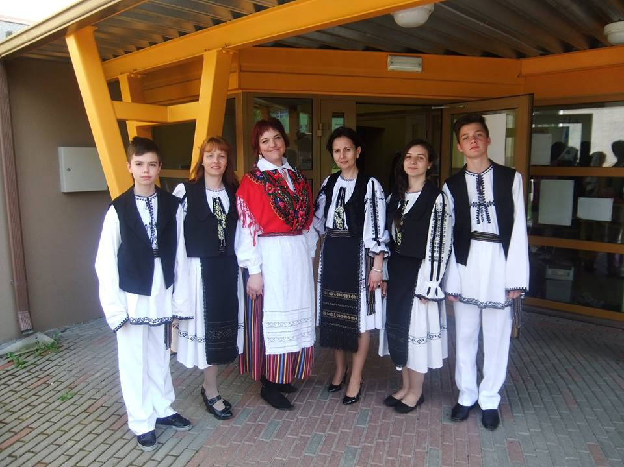
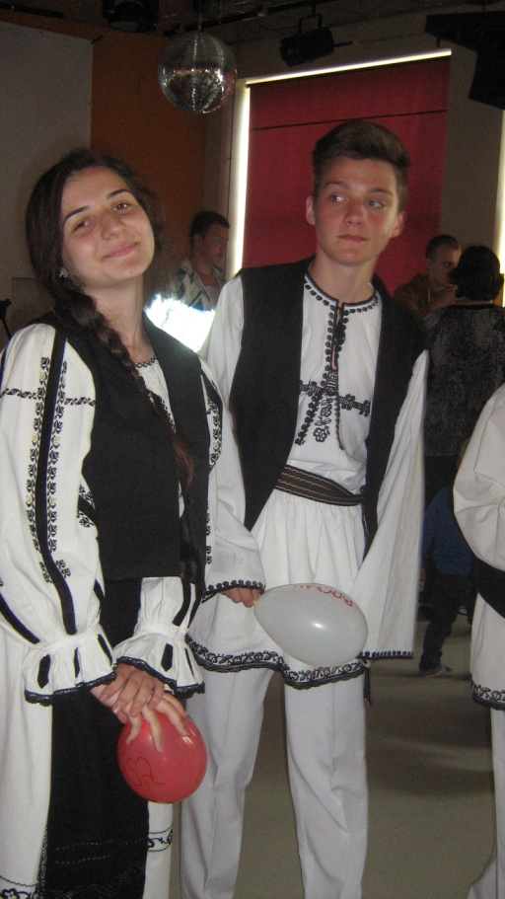
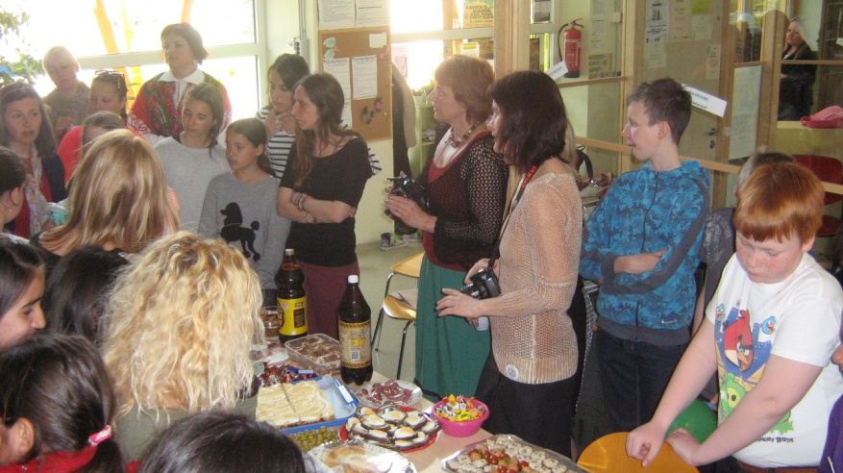
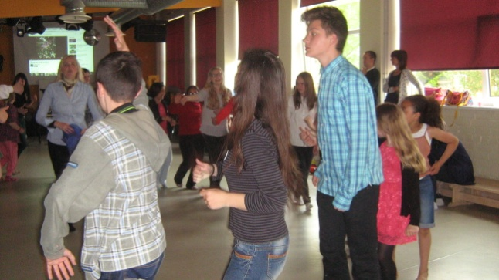
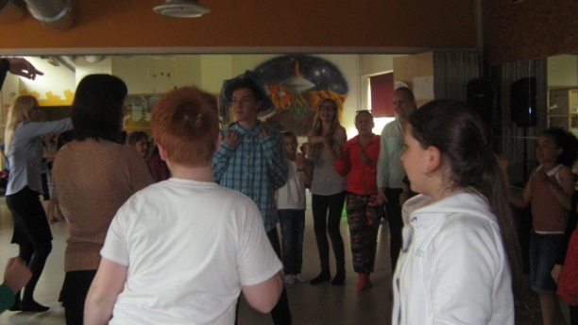
In the evening, an International Event took place and it was followed by a School Party at Tűri Youth Centre.

Slide 17
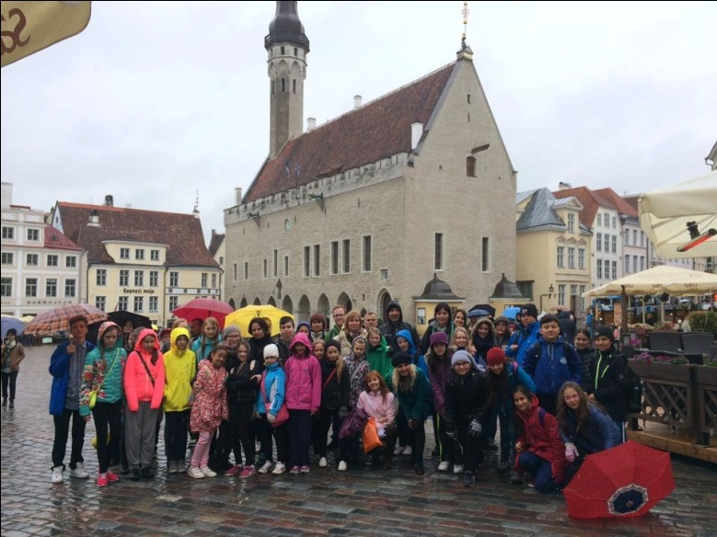
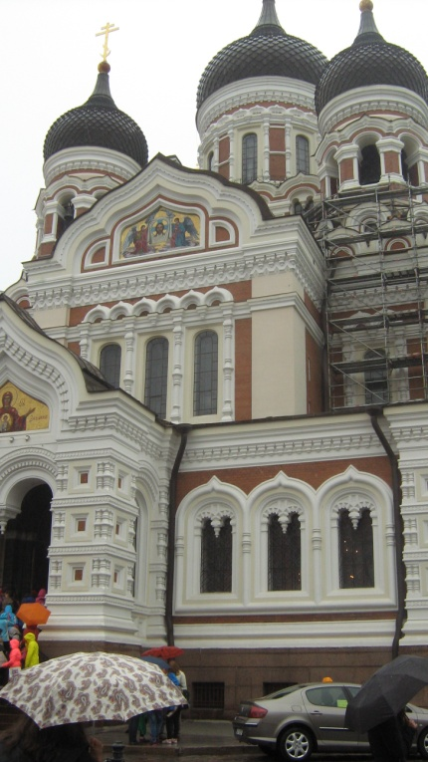
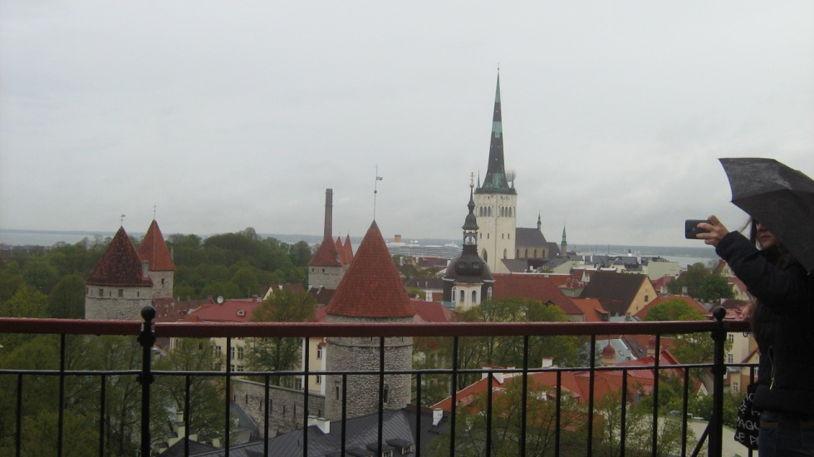
The visit in Estonia would not have been complete without the great trip in the old town, the capital city, Tallinn.

Slide 18
The adventure went on with a second visit to Scartho Junior Academy, Grimsby, England

Slide 19
The greatest theatre plays were put on stage by the pupils from Scartho Junior Academy, Grimsby, England, on Tuesday. The next day, they went climbing.

Slide 20
Presentation of Shakespeare’s plays and sonnets was made by the pupils.
It is very interesting to know the history, the heritage of each country involved in the project.
Through the centuries, lots of writers, poets, musicians had built a culture, a tradition, a set of feelings and lifestyles .
It is a duty to know their thoughts, feelings and work, to share them and compare them with other people from other places in the world .
It is also very important to transmit the culture’s heritage of the past to the young generation.

Slide 21
THANK YOU FOR ATTENTION !

