Slide 1
Where do the traditional sport`s name come from?
Student : Daria Elena Negrea
Coordinating Teacher: Ramona Gabriela Asan

Slide 2
Romanian Traditional Sport Oina
Oina (or Hoin) is a Romanian traditional sports game. Playing Oină it was spread throughout the country, with a large number of names and flavors: Banat was called "small lopta" or "pila" Transylvania "along" or "long lopta" in Sibiu area "flee" in Wallachia and Moldova "Hoin“(maybe from the Turkish word oiun ) and then rounders in Maramures "ojerul" or "oirul" in Dobrogea "over" etc. In some parts rounders play and the girls as "oiniţă" .is like sports games common to other countries, such as Schlagball the German, Finnish pesäpallo the game Paume in France, that Corr's Cluiche Irish.

Slide 3
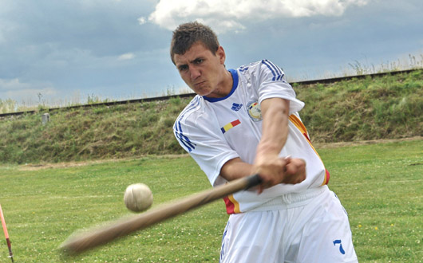
The game asks qualities sports complex (good running speed, quick reflexes movements of self-defense against kicks the ball, throwing and accuracy in hitting the ball with a stick or bat).

Slide 4
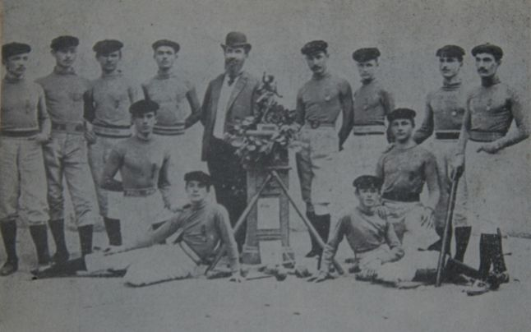
History of the game
Oină is practiced continuously at least from the XIV century according to the chronicles and time charters, it was first mentioned in documents in 1364 during the reign of Vlaicu Vodă. Another documentary appears in 1596, when Italian cosmograf Gian Lorenzo d'Anania game Oină mentions in his Universal System of the World Chapter description Upper Wallachia.
Oină references to be found in the work of Stephen Diaetetica 1762 Matyus printed in Cluj, then the priest Nicolae Stoica of Haţeg in 1763 which recounts his years in Timisoara where children play in the churchyard "small lopta."

Slide 5
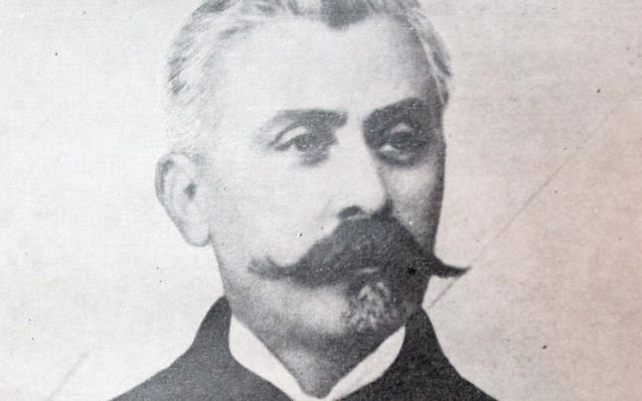
One who brings radical changes in Oină game, giving sports game character is Spiru Haret, considered the father oinei. By "education reform" from 1898 and other ministerial decisions, he introduced compulsory oinei practice in schools of all levels. "Oina can bring new life into Romanian school, being an admirable means of physical education, sport Romanian real kind of game," said Spiru Haret.

Slide 6
On 9 May 1899 in Bucharest was held first National Championship of Oină, winning the high school team Bălcescu in Brăila.
In the Official Gazette no. 49 of June 3, 1912 game rules are published in full, thus officially recognized Oină game.
In early December 1912 in Bucharest, it is founded "Sports Societies Federation of Romania" (FSSR) which included the "Commission Oină".

Slide 7
Romanian Federation of Oină is founded in June 1932. After the Second World War, Oină was regained the popularity, and started a lot of local and national competitions as: Hopes Cup, Regions Cup, Romania Cup, Schools Cup National Competition for Seniors and Juniors, etc.

