Slide 1
Hanzade Doğan Boyner

Slide 2
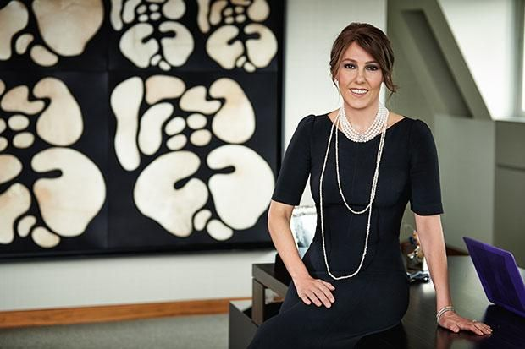

Slide 3
Biography
Dogan Boyner, in addition to his achievements in the field of entrepreneurship, has also been a leader in the management of many well-established companies in Turkey

Slide 4
He is the Vice President of Doğan Holding, one of Turkey’s largest conglomerates operating in the energy, Media, Industry, Trade, Insurance and tourism sectors. Before that, he was chairman of Dogan Media Group, which also includes Posta, one of Turkey’s best-selling daily newspapers.

Slide 5
Dogan Boyner, who is also head of Petrol Ofisi, took an active role in the partnership agreement between Dogan Holding to establish strategic cooperation with OMV, the leading oil and gas company in Central Europe, and later served as chairman of the board of Directors.[3]

Slide 6
Dogan Boyner, who participated in international forums as a speaker, also participated as a speaker at the 2020 World Economic Forum (WEF) Annual Meeting [4] in Davos and the 2019 Fortune Global Forum in Paris.[5] he is a founding member and vice president of the Global Relations forum, a member of the Board of Trustees of the Brookings Institution, and an active member of the Board of Supervisors at Columbia Business School, Columbia University.[6]

