Slide 1
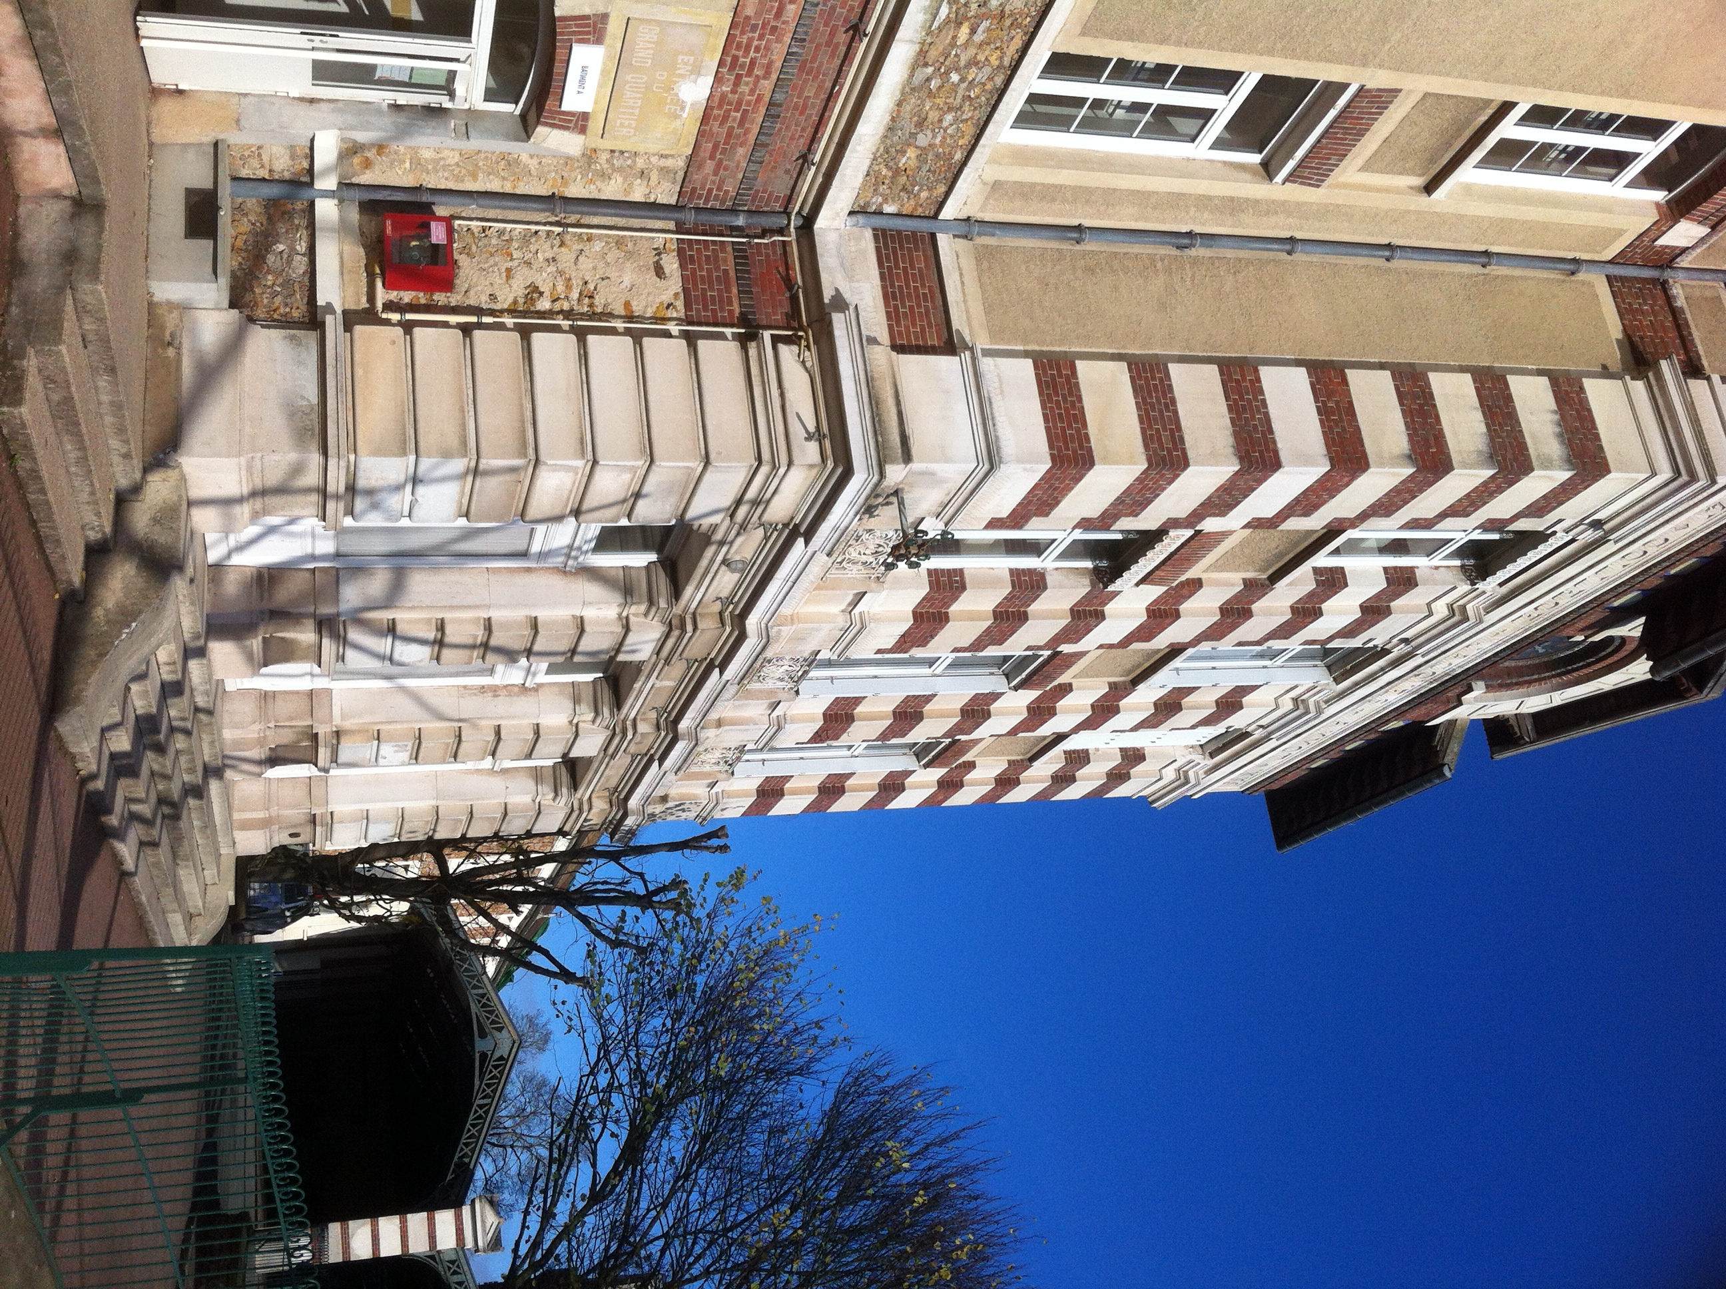
Jacques Amyot
school
500 pupils
Mr.Makhlouf
Mr.Galina Fortes
We start at 8!

Slide 2
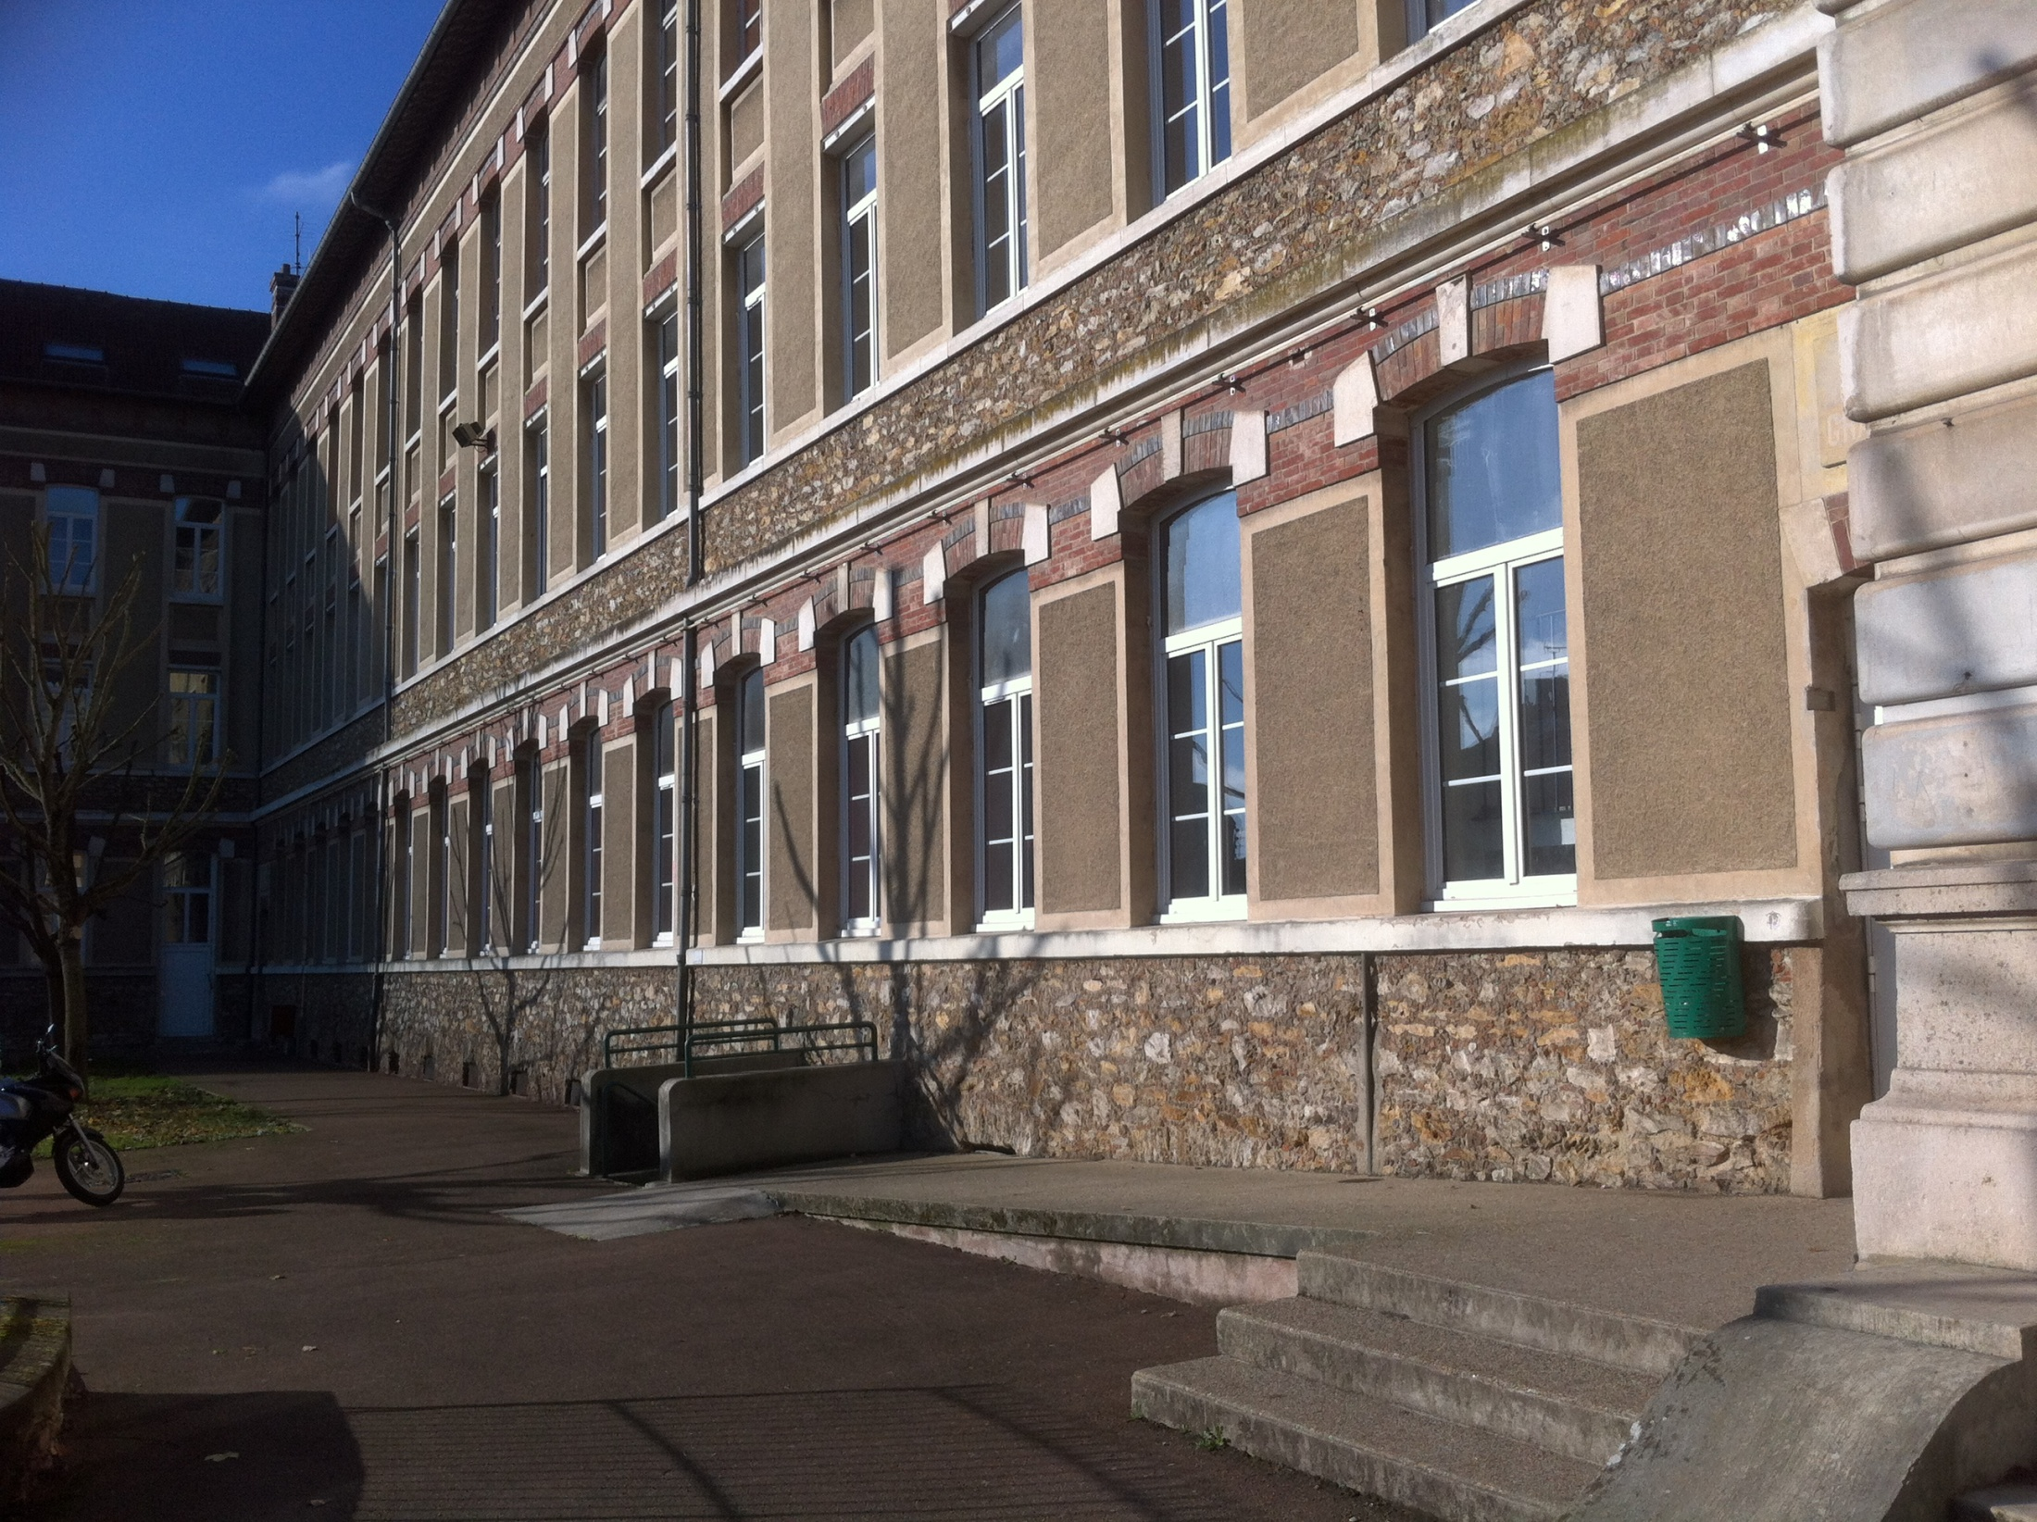
This Is the A Building

Slide 3
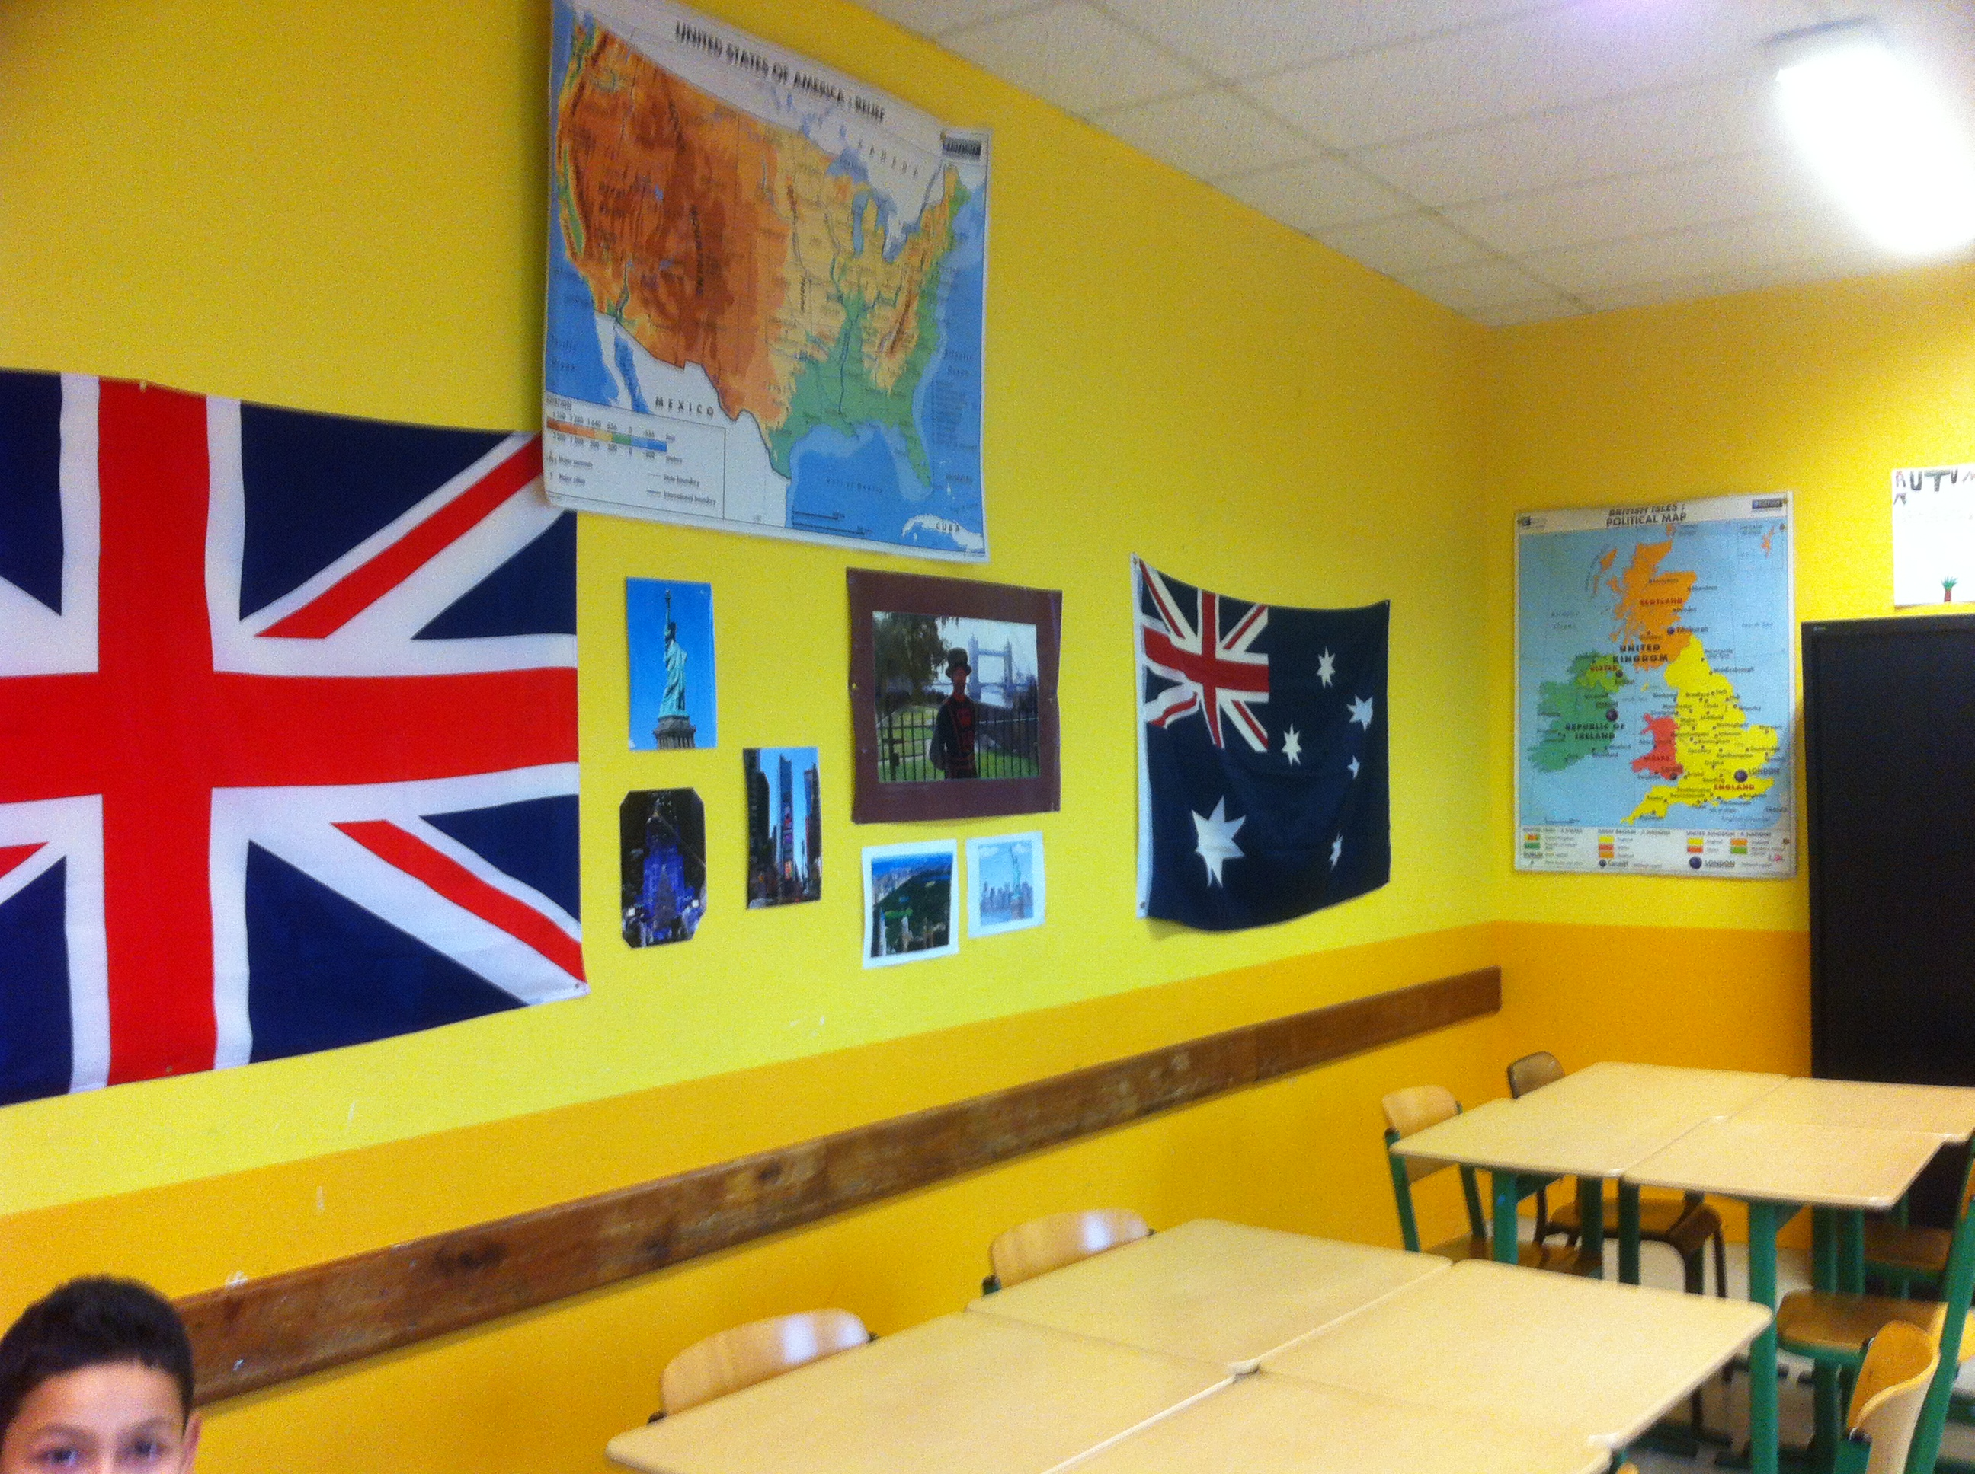
Corridor
This is the corridor . I love running in the corridor but it’s forbidden .
By Wilson

Slide 4
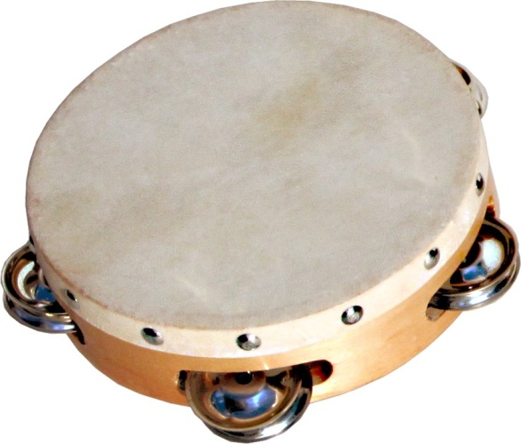
This is the musicroom. There are instruments for example piano,tambourine… There are white board,computer,projector. The wall is white. We learn songs.
Music class

Slide 5
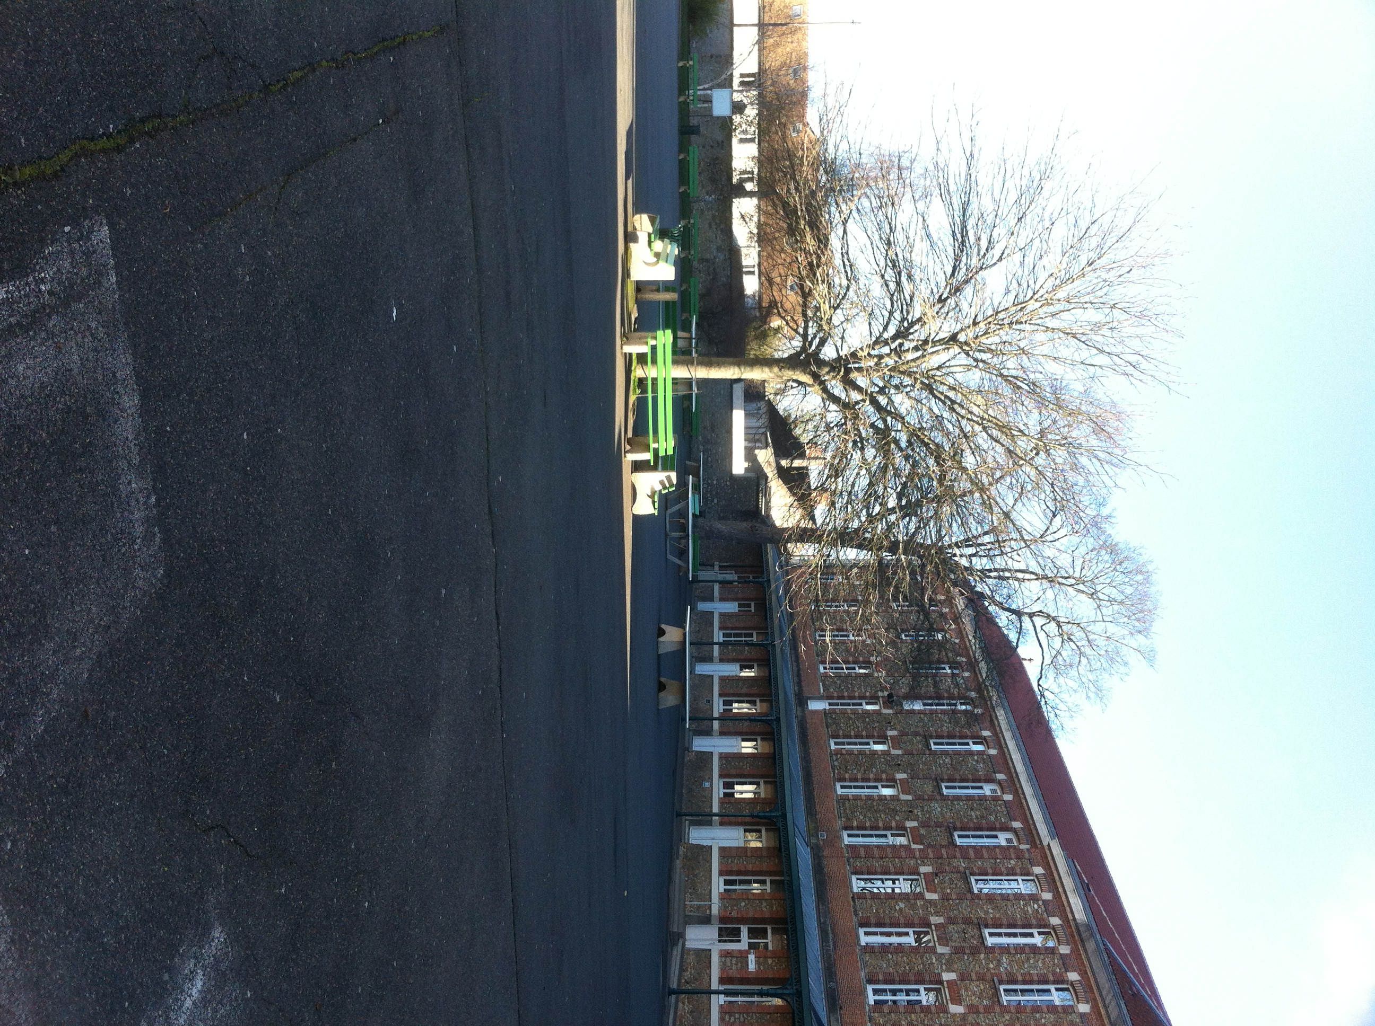
Playground

Slide 6
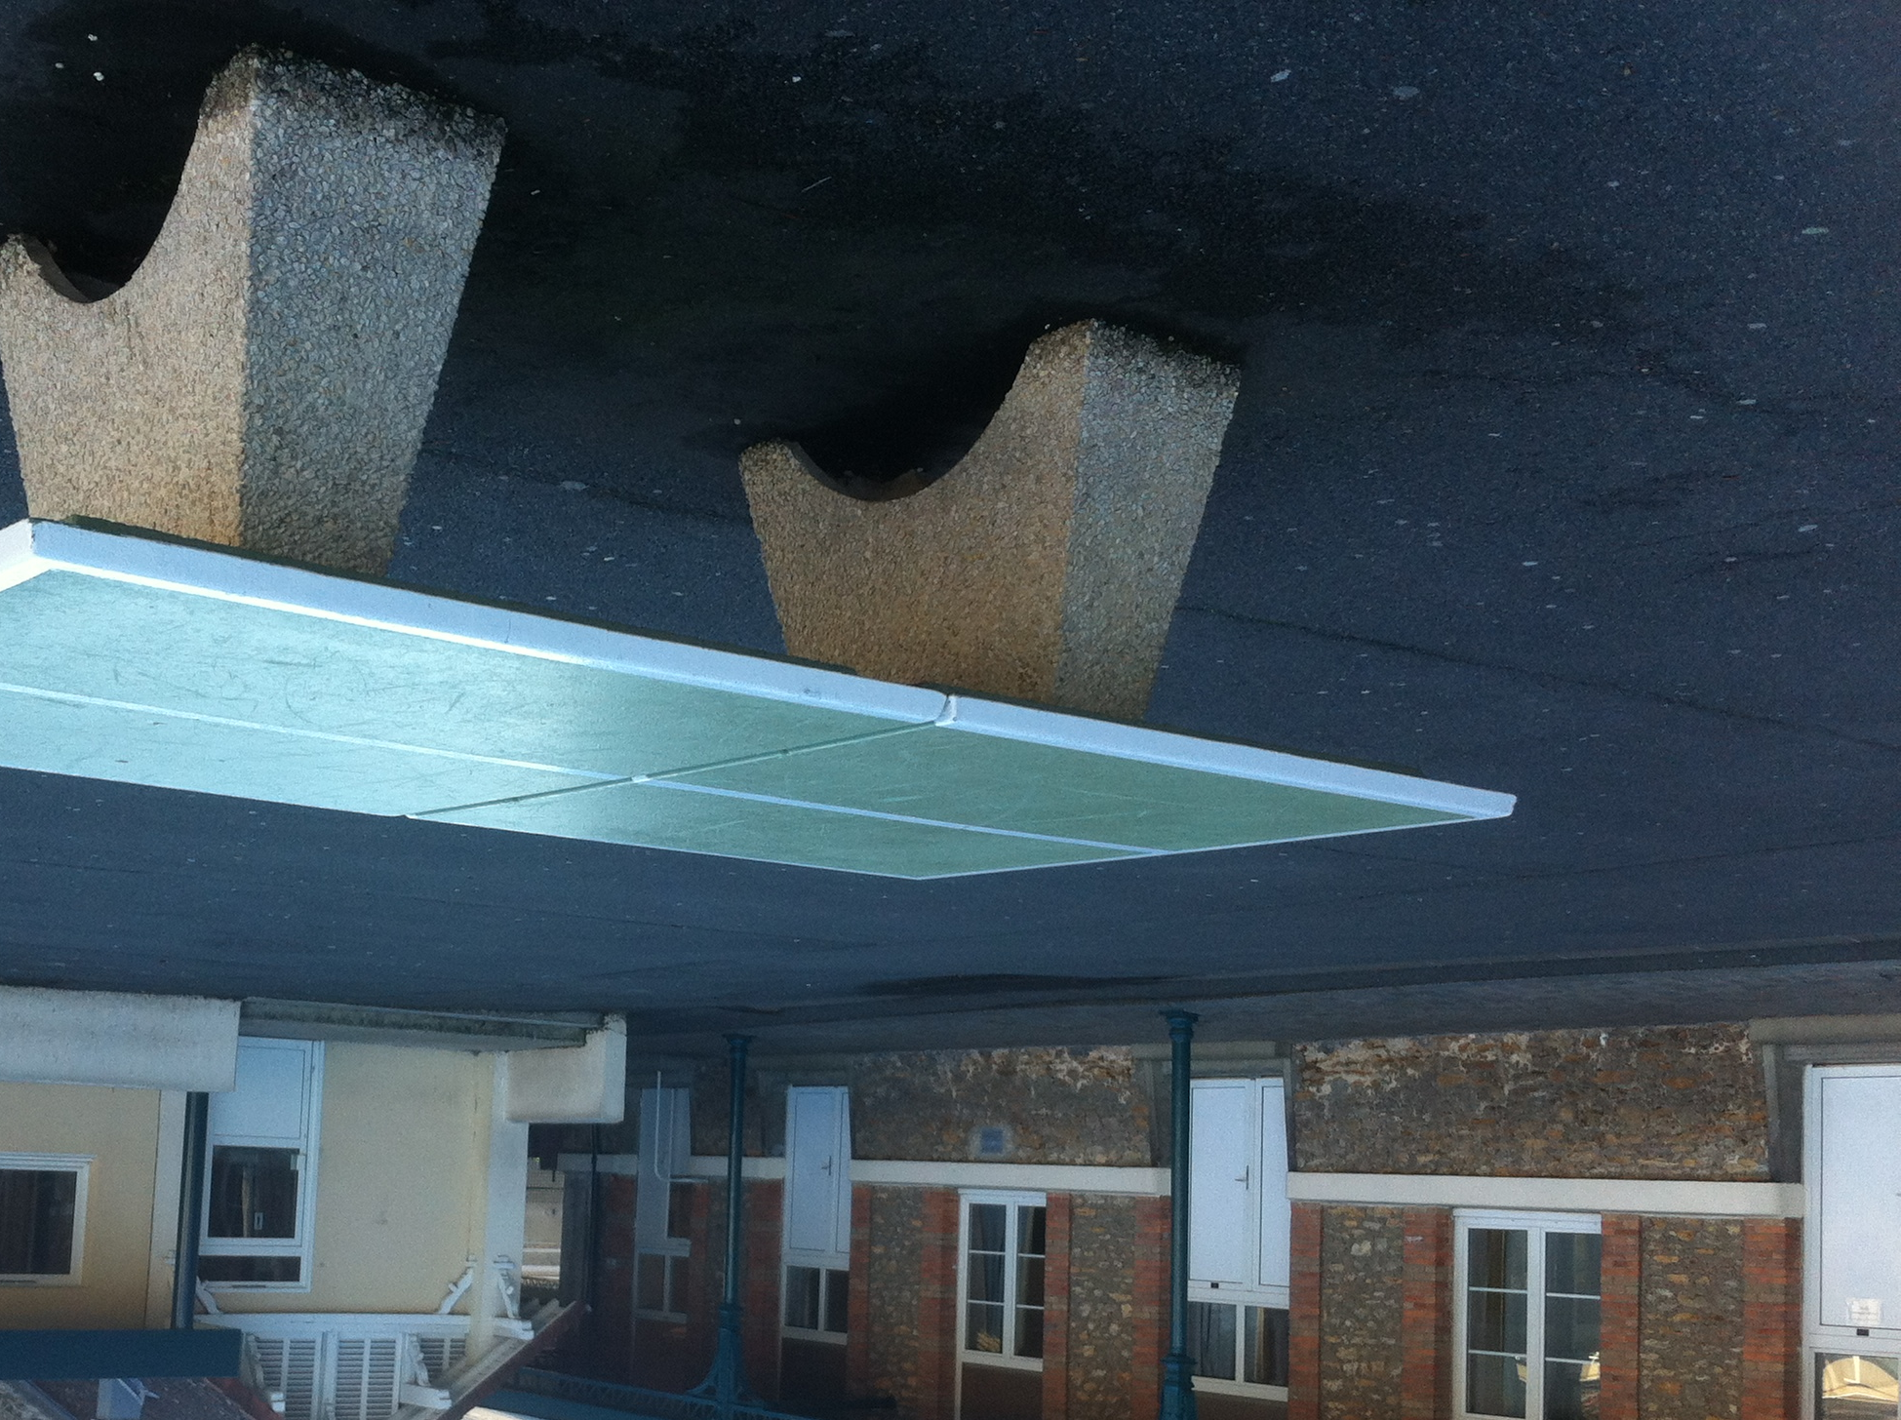
Ping-pong table
In the big playground there are ping-pong tables

Slide 7
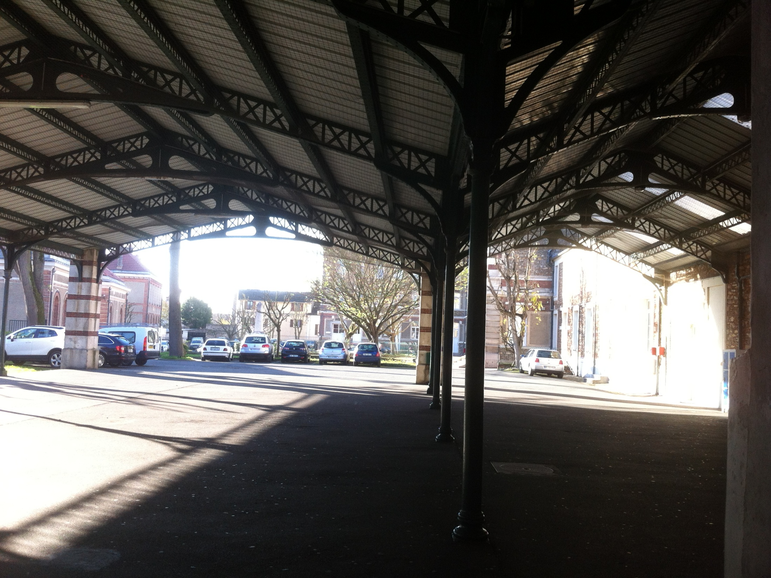
covered playground

Slide 8
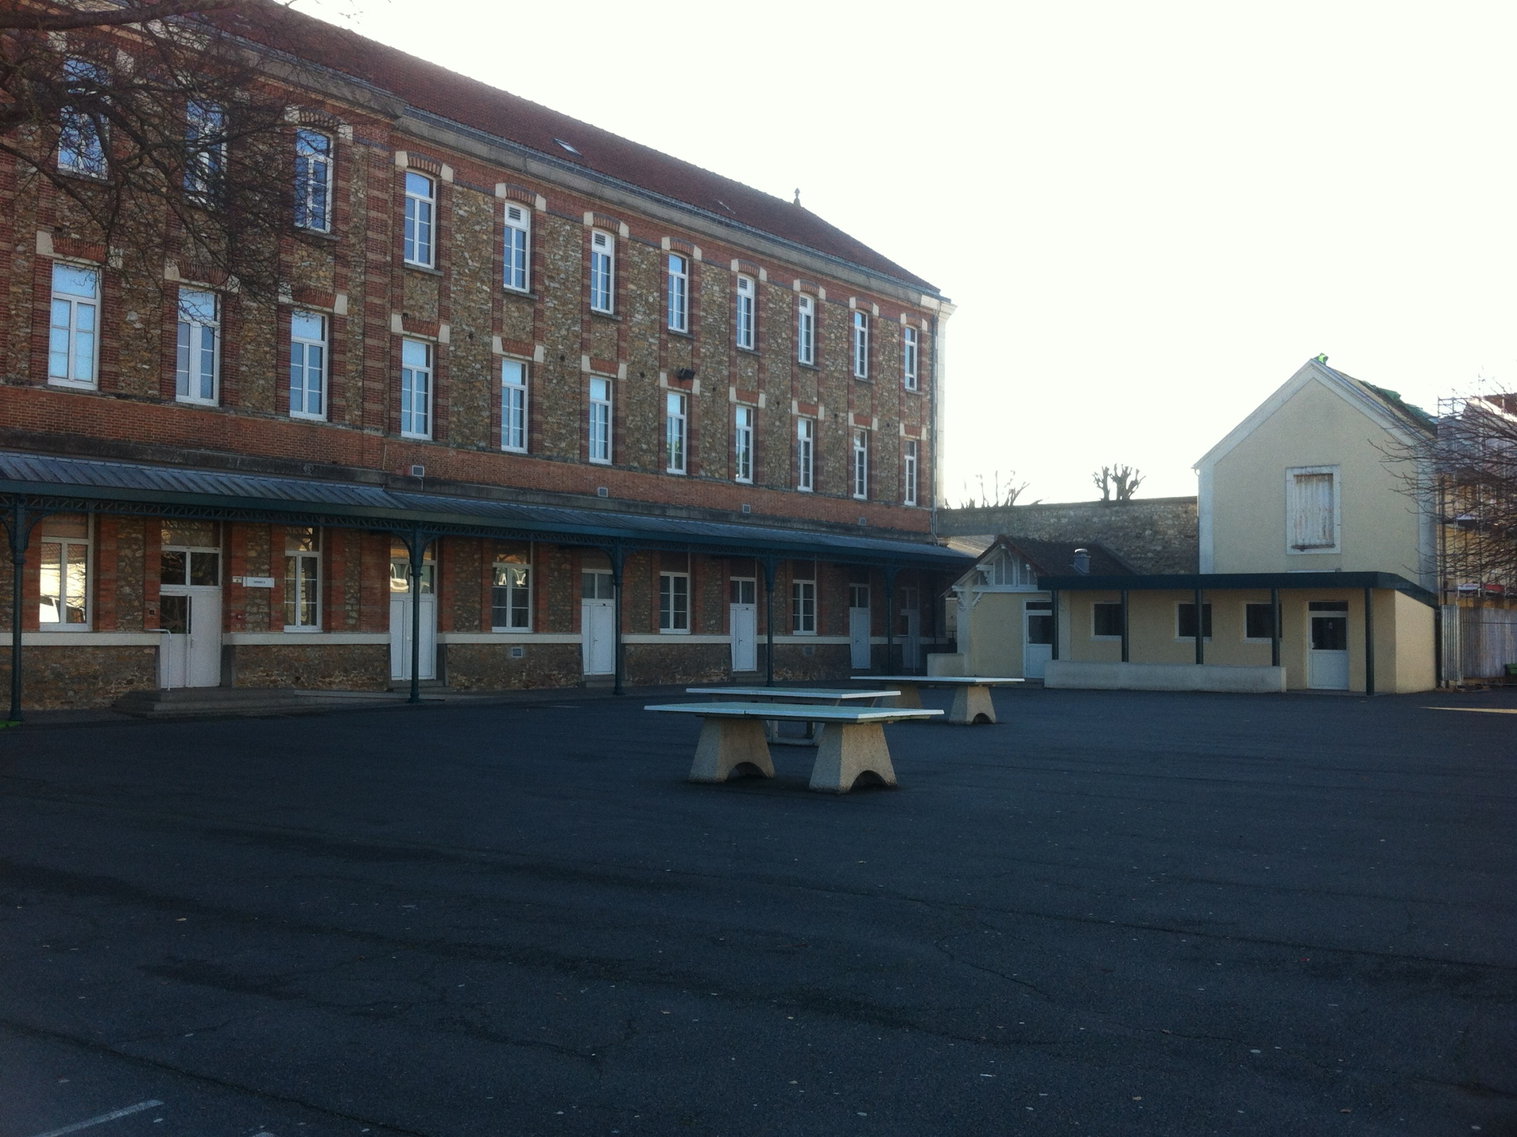
big playground
BUILDING B

