Slide 1
Pavao Belas Elementary School
Brdovec
Zagrebačka županija
(Zagreb County)
Republic of Croatia

Slide 2
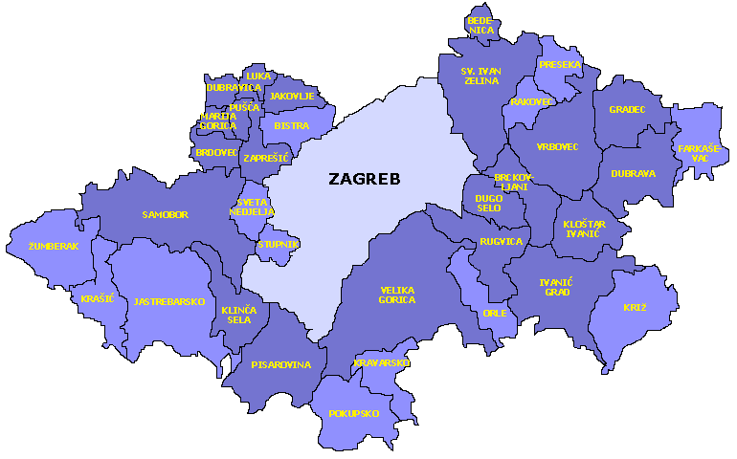
The school is located in Brdovec

Slide 3
THE HISTORY OF THE SCHOOL
In 1836, parish priest Jellak started the first private school
in the parish house Stjepan Zagozda gives private lessons to children
the first public school in Brdovec was founded by the parish priest Pavao Belas in 1854.
classes are held at the parish house
Pavao Belas
Parish house

Slide 4
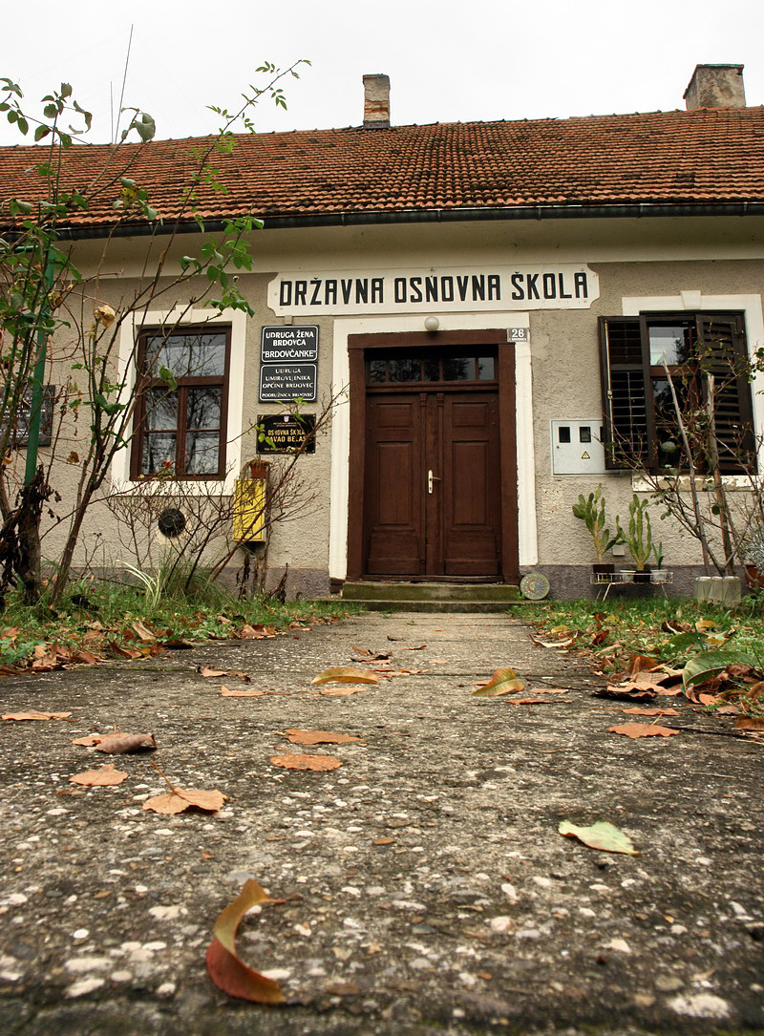
OLD SCHOOL
In 1869, a school was built alongside main road
Pavao Belas, the parish priest was the first school master
1875 the first library
1893 school playground
Public school Brdovec
State Elementary School

Slide 5
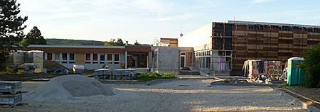
Regional School
since 1954 the school has become the regional school of the Antun Augustinčić Elementary School in Zapresic
it is very small: it has got three classrooms and one small additional room
RS Antun Augustinčić
Old school - new school

Slide 6
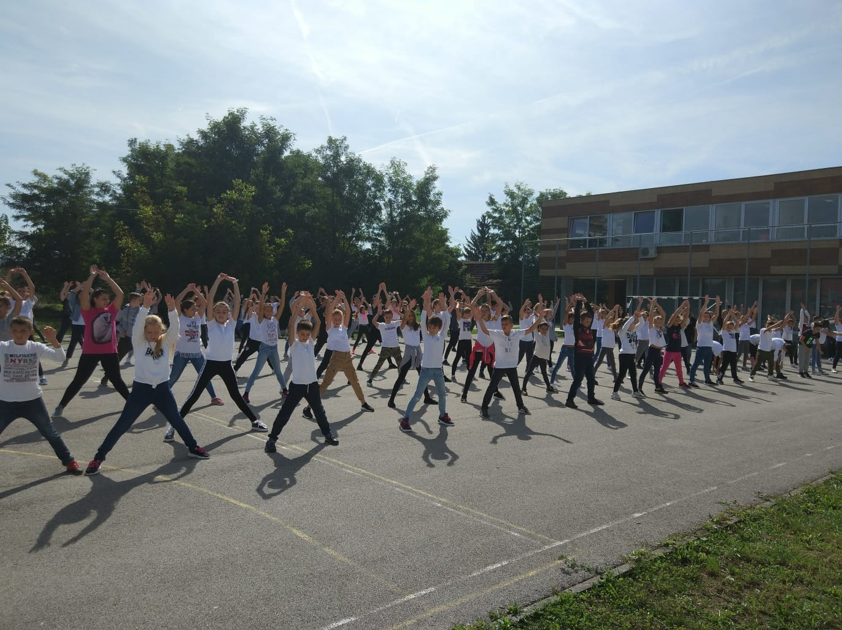
https://www.youtube.com/watch?v=UrrUNKebhbE&t=18s

Slide 7
Our new modern school with a hall

Slide 8
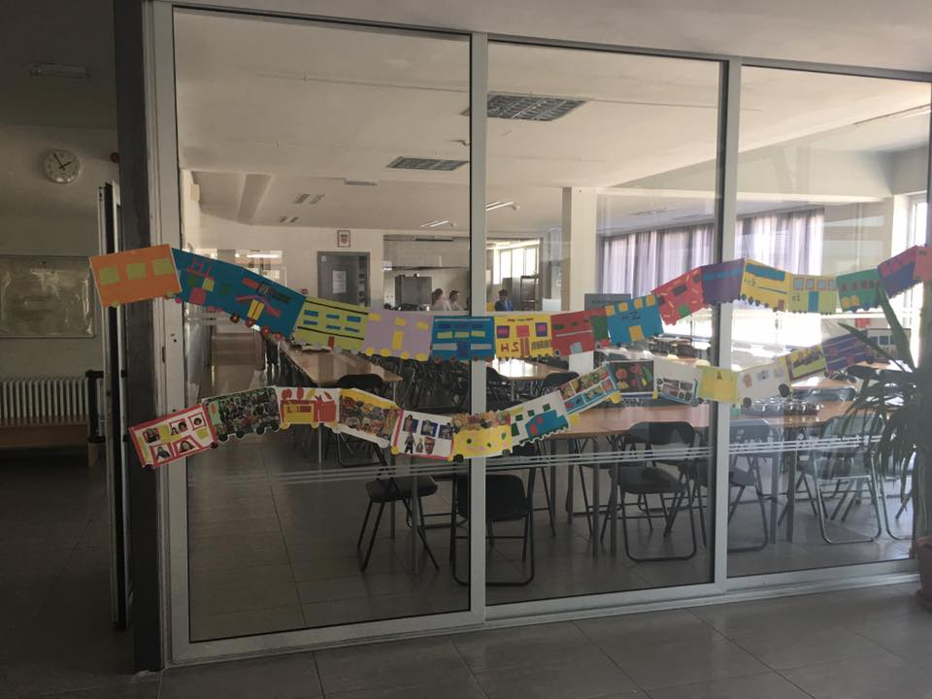
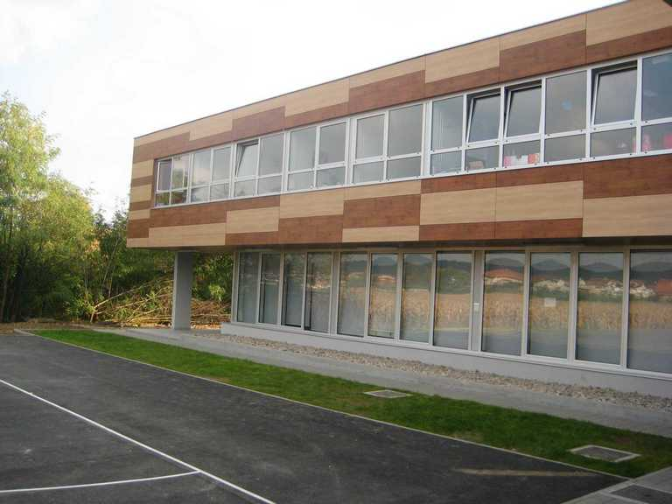
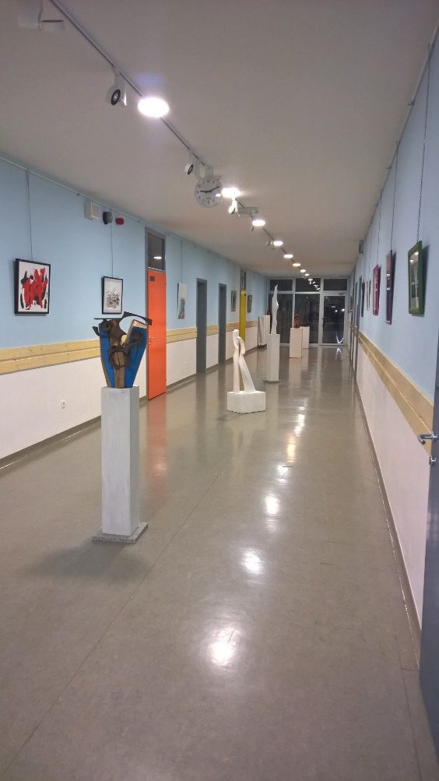
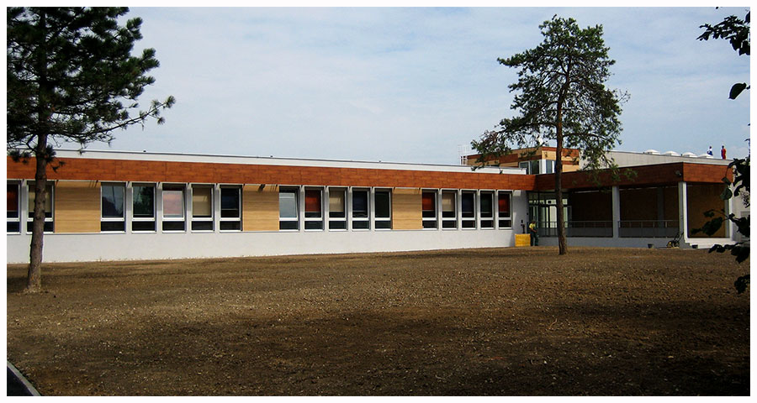

Slide 9
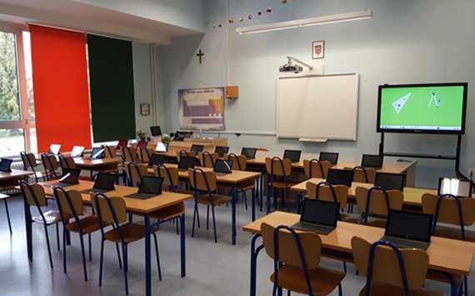
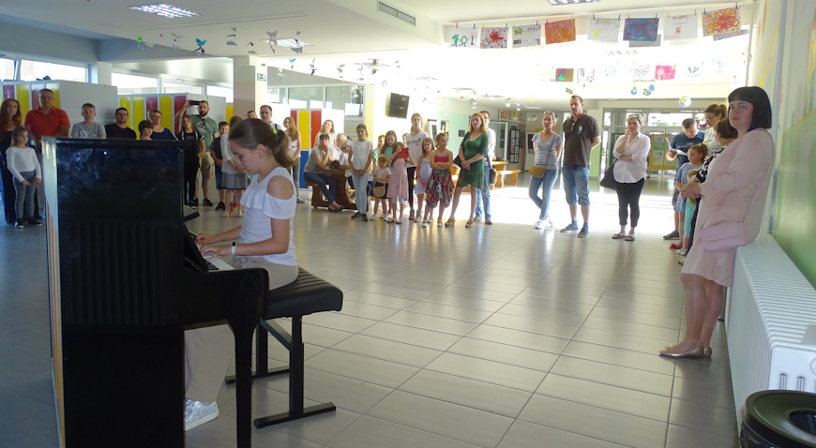

Slide 10
OŠ Pavao Belas
● March 1st 2009 school starts working
● Today: 450 students in 19 grades
● Music School - 120 students in 6 grades
● 64 teachers

Slide 11
Daf programme -exchange of students with Hungary !
Students Cooperative Pužek brdovečki!
Lots of fieldwork!
Movie Group
SCHOOL LIFE
In addition to English, students can also choose German from 1st grade!
Lots of projects!
5th-8th grades, classes in the morning

Slide 12
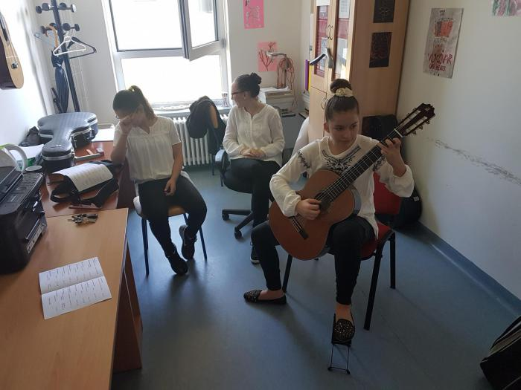
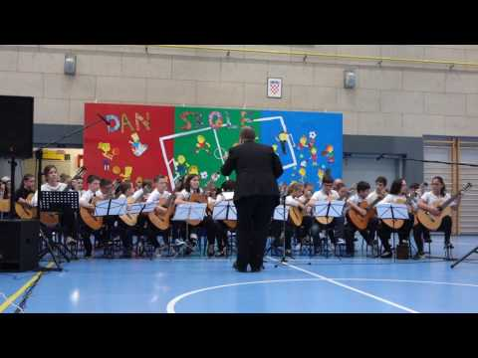
Music School
The Pavao Belas Elementary School of Music was founded in 2013
https://www.youtube.com/watch?v=h7MjvdFQ_3s&t=65s
https://www.youtube.com/watch?v=dmvev83ML5U

Slide 13
