Slide 1
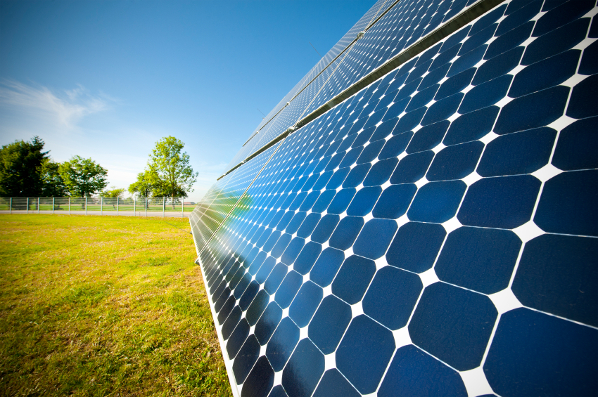
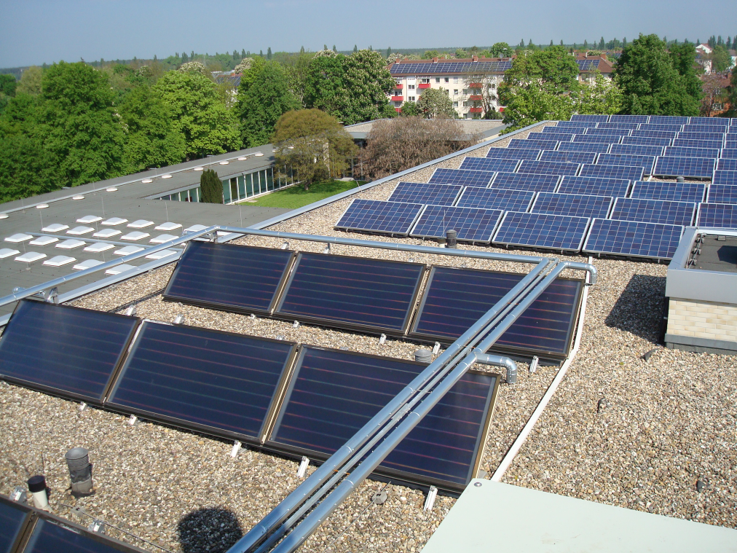
Solar energy

Slide 2
Solar energy in Germany:
There are many good reasons for the production of solar energy:
Solar energy is an inexhaustible energy source in contrast to fossil energy sources.
Solar energy doesn´t produce CO2
Solar energy is favourable

Slide 3
Sunlight in kWh/m²

Slide 4
Solar production in Germany
In Germany there are 2.15 million solar plants installed, which corresponds to a collector area of 19.2 million square kilometres
In 2015, about 7,500 gigawatt hours in warmth were produced. This corresponds to 7.5 billion kilowatt hours. Moreover, 101 000 new plants were built.

Slide 5
Development of the production of solar energy in Germany

