Slide 1
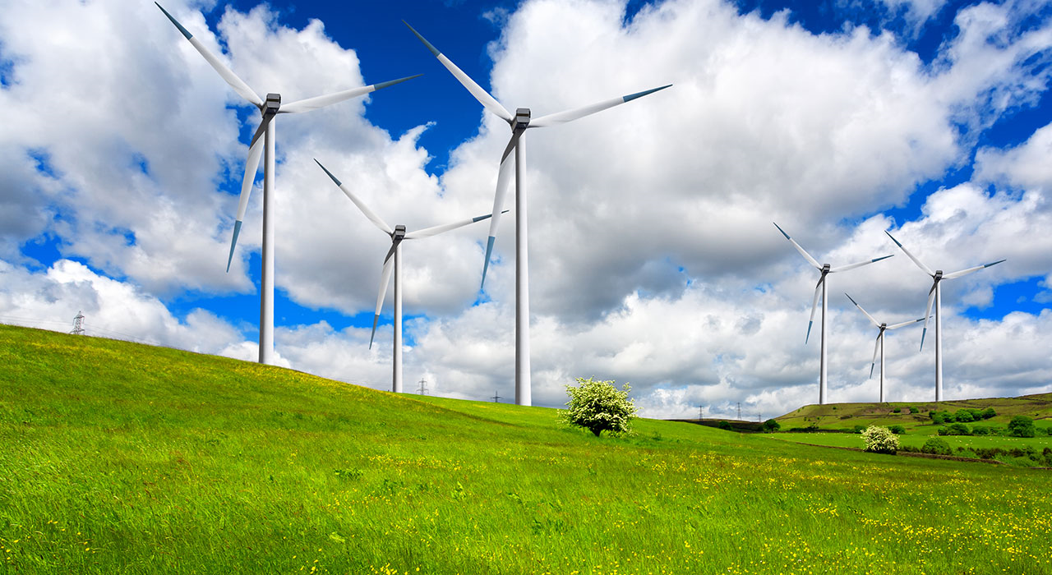
Wind energy

Slide 2
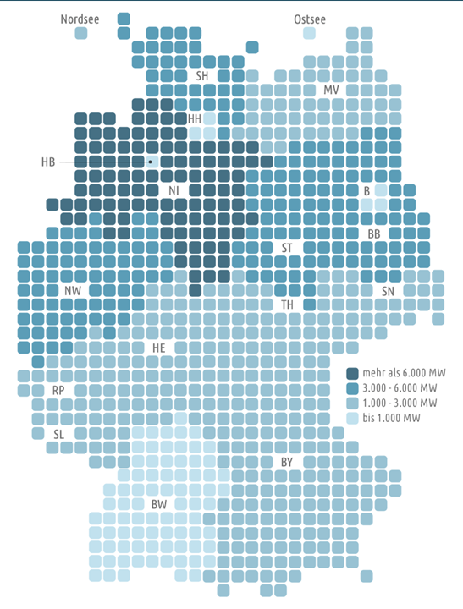
Spreading in Germany
2015 26744 wind power stations are in operation in Germany
Most of the power is installed in
Lower Saxony
Wind energy enjoys a wide spread in
the north of Germany, there are
42% of the installed wind power
stations
Each year thousands of wind power stations are built and the numbers of new contructions have increased steadily since 1970

Slide 3
Pro and Cons
Pro | Cons
-wind can´t be exhausted, it is abundant | -big wind parks can´t even provide a city
-no emissions of dangerous gases | -dangerous for bird swarms to fly into the rotor blades and die
-wind power stations don´t need much space in comparison with the conventional power stations | -if there is no wind for a day, the people won´t have any electricity because energy can´t b stored well; for these situations the conventional power stations would be needed
-the idea of wind power is still expandable | -wind parks in residential areas aren´t possible due to the noise
-around 70,000 workers are part of this line of business and the numbers are still increasing | -wind isn´t a reliable source of energy: the power always depends on the weather, you can´t control the wind´s intensity
-wind is cheap and clean

Slide 4
Wind energy in Winsen
About 60 wind power stations have already been built in the district Harburg
In the area near Winsen there are good conditions for wind power and 0.5% of the area can be used for this industry
65 further stations are planned to be built until 2025
In the time of energy transition also Winsen wants to produce its own power produced by regenerative energy sources

Slide 5
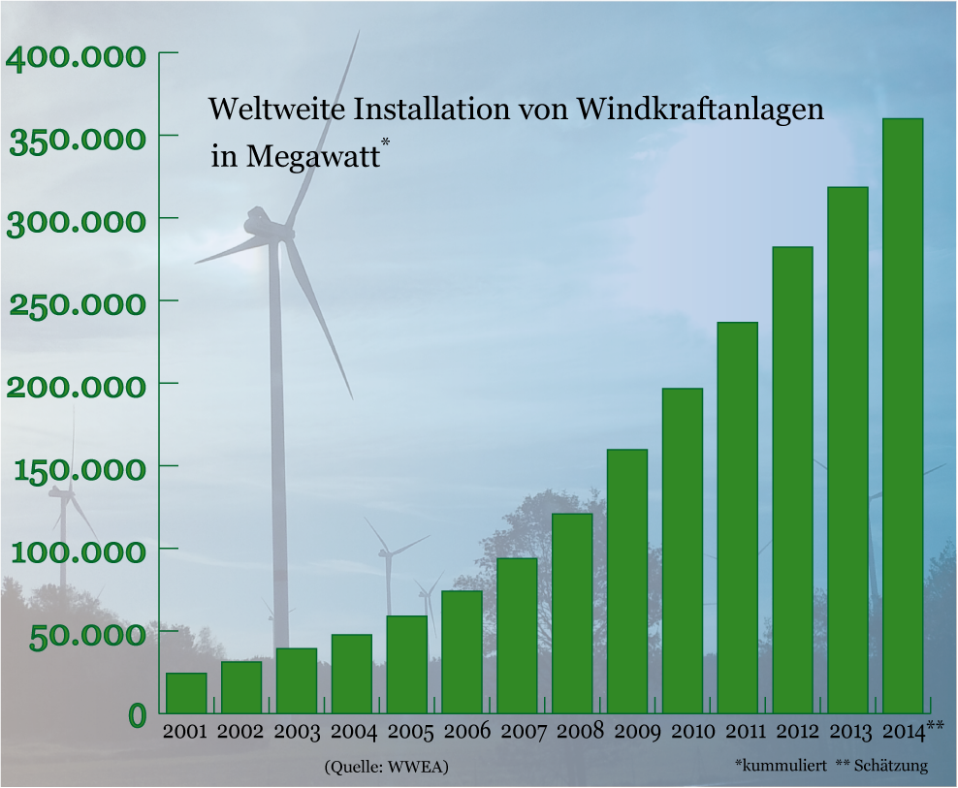
Development
In spite of modern technology the potential of wind power will not be exhausted for a long time
Experts say that in future wind energy will produce 25% of the energy needed in Germany (today it covers round about 10% of the requirements)
Additionally wind power stations will become more and more powerful due to bigger and very powerful constructions; old stations are planned to be upgraded

