Slide 1
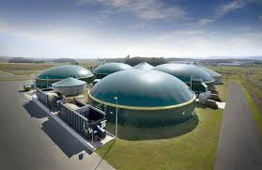
Biogas plant

Slide 2
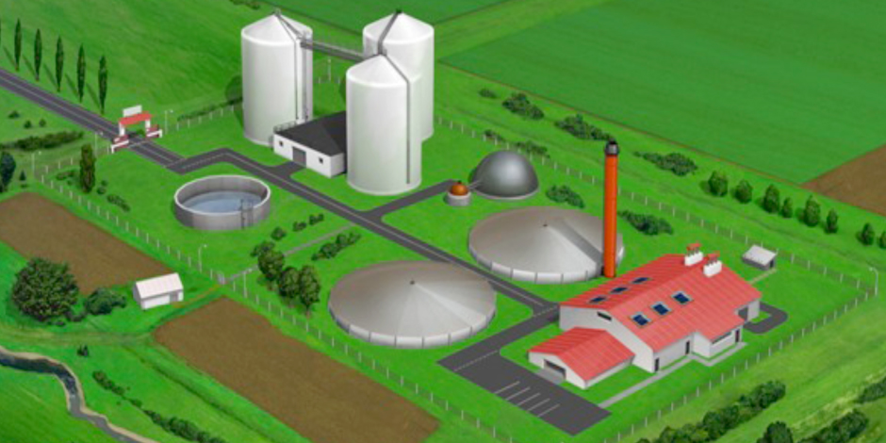
Biogas is one kind of the renewable energies in Germany.
A biogas plant is used to produce biogas by fermentation of biomass. In agricultural biogas plants animal excrements (manure, fecal matter) and energy crops are usually used as substrates.

Slide 3
Biogas plants in Germany
In Germany there are approximately 9,000 biogas plants.
8.4 billion people get their electric power from biogas plants.
Moreover, 43,000 people work at biogas plants.

Slide 4
Advantages
good for the environment
waste (from cows) gets recycled
more workplaces
efficient power generation
low risks (production isn‘t dangerous)
power can be regulated
permanently available
storable (usable in emergency situations)

Slide 5
Disadvantages
high production costs
bad smell
impact on groundwater and biodiversity

Slide 6
Biogas plant in Winsen
There is a biogas plant in Stelle, a village near Winsen.
We visited this biogas plant on Dec. 6, 2016 It was an interesting experience for all of us.

Slide 7
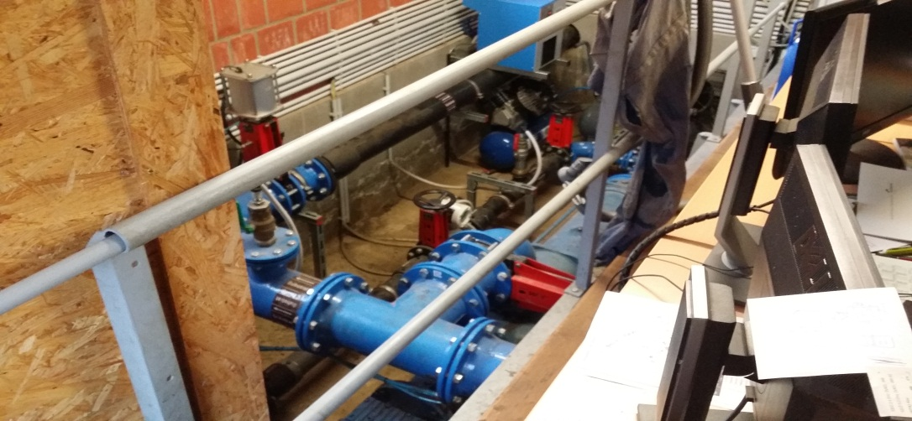
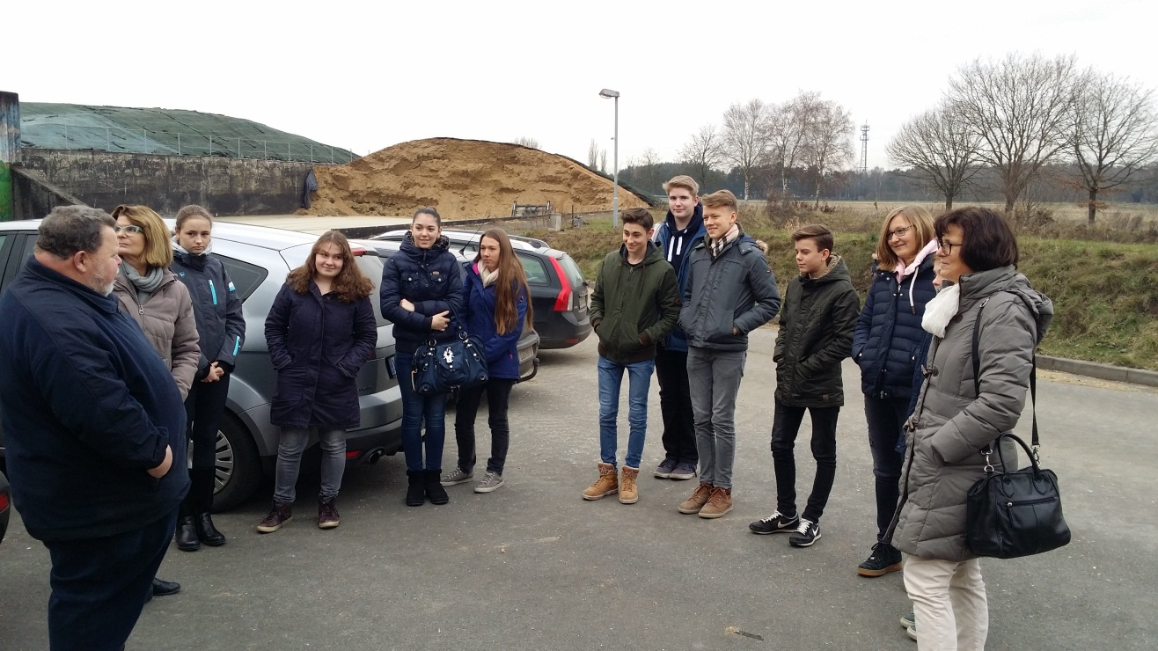
Fotos

