Slide 1
Hydropower in Germany

Slide 2
General
Since the 19th century water force has been used to generate electricity. In Germany, hydropower has been the most important regenerative energy source. It was replaced by wind force in 2004.
In 2013 4.4% of the electricity produced in Germany was generated by hydroelectric power.
At present there are ca. 7300 hydroelectric power plants in Germany. In Bavaria, there are over 3600 hydroelectric power plants.

Slide 3
History
In ancient times, the Romans developed the idea of the hydroelectric power station. These power plants were used exclusively for the operation of mill-stones. So, the first hydroelectric power station in Germany was built in the 6th century. In the 8th century a revolutionary invention was made, the back - and-forth movement. The possibilities of the hydroelectric power plant multiplied and machines like looms operated.

Slide 4
Pro and Cons
Pro | Con
Water is part of renewable raw materials | Water is lost when energy is produced
Fossil energy resources such as coal, petroleum and gas are spared | Intervention in the water balance -> Ecological balance changed
Independence from conventional energy sources | Endangered fish and micro-organisms, migration of fish is not possible
Climate protection, because it is CO₂ neutral | Lower flow rate-> Lower oxygen content, increased water temperature
Plant parts are recyclable after the end of the operating period | Imbalance in groundwater levels
Flood protection for sub-trailers | Dam burst can be dangerous
Storage lakes are also storage for drinking water | Large areas are flooded when the lake is built
Hydropower and variable renewable energies complement each other, thus reducing the need for storage

Slide 5
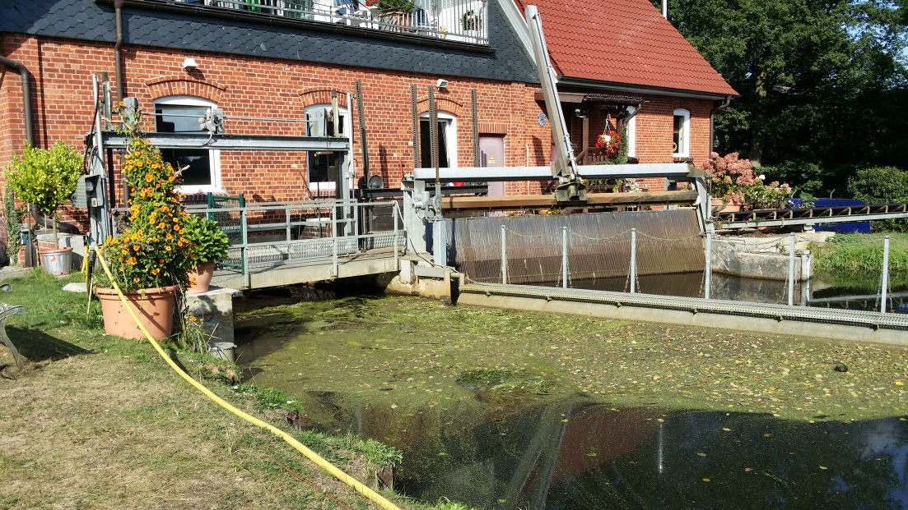
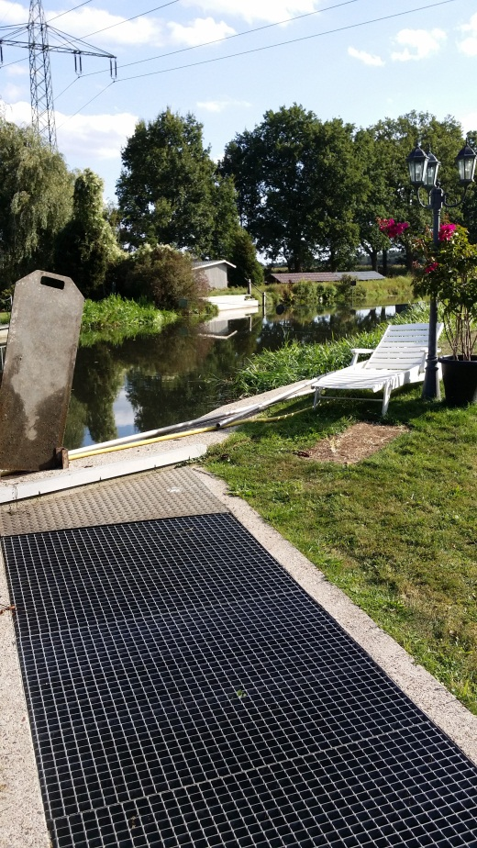
Visit
hydroelectric power station Luhdorf, near Winsen (27.09.2016)

