Slide 1
Gymnasium Winsen

Slide 2
General information
Gymnasium Winsen was founded in 1955 as the first high school in the area of Winsen. Today we are a modern school that values its traditions at the same time.
At the moment our school has got 970 students. We are always open to innovation and offer a growing equipment with modern technology to our students.
Our school community works in an open-minded and trusting atmosphere, which is characterized by mutual respect and esteem.
Our way of teaching is characterized by methodical variety and the support of our students‘ self-confidence.
Our students are always the centre of our interests.

Slide 3
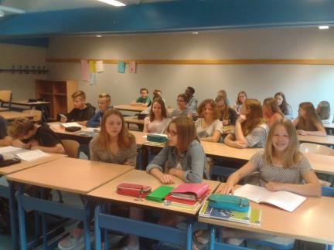
School life
classes

Slide 4
School life
Students using interactive whiteboards

Slide 5
School life
In the computer room

Slide 6
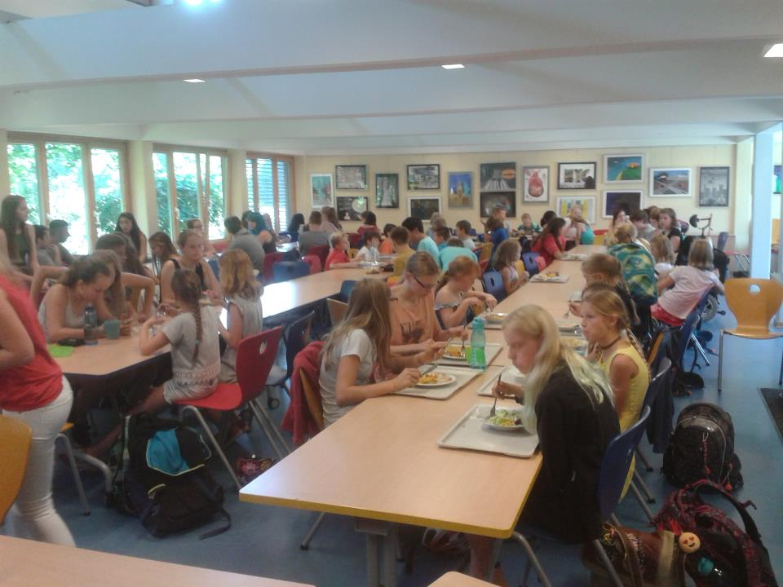
cafeteria

Slide 7
Climbing frame in the school yard

Slide 8
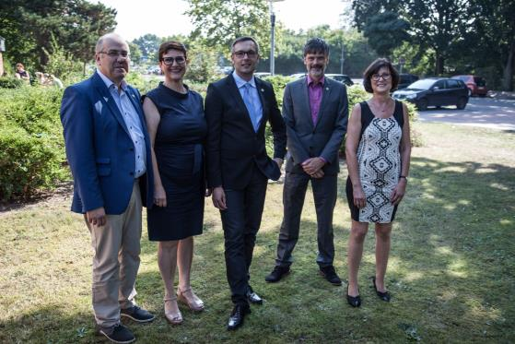
The school leading team

Slide 9
Projects and special activities at our school
Because Gymnasium Winsen is a full-time day school, there are a lot of activities and clubs in the afternoon including sports, languages, theatre, music sciences and many other fields.
Furthermore we have already carried out and are still active in a wide range of exchange projects with Japan, the USA, Switzerland, Turkey, France, Spain, Poland and Romania.
Additionally we have a long tradition of multilateral projects, we have successfully carried out two Comenius-Projects and are now involved in an Erasmus+ Project together with six other countries.

Slide 10
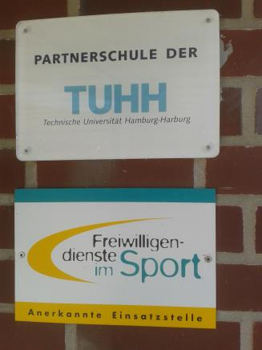
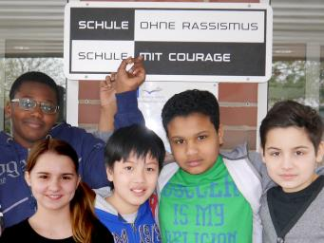
awards

Slide 11
Comenius projects:
2011 – 2013: Music Knows no Boundaries
(Germany, Italy, Greece, Spain, Turkey)
2013 – 2015: Places of Memory
(Germany, France, Turkey, Czech Republic)

Slide 12
Comenius projects

Slide 13
Comenius projects

Slide 14
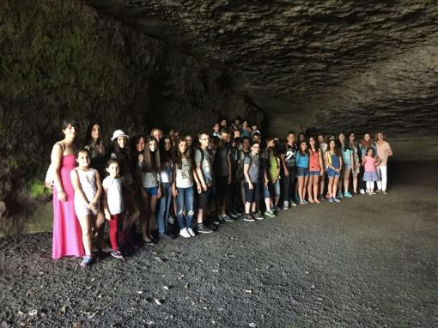
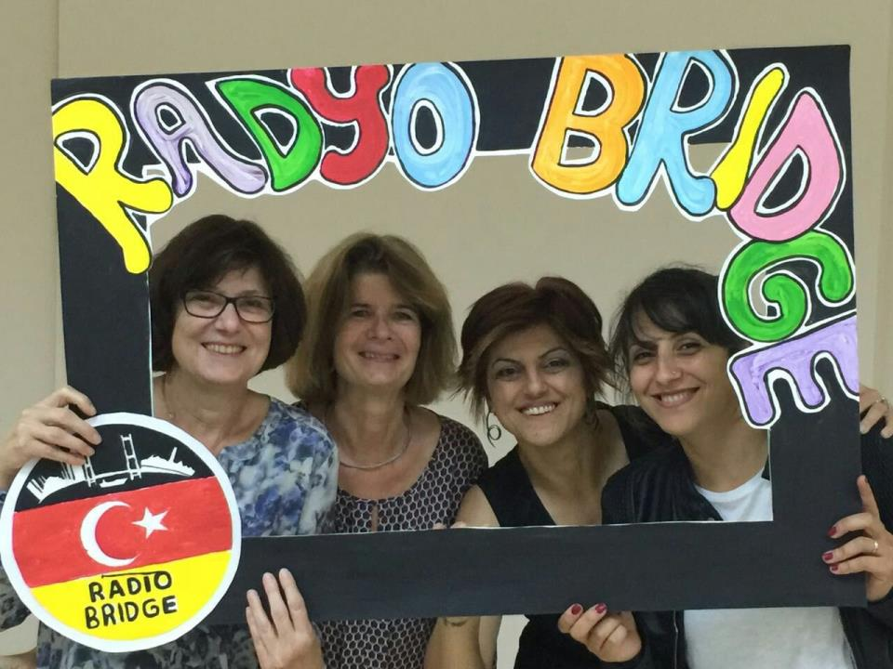
Exchanges: 2015/2016: Our Radio Bridge project with Turkey

