Slide 1
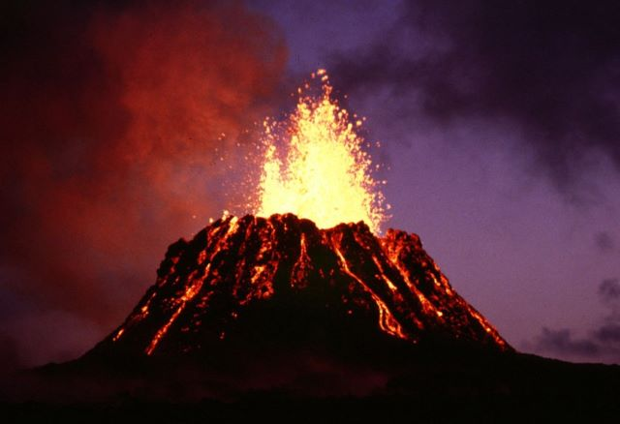
VOLCANOES

Slide 2
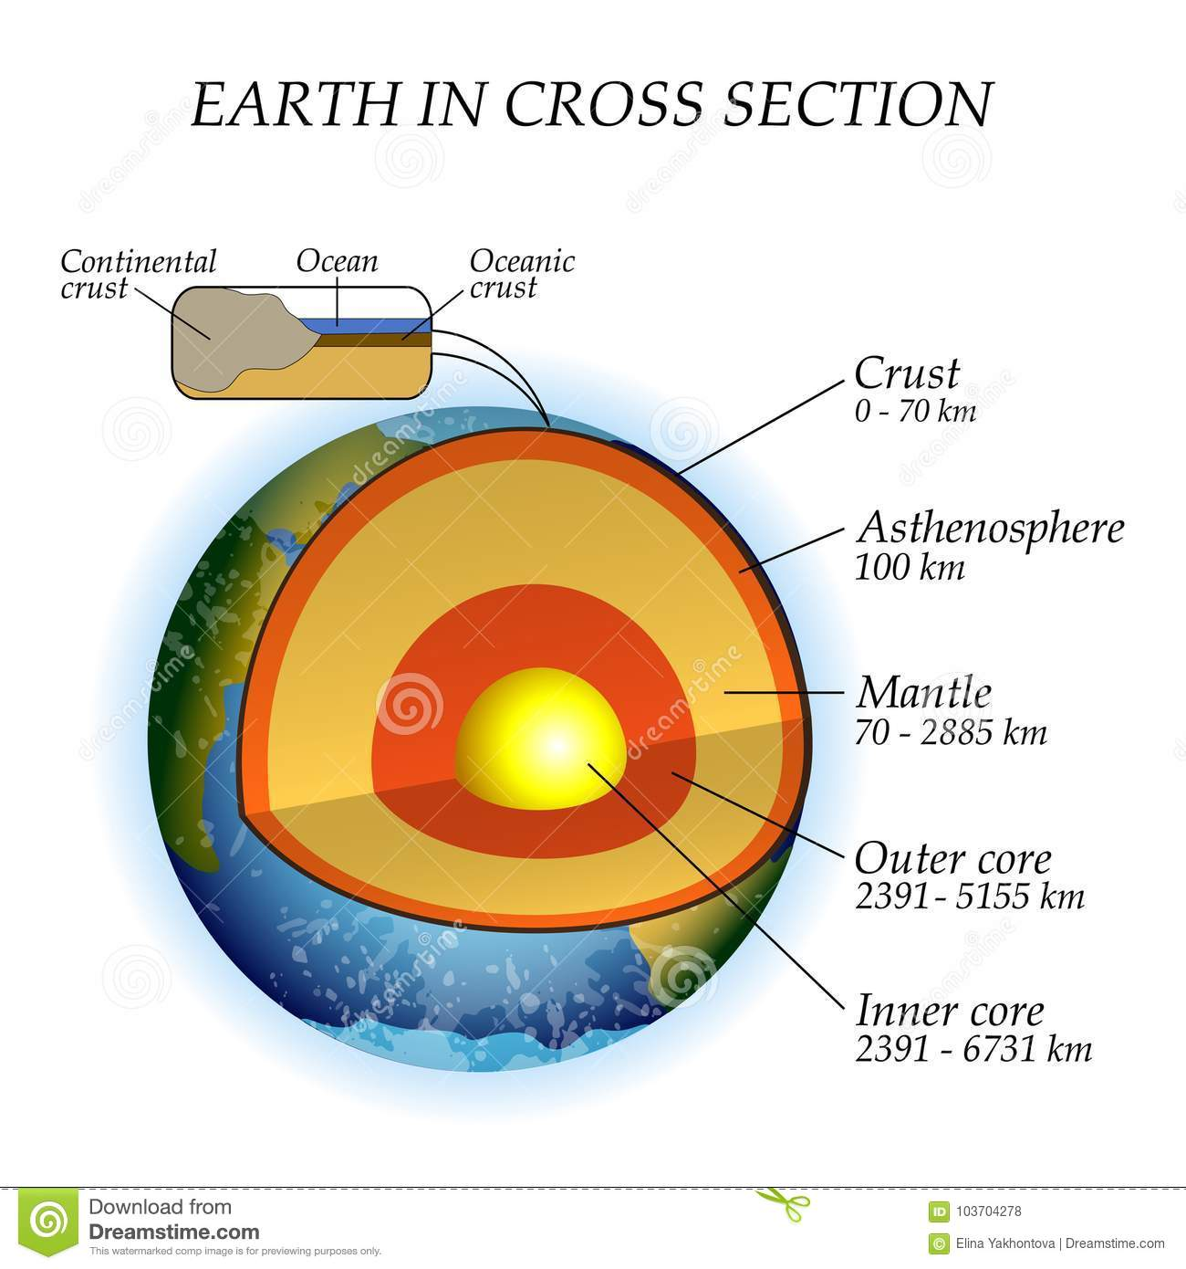
CREATION
The volcano is the open passage from the interior of the Earth, which allows the outflow or explosion of liquid rocks and gases from the interior (mantle) on the surface of the solid lava-like surface.

Slide 3
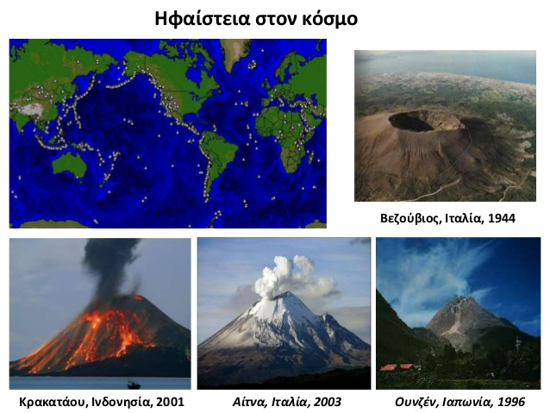
VOLCANOES IN THE WORLD

Slide 4
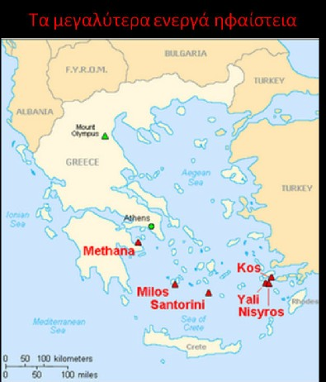
ACTIVE VOLCANOES IN GREECE

Slide 5
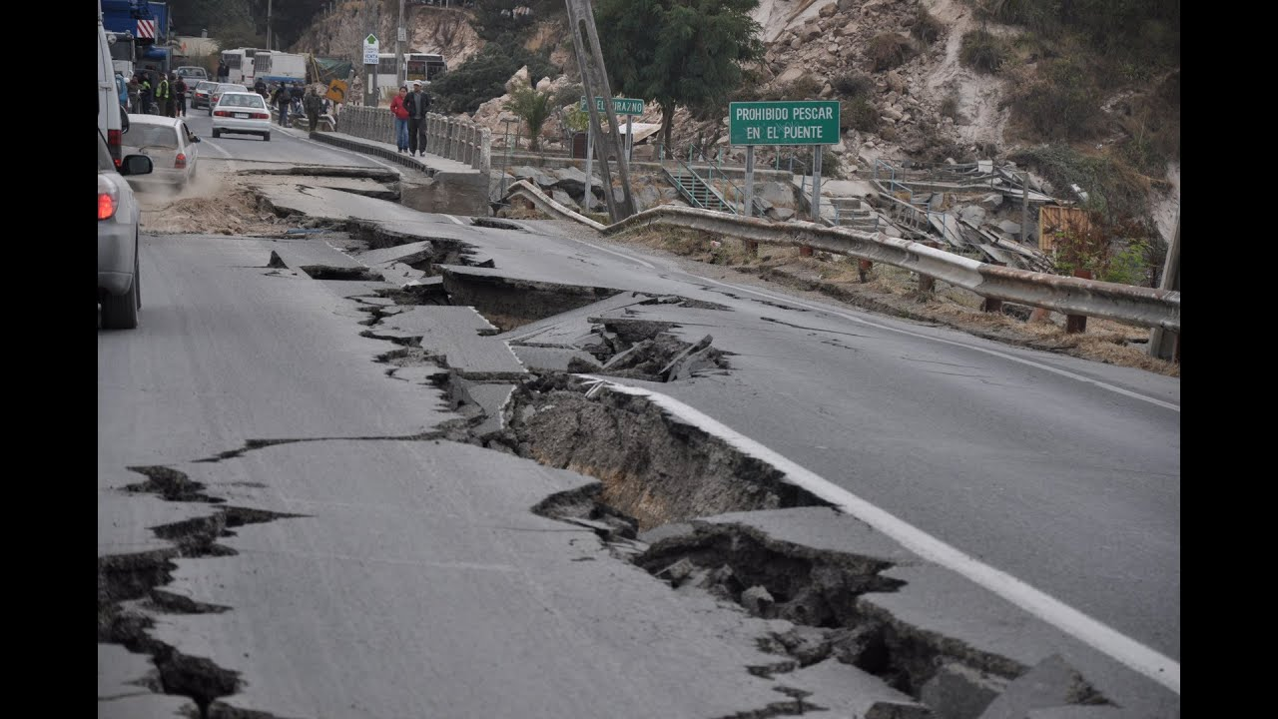
The impact of volcanoes on our lives
Volcanoes are known for their terrible eruptions, which often cause earthquakes. Indeed, volcanic eruptions are often a problem and can have tremendous impacts on both human lives and the economy and the environment.

