Slide 1
Volcanoes and Earthquakes
Manolis, Stratos & Eyripides
Primary school of Ippeios
For the etwinning project
Let’s Geopark!
2019-2020
Notes:
1

Slide 2
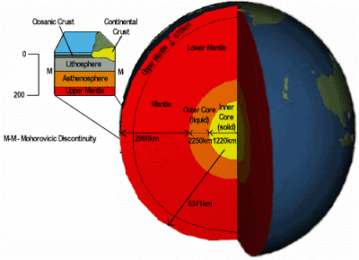
The inner structure of the earth resembles an onion consisting of successive layers.
Notes:
2

Slide 3
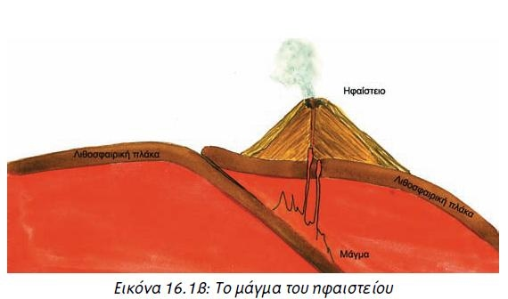
When two plates approach each other,
one sinks below each other and turns into magma
Notes:
3

Slide 4
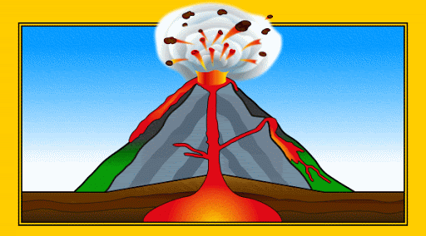
Magma through cracks created
ascends to the surface of the earth in the form of a lava.
Notes:
4

Slide 5
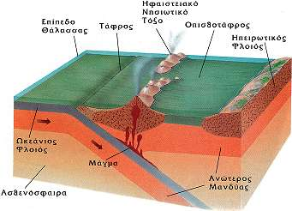
Floating with this movement causes collisions and large disturbances in the areas of the lithospheric plates, with the effect that the areas above these plates suffer earthquakes.
Notes:
5

Slide 6
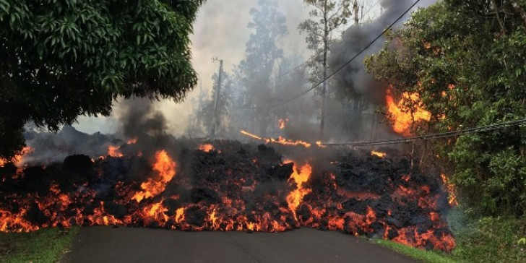
Earthquakes cause severe damage to buildings, roads, bridges and other structures of the people.
Notes:
6

