Slide 1
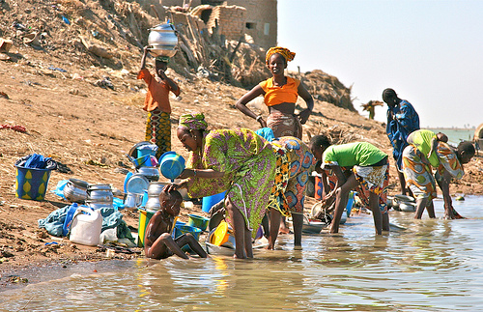
Help the people in Malawi
Made by:
Katie, Matt ,Anemarie ,Djessy

Slide 2
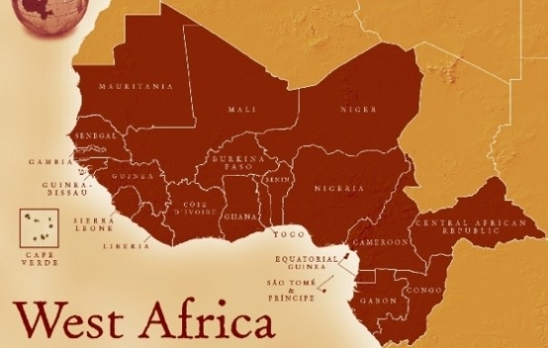
What was the target?
With a budget of £5,000 we tried to help a village in West Africa by providing them with clean, safe water, toilet and hygiene facilities.

Slide 3
Water supply
One of their main problems was the lack of clean water.
The school wanted a source of clean water near them to improve the working environment and to encourage more children to go to school.
Also the medics in the clinic needed a clean water supply which would enable them to sterilize all equipment which reduces risk of infection. To solve this we are going to put a locally made hand pump in between the two at the cost of £1000 this can be used by 150 people.
Also provide clean water, nearer to the homes of the villagers we are going to build a well that can be used by 150 people, at the cost of this is £1000 .

Slide 4
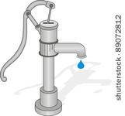
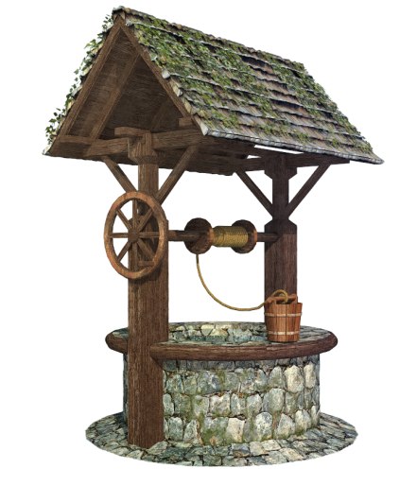
Maintaining the facilities
In case of any damage to the wells we are going to spend £500 to train one female engineer to fix pumps/wells.
We are also building a block of 6 composting latrines, but we are making 3 of these in different parts of the village. The cost of all 3 is £1050. We will put one next to the school and another near the clinic then the last will be closer to the homes of the villagers.

Slide 5
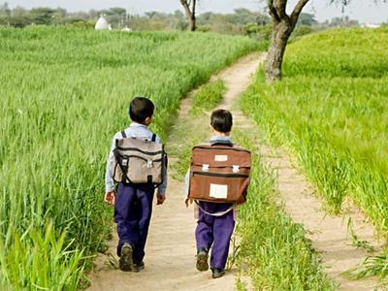
school
For the children's education we are paying £50 which pays for hygiene games which will teach 150 children.
We are also training a teacher to raise hygiene awareness to 150 children at the cost of £300.
There are only 150 children in the village so they will get enough education to teach their families as well.

Slide 6
Total costs
In total we spent £3900.

