Slide 1
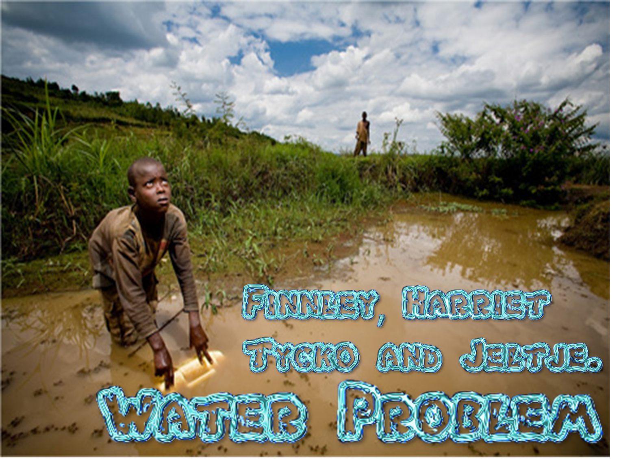
Water Problem

Slide 2
Malawi is a country in Africa suffering from a water crisis. We hope to help by supplying some things to the country.

Slide 3
It takes them 5 hours a day to get water.
More than 60% live in extreme poverty meaning they
can’t get water.
The water is contaminated meaning that they get ill or more ill every time they drink ( they die slowly).
The children should be in school but instead they have to spend the day getting water.

Slide 4
12.5% of children will die before their 5th Birthday.
More than 60% live in extreme poverty meaning they can’t get water.

Slide 5
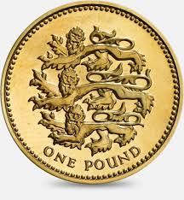
Japanese Pump X2 £1500
We would need this so they can have clean water.
Hygiene educator. £500
We would need this so people can keep clean.
Tell the community our plan so they can give feedback. £1000
We would need this so the community can be involved and understand.
Train the Teacher. £300
We would need this because it is useful for people to know how to be hygienic. It could save their life.
Compost latrines. £350
We need this because obviously they need clean toilets and it will help the plants be clean and safe to eat.
Mechanic . £500
We need this because if we don’t get it, the pumps will break and we’ll end up spending more.

Slide 6
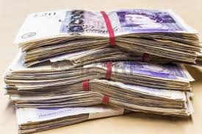
We have £850 left over but we’ve decided not to spend it so we can use it in another village in need as this one has everything we can supply now.

Slide 7
From this we hope the outcome will be:
People will be cleaner and it will be nicer to live there.
The water will not be dirty so people will not get ill or die from water related illnesses.
The food they eat will be cleaner and more healthy as they will not be made/ cleaned with dirty water.
Children can attend school because they won’t need to spend so much time collecting water.
Hopefully the statistics of death rate will decrease

