Slide 1
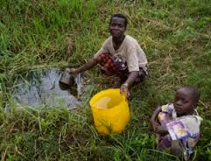
The water crisis in Malawi!

Slide 2
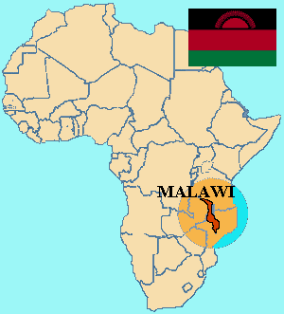
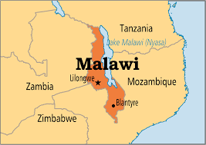
Were is Malawi?
Malawi is in the south, east of Africa next to Zambia and Mozambique

Slide 3
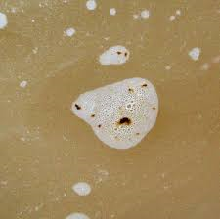
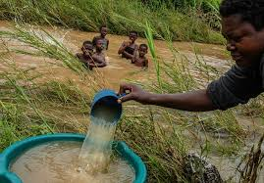
The water crisis
The water crisis in Malawi is serious and people are drinking filthy water and being really unhygienic and filthy as they don’t wash their hands and they fix drinking bottles with sand and other materials from the floor to help them carry water.

Slide 4
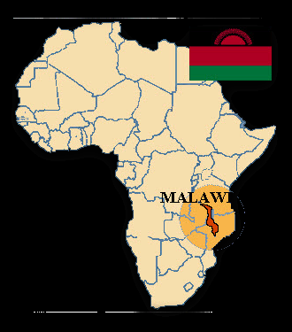
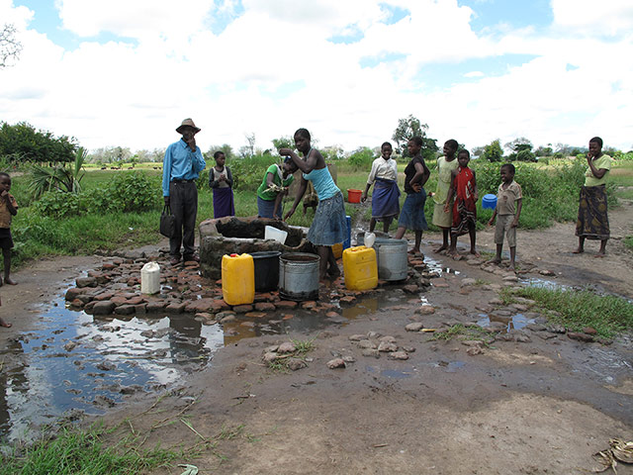
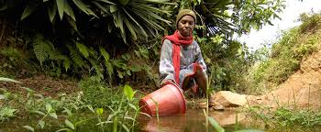
Helping the Water Crisis In Malawi!

Slide 5
Village information
The village has a population of 300 people, with no access to any clean water or toilet facilities. They have a lack of hygiene knowledge because the nearest source of water is six kilometres away, therefore they spend up to five hours a day collecting water instead of school. As the village water is dirty, it causes them to be to sick to be able to work. The village is a dry area and has little rain however there is ground water.
150 children
75 women
75 men

Slide 6
What we can do to help!
Budget of £5,000
Education of hygiene
£50 = games that will teach 150 children
£150 = puppet show to demonstrate to 250 people about hygiene
total = £200
Facilities
£2000 = for two hand-pumps, used by 300 people
£50 = a composting latrine for two families of five, will also provide free fertilizer to increase crop output.
£500 = rehabilitate existing wells, using near by parts, will be used by 100 people therefore, they have more than enough portable water encase of population increasing.
£1050 = will build 18 block of composting latrines to be used by 300 people.
Total = £3600
Workers
£500 = for one female engineer to maintain pumps/wells.
£500 = to train and pay salary of hygiene educator for a year, who can teach 300 people
Total = £1000
£200 left over, which can be used to help pay for any repairs maybe needed over the years.

