Slide 1
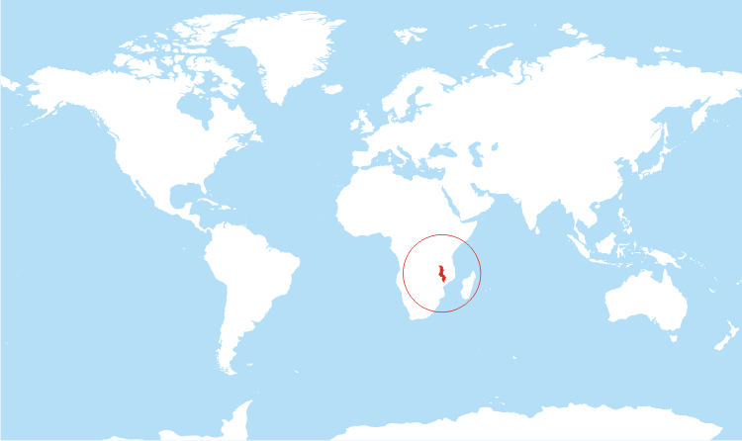
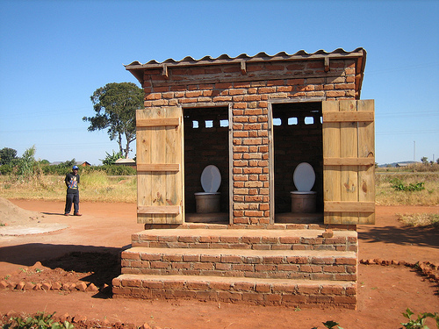
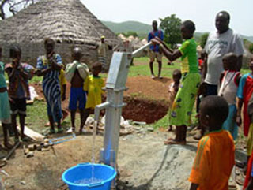
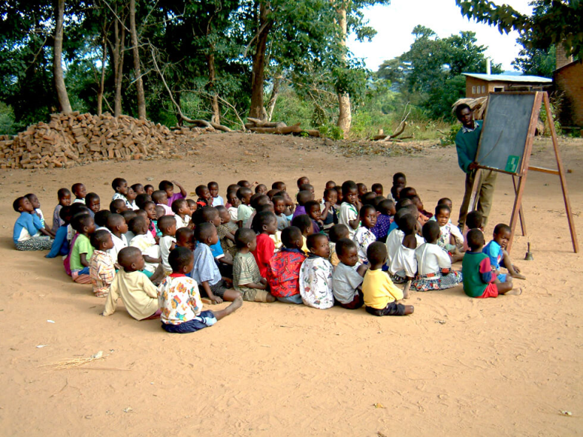
Malawi water and hygiene

Slide 2
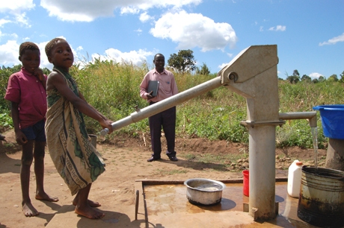
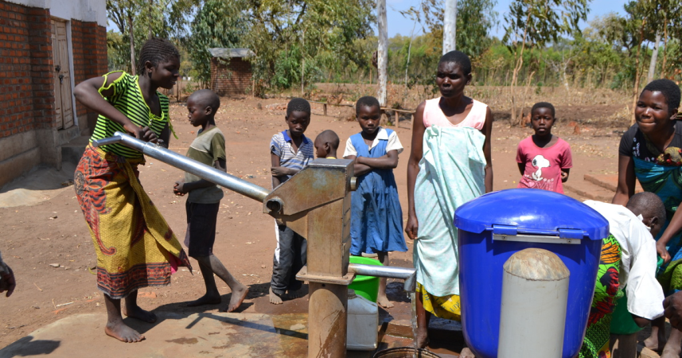
Malawi water
We are going to spend £500 to
train and pay one female engineer
to maintain pumps and wells.
We are also going to spend
£2000 for locally made hand
pumps for 300 people.

Slide 3
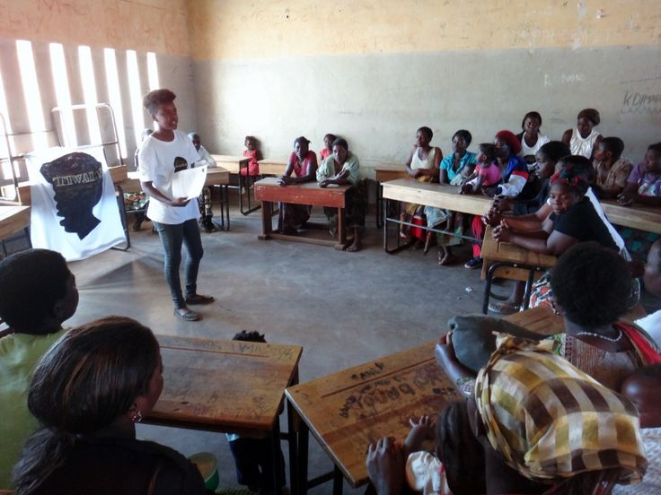
Malawi Hygiene
We are going to spend £50 for hygiene games that will reach 150 children.
We will also spend £1000 for 2
years of training and paying
the salary of hygiene educator
that will reach 300 people.

Slide 4
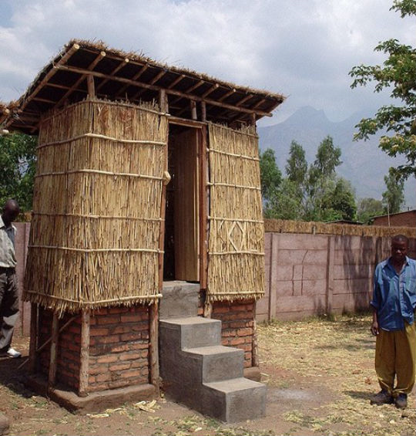
Malawi Toilets
We are spending £1050 to build
a block of eighteen composting
latrines used by 300 people.

Slide 5
Money spent
We have spent: £4600
£50 on Hygiene games for 150 children.
£1050 on Toilets for 300 people.
£1000 on 2 years of hygiene education for 300 people.
£500 on an engineer to maintain pumps.
£2000 on water pumps for 300 people.

Slide 6
Why we spent the money
They must learn about hygiene before they get sick.
We give them water pumps so everyone will have access to clean water.
People can go to school if they don’t have to walk very far so having close water pumps will help.
Also for hygiene, give everybody access to close toilets so they won’t have to be scared about going in a bush.

