Slide 1
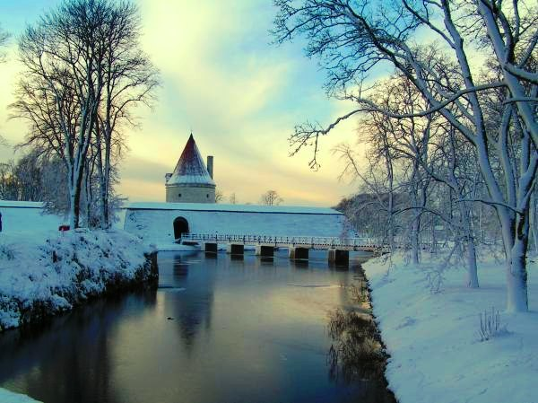
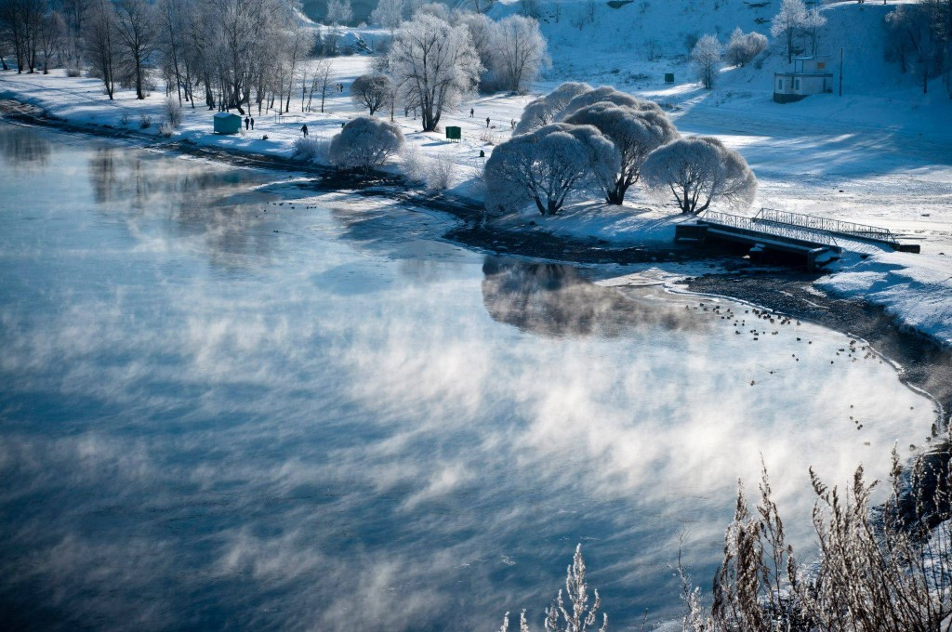
WINTER

Slide 2
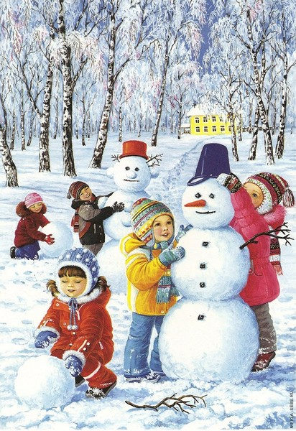
In winter, the weather will go cold
it's snowing
IN warmer weather you can build a snowman

Slide 3
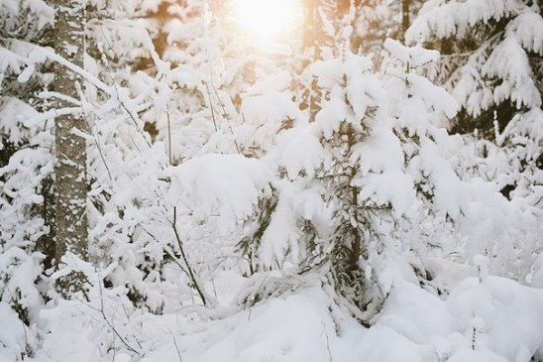
In winter, the plants are not growing. Snow protects them from the cold.

Slide 4
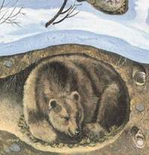
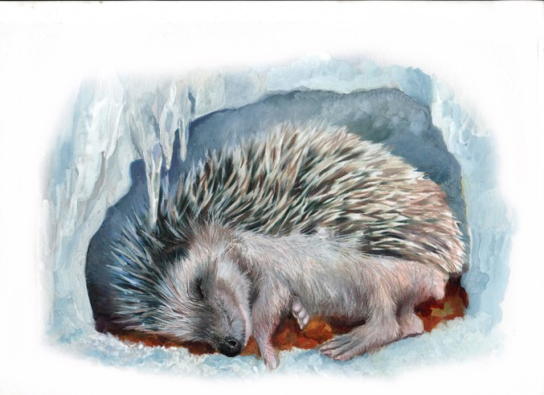
A bear and a hedgehog are sleeping during the winter time

Slide 5
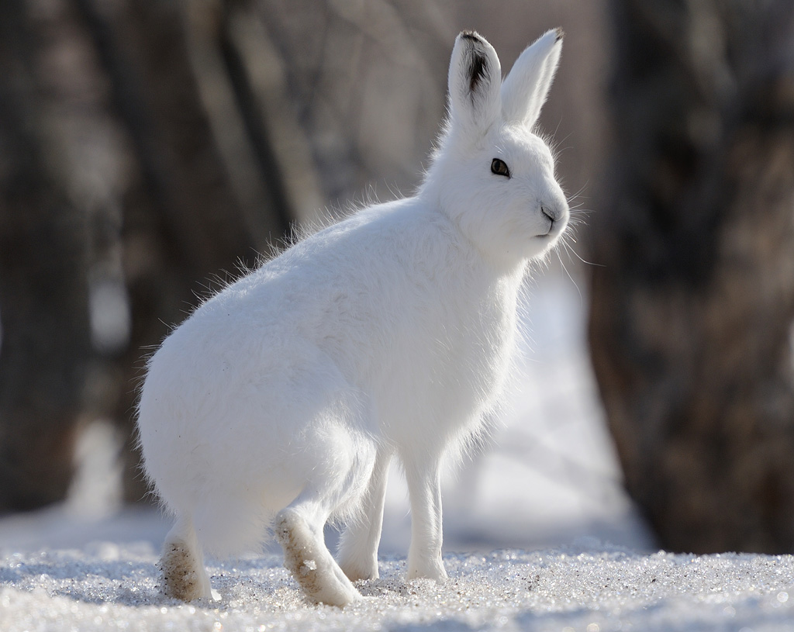
The hares are lighter and warmer in winter fur coat.

Slide 6
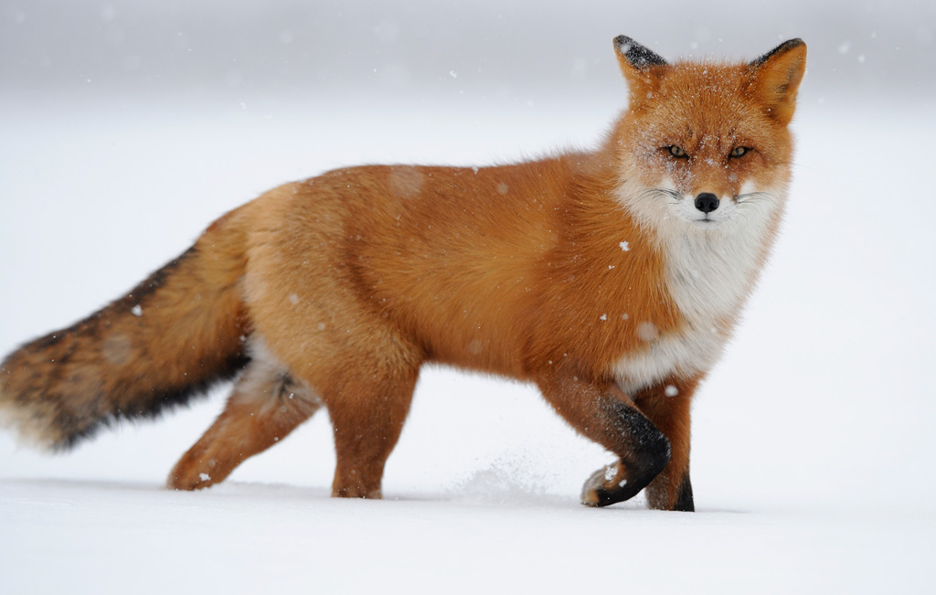
Fox is lighter and warmer than a fur coat

Slide 7
Thank you for attention

