Slide 1
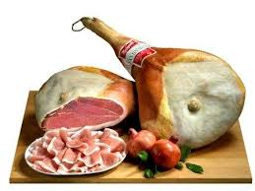
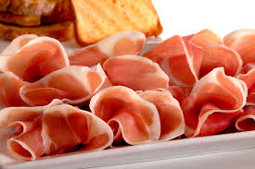
San Daniele Raw Ham

Slide 2
AREA OF PRODUCTION
San Daniele, in Friuli Venezia Giulia
CURING
After processing, there is the pressing phase lasting from 24 to 48 hours. Then the ham is left to rest for four months, after which there is a refinement of at least 13 months.
PARTICULAR SIGNS
The trotter is left in the ham, giving it a singular form "a guitar", also due to the exclusive pressing. The Consortium brand are the stylized letters "SD"

Slide 3
ORGANOLEPTIC PROPERTIES
It is reddish with some thin streak of white fat. The aroma is intense and characteristic, but varies according to the maturation period. The taste is sweetly fruity, enveloping but delicate.
PAIRINGS
With some bread it is ideal for a snack. Excellent with melon and fruit pulp, figs, pears, grapes or pineapple

