Slide 1
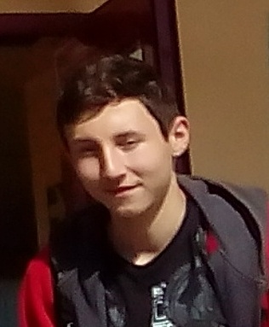
Hy, my name is Alex and I'm from Romania. I'm 15 years old and I live in Scilla in province of Reggio. I attend the Hotel and Catering vocational school, I'm in the second class.I like this school and I'm having a lot of fun in my class. I love sports but in particular the "Parkour", I spend my time with my best friend Nicola. I like cooking and also eating. :) I love drawing and painting.
Nice to meet you all
I hope to meet you all

