Slide 1
A. S. 2017 / 2018
A Melting Pot of
Food, Culture and Health

Slide 2
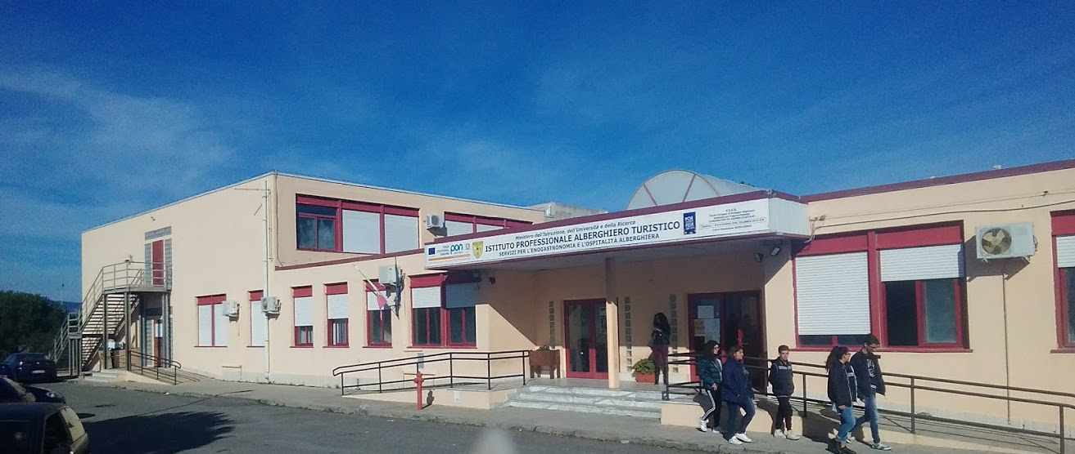
Our school is called IPALTUR
Istituto Professionale Alberghiero Turistico
It is a Hotel, Catering and Tourism Vocational School.

Slide 3
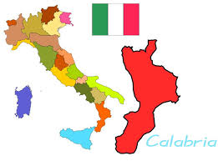
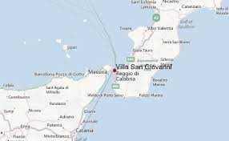
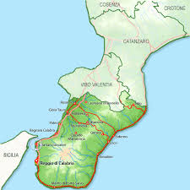
It is based in
Villa San Giovanni,
a little town in province
of Reggio Calabria
(Calabria – Southern Italy)

Slide 4
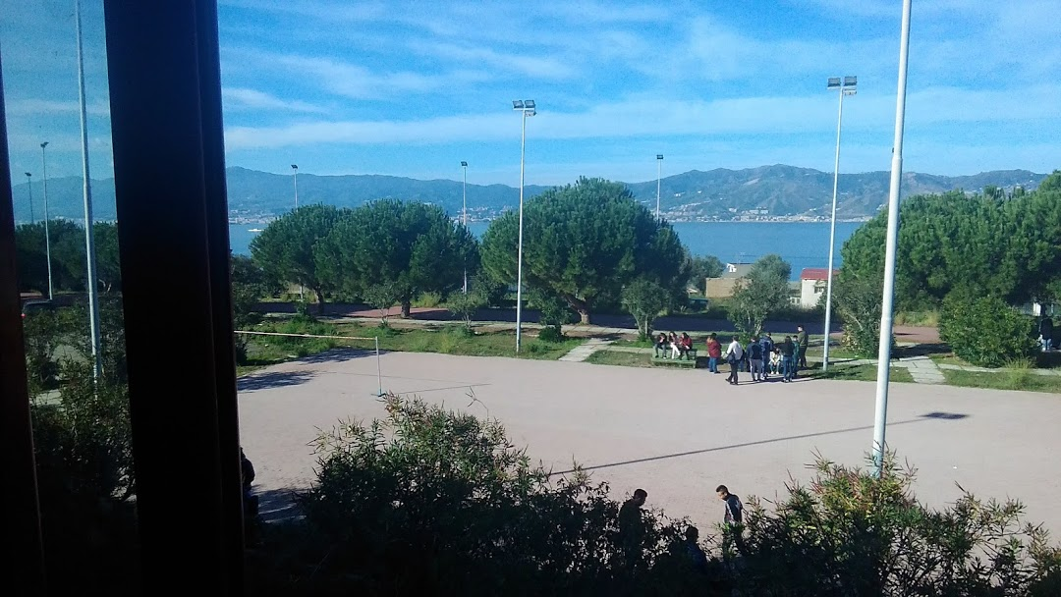
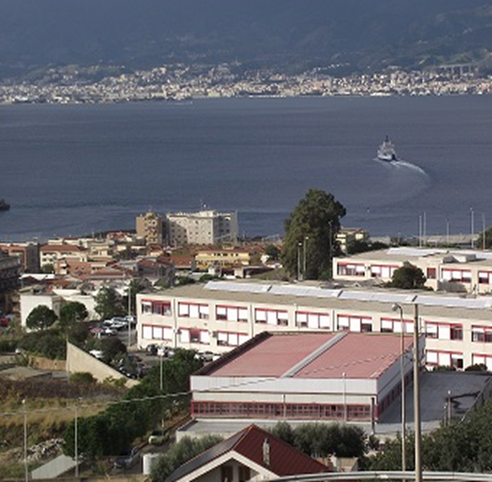
The School building
overlooks
the Straight of Messina
in front of Sicily,
in the Mediterranean Sea
From our windows
we can enjoy
a wonderful view

Slide 5
We start our lessons in the
middle of September
and finish around the
middle of June
SCHOOL TIME AND TIMETABLE

Slide 6
8:00 to 13:30 pm two days a week
We go to school from Monday to
Saturday
8:00 to 12:30 pm four days a week

Slide 7
We’re on holiday
two weeks at Christmas
one week at Easter
on 1st and 2nd November, 8th December
25th April, 2nd May, 2nd June
some days given by the local
authorities : the Saint Patron’s day and
the “ponte” days (giorni ponte), when
an only school day follows a festive one

Slide 8
Lots of students travel by bus or by car to get to school and have a long journey
They have to get up quite early in the morning and get back home quite late in the afternoon as this kind of school is the closest one in the area

Slide 9
The whole academic path lasts five years:
two + three
The first two years (“biennio”)
are common to all students and aim at orienting our future choice, so that we can realize what we like best or we are stronger on

Slide 10
THE COMMON “BIENNIO”
SUBKECTSS | 1st Class | 2nd Class
ITALIAN | 4 | 4
ENGLISH | 3 | 3
HISTORY | 2 | 2
GEOGRAPHY | 1 | -
MATHS | 4 | 4
LAW AND ECONOMY | 2 | 2
SCIENCE | 2 | 2
PHYSICAL EDUCATION | 2 | 2
RELIGION OR ALTERNATIVE ACTIVITIES | 1 | 1
FISICS | 2 | -
CHEMISTRY | - | 2
FOOD | 2 | 2
WINE-WND-GASTRONOMY LABORATORY (COOKING) | 2 | 2
WINE-WND-GASTRONOMY LABORATORY (DINING SERVICES) | 2 | 2
HOTEL MANAGEMENT | 2 | 2
SECOND FOREIGN LANGUAGE (IT DEPENDS ON THE SECTION) | 2 | 2
TOTAL HOURS | 33 | 32
SUBJECTS

Slide 11
The next three years
we have to choose
one of the following professional courses:

Slide 12
Wine-Gastronomy option
“Cooking”
Wine-Gastronomy option
“Pastry”
Wine-Gastronomy option
“Dining and Bar services”
Hotel Management

Slide 13
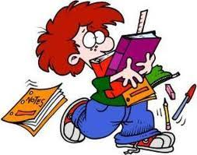
The common subjects we study are:
HISTORY
MATHS
FOOD
ITALIAN
ENGLISH
PHYSICAL
EDUCATION
RELIGION
BUSINESS
ADMINISTRATION
FRENCH or SPANISH

Slide 14
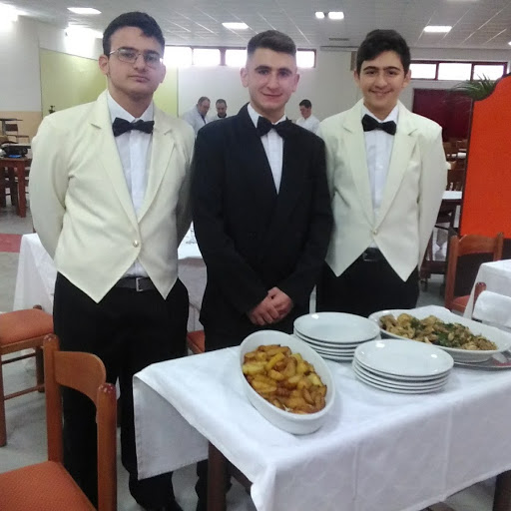
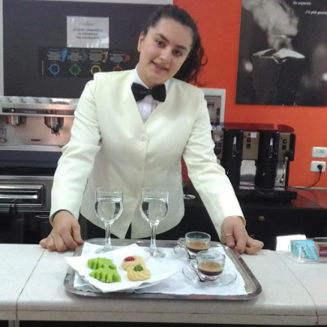
ONCE A WEEK WE DO PRACTICAL ACTIVITIES IN OUR SCHOOL LABS

Slide 15
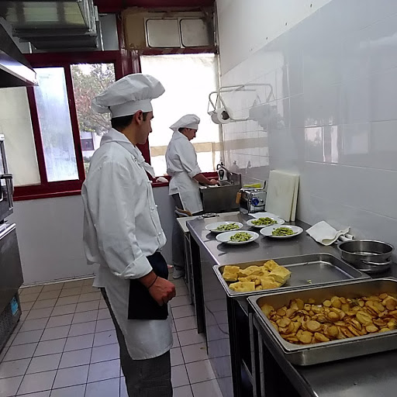
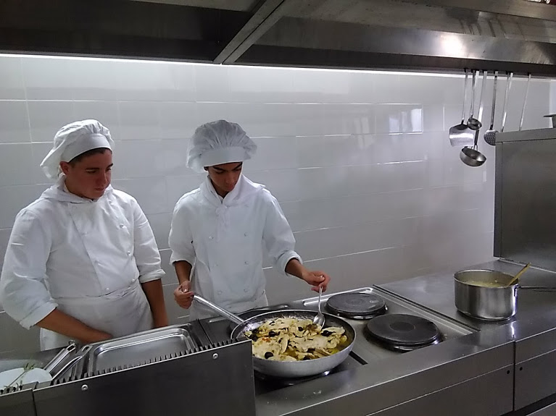
Our activities in the kitchen

Slide 16
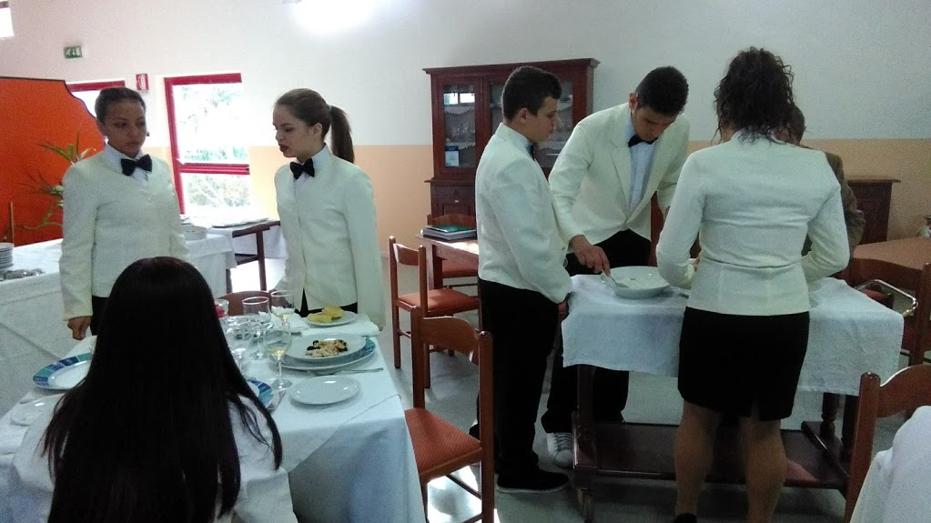
Our activities in the dining - room

Slide 17
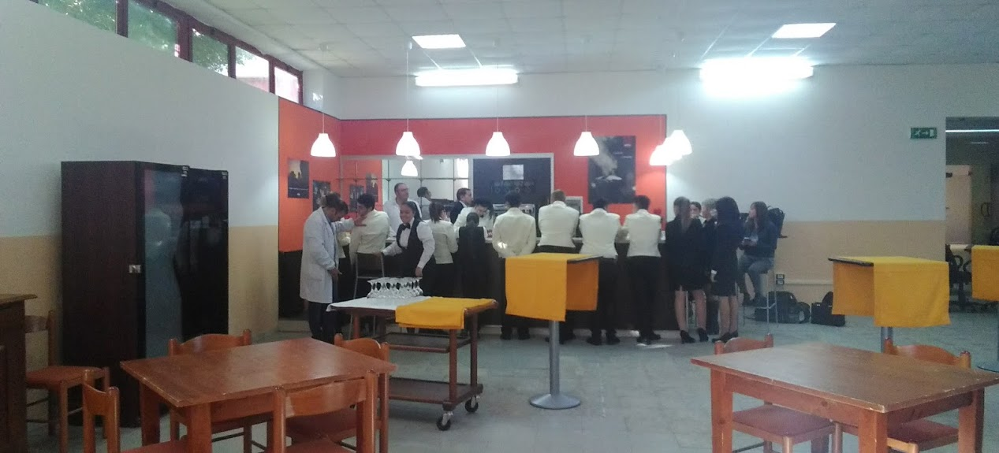
Our activities at the bar

Slide 18
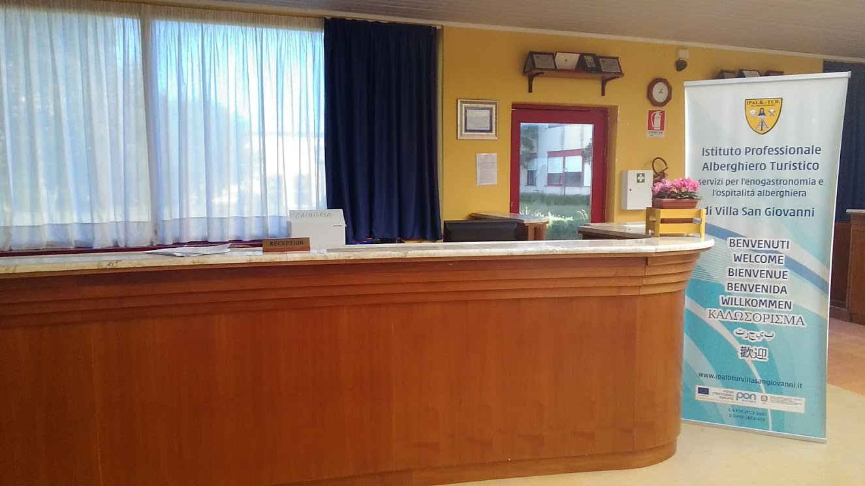
This is our Reception area

Slide 19
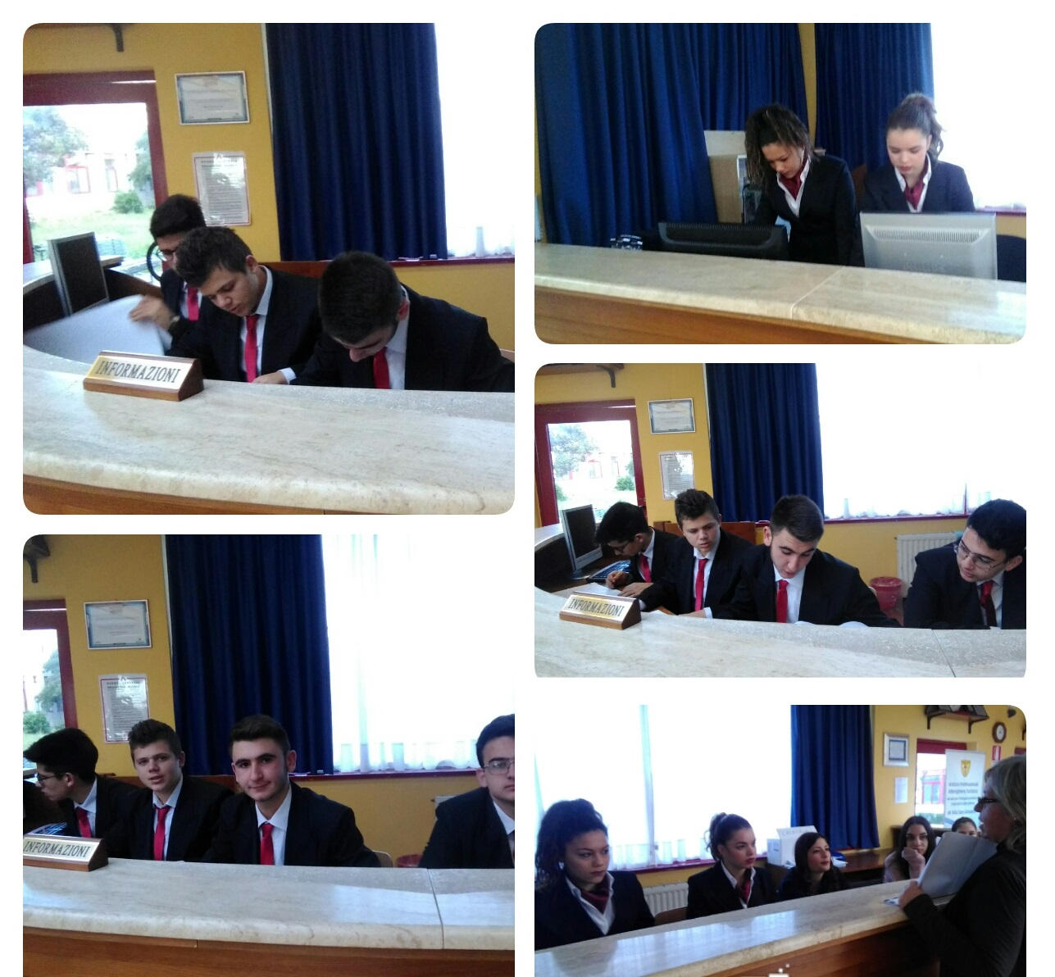
Our Hotel Management activities

Slide 20
THE SCHOOL-JOB ALTERNIATION
IS COMPULSORY
TO BE ADMITTED TO THE FINAL STAGE EXAM.
.
We usually do it at restaurants or bars, during the school year

Slide 21
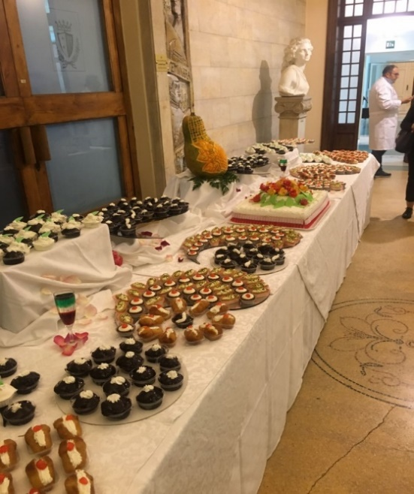
We often participate to outside events

Slide 22
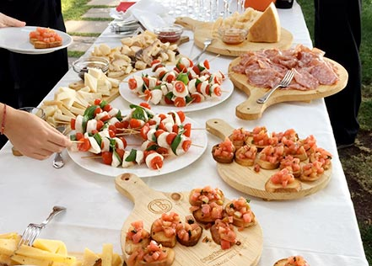
and arrange functions
at school on particular occasions

Slide 23
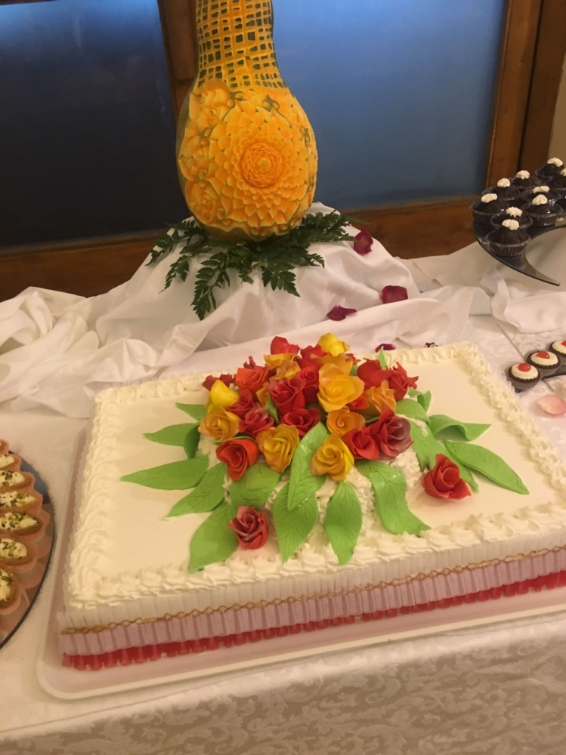

Slide 24
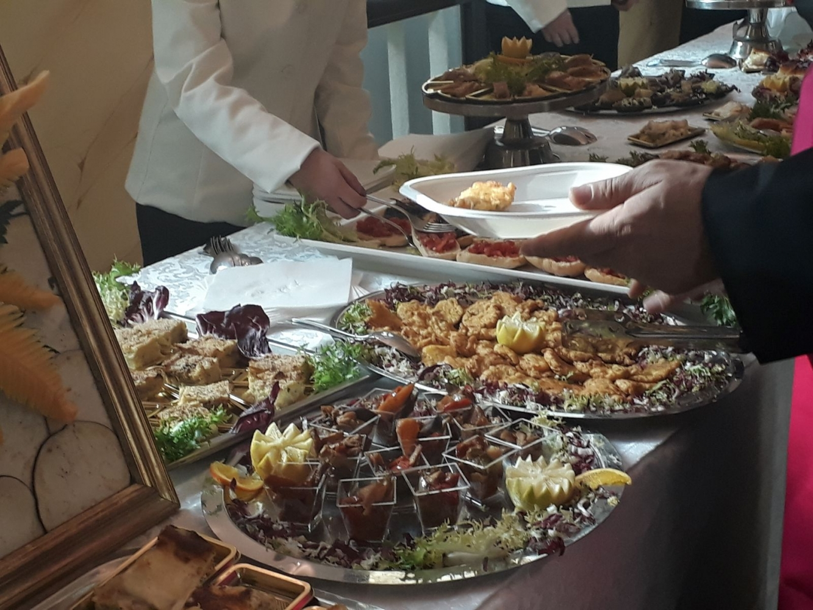

Slide 25
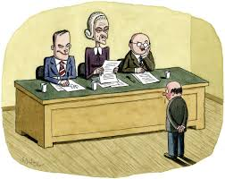
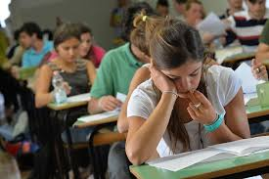
At the end of the five years we have to be admitted to the final
State Exam
We need to get as minimum mark 6/10 in every subjects + school-job alternation

Slide 26
The State Exam consists of
◊ oral test
relating to the fifth
year subjects
◊ written tests
(Three)

Slide 27
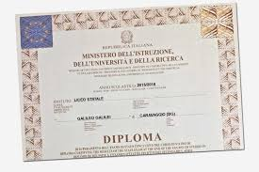
To get the DIPLOMA
(The English A-levels)
the minimum mark is 60/ 100 with
or without honours

Slide 28
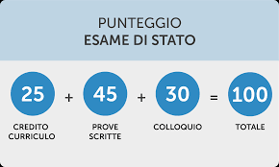
DETAILED State Exam mark

Slide 29
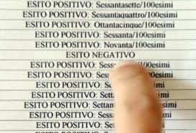
The State Exam approximately starts on 20th of June and ends by 15th of July

Slide 30
After graduating from our Secondary School
we can decide to go to University or to work

Slide 31
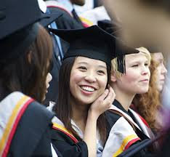
You can choose any University Faculty but lots of them have limited enrolment based on admissiond tests

Slide 32
Luckily, in spite of the current unemployment,
our school offers good

Slide 33
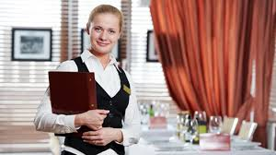
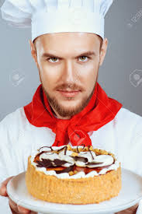
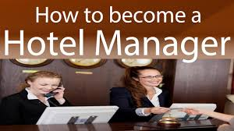
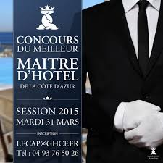

Slide 34
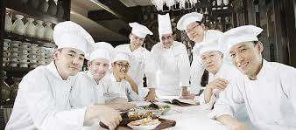
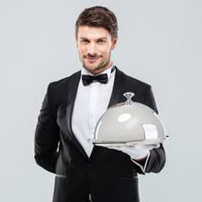
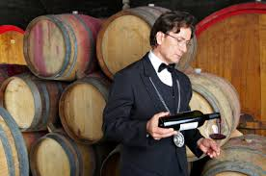
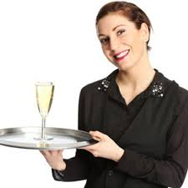

Slide 35
Thank you
very much
for your interest
in
our School!

