Slide 1
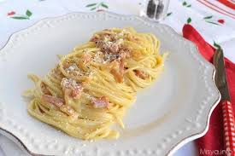
Carbonara Spaghetti

Slide 2
Ingredients
60g of bacon
60g of pecorino cheese
60g of parmesan
3 large eggs
320g of spaghetti
2 garlic cloves
50g of unsalted butter or 5 spoons of olive oil
Maldon salt and freshly grated black pepper

Slide 3
Method
Put a large saucepan of water on to boil. Chop the bacon finely, having first removed any rind. Beat the eggs in a medium bowl and season with a little freshly grated black pepper. Set everything aside.
Add 1 tsp salt to the boiling water, add spaghetti and when the water comes back to the boil, cook at a constant simmer, covered, for 10 minutes.

Slide 4
While spaghetti is cooking, brown the bacon with the garlic in oil or butter into a large frying pan or wok. Leave to cook on a medium heat for about 5 minutes, often stirring, until the bacon is golden and crispy and remove the garlic.

Slide 5
When spaghetti is ready, drain and put it in the frying pan with the bacon.
Mix most of the cheese in with the eggs, keeping a small handful back for sprinkling over later.
Take the pan of spaghetti and bacon off the heat. Now quickly pour in eggs and cheese. Using the tongs or a long fork, lift up the spaghetti so it mixes easily with the egg mixture, which thickens but doesn’t scramble, and everything is coated.
Add extra pasta cooking water to keep it saucy. You don’t want it wet, just moist. Season with a little salt, if needed.
Use a long-pronged fork to twist the pasta on to the serving plate or bowl. Serve immediately sprinkling with the remaining cheese and black pepper.

Slide 6
