Slide 1
The Calabrians love their land, but above all their flavors, such as Peperoncino. The chilli is a vegetable present in almost all the recipes of Calabria, and any Calabrese loves chilli.
Peperoncino Calabrese

Slide 2
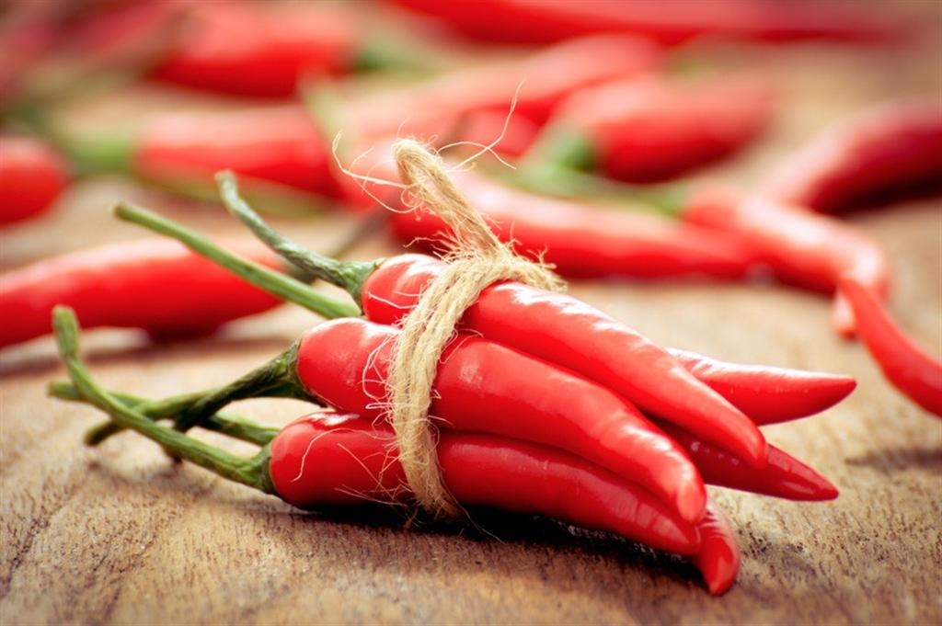
Gastronomy
They can be eaten raw, in oil, dried or processed for creams and spicy salami, such as'nduja, Calabrian sausage, Calabrian soppressata, Calabrian spianata, capicollo…

Slide 3
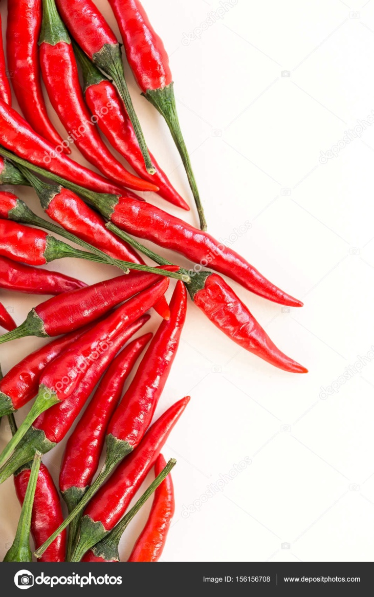
Health benefits of chilli pepper
Chilli pepper contains an impressive list of plant derived chemical compounds that are known to have disease preventing and health promoting properties.
Chillies contain health benefiting an alkaloid compound, capsaicin, which gives them strong spicy, pungent character. Early laboratory studies on experimental mammals suggest that capsaicin has anti-bacterial, anti-carcinogenic, analgesic and anti-diabetic properties. It also found to reduce LDL cholesterol levels in obese.
Fresh chilli peppers, red and green, are a rich source of vitamin-C. 100 g fresh chilies provide about 143.7 µg or about 240% of RDA. Vitamin-C is a potent water-soluble antioxidant. It is essential for the collagen synthesis inside the human body. Collagen is one of the main structural protein required for maintaining the integrity of blood vessels, skin, organs, and bones. Regular consumption of foods rich in vitamin-C helps protect from scurvy, develop resistance against infectious agents (boosts immunity), and scavenge harmful, pro-inflammatory free radicals from the body.
They are also good in other antioxidants such as vitamin-A, and flavonoids like β-carotene, α-carotene, lutein, zeaxanthin, and cryptoxanthin. These antioxidant substances in capsicum help protect the body from injurious effects of free radicals generated during stress, diseases conditions.
Chillies carry a good amount of minerals like potassium, manganese, iron, and magnesium. Potassium is an important component of cell and body fluids that helps controlling heart rate and blood pressure. The human body use manganese as a co-factor for the antioxidant enzyme, superoxide dismutase.
Chillies are also good in the B-complex group of vitamins such as niacin, pyridoxine (vitamin B-6), riboflavin and thiamin (vitamin B-1). These vitamins are essential in the sense that human body requires them from external sources to replenish.

