Slide 1
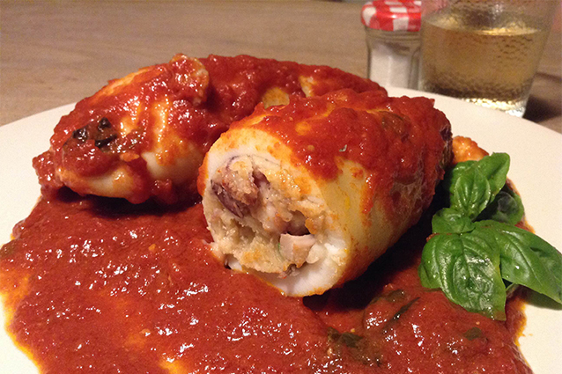
stuffed squids
For 2 people
-squids: 2 large or 4 small
-olive oil
-white onion: half
-white wine: half a glass
-parsley
-breadcrumbs or stale bread
-egg: 1
-salt
-pepper
-tomato sauce: 500 ml
-garlic: 1 clove
-olive oil

Slide 2
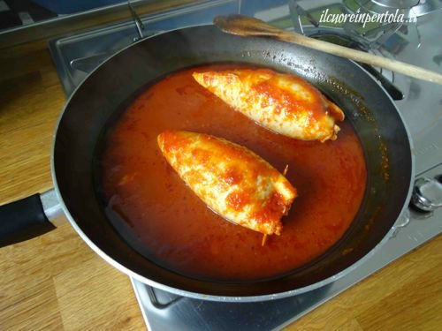
how to prepare them
First clean the squid by removing pen, skin, eyes and beak. Remove the wings and the tentacles. Empty the bags, wash them and keep aside.
Cut the tentacles and wings into small pieces.
Take a pan, add a couple of tablespoon of olive oil and add some chopped onion. As soon as the onion is wilted add the tentacles into small pieces, blend with the white wine and, as soon as the alcohol has evaporated, add salt, add a ladle of hot water, cover with the lid and cook for about ten minutes until when they are cooked.

Slide 3
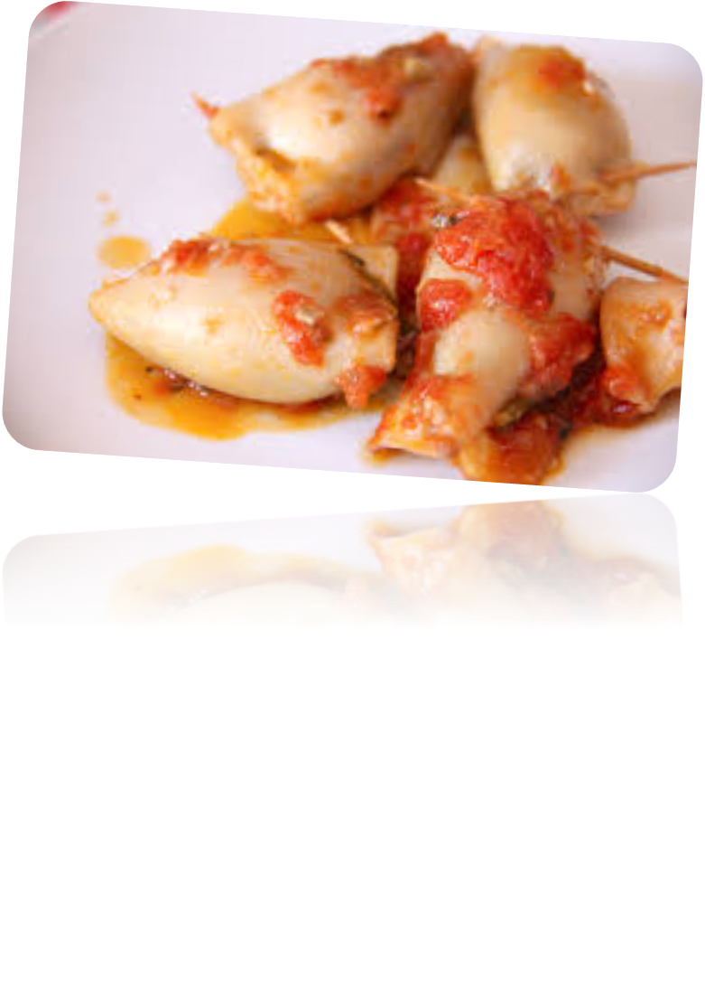
At this point, add some black pepper and chopped parsley.
Grind the stale bread (or use the bread crumbs) and add it to the tentacles. Stir and pour into a bowl. Add an egg and stir.
With the help of a teaspoon, stuff the sacks of the squid with the filling by pushing it all the way down. A centimeter from the end, stop and close the squid with a toothpick.
Now you have to cook the squids with the sauce. Take a saucepan, a couple of tablespoons of olive oil, a clove of garlic, a piece of pepper and, as soon as the garlic begins to fry, add the tomato sauce. Add salt and, once the sauce has boiled, add the stuffed squid. Lower the heat, cover with a lid and cook for about twenty minutes turning the squids from time to time.
Add the chopped parsley and serve your stuffed calamari with the sauce.

