Slide 1
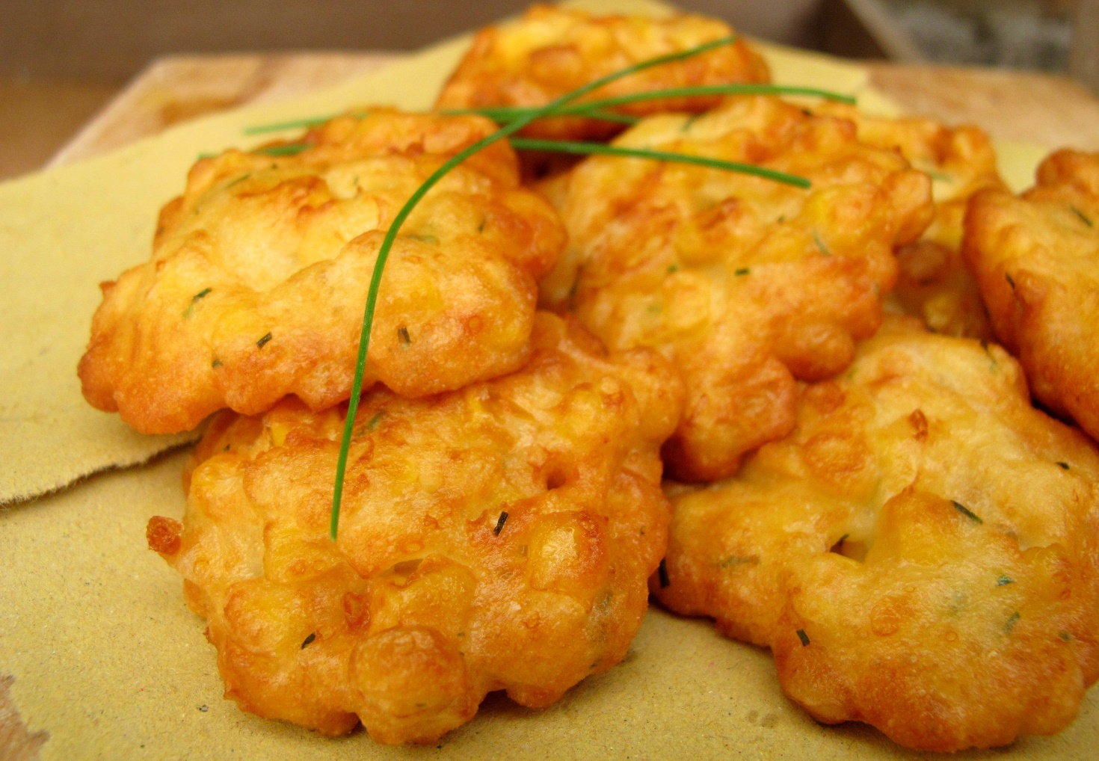
frittelle di sciurilli
- 300 g of courgettes flowers
- 500 g of 00 flour
- 400 ml of water
- 1 egg
- 20 g of brewer's yeast
- 20 grams of Parmesan cheese
-1 tablespoon of salt
-1 pinch of pepper
- seed oil

Slide 2
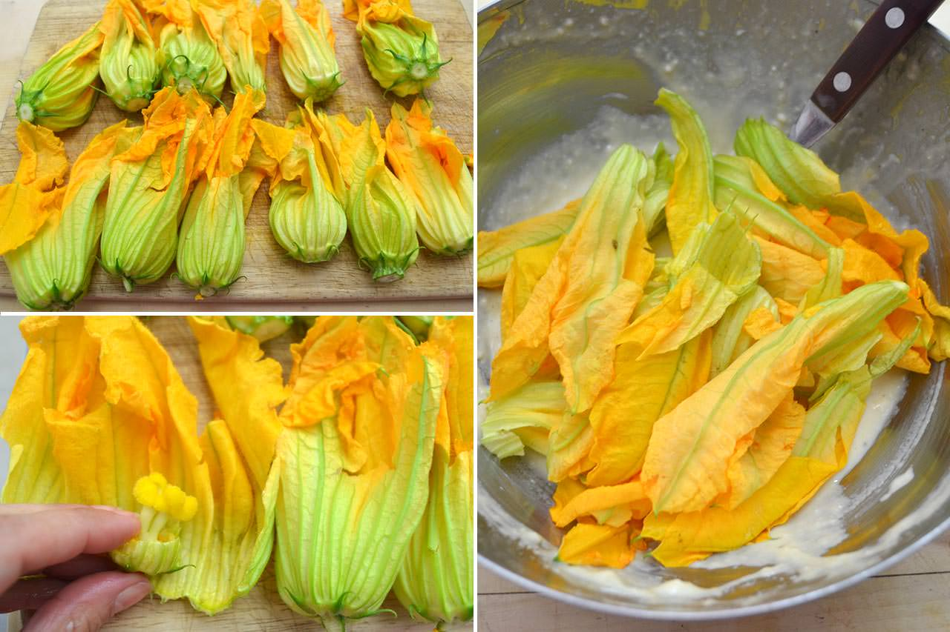
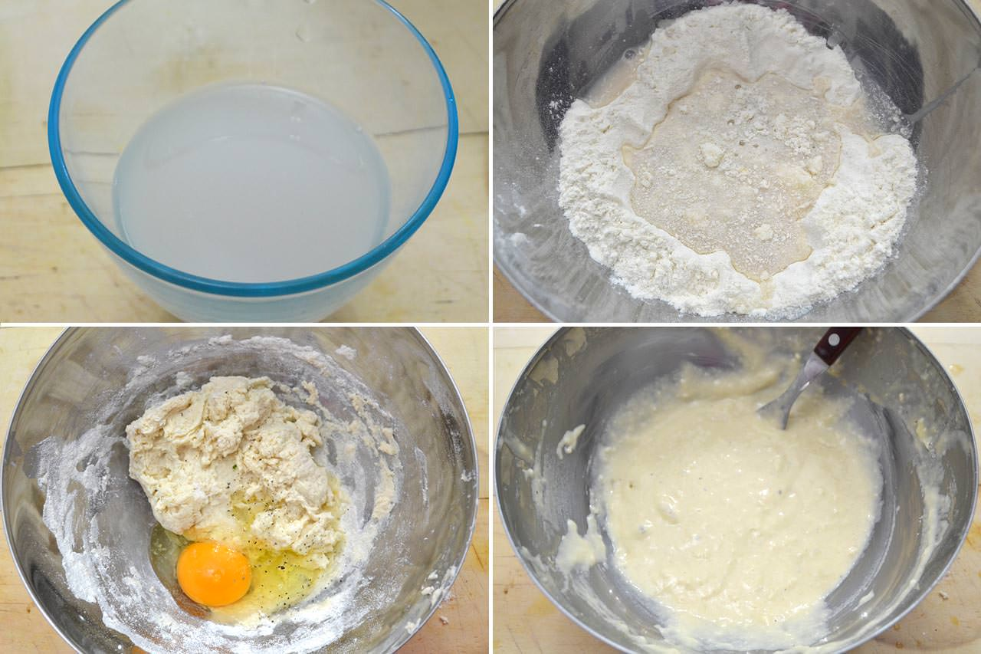
How to prepare them
Dispose the flour to fountain in a bowl, start kneading, adding to it the dissolved yeast in warm water.
Add an egg, salt and pepper until the batter is smooth and soft.
Clean the zucchini flowers by removing the green and hard base, then rinse, dry and add them to the batter together with the Parmesan cheese.

Slide 3
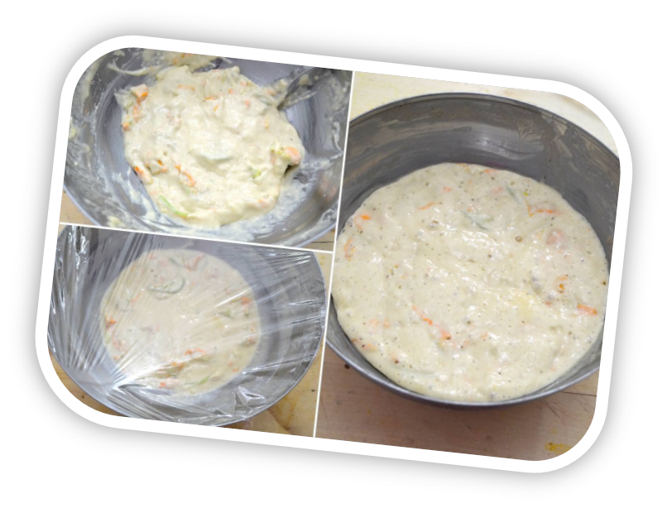
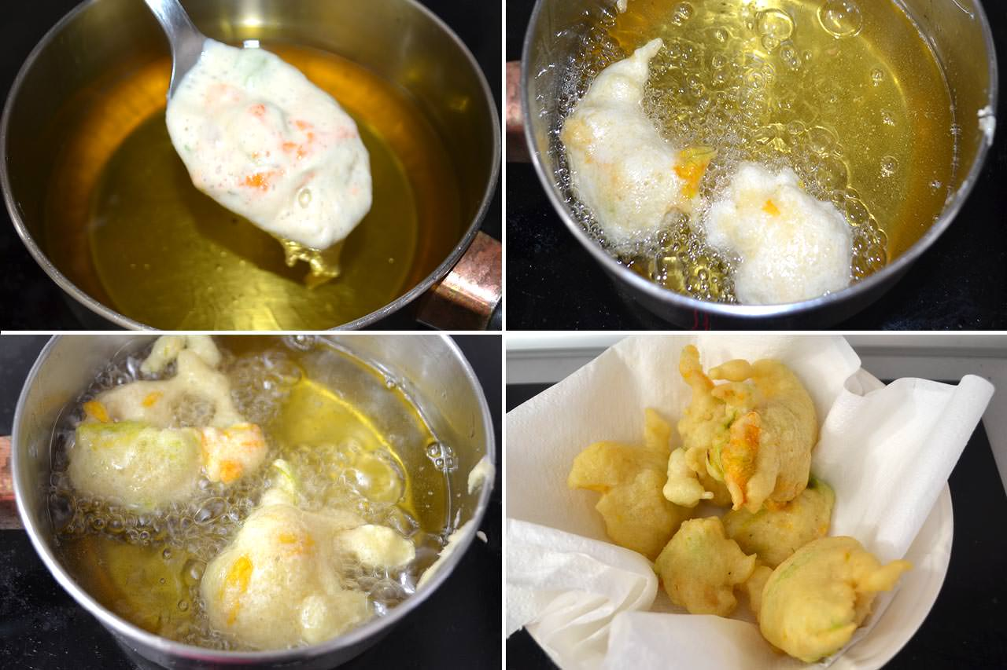
Once the dough has doubled in volume, proceed with frying.
Heat some oil in a pan and fry the sciurilli letting the mixture fall into spoonfuls in boiling oil.
Cook on both sides for a couple of minutes, then lift and let them dry on paper towels.
Serve hot and crunchy.
knead to mix everything well. Cover the bowl with transparent paper and let it rise for about 2 hours.

