Slide 1
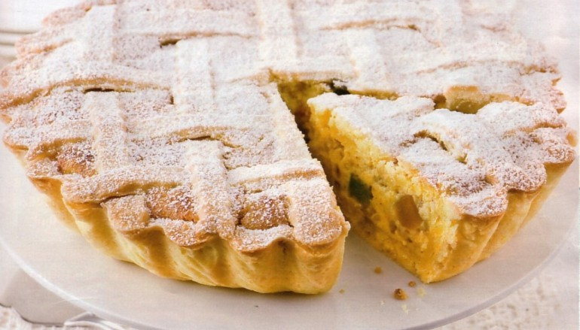
Pastiera
an Easter cake
Ingredients:
For the dough
300 gr of flour
3 eggs
3 tablespoons of sugar
a knob of butter
grated rind of a lemon
For the filling
500 gr of precooked wheat
12 kg of fresh ricotta
350 gr of sugar
400 ml of milk
7 eggs
a phial of orange blossom aroma
a pinch of cinnamon powder
grated lemon peel

Slide 2
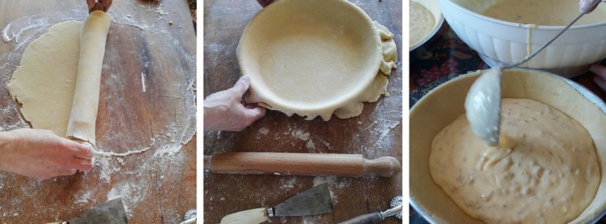
How to prepare it
Mix the wheat with milk, bringing to a boil for 20 minutes , stirring from time to time, stain the ricotta cheese with a few tablespoons of granulated sugar and orange blossom aroma vials. Prepare the pastry, placing the flour in a fountain on a pastry board, with the sugar and grated lemon rind. We mix the whole eggs and start to knead until a firm loaf is formed, after, wrap it in foil and keep it in the fridge until it is time to roll out the pastry. In the meanwhile, when the grain is cooled, we add the grated peel of lemons, whole eggs and flavoured ricotta. Finally, mix the sugar and mix all the mixture, using electric whips to remove all the lumps. Once prepared the filling, roll out the pastry and line the round molds of various diameter width (the true and traditional Neapolitan pastiera is high, moist and creamy). Pour inside the base some ladles of filling, almost to the brim. With the remaining dough, we obtain some strips that we will place crossed over the cream of wheat and ricotta. Bake at 180 degrees for about 50 minutes.

