Slide 1
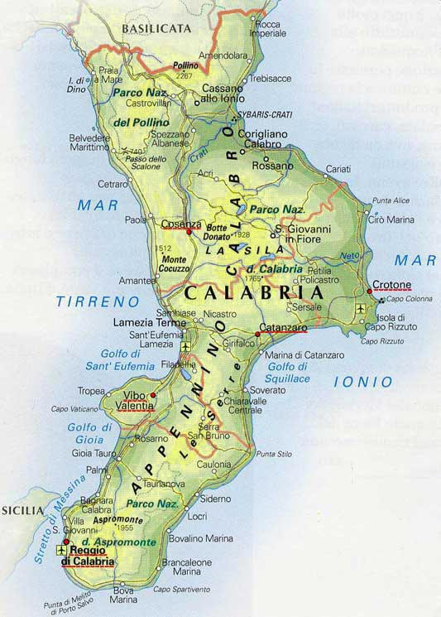
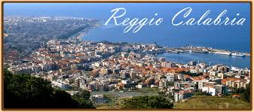
This is Calabria
Our region .
It is situated in the south of Italy just on the tip of the boot.
Italy’s shape is like a boot

Slide 2
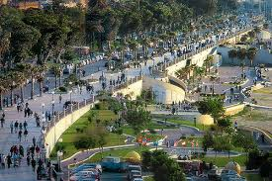
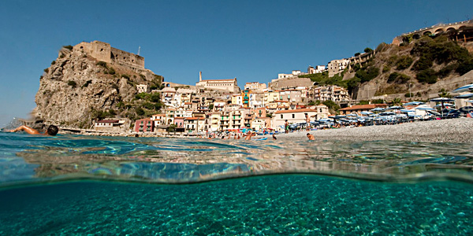
SCILLA
REGGIO CALABRIA
These are the places we live in: Reggio Calabria, our main city and our province.
Scilla, a little town on the sea.

Slide 3
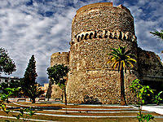
Ruffo Castle
These are some famous ancient castles in Calabria
Aragonese Castle

Slide 4
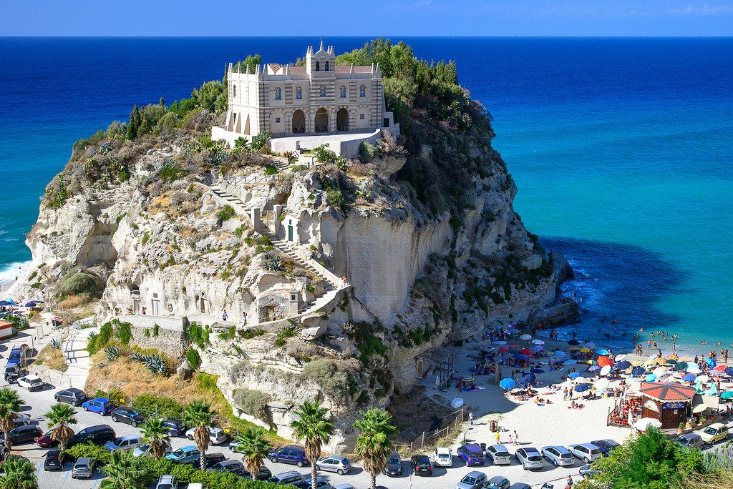
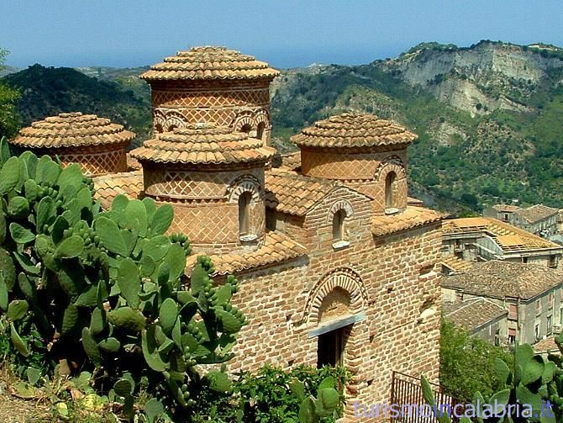
Some Calabrian attractions
Cattolica of Stilo
The Catholic Church is a small Byzantine church with a central plan of a square shape, and is located at the foot of Mount Consolino in Stilo in the province of Reggio Calabria
This is the Santuario of Tropea
Reopened to worship after 9 years, the church of Santa Maria dell'Isola stands on a beautiful isle that is recognized as a symbol of Tropea, a popular tourist resort on the Calabrian Tyrrhenian Sea.

Slide 5
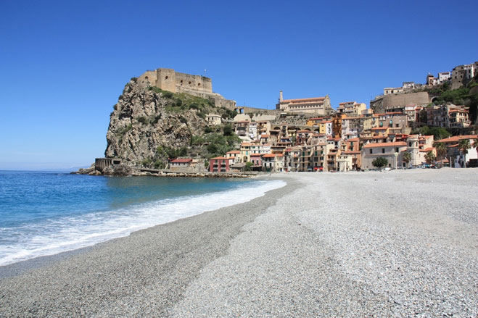
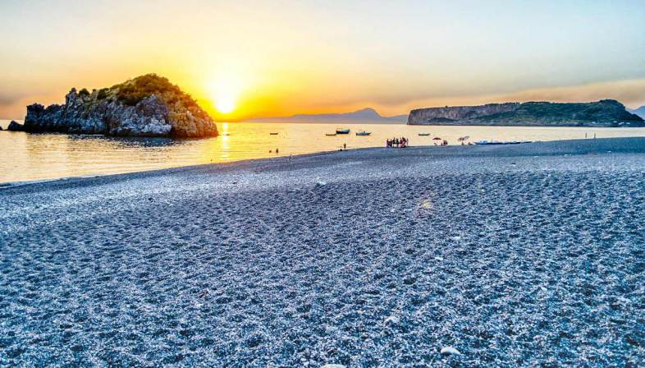
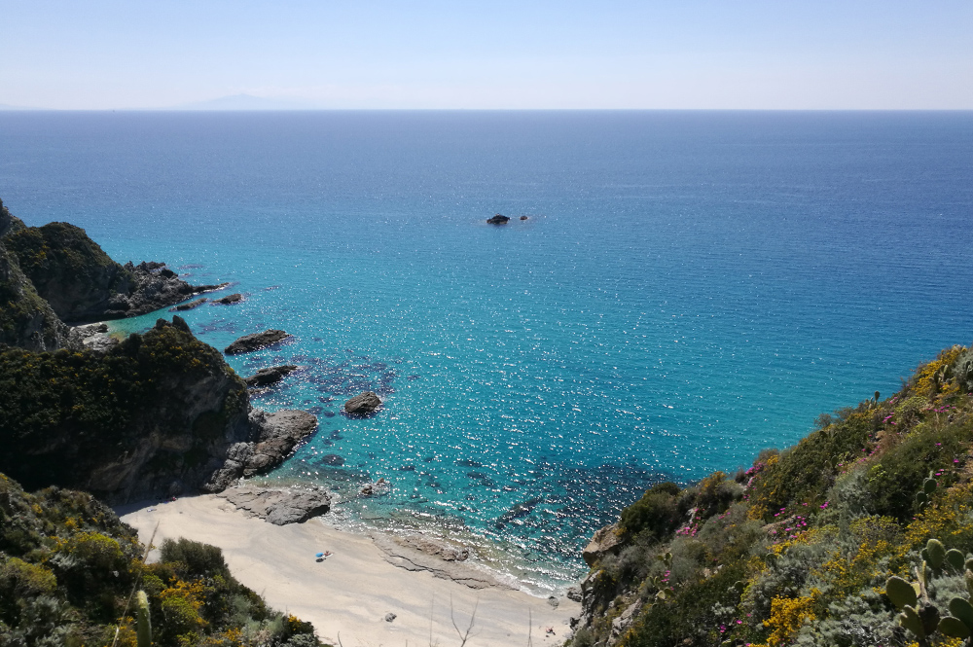
These are some nice beaches
where we often go.

Slide 6
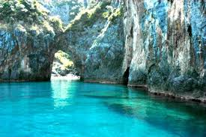
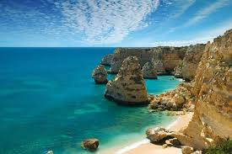
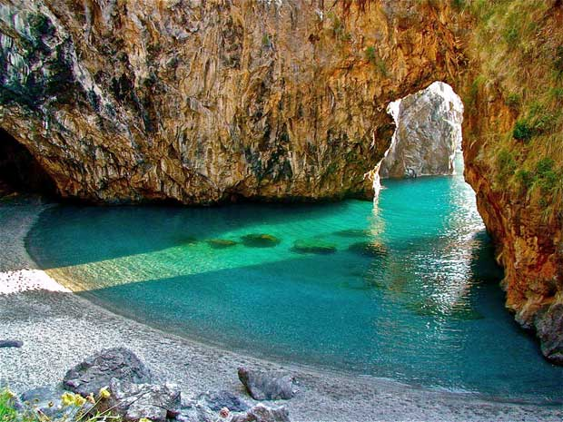
Capo Vaticano
Tropea’s caves

