Slide 1
Grana Padano and Parmigiano Reggiano

Slide 2
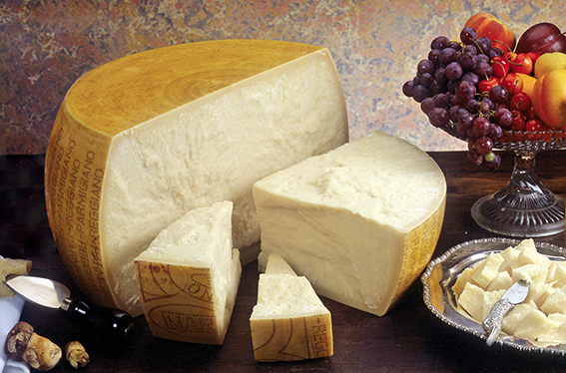
Parmigiano Reggiano
The origins of this cheese date back to the Middle Ages and are generally located around the 12th century, historically next to the great monasteries and mighty castles where the first toll booths appeared: small buildings with a square or polygonal plan where milk processing took place.

Slide 3
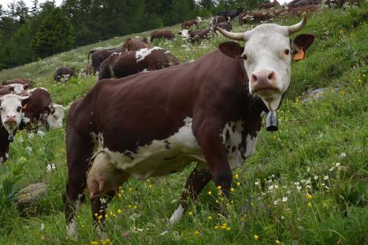
It is a product with a protected designation of origin (D.O.P.) Only the cheese produced according to the rules gathered in the Production Regulations can boast the Parmigiano-Reggiano brand. Currently, most of the production of Parmigiano-Reggiano occurs with milk produced by Frisone cows, introduced in the territory during the twentieth century, but the breed traditionally exploited for the production of cheese is the red Reggiana, with triple attitude (milk, labor and meat) , probably introduced by the Lombards.

Slide 4
Ingredients
Potassium 100 mg
Magnesium 43 mg
Zinc 4 mg
Vitamin A 270 μg
Vitamin B1 34 μg
Vitamin B2 370 μg
Vitamin B6 110 μg
Vitamin B12 4.2 μg
Vitamin PP 55 μg
Pantothenic acid 320 μg
Choline 40 mg
Biotin 23 μg
100 grams of seasoned Parmigiano Reggiano contains:
Water 30.8 g
Total protein 33.0 g
Fat 28.4 g
Energy value 392 kcal
Sodium chloride 1.39 g
Calcium 1160 mg
Phosphorus 680 mg
Sodium 650 mg

Slide 5
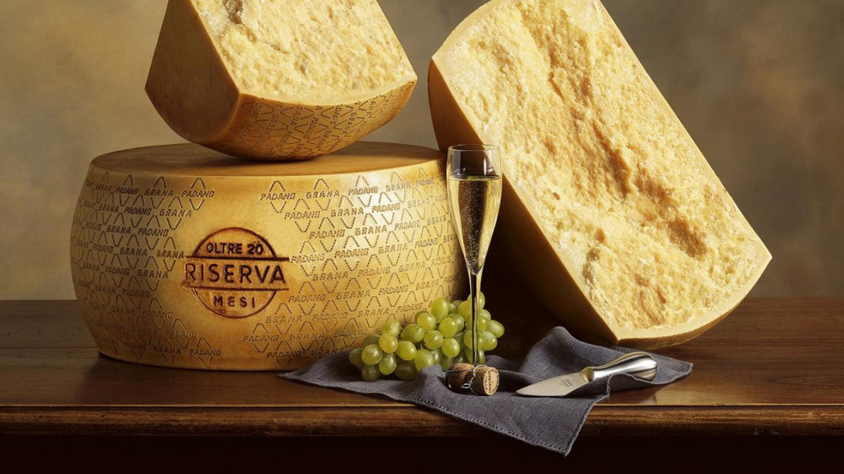
Grana Padano
Grana Padano is an Italian PDO cheese a hard and cooked pasta and a slow maturation.
They are produced in thirty-two provinces of Emilia-Romagna, Lombardy, Piedmont, Trentino-Alto Adige and Veneto; all stages of the production chain (breeding and milking of cows, collection and transformation of milk into cheese, maturing, possible scraping) must necessarily take place in the area of ​​origin.

Slide 6
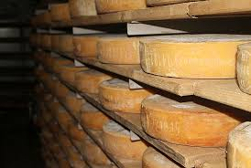
The history
The story tells that the grana cheese of the Po Valley was born in 1134 in the abbey of Chiaravalle, a few kilometers south of Milan. It was produced in special boilers inside the monasteries that can be considered the first dairies.
On October 30, 1955, the Decree of the President of the Republic was issued no. 1269 on the "Recognition of the denominations about the processing methods, product characteristics and production areas of the cheese”.

Slide 7
Ingredients
Grana Padano contain:
Humidity= 32 gr
Protein= 33 gr
Energy value= 398 kcal
Fats= 29 gr
Colesterol= 98.3 mg
Lactose= <1 mg
Salt= 1.5 gr
Calcium= 1165 mg
Phosphorus= 692 mg
Potassium= 120 mg
Iron= 0.14 mg
Copper= 0.5 mg
Zinc= 11 mg
Iodine= 35.5 µg
Selenium= 12 µg

Slide 8
The differences between Parmigiano Reggiano and Grana Padano
The area of ​​production of Grana Padano is much more extensive and therefore the grain will present a much more marked aromatic differentiation from one grain to another.
Parmesan milk can not reach the dairy at temperatures below 15 degrees while the grain at 8. This will greatly affect the bacterial load of milk in favor of the most natural and spicy aroma of Parmesan.
Parmesan cheese is produced only once a day with the mixture of the partially skimmed milk and the morning one. The grain can be produced twice a day.
The feeding of the Parmesan cows observe a more rigid disciplinary.
Parmesan is bigger and weighs a minimum of 40 kg, so it will need longer aging times.

