Slide 1
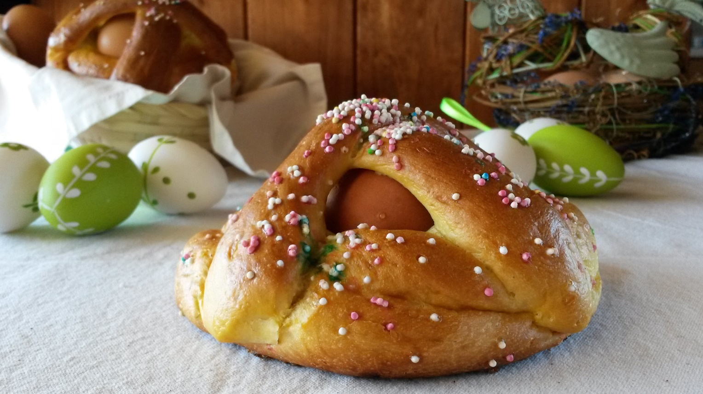
CUDDURACI
Easter pastry
- 1kg of flour
- 5 eggs
- 1 pinch of salt
- 300 grams of sugar
- 200 grams of butter
- 1 glass of anise liqueur
- 2 sachets of baking powder for cakes
- 2 lemons
- 2 egg whites
- coloured codette / confetti

Slide 2
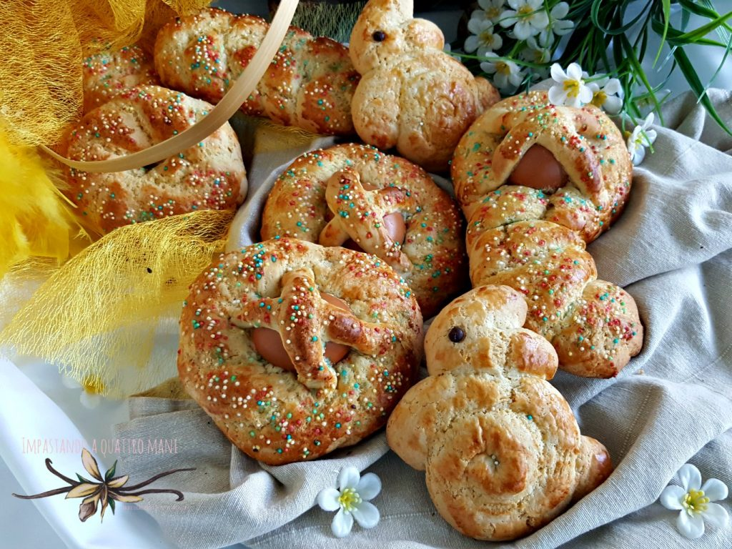
How to prepare it
1.Mix the flour with the sugar and the yeast in a bowl and then drill a hole in the center and pour the eggs, the pinch of salt, the peel of the grated lemons and the liqueur. Beat the liquid mixture with the fork and mix it with the dry ingredients then add the soft butter cut into small pieces.
2.Work the dough with your hands until you get a fairly soft and slimy dough, easy to work, and spread it to a height of about 1.5 cm then get some typical shapes (the braid is the best known along with the hearts and the crowns) . Insert a raw egg into each shape, if you like.
3.Spread on the surface of each biscuit the egg white and decorate with coloured codette. Bake at 180 degrees for about 20 minutes, let cool before eating.

